Slide 1
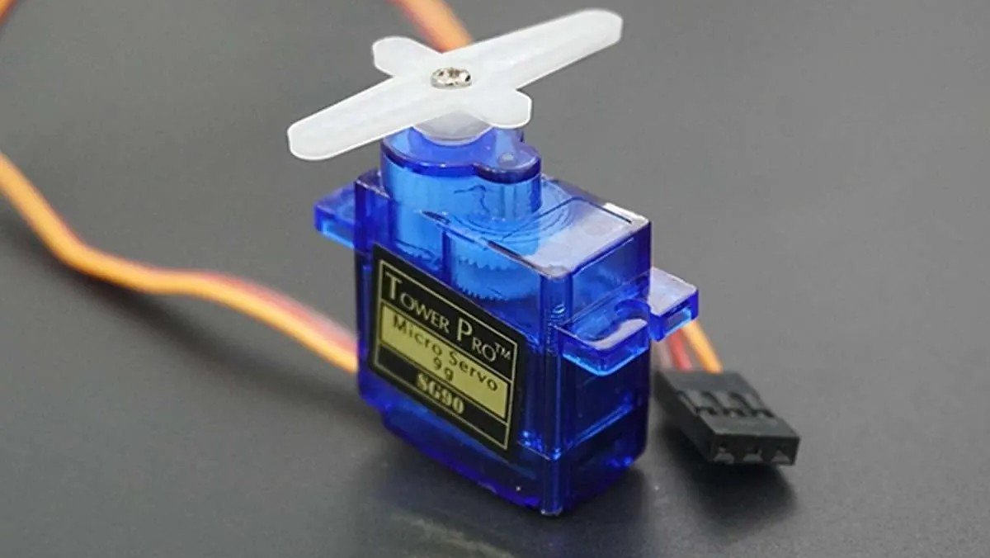
ELECTRONICS
Set an angle
By the end you will send a servo to an angle and have it stay there.
Notes:
A servo is told a position, not a speed.

Slide 2
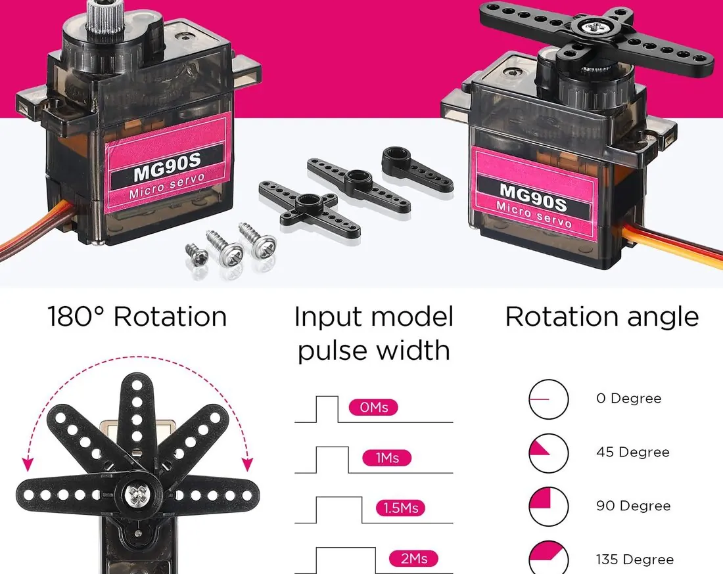


A normal motor keeps spinning. How do you tell a motor to stop at 90 degrees?
A small arm on the shaft.
An arm has to stop at an angle.
A camera has to hold its aim.
You do not tell it a speed.
You tell it an angle. It moves there and holds.
Notes:
Inside it, a sensor checks the angle and a circuit corrects it.

Slide 3
The signal is the angle
A pulse every 20 ms
The library
About 1 ms means 0°. About 1.5 ms means 90°. About 2 ms means 180°.
Servo hides those pulses. attach(pin) connects it. write(angle) sends the angle.
Power and ground as usual. The third wire is the signal.
Notes:
The angle is a number from 0 to 180.

Slide 4

Connect the servo
The build
1
Brown or black to GND.
2
Red to 5 V.
3
Signal, usually yellow or orange, to pin 9.
4
If it jitters, use a separate 5 V supply and join the grounds.
Use the live Tinkercad menus.
Notes:
A stalling servo can draw more current than the USB socket likes.

Slide 5
Go to 90, then to 180
#include <Servo.h>
Servo arm;
void setup() {
arm.attach(9);
}
void loop() {
arm.write(90);
delay(1000);
arm.write(180);
delay(1000);
}
#include <Servo.h>
Loads the library that makes the pulses.
attach(9)
The signal wire is on pin 9. Call this once, in setup().
write(90)
Go to 90 degrees and hold. write does not set a speed.
Notes:
delay here only waits so you can see the move. It is not the speed signal.

Slide 6
Sweep slowly
1
Use a for loop from 0 to 180, adding 2 each time.
CHECK
What is delay doing here?
2
write the angle, then delay(15).
3
Loop back from 180 down to 0.
It sets how fast the arm moves.
4
A smaller delay makes a faster sweep.
Notes:
The servo is still being told angles. The delay is the gap between those angles.

Slide 7
CHECK
ANSWER
What do you send a servo?
An angle.
You want it to stay at 90°.
write(90) tells it the position. It moves there and holds. You are not sending a speed.
Notes:
A DC motor was the speed one. This is the position one.

