Slide 1
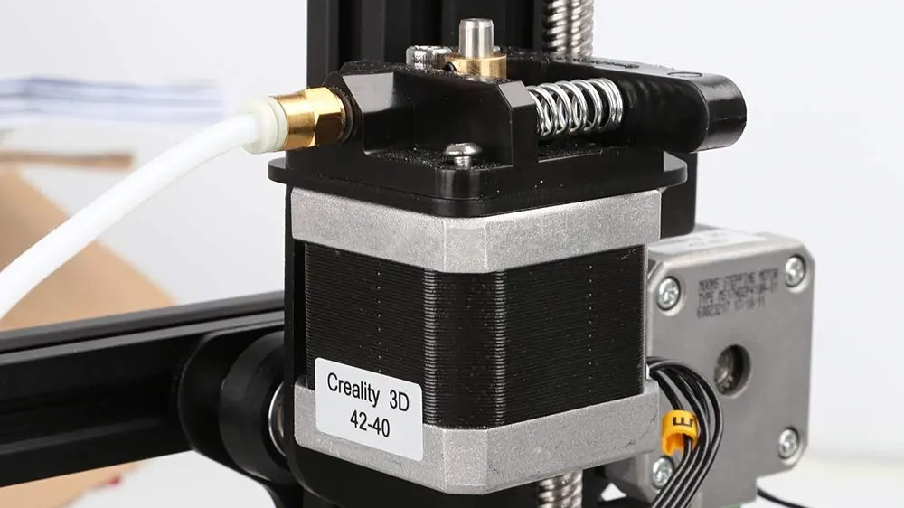
ELECTRONICS
Move in steps
By the end you will move a motor by a set number of steps.
Notes:
A step is a fixed angle. Count the steps and you know the angle.

Slide 2
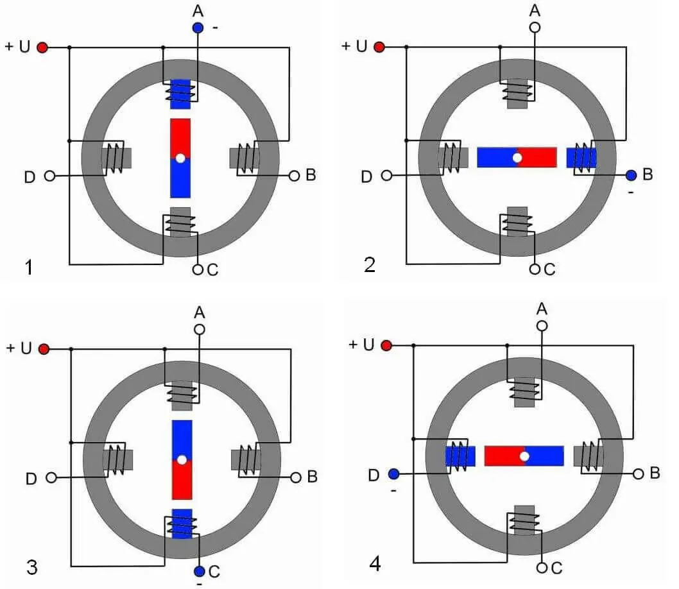

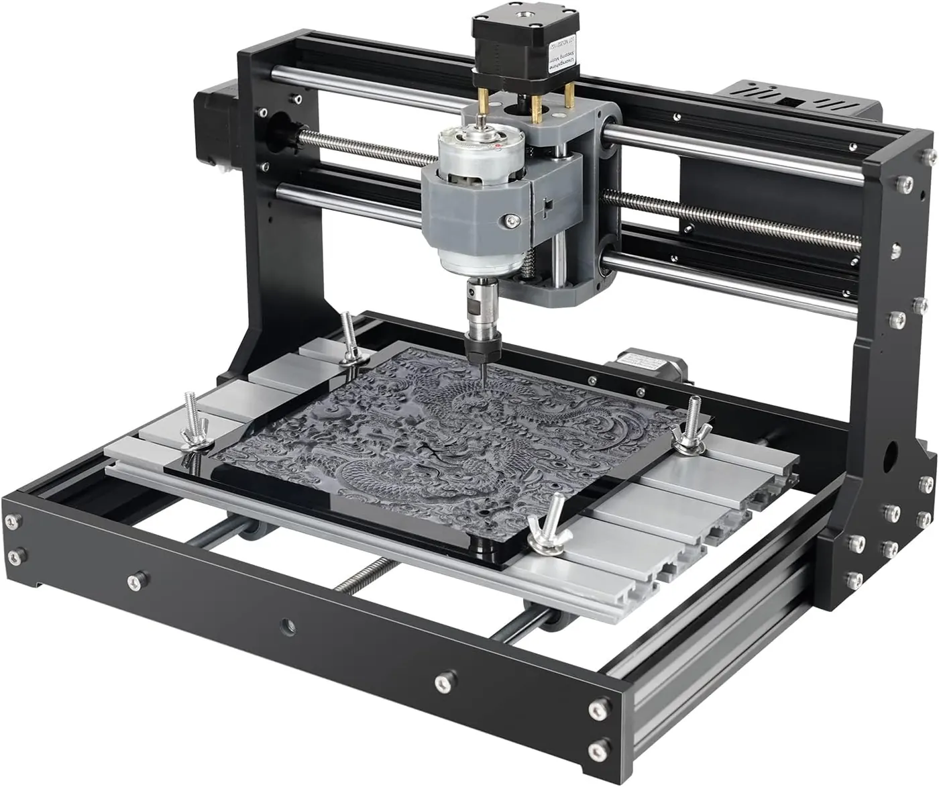
A DC motor spins, but you do not know how far it has turned. How can a motor move by a set angle?
Several coils, one shaft.
A printer head has to land in the right place.
A driver sits between the board and the coils.
The motor moves in fixed clicks.
You say how many steps. Each step is a known angle.
Notes:
It does not need a separate sensor to know where it was told to go. It counted.

Slide 3
Energise the coils in order
One step
The driver
Switching the coils in the next pattern pulls the shaft round by one fixed angle.
The coils need more current than a pin can give. A driver, such as a ULN2003, carries that current.
In Tinkercad the driver you have may be an L293D. The idea is the same.
Notes:
The Arduino decides the steps. The driver does the heavy current.

Slide 4
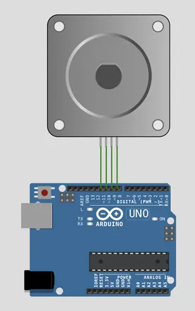
Wire the driver
The build
1
Motor coils to the driver outputs, in the driver's order.
2
Driver power to the supply. Grounds joined.
3
Four control pins to Arduino pins 8, 9, 10 and 11.
4
Know how many steps make one full turn. Often 2048 for these small motors.
Use the live Tinkercad menus.
Notes:
If it chatters and does not turn, the coil order is wrong. Swap one pair.

Slide 5
Turn 100 steps
#include <Stepper.h>
Stepper motor(2048, 8, 9, 10, 11);
void setup() {
motor.setSpeed(10);
}
void loop() {
motor.step(100);
delay(1000);
motor.step(-100);
delay(1000);
}
2048
Steps in one full turn. The four numbers are the pins, in coil order.
setSpeed(10)
A speed in revolutions per minute. Too fast and the motor skips steps.
step(100) and step(-100)
100 steps one way, then 100 steps back. A negative number reverses the direction.
Notes:
If it misses steps, lower the speed before you touch the wiring.

Slide 6
Turn a quarter of a circle
1
One full turn is 2048 steps.
CHECK
How many steps is a quarter turn?
2
A quarter turn is 2048 / 4.
3
step() that many steps.
512.
4
Check the arm or a mark on the shaft.
Notes:
2048 / 4 = 512. If their motor is marked 200 steps a turn, a quarter is 50. Use the number on the motor.

Slide 7
CHECK
ANSWER
What is one step?
A fixed angle.
The shaft has just moved a tiny amount.
One step is one fixed turn of the shaft. Count the steps and you know the angle.
Notes:
A DC motor does not give you that. It just spins.

