Slide 1
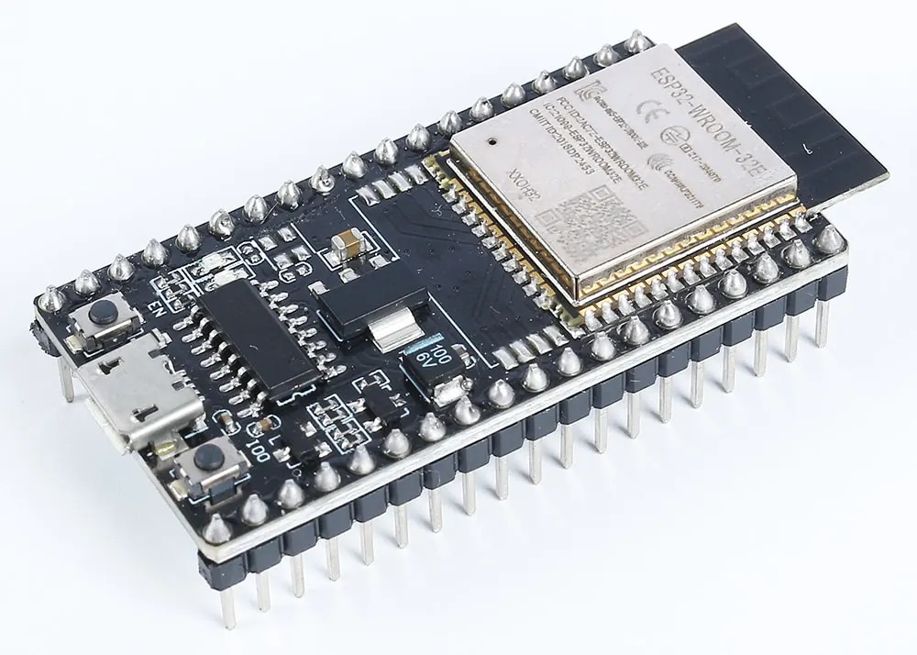
ELECTRONICS
A board with Wi-Fi
By the end you will say what an ESP32 adds, and how you prepare the IDE.
Notes:
Same kind of program. Extra setup, because it is a different board.

Slide 2
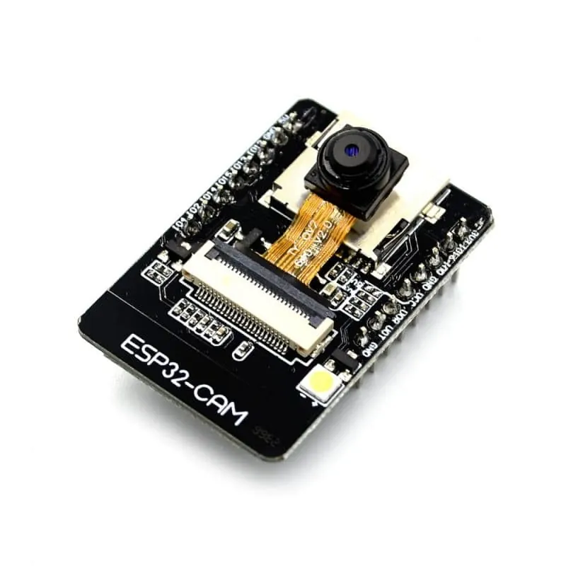

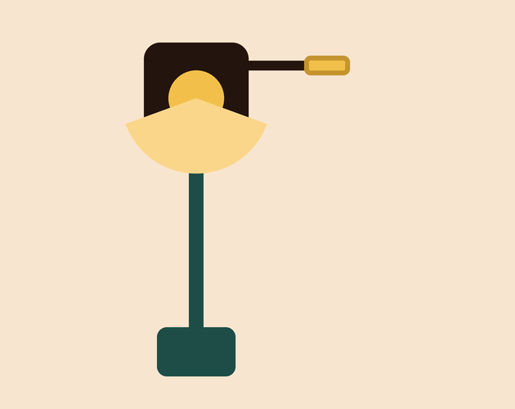
The Uno has to borrow a shield to reach Wi-Fi. What if the radio is already on the chip?
The chip, the camera, the aerial.
Wi-Fi, without an extra board.
Bluetooth is on the same chip.
The ESP32 is a different microcontroller.
Wi-Fi and Bluetooth are already on it.
Notes:
The ESP32-CAM also has a camera, so it can send a picture.

Slide 3
You still write a sketch. You tell the IDE about the new board first.
Board manager
Pick the board
Add the ESP32 package in the Arduino IDE. Then the IDE knows this board exists.
Choose the matching board, such as ESP32 Wrover Module for the camera board, and the right port.
The camera example is CameraWebServer. You uncomment the board you actually have, and comment out the others.
Notes:
After that, upload works the way it does on an Uno.

Slide 4
What is on the ESP32-CAM
The ESP32 chip, a camera, a reset button, and an aerial. It still has pins you can wire.
Notes:
Point at the reset button. Uploading often needs that button held at the right moment.

Slide 5
Get one sketch onto it
The build
1
Install the ESP32 boards in the Board Manager.
2
Select the board that matches the module in your hand.
3
Open CameraWebServer and set the camera model.
4
Upload. If it fails, hold the board's reset or boot button and try again.
Use the live Tinkercad menus.
Notes:
The usual failure is the wrong board selected, or the button not held during upload.

Slide 6
Find the address
1
Open the Serial Monitor at 115200.
CHECK
What should the phone show?
2
Press the board's reset button.
3
Read the Wi-Fi address it prints.
The camera picture.
4
Type that address into a phone on the same network.
Notes:
If the page does not load, the phone and the board are not on the same Wi-Fi.

Slide 7
CHECK
ANSWER
What does an ESP32 have that an Uno does not?
Wi-Fi and Bluetooth.
You want to send a reading without a cable.
The radio is on the chip. An ESP32-CAM also has a camera. You still write a sketch.
Notes:
You do have to install the board package first. The IDE does not know the ESP32 on a fresh install.

