Slide 1
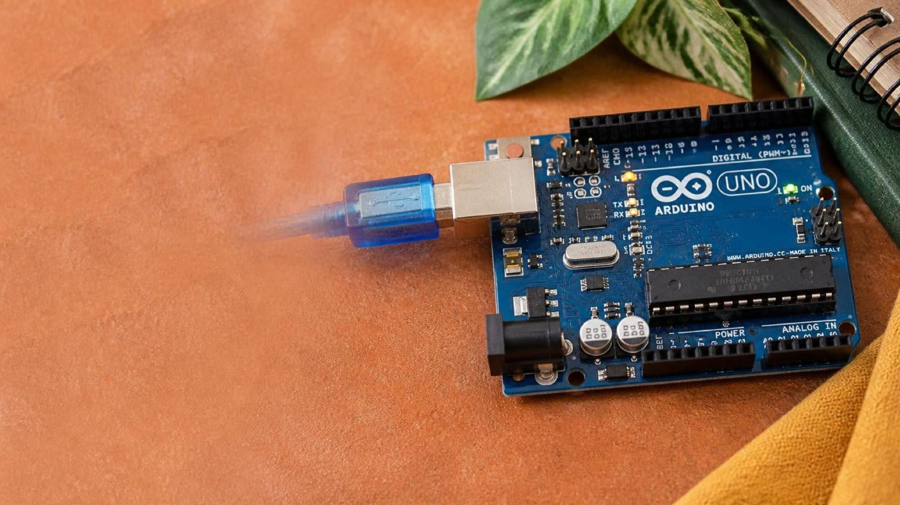
ELECTRONICS
A solar cell
By the end you will explain how a solar cell makes a voltage.
Notes:
Keep this at KS3. Light frees electrons. The junction sends them one way.

Slide 2


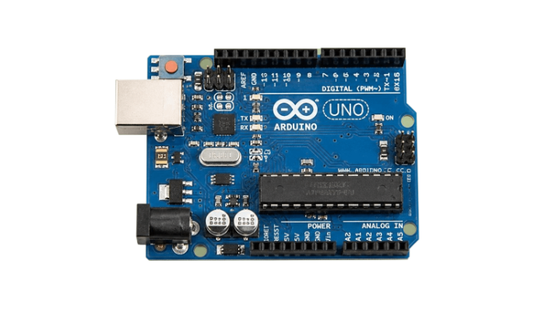
A calculator has no battery you can see, but it still switches on in the light. Where is the electricity coming from?
Light carries energy.
A store, for when the light goes.
The board still wants a steady 5 V.
The cell makes a voltage from light. It is not a store.
Light frees electrons. The cell sends them one way.
Notes:
A cloud, or a hand over the cell, and the voltage falls. That is why projects add a battery.

Slide 3
Two layers, and light
Two kinds of silicon
Light
One layer has extra electrons. The other has gaps electrons can fill. Where they meet is the junction.
A bright enough particle of light frees an electron. The junction's electric field sends that electron one way only.
A diode is the same junction used as a one-way gate. A solar cell uses it to separate charges.
Notes:
Electrons gathering on one side is a voltage. That is the photovoltaic effect.

Slide 4
Light is not a steady supply
The cell
A small power board
It makes a voltage while light is on it. Cover it, and the voltage drops.
It charges a 3.7 V battery from the cell or from USB, and gives a steady 5 V out to the project.
A protection chip stops the battery being charged too far, or emptied too far.
Notes:
The battery is the store. The cell is the source. They are different jobs.

Slide 5
Follow the power
On the board
1
Find the solar or USB input.
2
Find the battery connector.
3
Find the 5 V output that would feed your project.
4
Cover the cell and say which of those three has stopped.
Use the live Tinkercad menus.
Notes:
The output should stay up if the battery is charged. The cell voltage is the one that falls.

Slide 6
Say it in one sentence
1
Write what the light does to an electron.
CHECK
What does the battery add?
2
Write what the junction does next.
3
Write why the project still has a battery.
A store of energy.
4
Read the three sentences to a partner.
Notes:
The cell makes electricity only while the light is there. The battery keeps the project going when it is not.

Slide 7
CHECK
ANSWER
What does the junction do?
Sends it one way.
Light has just freed an electron.
The junction's field sends the freed electron one way, so charge gathers and a voltage appears.
Notes:
Without that one-way field, the freed electrons would not pile up as a useful voltage.

