Slide 1

YEAR 7 · ELECTRONICS · LESSON 2 OF 5
Reading a button
By the end you will light an LED while a button is held — and explain why a loose pin cannot be trusted.
BUILD: A PRESS-LIGHT
Notes:
Cover. Say what they will be able to do by the end: By the end you will light an LED while a button is held — and explain why a loose pin cannot be trusted.

Slide 2
STARTER · TWO QUESTIONS
What do you remember?
1
What voltage is on a pin set to HIGH?
5 V.
ANSWER
click to reveal
2
Which instruction switches a pin on?
digitalWrite(pin, HIGH).
ANSWER
click to reveal
Answer it in your head before I click.
Y7.2 · READING A BUTTON
Notes:
Recall from lesson 1, not a new question. If the
room cannot answer Q1, do not move on: write 5 V and 0 V on the board and ask
again.

Slide 3
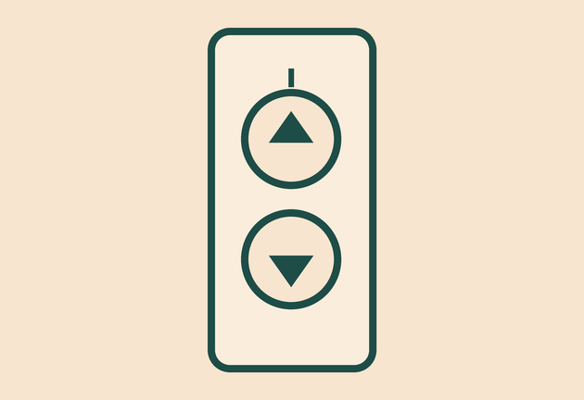

Why will a lift refuse to move with the door open?
Doorbell. It waits for a press.
Lift. Door shut and button pressed.
Keyboard. Every key is a switch.
Each one has to know whether something is pressed.
A pin can measure a voltage. That is how the board finds out.
Y7.2 · READING A BUTTON
Notes:
The question is rhetorical: the lift does not move
because a switch says the door is not shut. Get three examples from the room
before the gold line.

Slide 4
PREDICT · EVERYONE COMMITS
Before I show you
A button is wired to pin 2, and nothing else is on pin 2. The button is open. What does digitalRead(2) return?
A
B
C
LOW, because nothing is connected
HIGH, because nothing is connected
It changes at random
THE ANSWER
THE ANSWER
click to reveal
It changes at random.
A pin with nothing holding it is a tiny aerial. It picks up whatever is nearby — a hand, a cable, the mains — and flips between 0 and 1. That is called a floating pin.
Hands up for the one you chose — then we find out.
Y7.2 · READING A BUTTON
Notes:
This is the most important question in Year 7.
Most pupils will say LOW, because nothing is connected. Do not correct it —
let them wire it in the next slide and watch the numbers flicker.

Slide 5
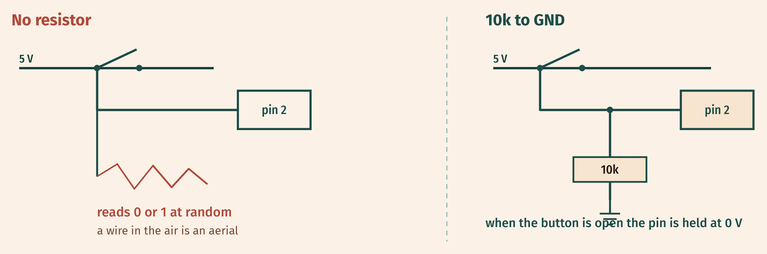
THE IDEA
An input pin must be held at a known voltage
A resistor ties the pin to 0 V, so it stays LOW until the button pulls it up to 5 V.
10 kΩ is a weak hold: enough to fix the voltage, not enough to waste current.
Notes:
Two pictures: the floating wire and the pulled-down
wire. The 10 kΩ is weak on purpose: it holds the voltage without wasting
current. If someone asks why not 100 Ω, that is exactly the answer.

Slide 6

BUILD · 15 MINUTES
Wire the button and the light
1
Push the button so it straddles the centre trench.
2
One side to 5 V, the other side to pin 2.
3
10 kΩ from pin 2 down to GND.
4
LED and 220 Ω from pin 13 to GND.
Illustrative interface. Use the live Tinkercad menus.
Y7.2 · READING A BUTTON
Notes:
The trench matters. Say it twice: the button
must straddle the centre trench, or its two legs are joined and it is always
closed. Walk the room and check only that.

Slide 7
DECODE THE CODE
Read it, then use it
void setup() {
pinMode(2, INPUT);
pinMode(13, OUTPUT);
Serial.begin(9600);
}
void loop() {
int pressed = digitalRead(2);
digitalWrite(13, pressed);
Serial.println(pressed);
delay(50);
}
PINMODE(2, INPUT)
Faces pin 2 inwards. It listens; it never pushes current out.
DIGITALREAD(2)
Answers one question: is pin 2 nearer 0 V or 5 V? HIGH or LOW.
DIGITALWRITE(13, PRESSED)
Whatever came in goes straight out. Press, and the LED is on.
Serial Monitor: the button at the bottom right.
Y7.2 · READING A BUTTON
Notes:
Read digitalWrite(13, pressed) slowly. The value
read from pin 2 is passed straight to pin 13 — no if needed yet. Serial is there
so they can see the number change.

Slide 8
TEST IT · 5 MINUTES
What success looks like
✓
Hold the button: the LED is on and the Monitor shows 1.
1
✓
Let go: the LED is off and the Monitor shows 0.
0
✓
Untouched, the Monitor scrolls steady 0s — not a mix.
steady 0
WATCH FOR
A mix of 0s and 1s with nothing pressed means the pin is floating: the 10 kΩ is missing or in the wrong row.
Y7.2 · READING A BUTTON
Notes:
Check the Serial Monitor as well as the LED. A
steady 0 with nothing pressed is the proof that the resistor is working.

Slide 9
DEBUG · 5 MINUTES
It does not work. Find the fault.
WHAT YOU SEE
A
The LED is in backwards
The LED is on all the time, and the Monitor shows 1, even with nothing pressed.
B
The button does not straddle the trench
C
delay(50) is too short
THE FAULT
THE FAULT
click to reveal
The button is shorted across its own legs.
Both legs are in one row, so the switch is permanently closed and pin 2 is permanently at 5 V. Lift the button so it crosses the centre trench, then test both states.
Y7.2 · READING A BUTTON
Notes:
The straddle error is the one to expect. Ask them
to trace the button's two legs with a finger and check the two legs are not in
the same row. Do not fix it for them.

Slide 10
CHECK · ONE QUESTION
Why does pin 2 need the 10 kΩ resistor?
A
B
C
To protect the button from too much current
To hold the pin at 0 V when the button is open
To make the LED brighter
THE ANSWER
ANSWER — B
click to reveal
To hold the pin at 0 V when the button is open.
The button is the only path to 5 V, and it is open. The resistor is the only path to 0 V, and it is always there. Without it the pin floats.
If you chose another one, say why. That is the useful bit.
Y7.2 · READING A BUTTON
Notes:
B. The resistor protects nothing here — the
button already limits current. Its job is to fix the voltage when the switch is
open.

Slide 11
STRETCH · IF YOU FINISHED EARLY
If that was easy
USE THE BOARD'S OWN RESISTOR
Move the button's 5 V wire to GND, remove the 10 kΩ, and change pinMode(2, INPUT) to INPUT_PULLUP. Now pressed reads LOW. Rewrite the LED line to match.
DEBOUNCE IT
Hold the button and watch the Monitor. Count how many 1s appear for one press. Add a check that ignores a press within 200 ms of the last one.
The board has a resistor inside the chip. INPUT_PULLUP connects it to 5 V instead of to 0 V.
Y7.2 · READING A BUTTON
Notes:
INPUT_PULLUP is genuinely useful and genuinely
confusing the first time, because the logic inverts. Only set it for pupils who
finished early and can handle a rule being upside down.

Slide 12
EXIT TICKET · BEFORE YOU LOG OFF
Two questions, then close the laptop.
When nothing holds an input pin, what does it read?
FINISH THE SENTENCE
1
A pin with nothing holding it is ________.
Which instruction reads pin 2?
2
One word for today
NEXT LESSON
Y7.3 — Two conditions
One button is easy. Two buttons need a rule.
Notes:
Collect the frames. The word "floating" should appear
in most of them; if it does not, it needs another pass at the start of Y7.3.

