Slide 1

YEAR 8 · ELECTRONICS · LESSON 3 OF 5
Dimming is a trick
By the end you will dim an LED, and explain why the pin is never actually at half voltage.
BUILD: A DIMMER
Notes:
Cover. Say what they will be able to do by the end: By the end you will dim an LED, and explain why the pin is never actually at half voltage.

Slide 2
STARTER · 2 MINUTES
What do you remember?
1
What does an LDR change with light?
Its resistance.
ANSWER
click to reveal
2
Why does A0 need two resistors?
To turn a resistance change into a voltage.
ANSWER
click to reveal
Answer it in your head before I click.
Y8.3 · DIMMING IS A TRICK
Notes:
Recall from Y8.2, and set up the new idea:
if a sensor can be a number, can an output be a number too?

Slide 3


How does a phone screen get exactly half brightness?
Half brightness, not half voltage.
A dimmer: on and off, very fast.
Your eye does the averaging.
The LED is never half on. It is on and off, faster than you can see.
If it switches faster than your eye, you see the average.
Y8.3 · DIMMING IS A TRICK
Notes:
Ask how a screen does 50% brightness. Most will
say "half the voltage". That is the misconception this lesson kills.

Slide 4
PREDICT · EVERYONE COMMITS
Before I show you
analogWrite(6, 128) sends a 50% signal to an LED. What is the voltage on pin 6?
A
B
C
2.5 V all the time
5 V half the time, 0 V half the time
0.5 V all the time
THE ANSWER
THE ANSWER
click to reveal
5 V half the time, 0 V half the time.
analogWrite does not make an in-between voltage. It switches the pin on and off hundreds of times a second, and your eye averages the result.
Hands up for the one you chose — then we find out.
Y8.3 · DIMMING IS A TRICK
Notes:
This is the heart of Year 8. Do not reveal until
every hand is up. The wrong answer is A, and it is wrong because the pin is a
switch, not a valve.

Slide 5
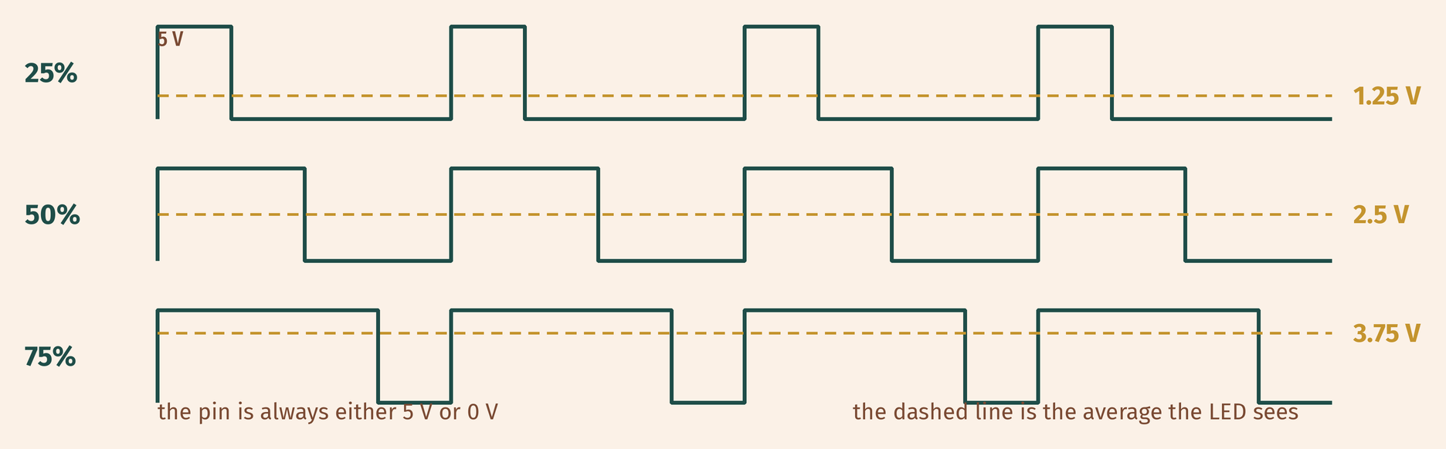
THE IDEA
Fast switching looks like an in-between value
The pin is only ever at 5 V or 0 V. The average is what you see.
25%, 50% and 75% duty. The dashed line is the average.
Notes:
Duty cycle is the word to teach: the fraction
of time the pin is on. 128 out of 255 is half. Show the three rows on the
diagram and ask which is brightest.

Slide 6

BUILD · 15 MINUTES
Wire a dimmer
1
Pot on A0, outer legs to 5 V and GND.
2
LED and 220 Ω on pin 6 — a PWM pin.
3
Pins 3, 5, 6, 9, 10, 11 can dim.
4
Print the value you send to the pin.
Illustrative interface. Use the live Tinkercad menus.
Y8.3 · DIMMING IS A TRICK
Notes:
Pin choice matters: 3, 5, 6, 9, 10, 11 are the
PWM pins on an Uno. Write the list on the board. Pins 5 and 6 run at a
different frequency — do not mention it unless asked.

Slide 7
DECODE THE CODE
From a dial to a duty cycle
void setup() {
pinMode(6, OUTPUT);
Serial.begin(9600);
}
void loop() {
int knob = analogRead(A0);
int level = map(knob, 0, 1023, 0, 255);
analogWrite(6, level);
Serial.println(level);
delay(30);
}
ANALOGWRITE(6, LEVEL)
0 is off, 255 is fully on, and everything between is a duty cycle.
MAP(KNOB, 0, 1023, 0, 255)
analogRead has 1024 steps; analogWrite takes 256. map converts.
PIN 6
Only PWM pins can do this: 3, 5, 6, 9, 10 and 11 on an Uno.
0 to 255 is 256 values, not 255.
Y8.3 · DIMMING IS A TRICK
Notes:
map() appears again, now 1024 steps to 256.
Ask why 255 and not 256: because 0 counts as a value.

Slide 8
TEST IT · 5 MINUTES
What success looks like
✓
Turning the knob dims smoothly from off to full.
0–255
✓
The LED does not visibly flicker.
no flicker
✓
Move the LED to pin 7: it only switches on and off.
no PWM
WATCH FOR
Flicker means the delay is too short for the change to settle, or the pin is not a PWM pin.
Y8.3 · DIMMING IS A TRICK
Notes:
The pin 7 test is the good one: it looks like a
failure but it is a fact about the board. Let them discover it.

Slide 9
DEBUG · 5 MINUTES
It does not work. Find the fault.
WHAT YOU SEE
A
The LED is on pin 7
The LED is either fully on or fully off. The knob does nothing in between.
B
The resistor is too big
C
map() is rounding
THE FAULT
THE FAULT
click to reveal
Pin 7 cannot do PWM.
analogWrite on a non-PWM pin just switches it. Move the LED to pin 6 and change the number in pinMode and analogWrite.
Y8.3 · DIMMING IS A TRICK
Notes:
A pupil who moves the LED and forgets the pin
number will see this. Ask them to read both the wiring and the analogWrite
line.

Slide 10
CHECK · ONE QUESTION
A pin is HIGH for 1 ms and LOW for 3 ms, over and over. What is the average voltage?
A
B
C
1.25 V
2.5 V
3.75 V
THE ANSWER
ANSWER — A
click to reveal
1.25 V.
It is on for one quarter of the time. One quarter of 5 V is 1.25 V. That fraction is called the duty cycle.
If you chose another one, say why. That is the useful bit.
Y8.3 · DIMMING IS A TRICK
Notes:
A. 1 ms on and 3 ms off is on for one quarter
of the time. Get them to write the fraction before choosing.

Slide 11
STRETCH · IF YOU FINISHED EARLY
If that was easy
FADE WITHOUT A KNOB
Use a for loop to take level from 0 to 255 and back again. Print the value. Time one full fade.
MIX A COLOUR
Red, green and blue on three PWM pins. Set three duty cycles and predict the colour before you run it.
An RGB LED is three LEDs in one package. Three duty cycles, one colour.
Y8.3 · DIMMING IS A TRICK
Notes:
Fading with a for loop removes the knob and
makes the duty cycle visible as a number climbing. The RGB task is how every
colour LED works.

Slide 12
EXIT TICKET · BEFORE YOU LOG OFF
Two questions, then close the laptop.
What two voltages can a PWM pin actually produce?
FINISH THE SENTENCE
1
Fast switching looks like an ________ value.
What does analogWrite(6, 64) mean?
2
One word for today
NEXT LESSON
Y8.4 — A number that means degrees
Turning a raw number into a unit you can trust.
Notes:
The first question has a two-word answer and it
is the whole lesson: 5 V and 0 V.

