Slide 1

YEAR 9 · ELECTRONICS · LESSON 2 OF 5
Control the speed
By the end you will control a motor's speed with PWM, and explain why half duty is not exactly half speed.
BUILD: A SPEED CONTROL
Notes:
Cover. Say what they will be able to do by the end: By the end you will control a motor's speed with PWM, and explain why half duty is not exactly half speed.

Slide 2
STARTER · 2 MINUTES
What do you remember?
1
Why can't a pin drive a motor directly?
The motor needs far more current than a pin can supply.
ANSWER
click to reveal
2
What does the transistor do?
A small base current switches a much larger collector current.
ANSWER
click to reveal
Answer it in your head before I click.
Y9.2 · CONTROL THE SPEED
Notes:
Both recalls are the foundations of the
driver. If the second is shaky, the transistor is still a mystery box.

Slide 3

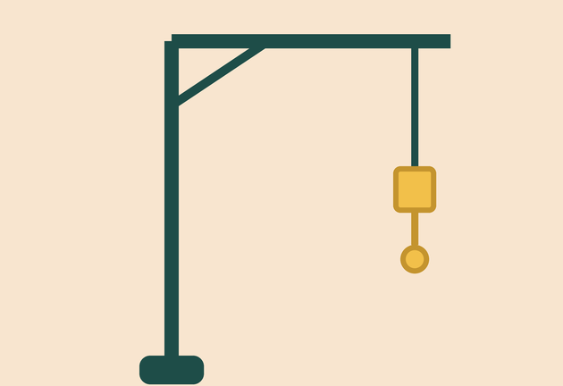
Why does a drill trigger change speed instead of just switching on?
A fan: speed is a range.
A toy car: slow for tight turns.
A crane: slow is safer.
Speed control is power control.
PWM through a transistor controls the average power the motor gets.
Y9.2 · CONTROL THE SPEED
Notes:
A drill trigger is a speed control, not a switch.
Ask what the trigger actually changes. It changes the average power, and PWM is
one way to do it.

Slide 4
PREDICT · EVERYONE COMMITS
Before I show you
You send 50% PWM to a motor. Is it exactly half speed?
A
B
C
Yes, exactly half
Roughly half, but not exactly
No: it stops
THE ANSWER
THE ANSWER
click to reveal
Roughly half, but not exactly.
Friction and the motor's own resistance take a fixed share of the power. Near the bottom of the range the motor may not turn at all. The relationship is close to a line, not a perfect one.
Hands up for the one you chose — then we find out.
Y9.2 · CONTROL THE SPEED
Notes:
Most classes say "exactly half". The honest
answer is B, and the deadband at the bottom is the evidence. If you have a motor
handy, run it at 20% and let them see it stall.

Slide 5
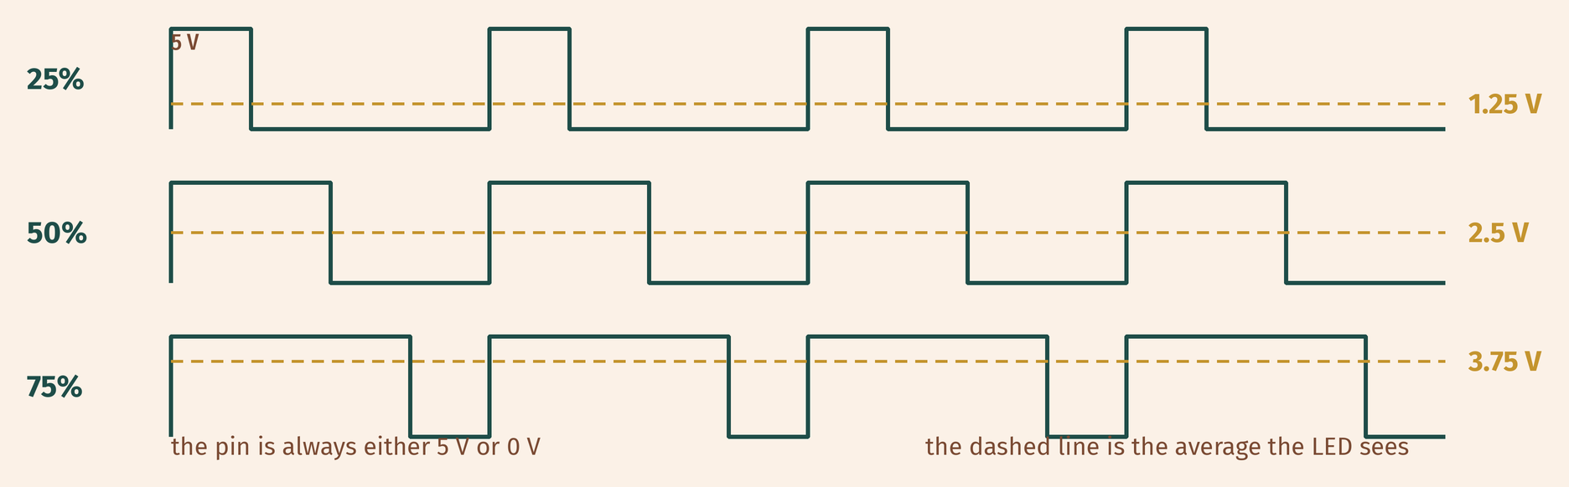
THE IDEA
Switching fast controls the average power
The transistor is a switch. Open and close it quickly and the motor sees the average.
The same waveform as the LED, with a much bigger current behind it.
Notes:
The waveform is the same one from Year 8, with a
motor instead of an LED. Point out that the motor's own inertia smooths the
pulses, just as your eye smooths the LED.

Slide 6

BUILD · 15 MINUTES
Add a speed dial
1
Keep the transistor and motor from Y9.1.
2
Pot: outer legs 5 V and GND, wiper to A0.
3
Drive the base from pin 9 — a PWM pin.
4
Keep the motor supply separate, grounds joined.
Illustrative interface. Use the live Tinkercad menus.
Y9.2 · CONTROL THE SPEED
Notes:
They keep the driver and add one input. Emphasise
that the motor supply stays separate: the pot is on the board's 5 V, the motor
is not.

Slide 7
DECODE THE CODE
A dial on the base
void setup() {
pinMode(9, OUTPUT);
Serial.begin(9600);
}
void loop() {
int knob = analogRead(A0);
int speed = map(knob, 0, 1023, 0, 255);
analogWrite(9, speed);
Serial.println(speed);
delay(50);
}
ANALOGWRITE(9, SPEED)
The base is switched on and off, and the transistor follows.
MAP(..., 0, 255)
The full duty range: 0 stops, 255 is fully on.
DELAY(50)
Short enough to feel responsive, long enough to read the Monitor.
Listen to the motor as you turn it.
Y9.2 · CONTROL THE SPEED
Notes:
map() and analogWrite() are both familiar. The only
new thing is that the output is a transistor, and the load is a motor.

Slide 8
TEST IT · 5 MINUTES
What success looks like
✓
The motor speeds up and slows down with the knob.
0–255
✓
Below about 60 it may hum without turning.
deadband
✓
The transistor is warm, not hot.
warm
WATCH FOR
If the motor jerks in steps rather than running smoothly, the PWM is simply slow enough to hear. That is normal for a motor.
Y9.2 · CONTROL THE SPEED
Notes:
The deadband is not a fault. It is the useful
surprise of the lesson: a motor at 10% duty may not have enough torque to
overcome friction.

Slide 9
DEBUG · 5 MINUTES
It does not work. Find the fault.
WHAT YOU SEE
A
analogWrite is not reaching the base
The motor runs at full speed whatever the knob does.
B
The motor is wired straight to the supply
C
map() is wrong
THE FAULT
THE FAULT
click to reveal
The motor's negative lead goes straight to ground, so the transistor is bypassed.
Trace the current path: supply, motor, collector, emitter, ground. If the motor avoids the transistor, the pin cannot control it.
Y9.2 · CONTROL THE SPEED
Notes:
A shorted transistor is easy to miss because
everything looks connected. Ask them to trace supply → motor → collector →
emitter → ground.

Slide 10
CHECK · ONE QUESTION
At 25% duty, what fraction of the supply voltage does the motor see on average?
A
B
C
A quarter
A half
All of it
THE ANSWER
ANSWER — A
click to reveal
A quarter.
The pin is on for a quarter of each cycle, so the average is a quarter of the supply. That is why 25% duty feels much slower than half.
If you chose another one, say why. That is the useful bit.
Y9.2 · CONTROL THE SPEED
Notes:
A. The average of a switch that is on a
quarter of the time is a quarter of the supply. Speed follows current, and
current follows voltage, roughly.

Slide 11
STRETCH · IF YOU FINISHED EARLY
If that was easy
FIND THE DEADBAND
Turn the knob up from 0 and note the first value where the motor actually turns. That is the deadband. Why does it exist?
RAMP IT
Ignore the pot. Use a for loop to take the speed from 0 to 255 over three seconds, then back. Time the ramp and check it matches.
A deadband is friction plus the motor's own resistance. Every motor has one.
Y9.2 · CONTROL THE SPEED
Notes:
Finding the deadband is a measurement, not a
guess, and it makes the non-linearity concrete. The ramp task removes the pot
and shows duty as a number.

Slide 12
EXIT TICKET · BEFORE YOU LOG OFF
Two questions, then close the laptop.
What does 25% duty do to the average power?
FINISH THE SENTENCE
1
PWM controls the ________ power.
Why is the speed not exactly proportional?
2
One word for today
NEXT LESSON
Y9.3 — A servo asks for a position
The same PWM idea, carrying a completely different message.
Notes:
The frame is "average". If they write "voltage", ask
what the pin's voltage actually is during the off half of the cycle.

