Slide 1
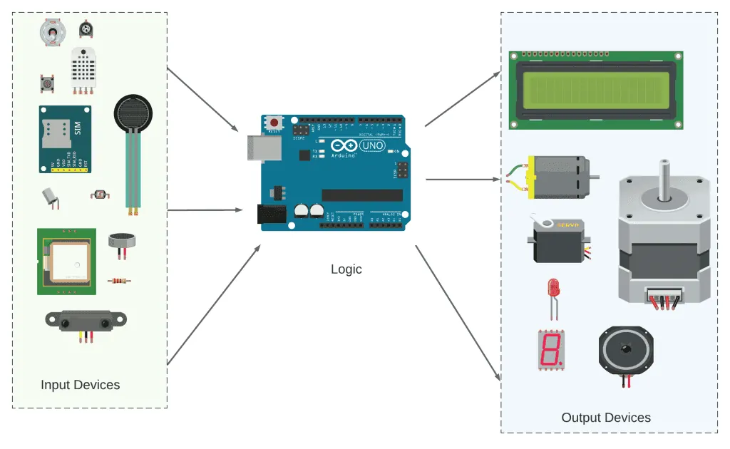
YEAR 7 · ELECTRONICS · LESSON 2
Press a Button
One finger in, one light out
Notes:
Welcome back. Last lesson the board did the talking. Today it
listens.

Slide 2
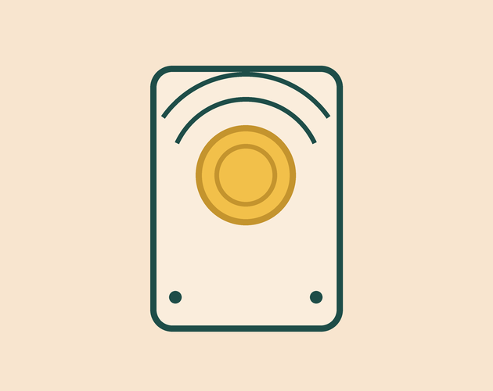
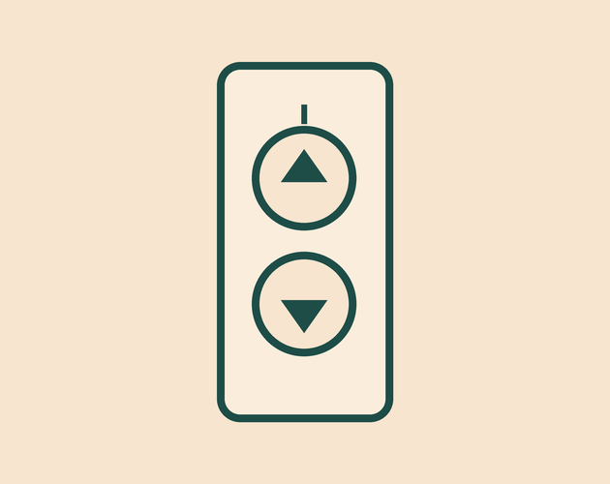

A doorbell, a lift button and a key. What do they all wait for?
Doorbell. Press it, a chime plays.
Lift button. Press it, doors slide.
Keyboard key. Press it, a letter appears.
None of them does anything until someone touches it.
Each one waits for an input. A finger is the signal.
Notes:
Ask for other examples before you move on: a kettle, a microwave,
a car door. Every one of them is waiting for a finger.

Slide 3
A pin can listen as well as speak
Output — the pin speaks
Input — the pin listens
Last lesson, pin 13 pushed power out to light an LED.
Now pin 2 reads what something else is doing.
Input
Code
Output
A finger presses the button.
It checks the reading.
The LED switches on.
Same pin. Same 5 volts. Only the direction changes.
Notes:
This is the whole lesson in one picture. Input, then the code
decides, then the output. Everything after this is detail.

Slide 4
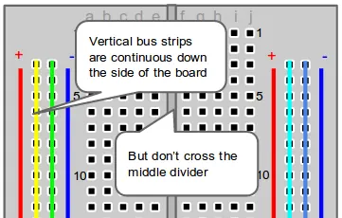
The same circuit, off the screen
Tinkercad draws it. The real pins are in the same place.
Notes:
BEAT 4 · PICTURE. One breather slide, almost no text. Point at the two
wires and name them: pin 2, and GND. Do not read anything aloud here.

Slide 5

Wire the button in Tinkercad
Four-minute challenge
1
Open the Blink circuit you made last lesson.
2
Drag a Pushbutton and a Breadboard Small onto the canvas.
3
Wire one side of the button to pin 2, and the other to GND.
4
That is the whole circuit. The board supplies the pull-up.
Illustrative interface. Use the live Tinkercad menus.
Notes:
Two wires only. If a student adds a resistor from memory, that is
the pull-down version and it still works, but the code would read HIGH when
pressed instead of LOW.

Slide 6
Decode the code
void setup() {
pinMode(2, INPUT_PULLUP);
pinMode(13, OUTPUT);
}
void loop() {
int pressed = digitalRead(2);
if (pressed == LOW) {
digitalWrite(13, HIGH);
} else {
digitalWrite(13, LOW);
}
}
INPUT_PULLUP = hold it HIGH
Pin 2 sits at HIGH on its own, so it never floats.
digitalRead(2) = look
LOW means the finger is down. HIGH means it is up.
if / else = choose
One line for pressed, one line for released.
Notes:
Three new words, that is all. Say out loud that LOW means pressed
— it is the opposite of what students expect, and it is what trips them up.

Slide 7
Mission 1: The Doorbell
1
Run the simulation. The light should be off.
WATCH CLOSELY
When is the light actually on?
2
Press and hold the button.
3
Let go, then press again a few times.
The reading is LOW while the button is down.
4
Say out loud which state turns the light on.
Notes:
Give them two minutes. The question in the panel is the whole
point of the mission, so take answers before moving on.

Slide 8
Mission 2: Wired Backwards
1
Swap HIGH and LOW in the two digitalWrite lines.
THINK FIRST
Why does it start ON?
2
Run it. The light is now on until you touch the button.
3
Predict what will happen before you press Run.
Because you told pin 13 to sit at HIGH.
EXTENSION · SECRET LATCH
Press once for on, again for off. You will need to remember the last reading.
Notes:
Changing one thing and predicting the result is the habit we want.
The extension is a real step up: it needs a variable that survives between loops,
which is lesson 6.

Slide 9
QUICK CHECK
ANSWER
Quick check: the pull-up
GND
INPUT_PULLUP holds pin 2 at HIGH until you press.
So why does the code check for LOW?
Pressing joins pin 2 to ground. Ground is 0 volts, and 0 volts reads LOW.
Think first. Then raise your hand.
Notes:
If they can explain this, they understand inputs. If not, it is
worth two minutes now rather than in lesson 4.

Slide 10
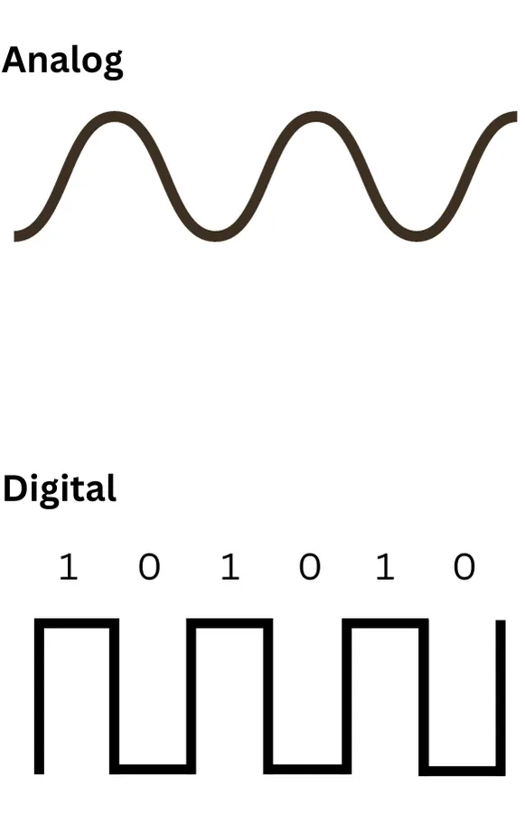
BEFORE YOU LOG OFF
Wrap-up and exit ticket
An input pin reads. The code decides. The output follows.
Name one thing you press every day. What does it switch on?
Write your answer on a slip or in the chat.
Input in. Output out.
EXIT TICKET
I press ________ . It switches on ________ .
Notes:
Collect the exit tickets on the way out. Anything that names an
input and an output is a pass.

