Slide 1
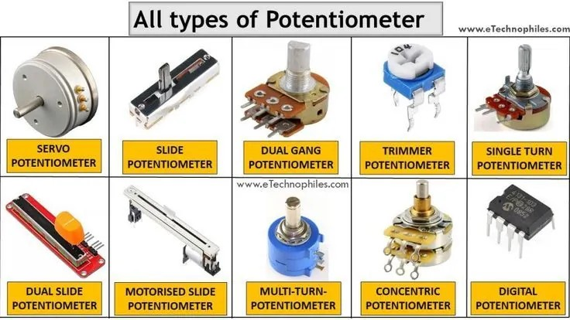
YEAR 7 · ELECTRONICS · LESSON 3
Turn a Knob
From a twist to a number to a brightness
Notes:
Last lesson the board could only hear yes or no. Today it
hears how much. Show the part and let them turn it before you say anything.

Slide 2
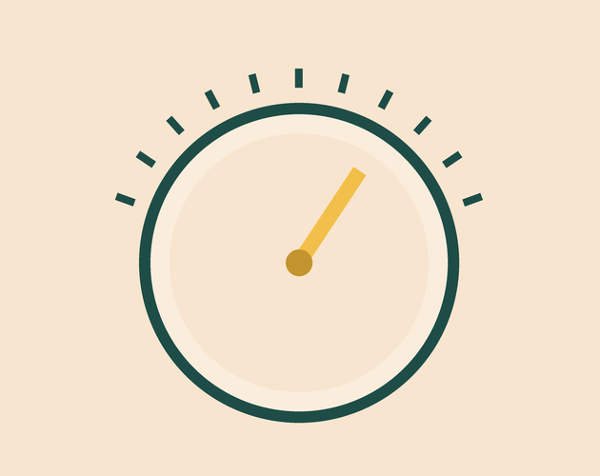
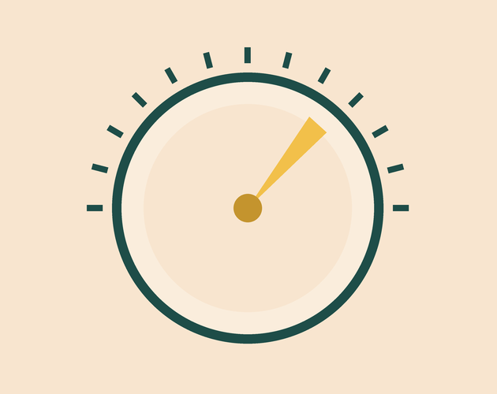

A volume knob, an oven dial and a dimmer switch. What changes?
Volume knob. Turn it, the sound changes.
Oven dial. Turn it, the heat changes.
Dimmer switch. Turn it, the lamp changes.
Inside, all three are the same part: a resistor you slide.
The knob moves the voltage smoothly, not in steps.
Notes:
Take their answers first. The point is that nothing clicks
between off and full - the change is continuous. That is what makes it analog.

Slide 3
Some pins read a whole range
Digital — two states
Analog — a whole range
Last lesson, pin 2 read HIGH or LOW. Nothing in between.
Pin A0 reads anywhere between 0 volts and 5 volts.
Input
Analog pin
Output
You turn the knob.
A0 turns the voltage into a number.
The LED gets brighter.
0 volts reads 0. 5 volts reads 1023.
Notes:
This is the whole lesson in one picture. A digital pin is a
light switch; an analog pin is a dimmer. Everything after this is detail.

Slide 4
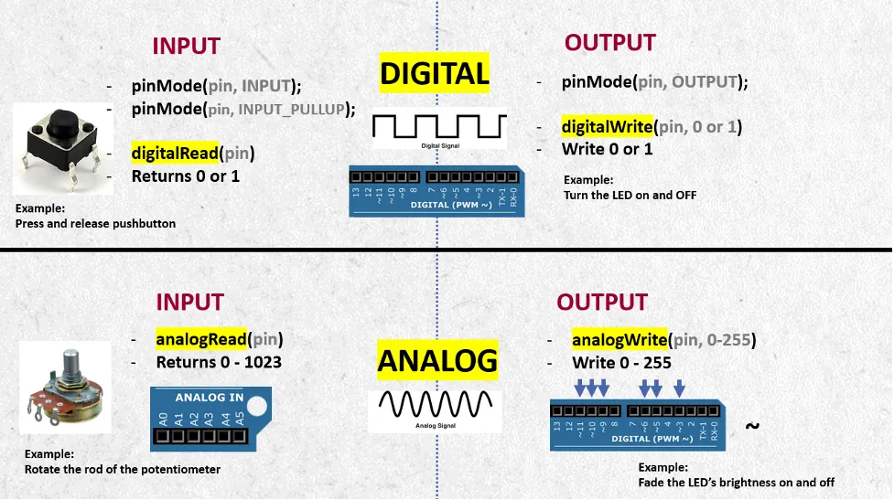
The knob on a real board
Three legs: power, ground, and the one that reports.
Notes:
BEAT 4 · PICTURE. Almost no text. Point at the three legs and say
which one carries the reading. Nothing else on this slide.

Slide 5
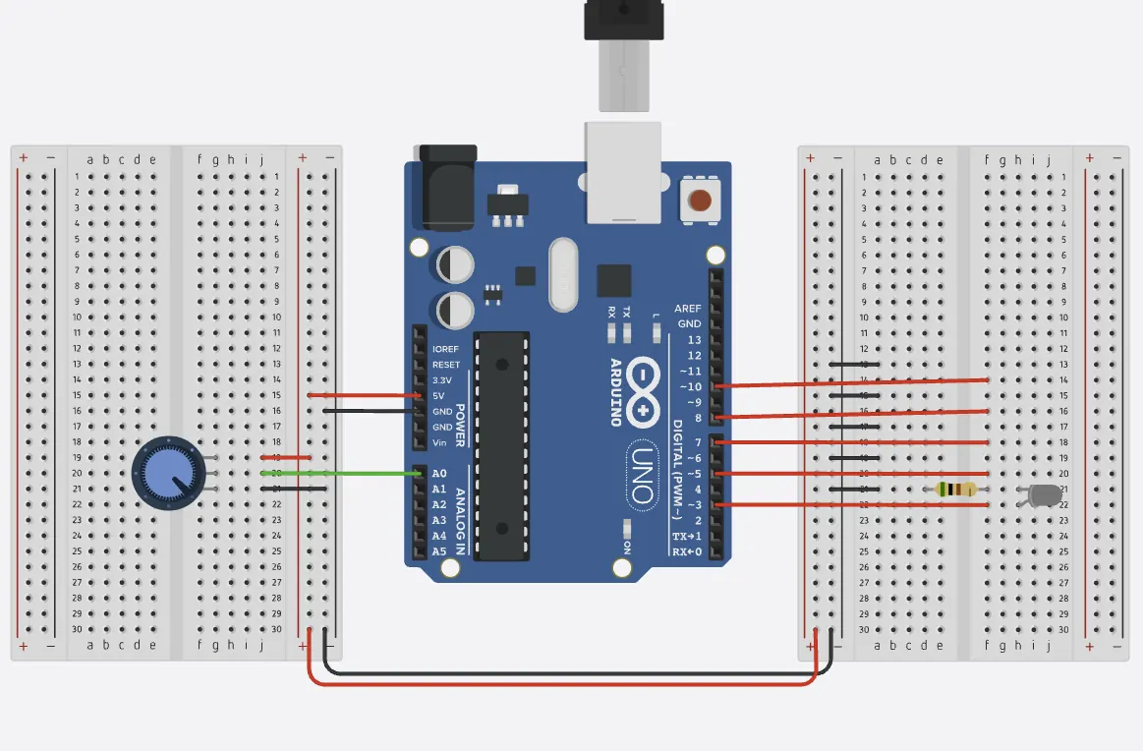
Wire the knob in Tinkercad
Five-minute challenge
1
Open last lesson's circuit and delete the button.
2
Drag a Potentiometer and a Breadboard Small onto the canvas.
3
Outer legs to 5V and GND. The middle leg goes to A0.
4
Add an LED on pin 9. That is the pin that can fade.
Illustrative interface. Use the live Tinkercad menus.
Notes:
Three wires to the knob, and the middle one is the one that
matters. If a student wires a middle leg to 5V, the reading never changes - that
is the mistake to watch for.

Slide 6
Decode the code
void setup() {
Serial.begin(9600);
pinMode(9, OUTPUT);
}
void loop() {
int knob = analogRead(A0);
int bright = knob / 4;
Serial.println(knob);
analogWrite(9, bright);
delay(50);
}
analogRead(A0) = measure
Gives a number from 0 to 1023, not just HIGH or LOW.
/ 4 = change the scale
1023 divided by 4 is about 255, which is what analogWrite takes.
analogWrite(9, n) = fade
Pin 9 switches on and off too fast to see, so the light looks dimmer.
Notes:
One new function does the measuring and one does the fading. The
divide-by-four line is the only arithmetic in the lesson - say it as squeezing a
big scale into a small one.

Slide 7
Mission 1: Read the Number
1
Run it, then open the Serial Monitor.
WATCH CLOSELY
Why is halfway about 512?
2
Turn the knob all the way one way, then the other.
3
Write down the smallest and the largest number you see.
Half of 1023. The wiper sits in the middle of the track.
4
Stop halfway. What number is showing?
Notes:
Let them find 0 and 1023 themselves. The halfway question is the
one that makes the range real, so take two or three answers before moving on.

Slide 8
Mission 2: Control the Brightness
1
Turn the knob slowly. Does the light fade, or jump?
THINK FIRST
What does / 8 change?
2
Change / 4 to / 8. Predict first, then run.
3
Now make the light go dark when the knob is turned up.
Only half the scale is used, so the top of the turn does nothing.
EXTENSION · A BAR GRAPH
Add three more LEDs and light them one by one as the number climbs.
Notes:
The prediction is the marked thinking here. For the last step they
need to subtract from 1023 rather than add, which is a genuine step up.

Slide 9
QUICK CHECK
ANSWER
Quick check: two scales
Squeezing
analogRead gives 0 to 1023. analogWrite takes 0 to 255.
So what is the divide doing?
It fits the big scale into the small one, so the whole turn is used.
Think first. Then raise your hand.
Notes:
If they can say why the divide is needed, they understand the two
scales. If not, do one more turn of the knob with the Serial Monitor open.

Slide 10
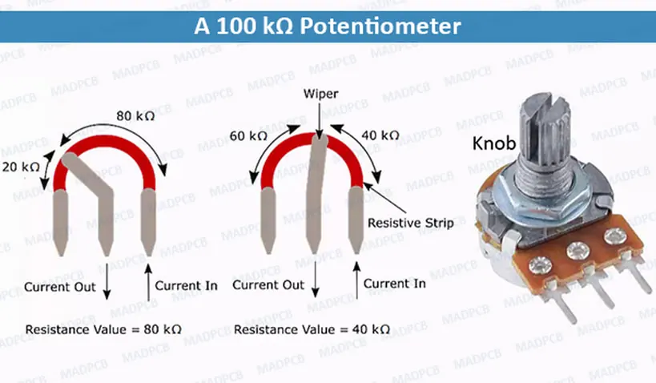
BEFORE YOU LOG OFF
Wrap-up and exit ticket
A knob is a resistor you can slide. The pin reads where it stopped.
Name something you turn at home. What does turning it change?
Write your answer on a slip or in the chat.
The wiper slides along the track.
EXIT TICKET
I turn ________ . It changes ________ .
Notes:
Collect the exit tickets on the way out. Anything that names a
thing you turn and something that changes is a pass.

