Slide 1
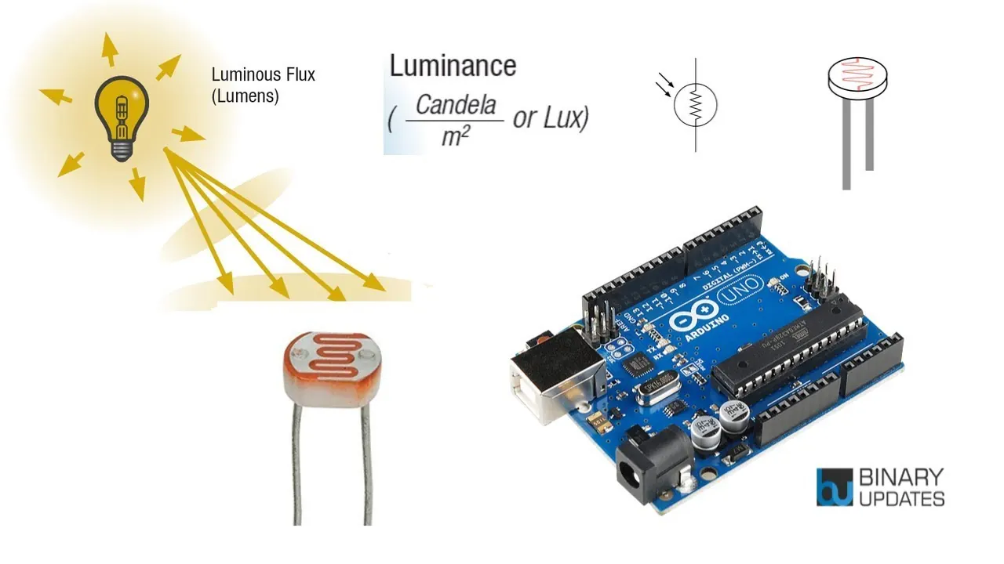
YEAR 7 · ELECTRONICS · LESSON 4
Sense the Light
Turning brightness into a number
Notes:
Last lesson the pin could only say on or off. Today it can say
how much.

Slide 2



A phone screen, a street lamp and headlights. What are they sensing?
Phone screen. Brighter in sunshine.
Street lamp. Switches on at dusk.
Headlights. Switch on in a tunnel.
None of them sees light the way you do.
They all measure light with a sensor, and turn it into a number.
Notes:
Ask what else does this: a night light, a car's rear-view mirror,
a plant grower. All of them are measuring, not just detecting.

Slide 3
Some signals have more than two values
Digital — two states
Analog — a whole range
A switch is HIGH or LOW. Nothing in between.
Bright to dark, in 1024 small steps.
Light in
Resistance
A number
The sensor sees the room.
More light, less resistance.
A0 reads 0 to 1023.
You have used digital. Today you read a range.
Notes:
The switch versus the dimmer is the comparison to say out loud.
Everything else in the lesson hangs off it.

Slide 4
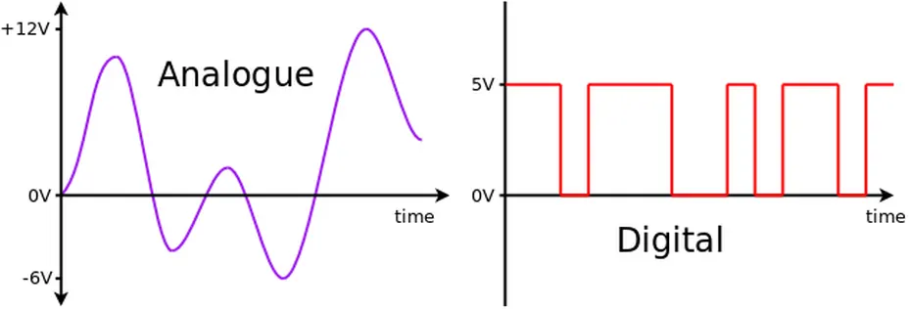
Light, and a resistor beside it
Together they turn light into a voltage. A0 reads that voltage.
Notes:
BEAT 4 · PICTURE. No new words. Two parts in a row: the sensor and
the fixed resistor. That pair is the whole of concept one.

Slide 5
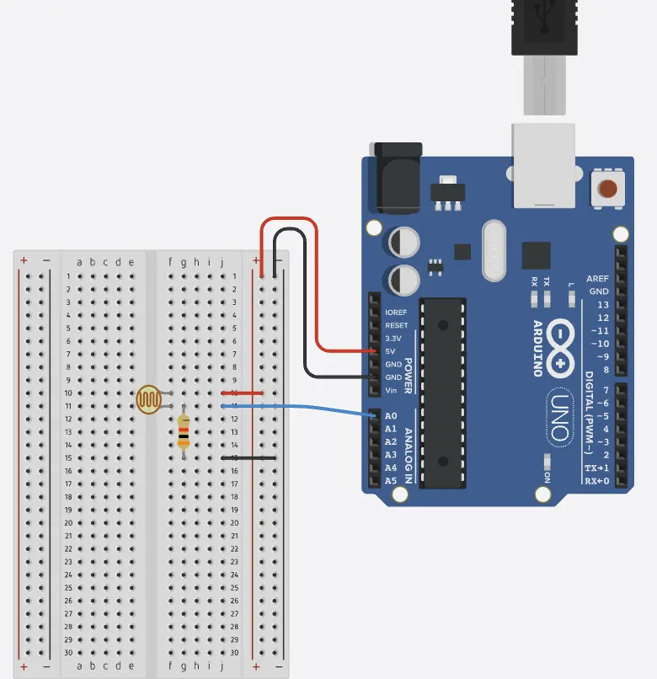
Add the light sensor
Four-minute challenge
1
Drag a Photoresistor onto the canvas.
2
Wire 5V to one leg, and that same leg to A0.
3
Wire A0 to a 10kΩ resistor, then the resistor to GND.
4
Cover the sensor with your hand. The reading must move.
Illustrative interface. Use the live Tinkercad menus.
Notes:
The 10k resistor is what turns resistance into a voltage the
board can read. Students do not need the maths, but they do need both legs to
land where the diagram says.

Slide 6
Decode the code
int sensor = A0;
void setup() {
Serial.begin(9600);
}
void loop() {
int reading = analogRead(sensor);
int percent = map(reading, 0, 1023, 0, 100);
Serial.print("Raw: ");
Serial.print(reading);
Serial.print(" Light: ");
Serial.println(percent);
delay(500);
}
analogRead(A0) = a range
Gives a whole number from 0 to 1023.
map(...) = rescale
Stretches 0–1023 into 0–100, so the number is readable.
Serial.println() = show
Prints the number in the Serial Monitor.
Notes:
Three new words again. map() is the only one that needs a second
look — it just changes the scale, nothing else.

Slide 7
Mission 1: Find the Dark
1
Open the Serial Monitor at the bottom of the code panel.
WATCH CLOSELY
Which way does the number move?
2
Cover the sensor with your hand.
3
Watch the number move.
Bright means a high number. Dark means a low one.
4
Write down the number in a dark room and in a lit room.
Notes:
Make every student write down two numbers. Those two numbers are
the whole of mission 2, so do not skip the writing.

Slide 8
Mission 2: A Night Light
1
Pick a threshold between your two numbers.
THINK FIRST
Why sit between the two numbers?
2
Light the LED whenever the reading is below it.
3
Cover the sensor. The light should come on.
Above it the room is bright. Below it, dark.
EXTENSION · STOP THE FLICKER
At the threshold the light may jitter. Turn on below 400, and off above 450.
Notes:
The extension introduces two thresholds. That is hysteresis, but
call it what it looks like: a light that stops flickering.

Slide 9
QUICK CHECK
ANSWER
Quick check: which way?
Down
0 is dark. 1023 is bright.
Someone covers the sensor. Which way does the number go?
Less light means more resistance, so a smaller voltage arrives at A0.
Think first. Then raise your hand.
Notes:
Push for the reason, not just the direction. More resistance,
smaller voltage, smaller number.

Slide 10
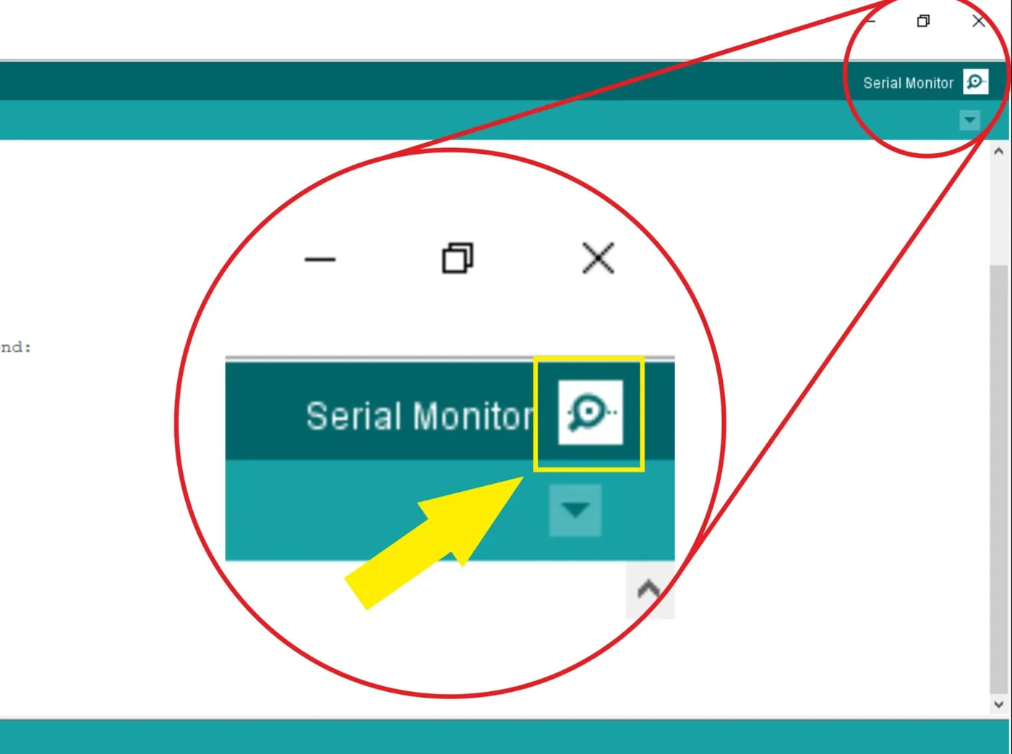
BEFORE YOU LOG OFF
Wrap-up and exit ticket
A sensor turns the world into a number. The code decides what that number means.
Name something that switches itself on. What is it sensing?
Write your answer on a slip or in the chat.
The number, live.
EXIT TICKET
My ________ switches on when it senses ________ .
Notes:
Good answers: a street lamp sensing light, a hand dryer sensing
movement, a kettle sensing steam.

