Slide 1
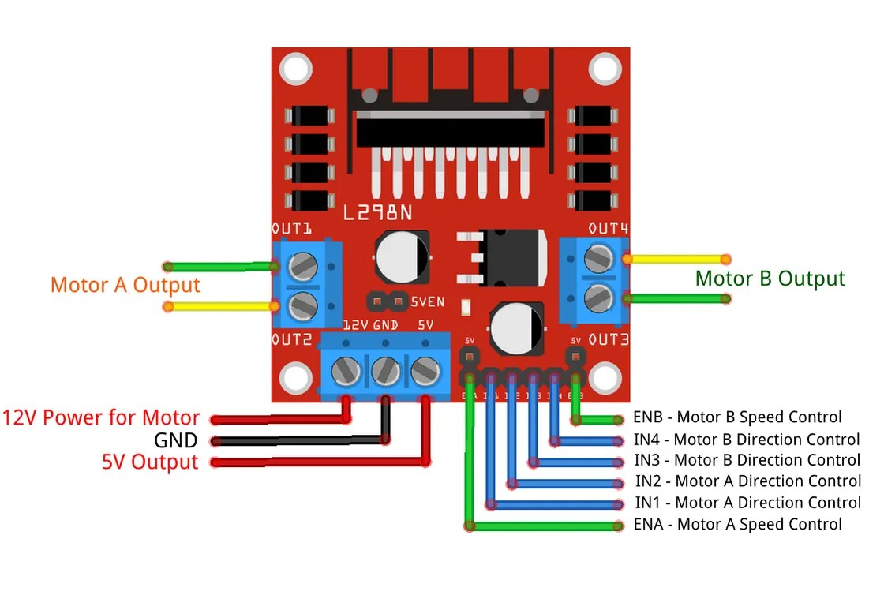
YEAR 9 · ELECTRONICS · LESSON 2
Motors Need a Driver
A pin decides. Something else does the work.
Notes:
A DC motor with a fan on its shaft, on a bench. Ask what is
pushing it round before you say the word transistor - they have met one already
in Year 8 L4 and it was on the board doing a job they did not ask about.

Slide 2



A fan, a toy car and a washing machine. What do all three need before they turn?
Fan. A blade on a spinning shaft.
Toy car. Small motor, light wheels.
Washing machine. Motor, belt, drum.
None of them is turned by a signal pin.
A motor wants far more current than a pin can give.
Notes:
They will say electricity, which is right and not enough. The
answer you want is a lot of it. A pin gives about twenty milliamps; a small
motor wants ten times that, and a washing machine wants thousands.

Slide 3
A pin is a signal, not a power supply
20 mA in, 200 mA out
A transistor is a switch
A pin is safe at about 20 mA. A small motor wants ten times that.
A small current at its base lets a big one through.
Base
Collector
Diode
Where the pin pushes.
Where the current flows.
Catches the surge.
The motor's coil kicks back when it stops. The diode gives that a path.
Notes:
Three legs, three jobs. The transistor is the switch; the diode
is there for the moment the motor switches off, and it is not optional - without
it the transistor dies.

Slide 4

Two wires and a case
Small and large, the same part: a coil, a magnet, and a shaft.
Notes:
BEAT 4 · PICTURE. Point at the two terminals and say which one
the transistor sits in front of. Nothing else on this slide.

Slide 5

Wire the motor in Tinkercad
Five-minute build
1
Open last lesson's circuit and delete the LED.
2
NPN transistor: base to pin 9 through a 1 kΩ resistor.
3
Motor between 5V and the collector. Emitter to GND.
4
Diode across the motor, band facing 5V.
Illustrative interface. Use the live Tinkercad menus.
Notes:
The diode's band is the stripe end. Put it in backwards and it
is a short circuit - Tinkercad will show it as a motor that will not stop.

Slide 6
Decode the code
int topSpeed = 200; // 0 to 255
int rampStep = 5; // how fast it gets there
void setup() {
pinMode(9, OUTPUT);
}
void loop() {
for (int s = 0; s <= topSpeed; s += rampStep) {
analogWrite(9, s);
delay(30);
}
delay(1500);
for (int s = topSpeed; s >= 0; s -= rampStep) {
analogWrite(9, s);
delay(30);
}
delay(1500);
}
topSpeed = the ceiling
255 is fully on. 200 is a little under full.
rampStep = the slope
Add 5 each time and it gets there gently. Add 40 and it lurches.
analogWrite = the average
On for part of each moment, off for the rest. The motor smooths it.
Notes:
Two numbers, and both are in the questions they will be marked
on. Say out loud that the pin is never at half power - it is only ever on or off,
very fast.

Slide 7
Mission 1: Top Speed
1
Run it at 200 and watch the blade.
WATCH CLOSELY
The pin is only ever on or off. What does 120 mean?
2
Change topSpeed to 120. Run it again.
3
Now try 40, then 255.
It is on for 120/255 of the time. The blade cannot tell.
4
Write down the number where it starts to stall.
Notes:
Stalling below about 60 is a real finding - it means the pulses
are too short to keep the rotor moving. That is the honest limit of PWM, and it
is worth naming.

Slide 8
Mission 2: A Gentle Start
1
Set rampStep to 25 and run it.
THINK FIRST
Why does the motor keep turning between pulses?
2
Set it to 1 and run it.
3
Which one starts without a jerk?
Its own momentum. The blade is already moving.
4
Find the largest rampStep that still starts cleanly.
EXTENSION · TWO SPEEDS
A second transistor on pin 10, and a slow ramp that stops when the fast one starts.
Notes:
They will conflate ramp with speed. Changing the ramp changes
how it gets to the top, not where the top is - keep the ceiling fixed while they
change the slope, so the difference is visible.

Slide 9
QUICK CHECK
ANSWER
Quick check: the average
Half the time
analogWrite(9, 128) does not put half the voltage on the motor.
So why does it turn at about half speed?
The pin is fully on for half of every moment, and the motor's momentum fills the gaps.
Think first. Then raise your hand.
Notes:
The wrong answer is 'it halves the voltage'. There is no half
voltage anywhere in this circuit - only a pin that switches, very fast.

Slide 10
BEFORE YOU LOG OFF
Wrap-up and exit ticket
A pin decides. A transistor delivers.
Name a motor that has to turn slowly.
Write your answer on a slip or in the chat.
One pin, one transistor, one motor.
EXIT TICKET
My motor spins fastest when analogWrite is ________ .
Notes:
Lift doors, a microwave turntable, a fan on its lowest setting.
Any answer where slow is the point is a pass.

