Slide 1
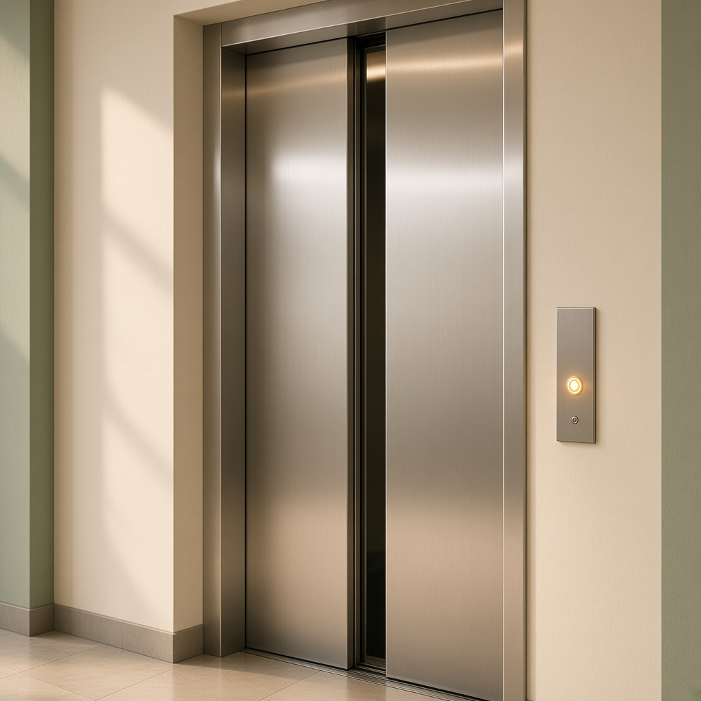
YEAR 7 · LESSON 3 OF 5
03
OF 5
The door is open and you press the button. Why should the lift stay still?
TODAY'S AIM
By the end you will use AND and OR, and write the rule in words before you write the code.
TWO THINGS MUST BE TRUE
Y7.3 · TWO THINGS MUST BE TRUE
Notes:
Cover. Say what they will be able to do by the end: By the end you will use AND and OR, and write the rule in words before you write the code.

Slide 2
STARTER · TWO QUICK QUESTIONS
Check what you know
1
What does digitalRead return?
HIGH or LOW.
ANSWER
click to reveal
2
In code, what do && and || mean?
&& means and. || means or.
ANSWER
click to reveal
Today you write the rule in words before you write the code.
Y7.3 · TWO THINGS MUST BE TRUE
Notes:
They need digitalRead and the words and/or. Do not start the build until the rule is in a sentence.

Slide 3
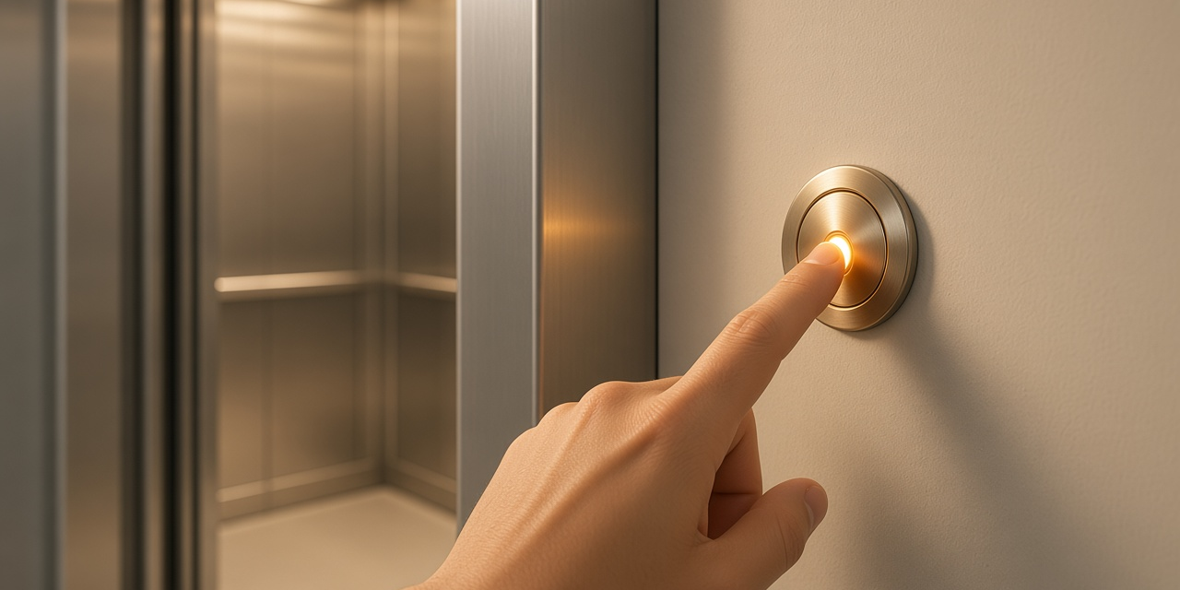
THE QUESTION · TALK TO A PARTNER
The door is open and you press the button. Why should the lift stay still?
WITH A PARTNER
Write the rule as one sentence: the lift moves only when…
The lift moves only when the door is shut AND the button is pressed. In code that is &&. Use || when either input is enough.
THE ANSWER
click to reveal
Y7.3 · TWO THINGS MUST BE TRUE
Notes:
Collect the sentence on the board before anyone opens the code.

Slide 4
PREDICT · ANSWER BEFORE I SHOW YOU
Which word fits: and, or, or not?
The motor must run only when the door is shut AND the button is pressed. Which line does that?
A
B
C
if (door == HIGH || button == HIGH)
if (door == HIGH && button == HIGH)
if (door == HIGH + button == HIGH)
THE ANSWER
THE ANSWER
click to reveal
The second one: &&.
&& means both sides must be true. || means either side is enough. On a keyboard, Shift + A needs both keys, so it behaves like &&.
Hands up for the one you chose — then we find out.
Y7.3 · TWO THINGS MUST BE TRUE
Notes:
The third option is nonsense on purpose; it
makes the difference between && and || the only real question. Reveal, then read
the line out loud as "if door AND button".

Slide 5
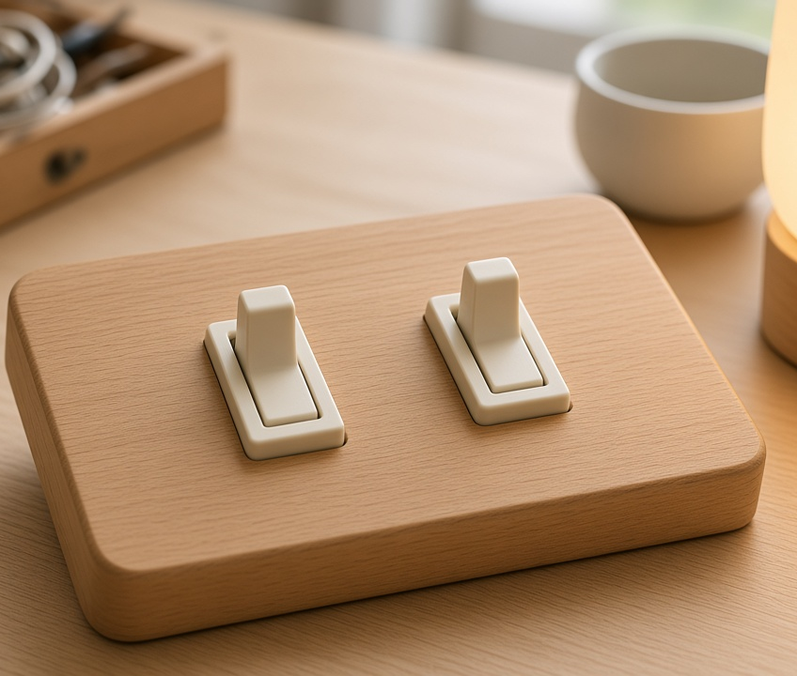
THE IDEA · THIS ANSWERS THE QUESTION
And means both. Or means either.
&& is true only when both inputs are true. || is true when at least one input is true. Write that rule as a sentence, then type it.
Write the rule in words first. Then match it to && or ||.
Notes:
Series and parallel are the same two switches wired
differently. If you have two physical switches and a torch bulb, wire both on the
desk — it takes two minutes and lands better than the picture.

Slide 6
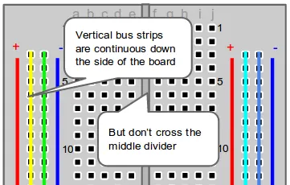
BUILD · 15 MINUTES
Two buttons, one light
1
Button A to pin 2, button B to pin 3.
2
A 10 kΩ pull-down from each pin to GND.
3
LED and 220 Ω on pin 13.
4
Fill in the four-row truth table in your book.
Illustrative interface. Use the live Tinkercad menus.
Y7.3 · TWO THINGS MUST BE TRUE
Notes:
Two pull-downs, one each. Pupils will try to share
one resistor between both buttons; that is the error to look for.

Slide 7
DECODE THE CODE
One rule, two inputs
void setup() {
pinMode(2, INPUT);
pinMode(3, INPUT);
pinMode(13, OUTPUT);
}
void loop() {
int a = digitalRead(2);
int b = digitalRead(3);
if (a == HIGH && b == HIGH) {
digitalWrite(13, HIGH);
} else {
digitalWrite(13, LOW);
}
}
&&
Both sides true. One false side and the whole line is false.
||
Either side true is enough. False only when both are false.
ELSE
Runs when the if was false. One per if, at most.
Say the condition out loud before you run it.
Y7.3 · TWO THINGS MUST BE TRUE
Notes:
Ask them to read the condition out loud before
running it. Half the room will read || as "and" — that is the misconception this
lesson exists to catch.

Slide 8
TEST · DOES IT DO WHAT YOU PLANNED?
Test all four rows
✓
Press A only: the LED stays off.
off
✓
Press B only: the LED stays off.
off
✓
Press both: the LED comes on.
on
WATCH FOR
If either button alone lights it, the condition is an OR wearing an AND's clothes. Read the line again.
Y7.3 · TWO THINGS MUST BE TRUE
Notes:
All four rows, out loud, as a class. The two
single-button rows are where a wrong operator shows itself.

Slide 9
DEBUG · 5 MINUTES
It does not work. Find the fault.
WHAT YOU SEE
A
The pins are swapped
The LED comes on when either button is pressed, not only when both are.
B
The code uses || where it needs &&
C
The LED is backwards
THE FAULT
THE FAULT
click to reveal
The || on the if line.
Read it aloud: 'if A or B'. The lift would open with the door still open. Change || to && and test all four rows again.
Y7.3 · TWO THINGS MUST BE TRUE
Notes:
One character wrong is the whole bug. Show the fix
as a one-character edit, not a rewrite.

Slide 10
CHECK · ONE QUESTION
Which operator is true when at least one of two buttons is pressed?
A
B
C
&&
||
!
THE ANSWER
ANSWER — B
click to reveal
|| — or.
|| is false only when both sides are false. ! is not a joiner: it flips one condition, so !HIGH is LOW.
If you chose another one, say why. That is the useful bit.
Y7.3 · TWO THINGS MUST BE TRUE
Notes:
B. The ! is worth a mention: it means NOT,
and it will appear in Year 8 when a sensor reads the wrong way round.

Slide 11
STRETCH · IF YOU FINISHED EARLY
If that was easy
THREE CONDITIONS
Add a third button on pin 4. The car starts only if all three are true. Then change it so it starts if the key AND (seat OR brake). Write the table first: it now has eight rows.
SAY IT IN WORDS
For each of the four rows, write one sentence: 'A pressed, B released, so the lift stays still because…' A table you cannot explain is a table you do not understand.
Eight rows is not eight times harder. It is the same rule, applied carefully.
Y7.3 · TWO THINGS MUST BE TRUE
Notes:
The second task is the real stretch: eight rows
forces them to be systematic instead of guessing.

Slide 12
EXIT TICKET
What does && mean?
1
When is || false?
2
FINISH THE SENTENCE
THE ANSWER
click to reveal
The lift moves only when the door is shut ________ the button is pressed.
The lift moves only when the door is shut and the button is pressed.
NEXT LESSON
Y7.4 — Keep a count
Next: a count that keeps going up each time you press.
Notes:
The frame is deliberately the exact sentence
structure of the code. Collect and check for the wrong joiner.

