Slide 1
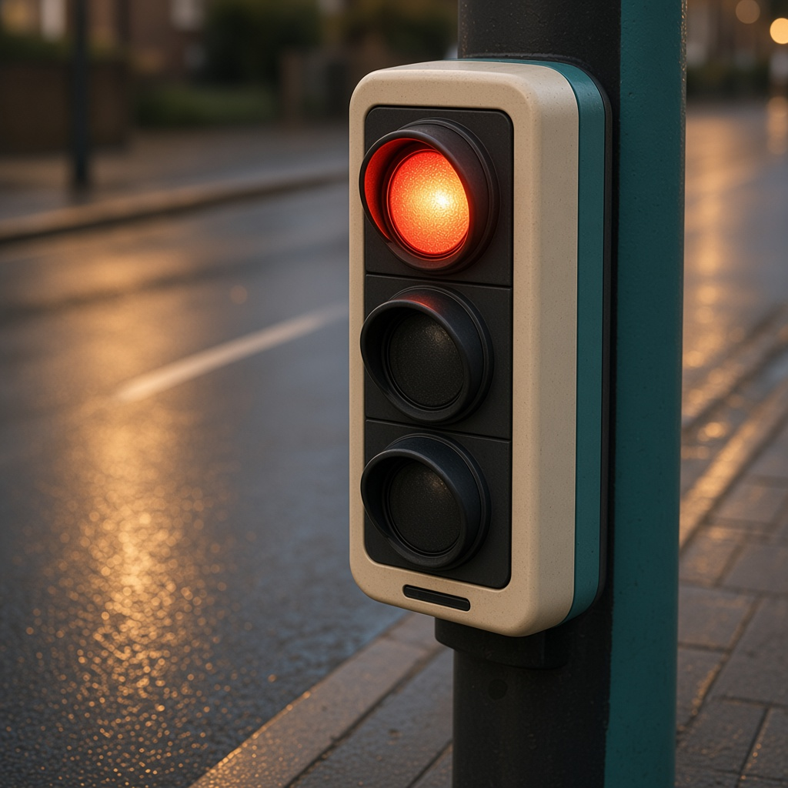
YEAR 7 · LESSON 5 OF 5
05
OF 5
How does a traffic light change on its own, with nobody pressing a switch?
TODAY'S AIM
By the end you will list the stages of a traffic light, build it, and set how long each stage lasts.
DESIGN A CROSSING
Y7.5 · DESIGN A CROSSING
Notes:
Cover. Say what they will be able to do by the end: By the end you will list the stages of a traffic light, build it, and set how long each stage lasts.

Slide 2
STARTER · TWO QUICK QUESTIONS
Check what you know
1
How do you turn one pin on and another off?
digitalWrite one pin HIGH and the other LOW.
ANSWER
click to reveal
2
What does delay() do?
It waits for a set number of milliseconds.
ANSWER
click to reveal
A traffic light is a list of stages. Each stage is which lamps are on, and for how long.
Y7.5 · DESIGN A CROSSING
Notes:
Recall digitalWrite and delay. They should list the stages before they build.

Slide 3

THE QUESTION · TALK TO A PARTNER
How does a traffic light change on its own, with nobody pressing a switch?
WITH A PARTNER
List the stages of a traffic light. For each one, which lamps are on, and for about how long?
Each stage is a pattern of lamps plus a time. The program works through the list, then starts again. Nobody has to press a button.
THE ANSWER
click to reveal
Y7.5 · DESIGN A CROSSING
Notes:
Get red, red-and-amber, green, amber on the board with times before the build.

Slide 4
PREDICT · ANSWER BEFORE I SHOW YOU
What is one stage of a traffic light?
A traffic light has three LEDs. How many can be on at the same time?
A
B
C
Only ever one
Sometimes two
All three
THE ANSWER
THE ANSWER
click to reveal
Sometimes two — red and amber together.
That state tells drivers the next one is green. It is a real state with a real duration, and it is why the light is a state machine and not three timers.
Hands up for the one you chose — then we find out.
Y7.5 · DESIGN A CROSSING
Notes:
Most will say one. The reveal is a real
technical detail, and it makes the point that the rules decide, not the
hardware.

Slide 5

THE IDEA · THIS ANSWERS THE QUESTION
A stage is a pattern and a time
Write each stage as which lamps are on and how many milliseconds it lasts. The loop runs the list from the top, then repeats.
A stage is which lamps are on, and how long that lasts.
Notes:
States first, arrows second. If they can draw the
four circles and the arrows, the code is a transcription job.

Slide 6

BUILD · 15 MINUTES
Three LEDs, one sequence
1
Red on pin 11, amber on 10, green on 9.
2
Every LED gets its own 220 Ω resistor.
3
All three short legs share the GND rail.
4
Draw the states and the times in your book first.
Illustrative interface. Use the live Tinkercad menus.
Y7.5 · DESIGN A CROSSING
Notes:
The design step is before the wiring, on purpose.
Pupils who wire first will code by trial and error and learn nothing about
states.

Slide 7
DECODE THE CODE
Four states, in order
void setup() {
pinMode(9, OUTPUT); // green
pinMode(10, OUTPUT); // amber
pinMode(11, OUTPUT); // red
}
void loop() {
digitalWrite(9, HIGH); // green
delay(6000);
digitalWrite(9, LOW);
digitalWrite(10, HIGH); // amber
delay(2000);
digitalWrite(10, LOW);
digitalWrite(11, HIGH); // red
delay(6000);
digitalWrite(10, HIGH); // red + amber
delay(2000);
digitalWrite(11, LOW);
digitalWrite(10, LOW); // back to green
}
EVERY STATE SETS EVERY PIN
A pin stays where you left it. Switching one on is not switching the others off.
DELAY(6000)
Six seconds of doing nothing at all. Nothing else on the board runs during a delay.
ORDER MATTERS
The loop runs top to bottom, then starts again. The last line leads back to the first state.
Time one full cycle with a stopwatch.
Y7.5 · DESIGN A CROSSING
Notes:
Read the sequence as a story, not as code: green,
wait, amber, wait, red, wait, red and amber, wait. Then the code is obvious.
Point out that delay stops everything — this is the seed for Year 9.

Slide 8
TEST · DOES IT DO WHAT YOU PLANNED?
What success looks like
✓
The four states run in order: green, amber, red, red+amber.
4 states
✓
Each state lasts as long as you planned.
6/2/6/2 s
✓
No two LEDs are lit unless you meant them to be.
no overlap
WATCH FOR
Green and red together means a missing digitalWrite(..., LOW). Walk the sequence and write down all three pins for each state.
Y7.5 · DESIGN A CROSSING
Notes:
Watch one full cycle with a stopwatch. If green
never goes off, a LOW is missing.

Slide 9
DEBUG · 5 MINUTES
It does not work. Find the fault.
WHAT YOU SEE
A
A resistor is missing
Green and red are lit at the same time.
B
One pin is never switched off
C
delay() is too short
THE FAULT
THE FAULT
click to reveal
One digitalWrite(..., LOW) is missing.
A pin keeps its last value. Every state must set every LED, even the ones that are staying off. Write the three pins out for each state and the gap appears.
Y7.5 · DESIGN A CROSSING
Notes:
The classic. Ask for a table of all three pins
per state — the missing LOW shows up immediately in a table and is invisible in
the code.

Slide 10
CHECK · ONE QUESTION
What is a state?
A
B
C
A delay
The set of outputs at one moment
A pin number
THE ANSWER
ANSWER — B
click to reveal
The set of outputs at one moment.
A state is the whole picture: which lamps are on right now. A machine is a list of states and the rules for moving between them.
If you chose another one, say why. That is the useful bit.
Y7.5 · DESIGN A CROSSING
Notes:
B. Insist on the words "at one moment":
a state is a snapshot, not a duration. The duration is how long you stay in it.

Slide 11
STRETCH · IF YOU FINISHED EARLY
If that was easy
ADD A PEDESTRIAN LIGHT
A fourth LED and a button. Pressing the button must not interrupt the cycle: it sets a flag, and the next red lasts longer.
WRITE THE DESIGN, NOT THE CODE
Make a table: state, which lamps, how long, what leaves it. Hand it to someone else and see if they can build it from the table alone.
A flag is a variable that remembers a request. That is a Year 8 idea arriving early.
Y7.5 · DESIGN A CROSSING
Notes:
The pedestrian button is the right stretch
because it introduces a flag — a variable that remembers a request. That is a
Year 8 idea arriving early.

Slide 12
EXIT TICKET
Name the four states, in order.
1
Why does a pin stay on if you never switch it off?
2
FINISH THE SENTENCE
THE ANSWER
click to reveal
A traffic light program is a list of ________ and the time for each one.
A traffic light program is a list of stages and the time for each one.
NEXT LESSON
That is Year 7
Year 8 starts with a knob: a number from 0 to 1023, not just on or off.
Notes:
Close the year on the arc: switch, listen,
decide, remember, sequence. Year 8 starts with a pin that reads a number.

