Slide 1
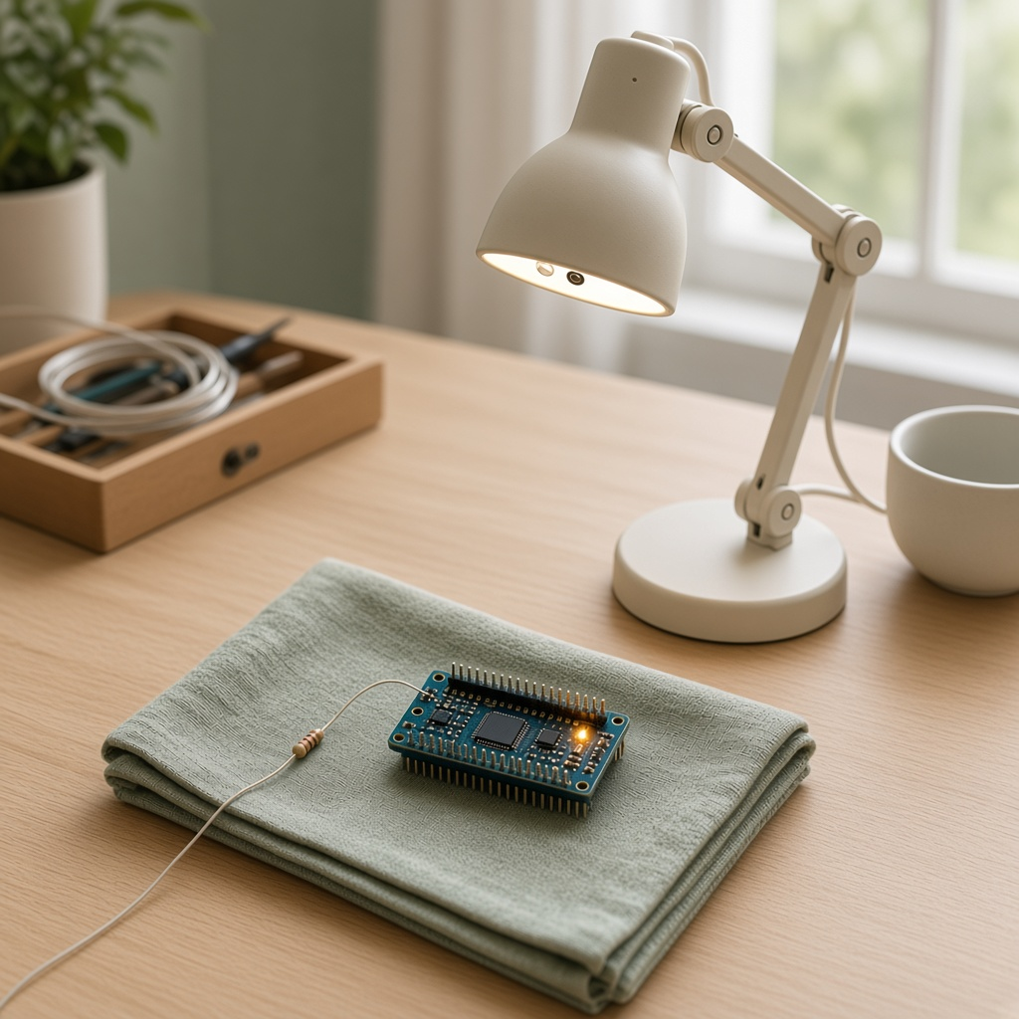
YEAR 9 · LESSON 4 OF 5
04
OF 5
How can the lamp turn itself towards the light, then stop?
TODAY'S AIM
By the end you will make a servo move towards the brighter sensor and stop when the two readings are close.
TURN TOWARDS THE LIGHT
Y9.4 · TURN TOWARDS THE LIGHT
Notes:
Cover. Say what they will be able to do by the end: By the end you will make a servo move towards the brighter sensor and stop when the two readings are close.

Slide 2
STARTER · TWO QUICK QUESTIONS
Check what you know
1
What does a servo need you to send?
An angle.
ANSWER
click to reveal
2
What does analogRead give you from a light sensor?
A number from 0 to 1023.
ANSWER
click to reveal
Compare the two sensors, move a little, then check again.
Y9.4 · TURN TOWARDS THE LIGHT
Notes:
They can set an angle and read a sensor. Today the program chooses the next angle itself.

Slide 3
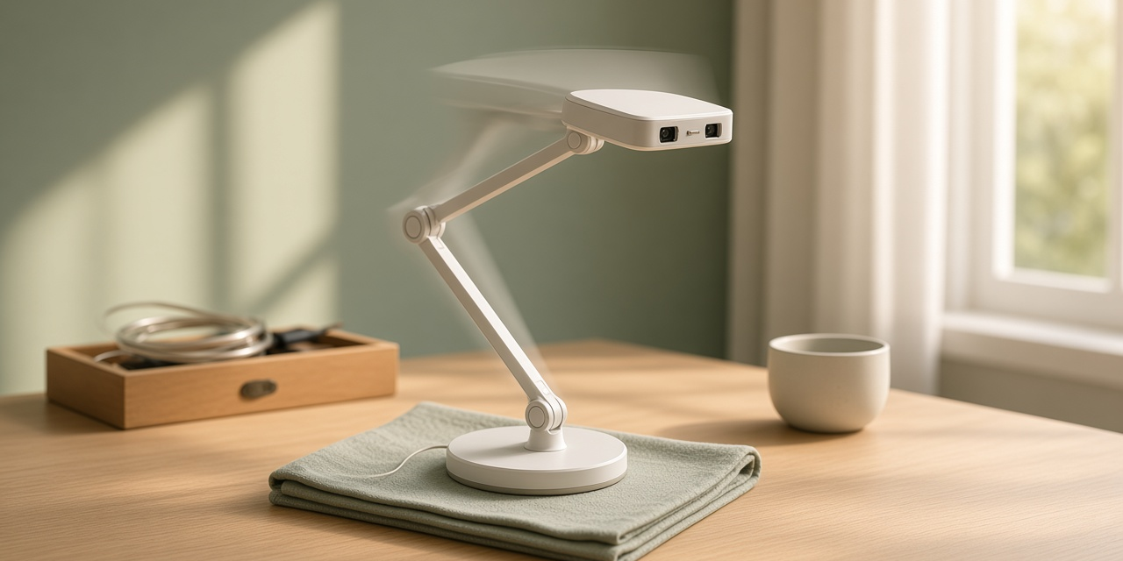
THE QUESTION · TALK TO A PARTNER
How can the lamp turn itself towards the light, then stop?
WITH A PARTNER
One sensor reads 600 and the other reads 400. Which way should the servo move? When should it stop?
Move towards the sensor with the higher reading. The error is the difference between the two readings. Stop when that difference is small.
THE ANSWER
click to reveal
Y9.4 · TURN TOWARDS THE LIGHT
Notes:
They should point towards the brighter side, and say stop when the readings are close.

Slide 4
PREDICT · ANSWER BEFORE I SHOW YOU
When should the servo stop moving?
The two light readings are 600 and 610. What should the servo do?
A
B
C
Keep turning
Stop, because the readings are close
Go back to 0 degrees
THE ANSWER
THE ANSWER
click to reveal
Stop, because the readings are close.
A difference of 10 is small. The program only moves when one reading is more than 40 above the other. Close readings mean stop.
Hands up for the one you chose — then we find out.
Y9.4 · TURN TOWARDS THE LIGHT
Notes:
C surprises people. It is hysteresis from Y8.5,
now inside a loop. The output has memory, and that memory is a feature.

Slide 5
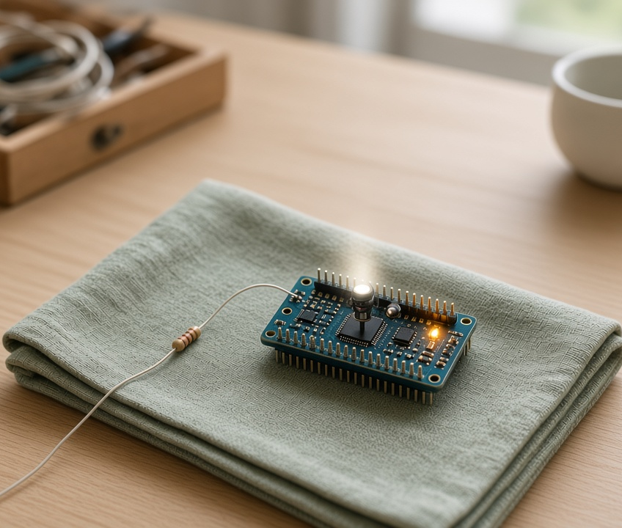
THE IDEA · THIS ANSWERS THE QUESTION
Move, then check again
The error is the difference between the two light readings. If the error is large, move the servo a step towards the brighter sensor. If the error is small, stop. Then read the sensors again.
When the two readings are close. The error is small.
Notes:
Error = target − measured. The controller acts on
the error, not on the measurement. That distinction is the lesson. Draw the loop
on the board with the class.

Slide 6

BUILD · 15 MINUTES
Add two light sensors
1
Two LDRs, left and right, into A0 and A1.
2
Each needs its own 10 kΩ to GND.
3
Servo signal on pin 9, separate supply.
4
Shade one sensor and watch the arm turn.
Illustrative interface. Use the live Tinkercad menus.
Y9.4 · TURN TOWARDS THE LIGHT
Notes:
Two LDRs make a pair of eyes. The divider is the
one from Y8.2, twice. Shade one sensor with a hand — that is the whole demo, and
it is satisfying.

Slide 7
DECODE THE CODE
The loop, in twelve lines
#include <Servo.h>
Servo arm;
int angle = 90;
void setup() {
arm.attach(9);
arm.write(angle);
Serial.begin(9600);
}
void loop() {
int left = analogRead(A0);
int right = analogRead(A1);
if (left > right + 40) angle = angle - 2;
if (right > left + 40) angle = angle + 2;
angle = constrain(angle, 0, 180);
arm.write(angle);
Serial.println(angle);
delay(20);
}
LEFT > RIGHT + 40
If the two readings are within 40 of each other, do nothing. That stops the arm swinging back and forth.
ANGLE = ANGLE - 2
The correction. Small steps, often, beat one big jump.
CONSTRAIN(ANGLE, 0, 180)
Keeps the command inside the servo's travel.
Shade one LDR with your hand.
Y9.4 · TURN TOWARDS THE LIGHT
Notes:
The deadband (+ 40) is the anti-hunting device.
Without it the arm oscillates forever. If a pupil asks why 40, the honest answer
is: because the sensors disagree by about 30 when the light is even.

Slide 8
TEST · DOES IT DO WHAT YOU PLANNED?
What success looks like
✓
Torch on the left: the arm turns left.
left
✓
Torch on the right: it turns right.
right
✓
Hold the torch still: the arm stops, and does not swing back and forth.
stops
WATCH FOR
If the arm keeps swinging, 40 is too small. Change it to 80 and try again.
Y9.4 · TURN TOWARDS THE LIGHT
Notes:
Settling is the sign of a working loop. Hunting is
the sign of over-correction. Ask them to find the widest deadband that still
tracks, and the narrowest that does not hunt.

Slide 9
DEBUG · 5 MINUTES
It does not work. Find the fault.
WHAT YOU SEE
A
The servo is broken
The arm swings past the light and keeps going back and forth.
B
The gap of 40 is too small
C
The sensors are swapped
THE FAULT
THE FAULT
click to reveal
The gap is too small for how much the two sensors disagree.
Make the gap wider (40 to 80), or take smaller steps (2 to 1). If each step is too big, the arm goes past the light and swings back.
Y9.4 · TURN TOWARDS THE LIGHT
Notes:
Oscillation is the classic control failure. It is
not a bug in the sensor; it is a correction that is too big for the error.

Slide 10
CHECK · ONE QUESTION
In this program, what is the error?
A
B
C
A mistake in the code
The difference between the two light readings
The delay between readings
THE ANSWER
ANSWER — B
click to reveal
The difference between the two light readings.
The error is how far apart the two readings are. The program tries to make that smaller. When the difference is under 40, it stops.
If you chose another one, say why. That is the useful bit.
Y9.4 · TURN TOWARDS THE LIGHT
Notes:
B. Error is a number, not a mistake. That
distinction is worth making explicit in a room full of Year 9s.

Slide 11
STRETCH · IF YOU FINISHED EARLY
If that was easy
BIGGER ERROR, BIGGER STEP
Make the step depend on the difference: step = (left - right) / 20. A small difference means a small move. Watch how much more smoothly it stops.
LOG THE ERROR
Print left, right and angle every pass. Find the moment the error crosses zero. That is the arm arriving.
A bigger difference means a bigger step. That is how most real controllers work.
Y9.4 · TURN TOWARDS THE LIGHT
Notes:
Proportional control is the real thing, and it
is one line. They will see the arm settle much more smoothly.

Slide 12
EXIT TICKET
The left sensor is brighter. Which way does the servo move?
1
When should it stop?
2
FINISH THE SENTENCE
THE ANSWER
click to reveal
The error is the difference between the two ________.
The error is the difference between the two readings.
NEXT LESSON
Y9.5 — Send a reading
Next: print each reading on its own line so another program can read it.
Notes:
The frame is the definition. If the room cannot
give the four parts, write them on the board and move on — Y9.5 uses them in the
capstone brief.

