Slide 1

YEAR 7 · ELECTRONICS · LESSON 5
Make a Sound
From a pin flipping to a note you can hear
Notes:
Last lesson the board could measure. Today it can be heard.
Ask what they think is inside a doorbell before you show them anything.

Slide 2



A doorbell, a phone alarm and a piano. Where does the sound come from?
Doorbell. A small part on the wall.
Phone alarm. A part the size of a pea.
Piano. A string, hit by a hammer.
Two of them use a part no bigger than a coin.
A buzzer clicks each time its pin changes. Fast enough, you hear a note.
Notes:
Take the piano answer seriously - it is a different mechanism, and
saying so makes the point. A buzzer is not a speaker. It is a pin switching, and
the ear turns that switching into a pitch.

Slide 3
Sound is a pin flipping fast
A slow pin
A fast pin
Click. Click. Click. You hear separate clicks.
Hundreds a second. The clicks blend into one note.
Frequency
tone(8, 262)
Pitch
Flips per second. We call it hertz.
The board does the flipping.
Bigger number, higher note.
262 Hz is middle C. 440 Hz is the A above it.
Notes:
This is the whole lesson: frequency is speed, pitch is what you
hear. Say the two examples out loud so the numbers mean something.

Slide 4
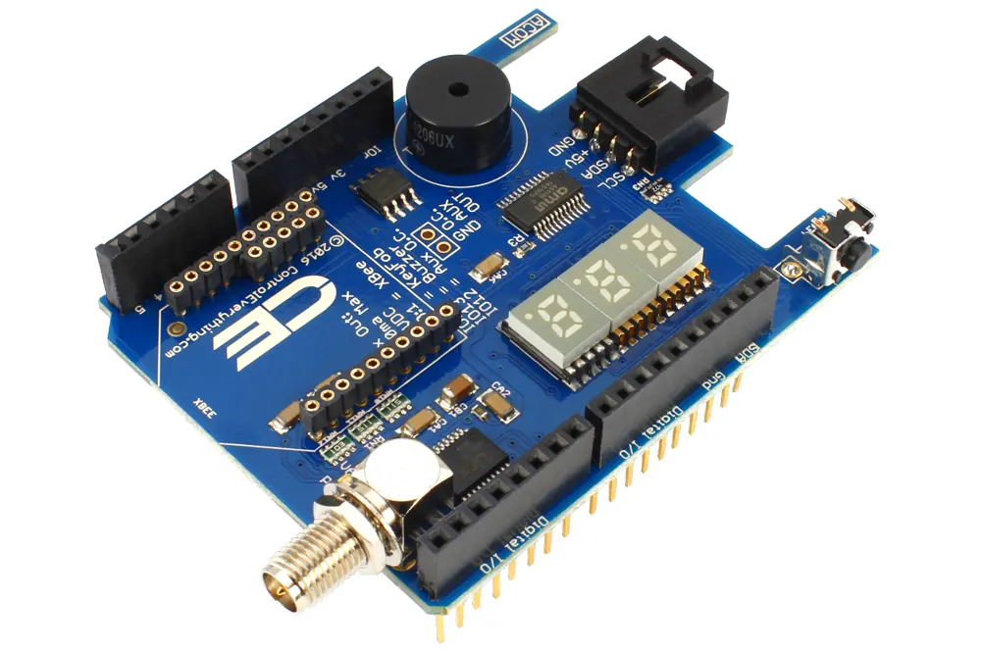
The buzzer on the board
Two legs. One takes the signal, one goes to ground.
Notes:
SLIDE 4 · PICTURE. One breather slide. Point at the two legs and
say which pin drives it. Nothing else on this slide.

Slide 5
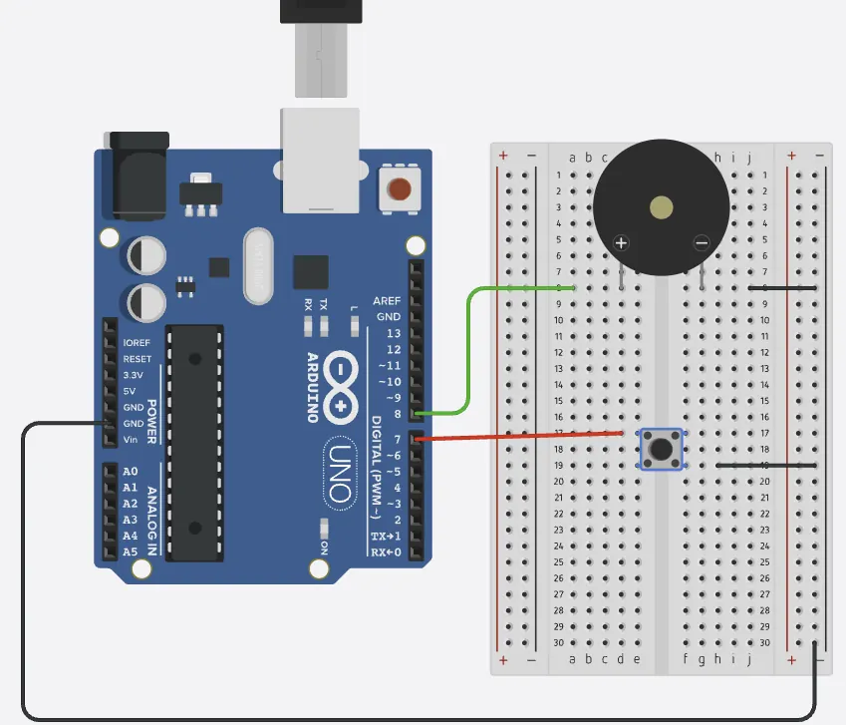
Wire the buzzer in Tinkercad
Three-minute build
1
Open last lesson's circuit and delete the LED.
2
Drag a Piezo onto the canvas.
3
One leg to pin 8, the other to GND.
4
Run it. Nothing happens until the code sends a tone.
Illustrative interface. Use the live Tinkercad menus.
Notes:
A piezo buzzer has no polarity to worry about. The mistake to
watch for is wiring it to 5V, which makes it hum and ignores the pin entirely.

Slide 6
Decode the code
void setup() {
pinMode(8, OUTPUT);
}
void loop() {
tone(8, 262, 400);
delay(500);
tone(8, 440, 400);
delay(500);
}
tone(8, 262) = play
Pin 8 flips 262 times a second.
The third number = length
400 ms, then it stops by itself.
delay() = the gap
Without it the two notes run together.
Notes:
Three numbers in one line, and each has a job. Point at them in
that order: where, how high, how long.

Slide 7
Mission 1: Two Notes
1
Run it and listen to the two notes.
WATCH CLOSELY
What makes a note higher?
2
Change 440 to 880 and run it again.
3
Which of the two is higher?
The frequency: more flips every second.
4
Now change 262 to 131. What happened?
Notes:
Let them hear it before you name it. 131 Hz is an octave below
middle C, so the drop is obvious - that contrast is the point.

Slide 8
Mission 2: Make It Musical
1
Shorten both 400s to 100. Run it.
THINK FIRST
What happens if the gap disappears?
2
Shorten the delays to 150 as well.
3
Now play three notes in a row.
The notes blur into one long sound.
EXTENSION · A SCALE
C, D, E is 262, 294, 330 Hz. Add them to the loop and you have a tune.
Notes:
Note length and gap are two different numbers, and students
conflate them. Changing one and not the other is how they find that out.

Slide 9
QUICK CHECK
ANSWER
Quick check: two numbers
Higher
tone(8, 262, 400) plays 262 Hz for 400 ms.
What changes if the middle number becomes 523?
523 Hz is an octave above 262, so the note sounds higher, not longer.
Think first. Then raise your hand.
Notes:
The trap is saying 'faster'. Push for higher: the note changes
pitch, and the length is a different number entirely.

Slide 10
BEFORE YOU LOG OFF
Wrap-up and exit ticket
A note is a pin flipping hundreds of times a second.
Name a sound you hear every day. Is it high or low?
Write your answer on a slip or in the chat.
One leg to a pin, one to ground.
EXIT TICKET
My ________ makes a ________ note.
Notes:
Kettles, alarms, reversing trucks, lift buttons. Any answer that
says high or low is a pass.

