Slide 1
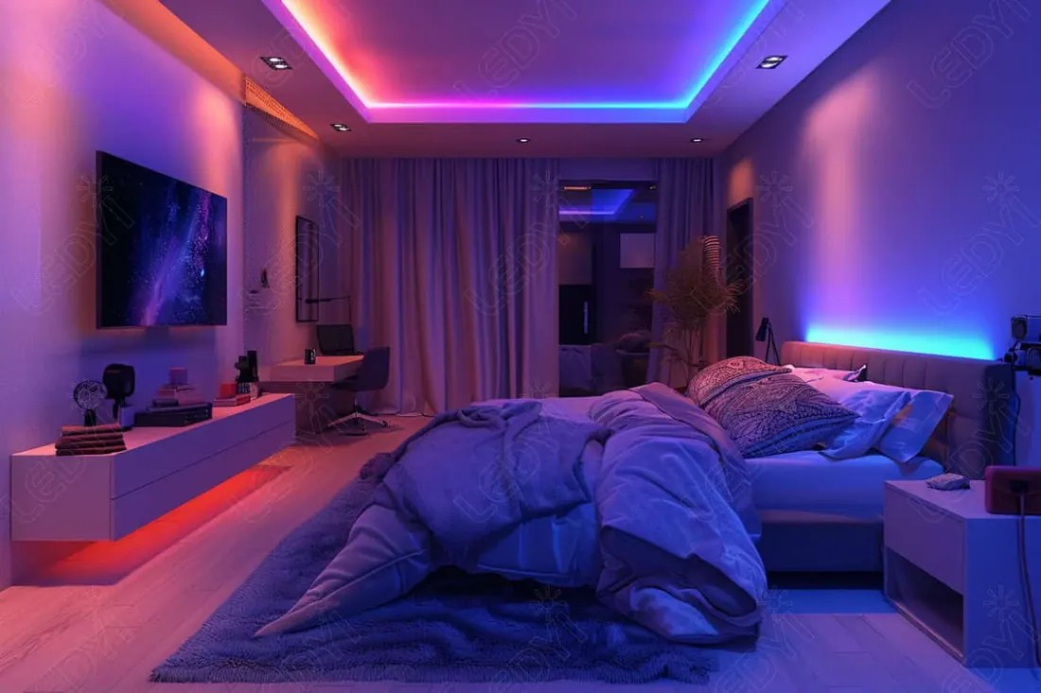
YEAR 8 · ELECTRONICS · LESSON 2
Colour from Three LEDs
Mixing light, not paint
Notes:
Last lesson was one resistor and one colour. Today the same
board makes every colour - with three of them and three numbers.

Slide 2



A screen shows millions of colours. How many lights does it have?
Phone screen. Hold a magnifier to it.
Television. Same trick, much bigger.
Stage light. Three lamps, one lens.
Zoom into a white screen and you will see dots, not white.
Three: red, green and blue. Every other colour is a mix.
Notes:
If you have a phone and a magnifier, do it live. The dots are
the whole lesson, seen rather than told.

Slide 3
Three LEDs in one package
One lens, four legs
Shared leg to ground
Three colours and one leg they share.
On a common cathode part, it is the longest leg.
Red + green
Red + blue
All three
Yellow.
Purple.
White.
Light adds up. Paint takes away.
Notes:
The last line is the one to say twice. On paper more colour means
muddier; in light more colour means brighter, until all three make white.

Slide 4
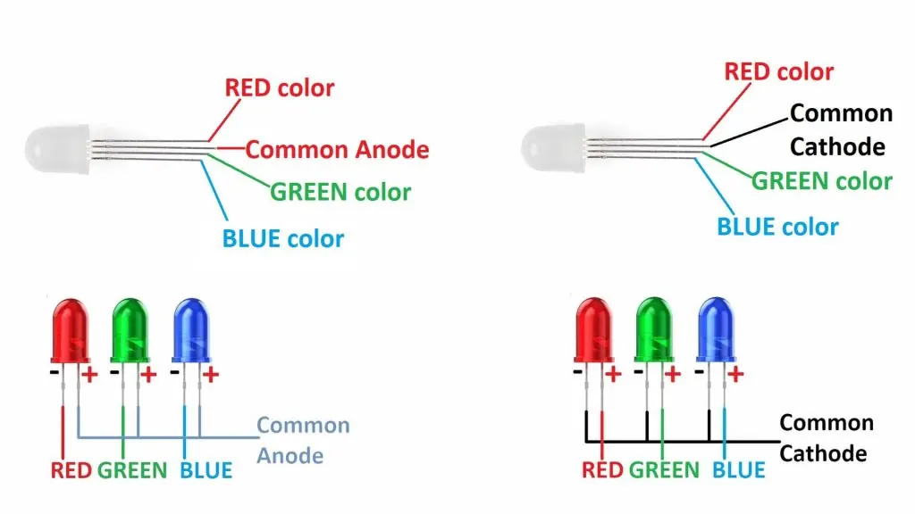
The RGB LED, up close
Four legs: one shared, three colours.
Notes:
SLIDE 4 · PICTURE. Point at the longest leg and name it as the
shared one. That single fact prevents most of the wiring mistakes.

Slide 5
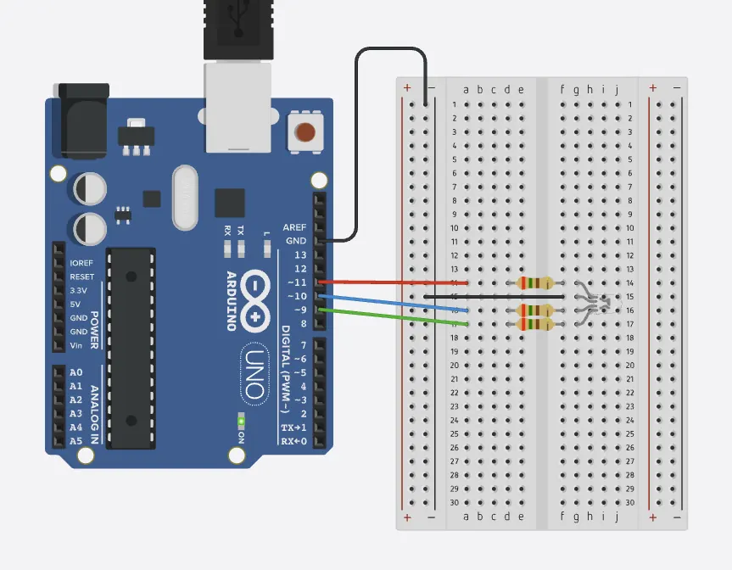
Wire the RGB LED
Five-minute challenge
1
Drag an RGB LED onto the canvas.
2
Longest leg to GND. That is the shared one.
3
Red to pin 9, green to 10, blue to 11. A 220 Ω resistor on each.
4
Run it. You should get one colour, not a rainbow.
Illustrative interface. Use the live Tinkercad menus.
Notes:
Three resistors, not one. A student who shares a resistor will
get a colour that changes when another channel changes, and will not know why.

Slide 6
Decode the code
void setup() {
pinMode(9, OUTPUT);
pinMode(10, OUTPUT);
pinMode(11, OUTPUT);
}
void loop() {
analogWrite(9, 255); // red
analogWrite(10, 255); // green
analogWrite(11, 0); // blue
}
analogWrite = how much
0 to 255. The pin switches fast and your eye averages it.
255 and 255 = yellow
Red and green at full, blue off.
Change one number
That changes the colour, not only the brightness.
Notes:
Three numbers between 0 and 255 describe every colour on the
slide. Say that sentence; it is the whole of concept two.

Slide 7
Mission 1: Mix Three
1
Make yellow, then purple.
WATCH CLOSELY
What makes white?
2
Make white. All three at 255.
3
Now make orange. Which number has to drop?
All three at full. Light adds up to white.
4
Write your three numbers down.
Notes:
Orange is the interesting one: red high, green about half, blue
off. Let them find it by turning numbers rather than being told.

Slide 8
Mission 2: Same Colour, Less Light
1
Pick a colour and note its three numbers.
THINK FIRST
Why does halving keep the colour?
2
Halve all three. Is it still the same colour?
3
Now change only the blue.
The mix is a ratio. Brightness is the total.
EXTENSION · A FADE
Count red from 0 to 255 in steps of 5 and the colour fades up by itself.
Notes:
This is the difference between colour and brightness, and they
are the same three numbers. The ratio stays, the total falls.

Slide 9
QUICK CHECK
ANSWER
Quick check: making yellow
Red + blue
Red 255, green 255, blue 0.
Which two numbers would make purple?
Red and blue at full, green at zero. Green is what makes it yellow.
Think first. Then raise your hand.
Notes:
If they say red and green, go back to the strip on the concept
slide. The pairs are worth memorising.

Slide 10
BEFORE YOU LOG OFF
Wrap-up and exit ticket
Every colour on a screen is three numbers between 0 and 255.
Name a colour. What three numbers would make it?
Write your answer on a slip or in the chat.
Three colours, one lens.
EXIT TICKET
My colour is ________ . It needs red ________ .
Notes:
Any answer with three numbers in the right ballpark is a pass.
Brown, grey and skin tones are the interesting ones to discuss.

