Slide 1
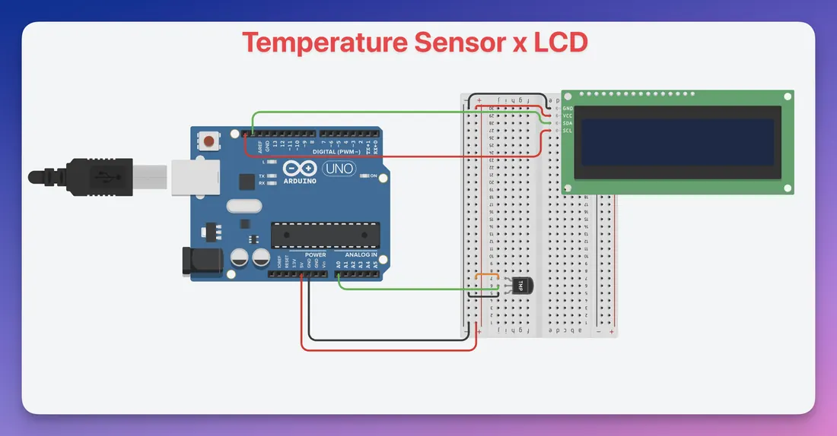
YEAR 8 · ELECTRONICS · LESSON 5
A Plant That Asks for Water
A sensor in the soil and a screen on the desk
Notes:
Two devices on one board today: something that measures and
something that shows. Both were single devices in the lessons before.

Slide 2



A plant cannot tell you it is thirsty. What could?
A leaf. It droops, too late.
The soil. It dries out first.
A sensor. It reports a number.
By the time you see the leaf, it has been thirsty for days.
Measure the soil, not the plant.
Notes:
Ask who has killed a plant. The class will have. The reason is
almost always that nobody measured anything until it was too late.

Slide 3
Measuring water without touching it
Two plates, one capacitor
No bare metal
Water between them changes the reading.
So it does not corrode like the old two-probe type.
Wet soil
Dry soil
Your call
A low number.
A high number.
Pick the threshold.
This sensor reads lower when the soil is wetter. Check yours.
Notes:
The direction catches everyone out, so make them read it off the
Serial Monitor rather than trusting the slide.

Slide 4
A screen is another output
It shows the number the sensor made.
Notes:
SLIDE 4 · PICTURE. A display is just an output, like an LED, with
more pixels. Nothing to wire on this slide.

Slide 5
Build the thirsty plant
Eight-minute build
1
Push the soil sensor into a cup of dry soil.
2
Sensor to A0, and to 5V and GND.
3
Wire the screen: SDA to A4, SCL to A5.
4
Put your own dry and wet numbers into the sketch.
Notes:
The screen has only four wires and one library. If a student's
screen stays blank, check SDA and SCL before anything else.

Slide 6
Decode the code
int dry = 620;
int wet = 280;
void setup() {
Serial.begin(9600);
}
void loop() {
int soil = analogRead(A0);
int percent = map(soil, dry, wet, 0, 100);
Serial.println(percent);
delay(1000);
}
dry and wet = your numbers
Measure them yourself. Someone else's numbers lie.
map() = rescale
Dry becomes 0%. Wet becomes 100%.
#include = borrow code
The library knows how to talk to the screen.
Notes:
The two numbers at the top are the lesson. Everything else is
the same analogRead and map they have already used twice.

Slide 7
Mission 1: Calibrate
1
Read the sensor in dry soil. Write it down.
WATCH CLOSELY
Which way does the number move?
2
Read it in a cup of water. Write it down.
3
Put both numbers into the sketch.
Down. Your dry number is the bottom of the scale.
4
Move the sensor between the two. Watch the percentage.
Notes:
Calibration is a habit, and this is where they get it. Two
measurements, written down, are worth more than any datasheet number.

Slide 8
Mission 2: Ask for Water
1
Print WATER ME when the percentage is under 30.
THINK FIRST
Why is 30% your decision?
2
Test it in dry soil, then in wet.
3
Move the threshold to 50. What changed?
It depends on the plant. You choose the number.
EXTENSION · A PUMP
A small pump needs a transistor, not a pin. Same reason as the fan.
Notes:
A cactus and a fern do not want the same threshold. That is the
difference between a reading and a decision.

Slide 9
QUICK CHECK
ANSWER
Quick check: your numbers
Calibrate
The code needs a dry number and a wet number.
Why not copy them from the internet?
Every sensor and every soil differs. Yours are the only numbers that fit yours.
Think first. Then raise your hand.
Notes:
If they can say this in their own words, they understand that a
reading is not the same as a measurement you trust.

Slide 10
BEFORE YOU LOG OFF
Wrap-up and exit ticket
A sensor gives a number. Calibration is what makes it mean something.
What else would you need to calibrate before you trusted it?
Write your answer on a slip or in the chat.
The number, on the screen.
EXIT TICKET
My soil reads ________ dry, so I set the limit at ________ .
Notes:
Good answers: a scale before weighing, a thermometer in ice
water, a microphone before recording. Any two-point check is a pass.

