Slide 1
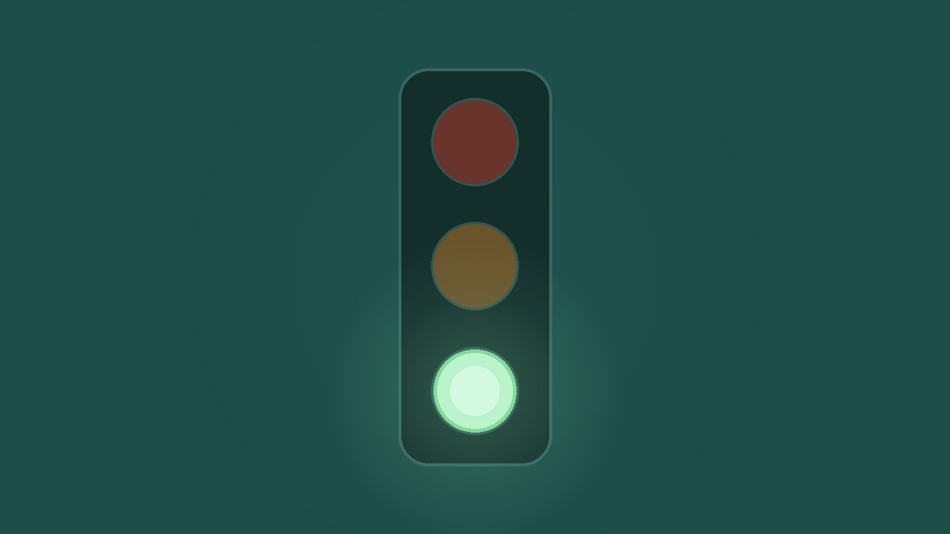
YEAR 9 · ELECTRONICS · LESSON 5
When Two Rules Disagree
A comparison is already a value. Rules must not overlap.
Notes:
The marked project of the half-term. Everything from the year
is in it: an input with a number, and three outputs that must not argue.

Slide 2
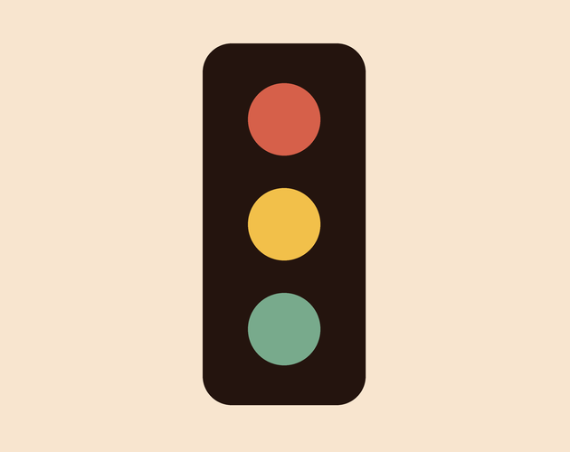


A traffic light, a lift and a train signal. What if two of their rules were true at once?
Traffic light. One colour. Always.
Lift. Open or moving, never both.
Train signal. One lamp means one thing.
Two greens at a junction is an accident.
Overlapping rules light everything at once.
Notes:
These systems are safe because someone wrote the rules so
that only one can be true. That is design, not luck, and it is what they are
about to do.

Slide 3
A comparison is already true or false
true is 1, false is 0
else if means only if
digitalWrite(4, cm > 30) is a decision in one line.
The one before must have been false, so the order decides.
One zone
Off first
Test the edge
Each light gets exactly one.
Or the last light stays on.
30 cm is where it breaks.
Read it out loud: if it is nearer than 30, red.
Notes:
Reading code aloud as English is the check they will use for
the rest of the course. If the sentence sounds wrong, the rules overlap.

Slide 4

Three rules, one lamp lit
Three zones, three lamps, and exactly one on.
Notes:
SLIDE 4 · PICTURE. Count the lit lamps. One. That single fact is
the requirement they will be marked against.

Slide 5
Build the junction
Ten-minute challenge
1
Ultrasonic: Trig to 7, Echo to 8.
2
Three LEDs on pins 4, 5 and 6, each through 220 Ω.
3
Print the distance. Get that working first.
4
Then add the lights, one zone at a time.
Notes:
Sensor first, lights second. If the number is wrong, no
amount of light logic will save it, and they will debug the wrong half.

Slide 6
Decode the code
int near = 30; // cm
int far = 80;
void setup() {
pinMode(4, OUTPUT); // red
pinMode(5, OUTPUT); // amber
pinMode(6, OUTPUT); // green
pinMode(7, OUTPUT); // trig
pinMode(8, INPUT); // echo
}
void loop() {
digitalWrite(7, HIGH);
delayMicroseconds(10);
digitalWrite(7, LOW);
int cm = pulseIn(8, HIGH) / 58;
digitalWrite(4, LOW); // all off
digitalWrite(5, LOW);
digitalWrite(6, LOW);
if (cm < near) digitalWrite(4, HIGH);
else if (cm < far) digitalWrite(5, HIGH);
else digitalWrite(6, HIGH);
delay(200);
}
off first
Without those three lines the light that was on stays on.
else if = the order
Red is asked first. Once it matches, the others are skipped.
cm < near is a value
True or false. A pin can take either directly.
Notes:
The three off lines look like clutter and they are the lesson.
Cover them with your hand and ask what happens - two lights, then three.

Slide 7
Mission 1: Set Your Zones
1
Run it and wave your hand in and out.
WATCH CLOSELY
What happens at exactly 50 cm?
2
Move near to 20 and far to 50.
3
Find the exact distance where amber starts.
cm < far is false at 50, so it falls through to green.
4
Write both numbers down. They are your answers.
Notes:
The boundary is where marks are lost, so make them find it with
a ruler rather than by waving. Exactly 30 is amber, not red.

Slide 8
Mission 2: Break It
1
Change else if to a second plain if.
THINK FIRST
Is there a way to have two lights on and still be right?
2
Make both tests cm < 60 and wave your hand.
3
How many lights are on at 20 cm?
Only if the zones never overlap - red under 20, green over 60.
4
Put it back, then try near = 90, far = 20.
EXTENSION · POINT AND BEEP
Swap two lights for the servo and the buzzer, so the junction both points and sounds.
Notes:
Mission 2 is deliberately destructive. Breaking it on purpose,
then fixing it, is what makes the rule stick. The near = 90, far = 20 case lights
nothing at all, which is the other failure mode.

Slide 9
QUICK CHECK
ANSWER
Quick check: the overlap
Both lights
Red: under 30. Green: under 80. At 20 cm both are true.
What does the board do at 20 cm?
Two rules that can both be true will both act. else if is what stops it.
Think first. Then raise your hand.
Notes:
The board is not wrong. It did exactly what it was told,
twice. That distinction - the code is faithful, the rules were bad - is worth
saying out loud.

Slide 10
BEFORE YOU LOG OFF
Wrap-up and exit ticket
Rules must not overlap, so test the edges.
Name a place where two rules could disagree.
Write your answer on a slip or in the chat.
Only one lamp at a time.
EXIT TICKET
At exactly 30 cm my red light is ________ .
Notes:
A crossing, a lift, a boiler, a pedestrian light. The exit
ticket answer is off - 30 is not less than 30, so amber takes it.

