Slide 1
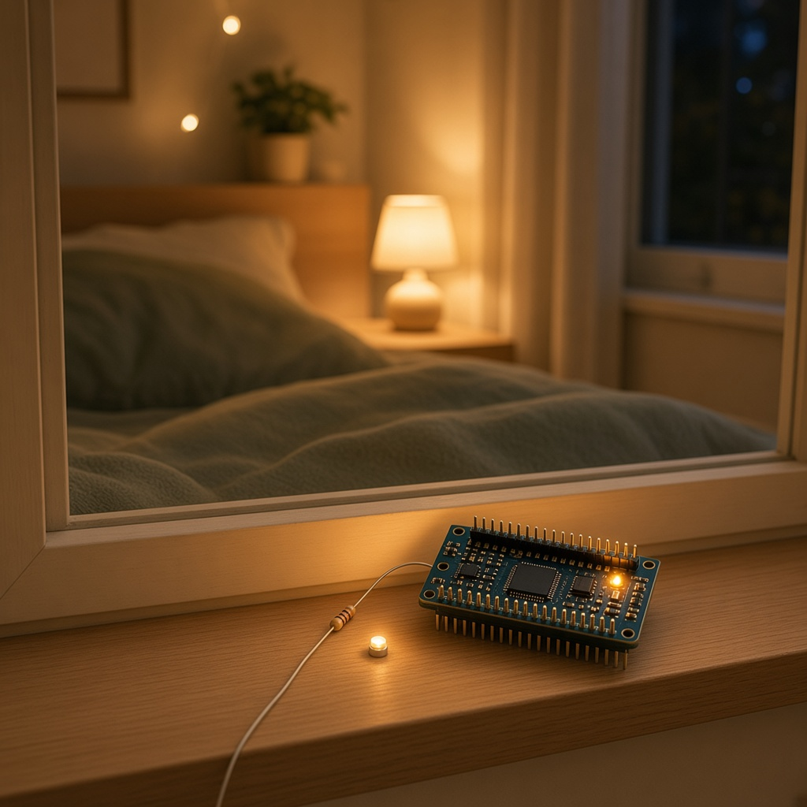
YEAR 8 · LESSON 2 OF 5
02
OF 5
How can a light come on by itself when the room gets dark?
TODAY'S AIM
By the end you will use a light sensor to get a number, and explain why it needs a second resistor.
A LIGHT THAT COMES ON IN THE DARK
Y8.2 · A LIGHT THAT COMES ON IN THE DARK
Notes:
Cover. Say what they will be able to do by the end: By the end you will use a light sensor to get a number, and explain why it needs a second resistor.

Slide 2
STARTER · TWO QUICK QUESTIONS
Check what you know
1
What does analogRead return?
A number from 0 to 1023.
ANSWER
click to reveal
2
What does an LDR do when it gets darker?
Its resistance goes up.
ANSWER
click to reveal
The board reads voltage. A second resistor turns the LDR's resistance into a voltage.
Y8.2 · A LIGHT THAT COMES ON IN THE DARK
Notes:
They can read a number. Today they need to know why one sensor is not enough on its own.

Slide 3
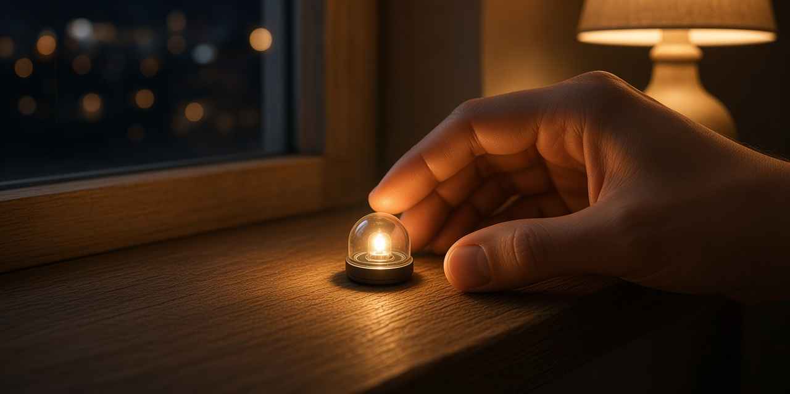
THE QUESTION · TALK TO A PARTNER
How can a light come on by itself when the room gets dark?
WITH A PARTNER
The board can only read a voltage. The LDR changes its resistance. What else does the circuit need?
A second resistor with the LDR makes a voltage divider. As the light changes, the voltage at the pin changes, and analogRead follows it.
THE ANSWER
click to reveal
Y8.2 · A LIGHT THAT COMES ON IN THE DARK
Notes:
The answer to look for is a second resistor, so the pin gets a voltage.

Slide 4
PREDICT · ANSWER BEFORE I SHOW YOU
Why is a second resistor needed?
An LDR is the top half of a voltage divider. You shine a light on it. What happens to the voltage at the middle?
A
B
C
It rises
It falls
It stays at 2.5 V
THE ANSWER
THE ANSWER
click to reveal
It rises.
More light means less resistance in the LDR, so it drops less of the 5 V. The middle point moves up. Put the LDR at the bottom and the same light makes the reading fall.
Hands up for the one you chose — then we find out.
Y8.2 · A LIGHT THAT COMES ON IN THE DARK
Notes:
The LDR is on top in the question, so the
answer is rises. The interesting part is the why: less resistance, less voltage
dropped, so the middle sits higher. The reverse divider is the stretch.

Slide 5
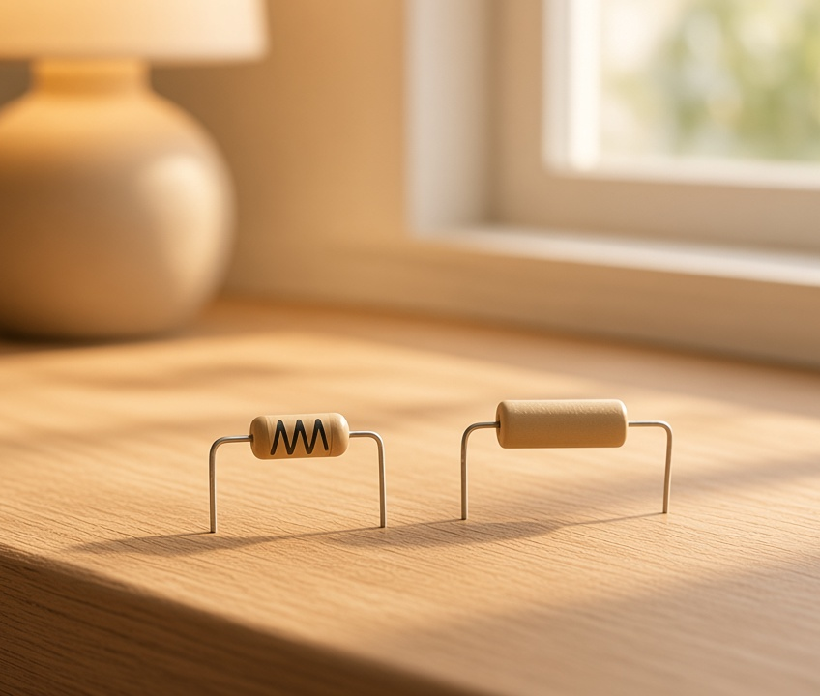
THE IDEA · THIS ANSWERS THE QUESTION
The board reads voltage
An LDR changes resistance as the light changes. On its own that does not give the pin a voltage. A second resistor makes a divider, so the reading changes with the light.
The board reads voltage. The second resistor turns a change in resistance into a change in voltage.
Notes:
The board cannot measure resistance. Say it three
times. A divider is two resistors in a row, and the middle is a fraction of the
supply set by their ratio.

Slide 6
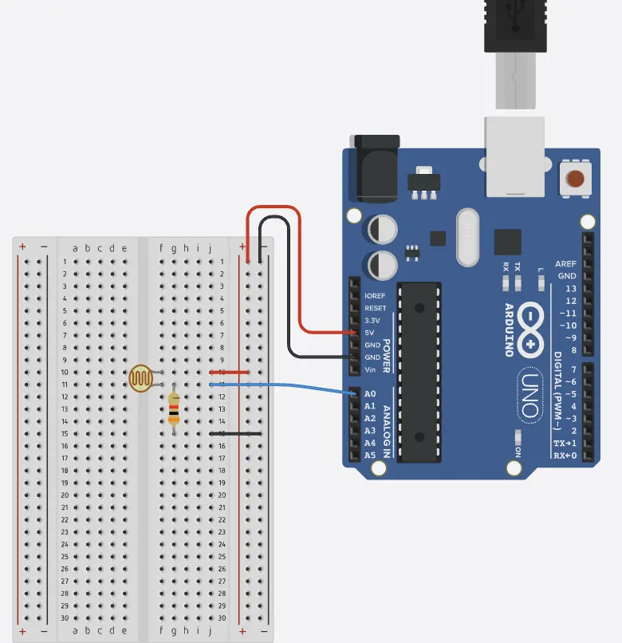
BUILD · 15 MINUTES
Make the divider
1
5 V to one leg of the LDR.
2
The other leg of the LDR to A0.
3
10 kΩ from A0 down to GND.
4
LED and 220 Ω on pin 9.
Illustrative interface. Use the live Tinkercad menus.
Y8.2 · A LIGHT THAT COMES ON IN THE DARK
Notes:
Legs of an LDR are symmetric, so there is no
wrong way round — which is why pupils assume it will just work. The 10 kΩ to
GND is the half they forget.

Slide 7
DECODE THE CODE
Sensor, rule, action
void setup() {
pinMode(9, OUTPUT);
Serial.begin(9600);
}
void loop() {
int light = analogRead(A0);
Serial.println(light);
if (light < 300) {
digitalWrite(9, HIGH);
} else {
digitalWrite(9, LOW);
}
}
INT LIGHT = ANALOGREAD(A0);
A snapshot, once per pass. It does not update by itself.
IF (LIGHT < 300)
The rule. Below 300 means darker, because the LDR is the top half.
DIGITALWRITE(9, HIGH)
The action. Sense, decide, act: that is the whole device.
Cover the sensor with your hand.
Y8.2 · A LIGHT THAT COMES ON IN THE DARK
Notes:
The shape is sensor, rule, action — the same
shape as every device in the course. Point that out now; it is the thread from
here to Year 9.

Slide 8
TEST · DOES IT DO WHAT YOU PLANNED?
What success looks like
✓
Cover the LDR: the number falls and the LED comes on.
below 300
✓
Shine a torch: the number rises and the LED goes off.
above 300
✓
The number moves smoothly as you shade it.
smooth
WATCH FOR
Stuck at 0 or 1023 and never moving? One leg of the LDR is not connected, or the 10 kΩ is missing.
Y8.2 · A LIGHT THAT COMES ON IN THE DARK
Notes:
If the numbers move the wrong way, the divider is
upside down, not broken. That is a good discussion, not an error.

Slide 9
DEBUG · 5 MINUTES
It does not work. Find the fault.
WHAT YOU SEE
A
The LDR is upside down
The reading is stuck at 1023 and the LED never comes on, whatever you do.
B
The 10 kΩ from A0 to GND is missing
C
The LED is backwards
THE FAULT
THE FAULT
click to reveal
There is no path from A0 down to GND.
With only the LDR, A0 is connected to 5 V through it, so it always reads near 1023. The 10 kΩ is the bottom half of the divider: it is what makes the middle voltage change.
Y8.2 · A LIGHT THAT COMES ON IN THE DARK
Notes:
The missing bottom resistor is the classic.
Trace the path from A0 to GND with a finger. If there is no path, it reads
1023.

Slide 10
CHECK · ONE QUESTION
Why can't the LDR be connected straight from 5 V to A0?
A
B
C
It would use too much current
A0 measures voltage, and the LDR only changes resistance
The LDR would burn out
THE ANSWER
ANSWER — B
click to reveal
Because A0 measures voltage, and the LDR only changes resistance.
On its own, the LDR would put almost 5 V on A0 whatever the light. The second resistor is what turns a change in resistance into a change in voltage.
If you chose another one, say why. That is the useful bit.
Y8.2 · A LIGHT THAT COMES ON IN THE DARK
Notes:
B. The answer is not about current at all. The
LDR would not burn out and would not use much current; it simply cannot produce
a voltage to measure on its own.

Slide 11
STRETCH · IF YOU FINISHED EARLY
If that was easy
SWAP THE DIVIDER
Put the LDR at the bottom and the 10 kΩ on top. Predict the numbers before you run it, then rewrite the if so the LED still comes on in the dark.
USE TWO THRESHOLDS
On below 300, off above 350. Why is that steadier than one threshold? Keep the answer for Y8.5.
Same components, opposite behaviour. The wiring is the design.
Y8.2 · A LIGHT THAT COMES ON IN THE DARK
Notes:
Swapping the divider is the single best way to
test whether they understood the ratio rather than memorised the direction.

Slide 12
EXIT TICKET · BEFORE YOU LOG OFF
Two questions, then close the laptop.
What does an LDR change when light falls on it?
FINISH THE SENTENCE
1
The board reads ________. The second resistor turns a change in resistance into that.
Why does A0 need a second resistor?
2
Then answer the question on the cover.
NEXT LESSON
Y8.3 — Dim an LED
Next: an LED that looks dim, even though a pin is only fully on or fully off.
Notes:
The frame is the sentence of the lesson and the
sentence of the whole unit.

