Slide 1
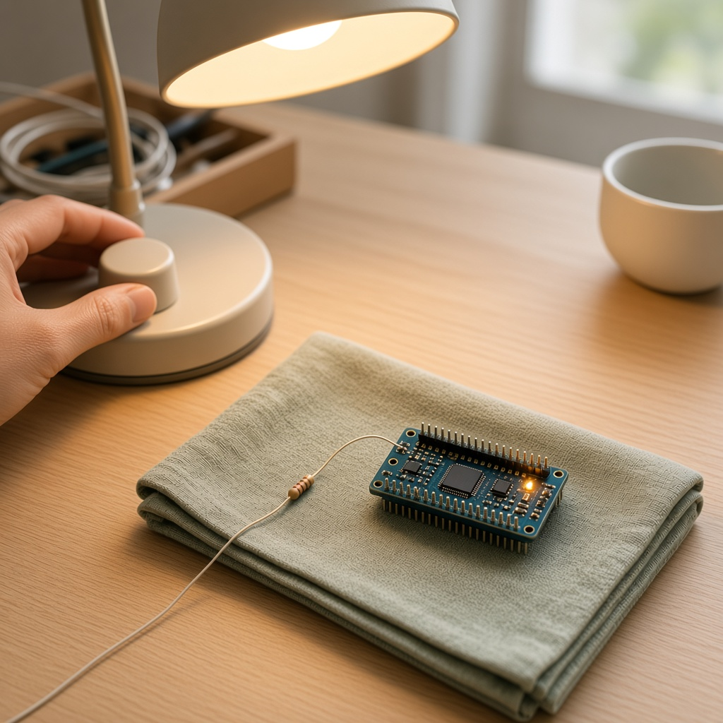
YEAR 8 · LESSON 3 OF 5
03
OF 5
A pin is only fully on or fully off. How can an LED look dim?
TODAY'S AIM
By the end you will dim an LED, and explain that the pin is never at a voltage in between.
DIM AN LED
Y8.3 · DIM AN LED
Notes:
Cover. Say what they will be able to do by the end: By the end you will dim an LED, and explain that the pin is never at a voltage in between.

Slide 2
STARTER · TWO QUICK QUESTIONS
Check what you know
1
Can a digital pin sit at 2.5 V?
No. It is 5 V or 0 V.
ANSWER
click to reveal
2
What does analogWrite do?
It switches the pin on and off very fast.
ANSWER
click to reveal
The LED looks dim because it is on for only part of the time.
Y8.3 · DIM AN LED
Notes:
They must not leave thinking the pin is at a voltage in between.

Slide 3
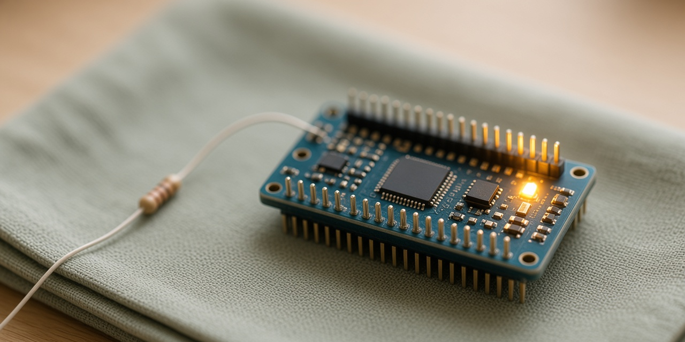
THE QUESTION · TALK TO A PARTNER
A pin is only fully on or fully off. How can an LED look dim?
WITH A PARTNER
If the pin cannot be at 2.5 V, how could an LED look as if it is only half on?
The pin switches fully on and fully off, faster than you can see. The LED looks dim when it is on for only part of the time. That fraction is the duty cycle.
THE ANSWER
click to reveal
Y8.3 · DIM AN LED
Notes:
Listen for 'on and off quickly', not 'a lower voltage'.

Slide 4
PREDICT · ANSWER BEFORE I SHOW YOU
Is the pin ever at a voltage in between?
analogWrite(6, 128) sends a 50% signal to an LED. What is the voltage on pin 6?
A
B
C
2.5 V all the time
5 V half the time, 0 V half the time
0.5 V all the time
THE ANSWER
THE ANSWER
click to reveal
5 V half the time, 0 V half the time.
analogWrite does not make an in-between voltage. It switches the pin on and off hundreds of times a second, and your eye averages the result.
Hands up for the one you chose — then we find out.
Y8.3 · DIM AN LED
Notes:
This is the heart of Year 8. Do not reveal until
every hand is up. The wrong answer is A, and it is wrong because the pin is a
switch, not a valve.

Slide 5
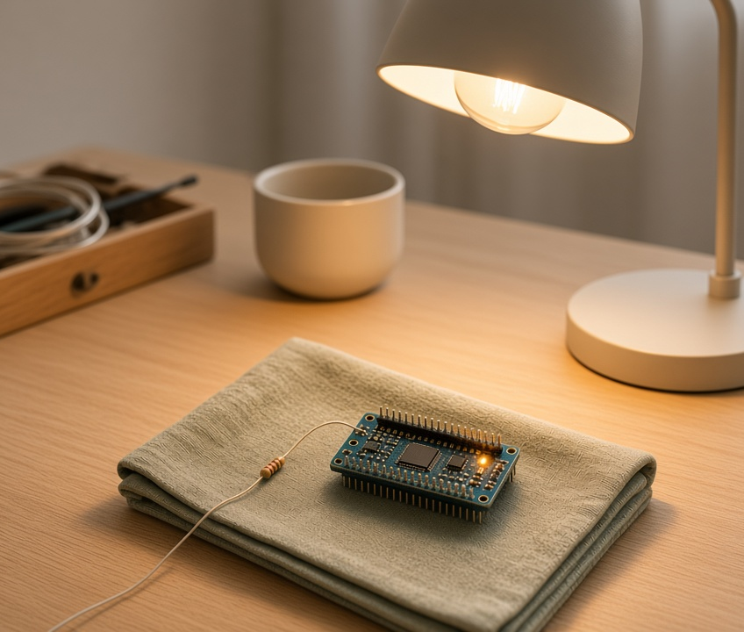
THE IDEA · THIS ANSWERS THE QUESTION
On for part of the time
analogWrite switches the pin on and off thousands of times a second. A low number means on for a small part of each cycle, so the LED looks dim. The pin is never at a voltage in between.
No. It is fully on or fully off. Your eye averages the flashes.
Notes:
Duty cycle is the word to teach: the fraction
of time the pin is on. 128 out of 255 is half. Show the three rows on the
diagram and ask which is brightest.

Slide 6

BUILD · 15 MINUTES
Wire a dimmer
1
Pot on A0, outer legs to 5 V and GND.
2
LED and 220 Ω on pin 6 — a PWM pin.
3
Pins 3, 5, 6, 9, 10, 11 can dim.
4
Print the value you send to the pin.
Illustrative interface. Use the live Tinkercad menus.
Y8.3 · DIM AN LED
Notes:
Pin choice matters: 3, 5, 6, 9, 10, 11 are the
PWM pins on an Uno. Write the list on the board. Pins 5 and 6 run at a
different frequency — do not mention it unless asked.

Slide 7
DECODE THE CODE
From a dial to a duty cycle
void setup() {
pinMode(6, OUTPUT);
Serial.begin(9600);
}
void loop() {
int knob = analogRead(A0);
int level = map(knob, 0, 1023, 0, 255);
analogWrite(6, level);
Serial.println(level);
delay(30);
}
ANALOGWRITE(6, LEVEL)
0 is off, 255 is fully on, and everything between is a duty cycle.
MAP(KNOB, 0, 1023, 0, 255)
analogRead has 1024 steps; analogWrite takes 256. map converts.
PIN 6
Only PWM pins can do this: 3, 5, 6, 9, 10 and 11 on an Uno.
0 to 255 is 256 values, not 255.
Y8.3 · DIM AN LED
Notes:
map() appears again, now 1024 steps to 256.
Ask why 255 and not 256: because 0 counts as a value.

Slide 8
TEST · DOES IT DO WHAT YOU PLANNED?
What success looks like
✓
Turning the knob dims smoothly from off to full.
0–255
✓
The LED does not visibly flicker.
no flicker
✓
Move the LED to pin 7: it only switches on and off.
no PWM
WATCH FOR
Flicker means the delay is too short for the change to settle, or the pin is not a PWM pin.
Y8.3 · DIM AN LED
Notes:
The pin 7 test is the good one: it looks like a
failure but it is a fact about the board. Let them discover it.

Slide 9
DEBUG · 5 MINUTES
It does not work. Find the fault.
WHAT YOU SEE
A
The LED is on pin 7
The LED is either fully on or fully off. The knob does nothing in between.
B
The resistor is too big
C
map() is rounding
THE FAULT
THE FAULT
click to reveal
Pin 7 cannot do PWM.
analogWrite on a non-PWM pin just switches it. Move the LED to pin 6 and change the number in pinMode and analogWrite.
Y8.3 · DIM AN LED
Notes:
A pupil who moves the LED and forgets the pin
number will see this. Ask them to read both the wiring and the analogWrite
line.

Slide 10
CHECK · ONE QUESTION
A pin is HIGH for 1 ms and LOW for 3 ms, over and over. What is the average voltage?
A
B
C
1.25 V
2.5 V
3.75 V
THE ANSWER
ANSWER — A
click to reveal
1.25 V.
It is on for one quarter of the time. One quarter of 5 V is 1.25 V. That fraction is called the duty cycle.
If you chose another one, say why. That is the useful bit.
Y8.3 · DIM AN LED
Notes:
A. 1 ms on and 3 ms off is on for one quarter
of the time. Get them to write the fraction before choosing.

Slide 11
STRETCH · IF YOU FINISHED EARLY
If that was easy
FADE WITHOUT A KNOB
Use a for loop to take level from 0 to 255 and back again. Print the value. Time one full fade.
MIX A COLOUR
Red, green and blue on three PWM pins. Set three duty cycles and predict the colour before you run it.
An RGB LED is three LEDs in one package. Three duty cycles, one colour.
Y8.3 · DIM AN LED
Notes:
Fading with a for loop removes the knob and
makes the duty cycle visible as a number climbing. The RGB task is how every
colour LED works.

Slide 12
EXIT TICKET · BEFORE YOU LOG OFF
Two questions, then close the laptop.
What two voltages can a PWM pin actually produce?
FINISH THE SENTENCE
1
The LED looks dim because the pin is on for only part of the ________.
What does analogWrite(6, 64) mean?
2
Then answer the question on the cover.
NEXT LESSON
Y8.4 — A number that means degrees
Next: turning that number into a temperature in °C.
Notes:
The first question has a two-word answer and it
is the whole lesson: 5 V and 0 V.

