Slide 1
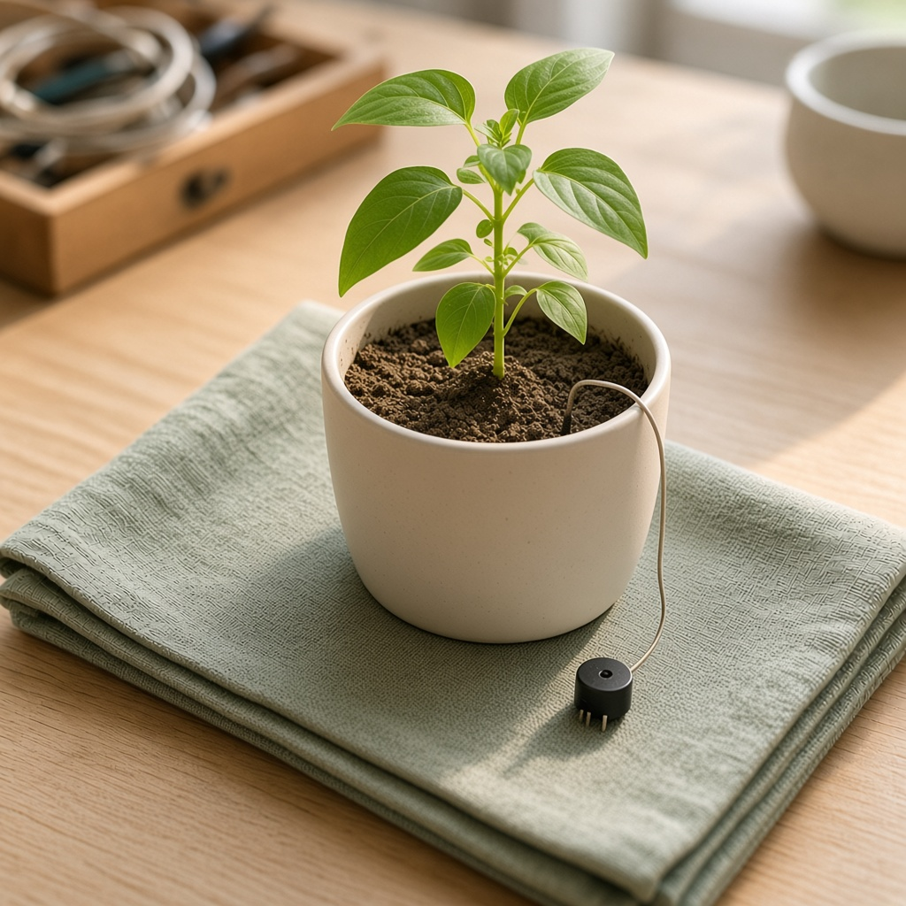
YEAR 8 · LESSON 5 OF 5
05
OF 5
Why does the buzzer keep switching on and off near the limit, and how do you stop it?
TODAY'S AIM
By the end you will turn a buzzer on when the soil is dry, and keep it off until the soil is wet enough.
AN ALARM THAT STAYS STEADY
Y8.5 · AN ALARM THAT STAYS STEADY
Notes:
Cover. Say what they will be able to do by the end: By the end you will turn a buzzer on when the soil is dry, and keep it off until the soil is wet enough.

Slide 2
STARTER · TWO QUICK QUESTIONS
Check what you know
1
What voltage does the TMP36 give at 0 °C?
0.5 V.
ANSWER
click to reveal
2
Why write 5.0 rather than 5?
So the division uses decimals, not whole numbers.
ANSWER
click to reveal
One limit is not enough when the reading wobbles.
Y8.5 · AN ALARM THAT STAYS STEADY
Notes:
Recall the temperature formula only if you need it. The new idea is two limits.

Slide 3
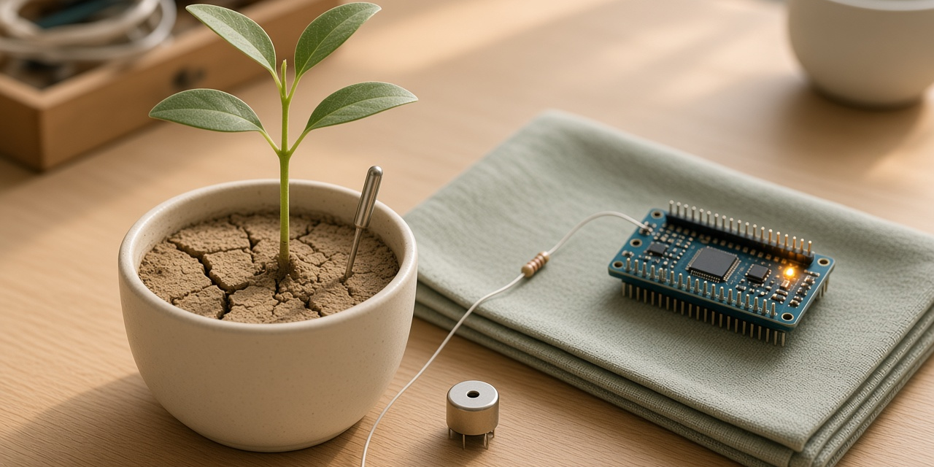
THE QUESTION · TALK TO A PARTNER
Why does the buzzer keep switching on and off near the limit, and how do you stop it?
WITH A PARTNER
The limit is 400. The reading wobbles between 398 and 402. What does the buzzer do, and how could you stop that?
With one limit, a small wobble turns the buzzer on and off. Use two limits with a gap. It turns on below the lower one and stays on until the reading passes the higher one.
THE ANSWER
click to reveal
Y8.5 · AN ALARM THAT STAYS STEADY
Notes:
They should hear the problem as clicking or flickering, and the fix as a gap.

Slide 4
PREDICT · ANSWER BEFORE I SHOW YOU
What if there is only one limit?
The threshold is 400. The reading wobbles between 398 and 402. What does the buzzer do?
A
B
C
Stays on
Stays off
Switches on and off rapidly
THE ANSWER
THE ANSWER
click to reveal
It keeps switching on and off.
One limit means a small wobble turns the buzzer on and off. Two limits, with a gap, stop that. It turns on below 380 and stays on until the reading goes above 420.
Hands up for the one you chose — then we find out.
Y8.5 · AN ALARM THAT STAYS STEADY
Notes:
Chattering is the phenomenon; hysteresis is
the fix. Let them watch a one-threshold version chatter in Tinkercad before
the reveal if you have time.

Slide 5
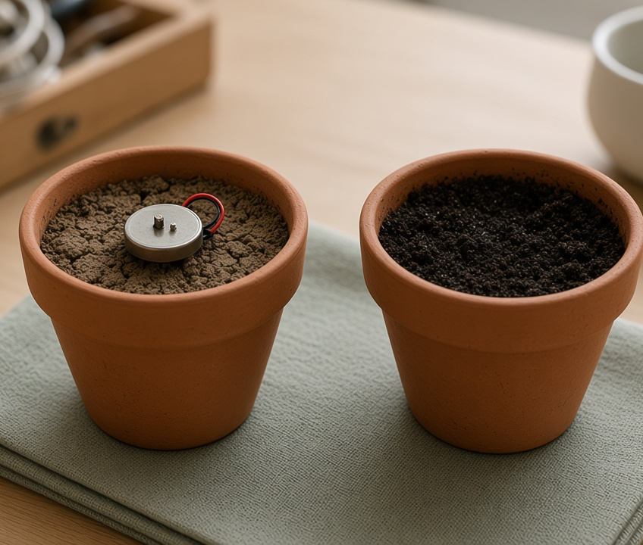
THE IDEA · THIS ANSWERS THE QUESTION
Two limits, with a gap
Turn the buzzer on when the reading goes below the lower limit. Leave it on until the reading goes above the higher limit. Between the two, do not change anything.
A wobble across one limit turns the buzzer on and off. Two limits, with a gap, stop that.
Notes:
The output has memory: it stays where it is
between the two thresholds. That is a state, arriving again from Year 7, now
used for a different job.

Slide 6
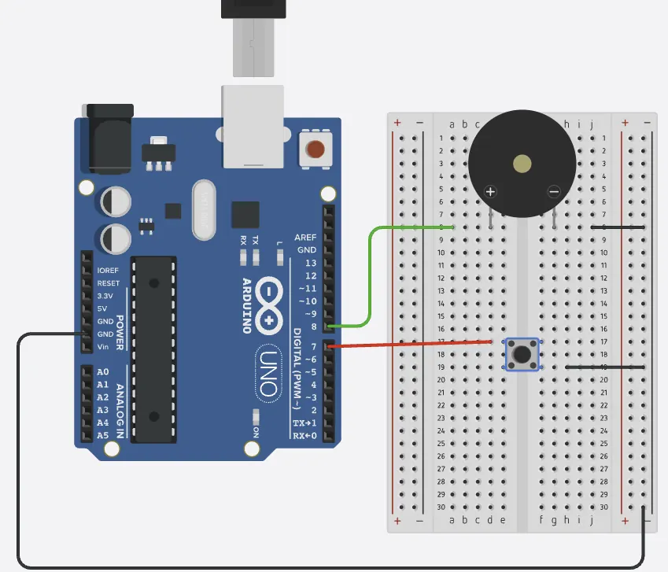
BUILD · 15 MINUTES
Wire the plant alarm
1
Probe into A0 and 5 V (two nails work).
2
10 kΩ from A0 down to GND.
3
Buzzer on pin 8, LED on pin 9.
4
Test in dry air, then in a wet cup.
Illustrative interface. Use the live Tinkercad menus.
Y8.5 · AN ALARM THAT STAYS STEADY
Notes:
If you have no soil probe, two nails in a cup
of soil work. Check the direction of the reading in dry and wet soil before any
code is written — it is the thing that decides the rule.

Slide 7
DECODE THE CODE
A flag, two rules, two outputs
int dry = 0;
void setup() {
pinMode(8, OUTPUT);
pinMode(9, OUTPUT);
Serial.begin(9600);
}
void loop() {
int wetness = analogRead(A0);
if (wetness < 380) dry = 1;
if (wetness > 420) dry = 0;
digitalWrite(8, dry);
digitalWrite(9, dry);
Serial.println(wetness);
delay(200);
}
IF (WETNESS < 380) DRY = 1;
One rule sets the flag. A variable that remembers a decision is a state.
IF (WETNESS > 420) DRY = 0;
A second rule clears it. Between the marks, nothing changes.
DIGITALWRITE(8, DRY)
The flag drives the output. The sensor never drives it directly.
Between 380 and 420, nothing happens.
Y8.5 · AN ALARM THAT STAYS STEADY
Notes:
The flag `dry` is the state. The two ifs set
and clear it. Nothing happens between 380 and 420, and that is the whole
trick.

Slide 8
TEST · DOES IT DO WHAT YOU PLANNED?
What success looks like
✓
Dry air: the buzzer sounds and the LED is on.
dry
✓
Wet tissue: both go off.
wet
✓
Near the limit: the buzzer does not keep clicking.
steady
WATCH FOR
If it keeps clicking, the two limits are too close, or you only wrote one. The gap must be wider than the wobble.
Y8.5 · AN ALARM THAT STAYS STEADY
Notes:
The boundary test is the one to spend time on.
Wave the probe slowly through the threshold and listen.

Slide 9
DEBUG · 5 MINUTES
It does not work. Find the fault.
WHAT YOU SEE
A
The buzzer is wired backwards
The buzzer is on when the soil is wet, and off when it is dry.
B
The comparison is the wrong way round
C
The delay is too long
THE FAULT
THE FAULT
click to reveal
The probe is the other way round in the divider: wet now reads low and dry reads high.
Print the reading in dry soil and in water before writing the rule. With the probe at the top of the divider, dry soil gives a low number, which is why the alarm tests below 380. Swap the probe and the 10 kΩ, or reverse both comparisons.
Y8.5 · AN ALARM THAT STAYS STEADY
Notes:
The inverted rule is the most common. Ask them to
print the reading in dry air first, then in water. Data before code.

Slide 10
CHECK · ONE QUESTION
Why two thresholds instead of one?
A
B
C
To make the code longer
So a reading that wobbles cannot make the buzzer switch on and off
Because analogRead is noisy
THE ANSWER
ANSWER — B
click to reveal
So a reading that wobbles cannot make the buzzer switch on and off.
One limit makes the buzzer switch every time the reading wobbles across it. A gap between two limits means it changes only when the reading has really moved.
If you chose another one, say why. That is the useful bit.
Y8.5 · AN ALARM THAT STAYS STEADY
Notes:
B. The gap is not a fudge; it is the width of the
noise, on purpose.

Slide 11
STRETCH · IF YOU FINISHED EARLY
If that was easy
THREE STATES
Print DRY, DAMP or WET using two thresholds and an else-if chain. Decide what the buzzer does in each state.
CHOOSE A THRESHOLD FROM DATA
Print the reading with millis() as a timestamp. Leave it running for ten minutes, then find the highest and lowest values. Pick your thresholds from those numbers.
A threshold chosen from data is a design decision. A guessed one is a bug waiting to happen.
Y8.5 · AN ALARM THAT STAYS STEADY
Notes:
The logging task is how a real threshold is
chosen: from data, not from a guess. Ten minutes of logging is enough to make
the point.

Slide 12
EXIT TICKET · BEFORE YOU LOG OFF
Two questions, then close the laptop.
Name the three parts of any automatic device.
FINISH THE SENTENCE
1
The buzzer stays steady because there are two ________, not one.
Why use two limits instead of one?
2
Then answer the question on the cover.
NEXT LESSON
That is Year 8
Year 9: a motor needs more current than a pin can give.
Notes:
Close the unit by naming the shape: sense,
decide, act. Year 9 adds the hard part — making something move.

