Slide 1
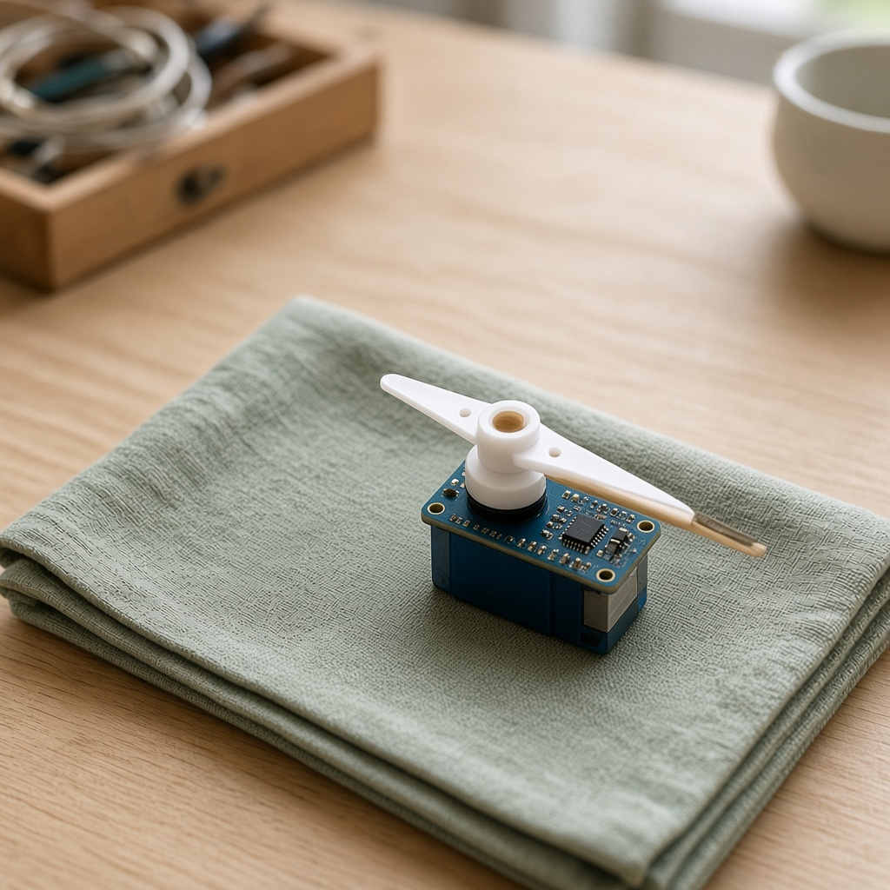
YEAR 9 · LESSON 3 OF 5
03
OF 5
How do you tell a motor to go to an angle and stay there?
TODAY'S AIM
By the end you will set a servo to an angle you choose, and explain that the signal is the angle, not the speed.
SET A SERVO TO AN ANGLE
Y9.3 · SET A SERVO TO AN ANGLE
Notes:
Cover. Say what they will be able to do by the end: By the end you will set a servo to an angle you choose, and explain that the signal is the angle, not the speed.

Slide 2
STARTER · TWO QUICK QUESTIONS
Check what you know
1
What did PWM control on the last motor?
Its speed. How much of the time it was on.
ANSWER
click to reveal
2
What is an angle?
A turn, measured in degrees.
ANSWER
click to reveal
A servo is told an angle. It moves there and holds.
Y9.3 · SET A SERVO TO AN ANGLE
Notes:
Separate speed from position before they see the servo.

Slide 3
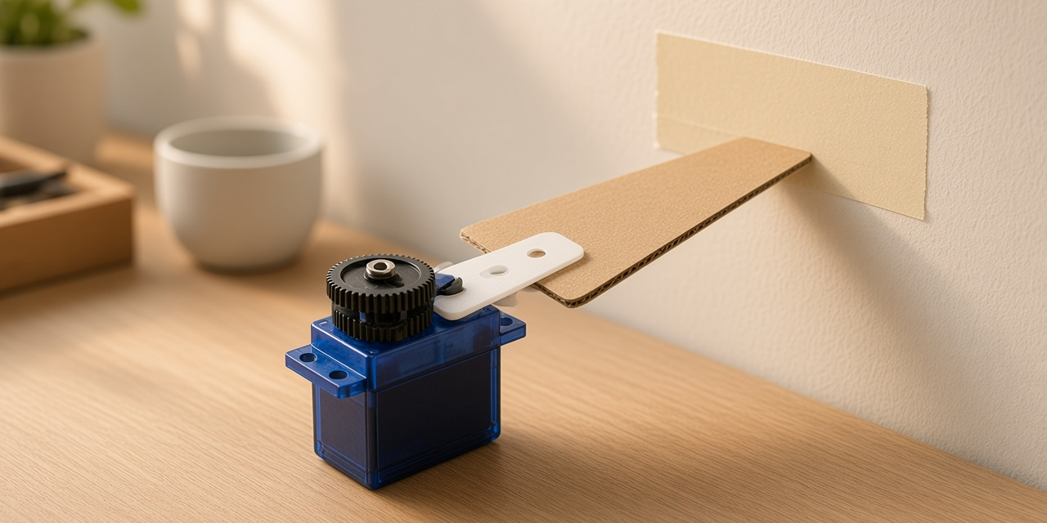
THE QUESTION · TALK TO A PARTNER
How do you tell a motor to go to an angle and stay there?
WITH A PARTNER
A normal motor keeps spinning while it is powered. What would you have to send a servo so it stops at 90 degrees?
You send the angle, not the speed. A short pulse repeats about every 20 ms. About 1 ms means 0°, 1.5 ms means 90°, and 2 ms means 180°.
THE ANSWER
click to reveal
Y9.3 · SET A SERVO TO AN ANGLE
Notes:
They should say a position or an angle. Then show that the pulse width is that angle.

Slide 4
PREDICT · ANSWER BEFORE I SHOW YOU
What are you sending: a speed, or an angle?
A servo gets a pulse every 20 ms. What does the width of the pulse tell it?
A
B
C
How fast to turn
What angle to hold
Which direction to spin
THE ANSWER
THE ANSWER
click to reveal
What angle to hold.
1.0 ms is one end of the range, 2.0 ms the other, and 1.5 ms the middle. The servo's own circuit turns the motor until its position matches the pulse.
Hands up for the one you chose — then we find out.
Y9.3 · SET A SERVO TO AN ANGLE
Notes:
B is right, and it is the difference between a
motor and a servo. A is the answer for a DC motor, and it is the misconception
to name out loud.

Slide 5
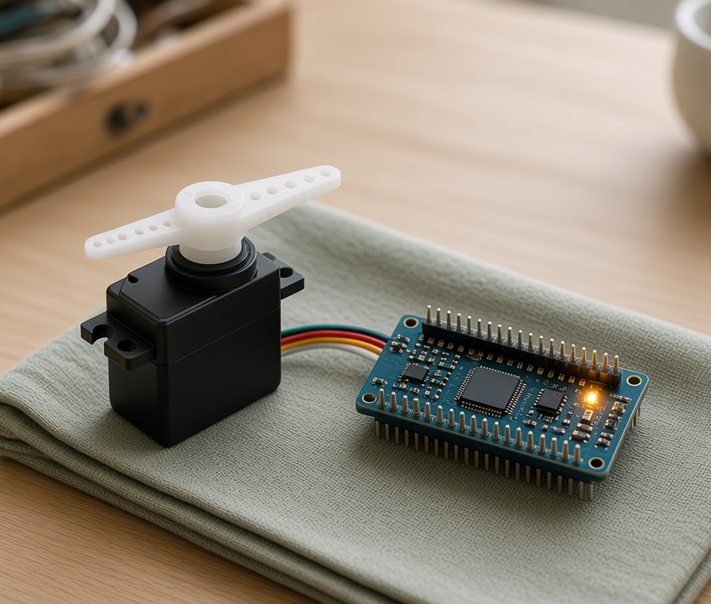
THE IDEA · THIS ANSWERS THE QUESTION
The signal is the angle
A servo expects a pulse about every 20 ms. A 1 ms pulse means about 0°. 1.5 ms means about 90°. 2 ms means about 180°. You tell it where to go, not how fast to spin.
An angle. The servo moves there and holds.
Notes:
This is a setpoint, the word used in every control
system. Write it on the board. Lesson 4 uses it again.

Slide 6

BUILD · 15 MINUTES
Three wires, one of them a signal
1
Signal wire to pin 9.
2
Power from a separate 5 V supply.
3
Join the grounds.
4
Pot on A0 to choose the angle.
Illustrative interface. Use the live Tinkercad menus.
Y9.3 · SET A SERVO TO AN ANGLE
Notes:
Three wires: power, ground, signal. The signal is
the only one that goes to the board. Power comes from a separate supply, and
the grounds are joined — the same rule as the motor.

Slide 7
DECODE THE CODE
Ask for an angle
#include <Servo.h>
Servo arm;
void setup() {
arm.attach(9);
Serial.begin(9600);
}
void loop() {
int knob = analogRead(A0);
int angle = map(knob, 0, 1023, 0, 180);
arm.write(angle);
Serial.println(angle);
delay(20);
}
#INCLUDE <SERVO.H>
Adds the library that generates the 20 ms pulse for you.
ARM.ATTACH(9);
Tells the library which pin sends the pulses.
ARM.WRITE(ANGLE);
An angle in degrees, 0 to 180. Not a speed, and not a duty cycle.
0 to 180 degrees, not 0 to 255.
Y9.3 · SET A SERVO TO AN ANGLE
Notes:
The Servo library does the pulse timing. Point
out that arm.write(90) is a position, not a speed — the word write is the same
as digitalWrite, but the meaning is different.

Slide 8
TEST · DOES IT DO WHAT YOU PLANNED?
What success looks like
✓
The arm follows the knob across the full range.
0–180°
✓
At 90 the arm sits in the middle of its travel.
90°
✓
It holds its position when you stop turning.
holds
WATCH FOR
Twitching or a board reset means the servo is drawing from the board's 5 V pin. Separate supply, shared ground.
Y9.3 · SET A SERVO TO AN ANGLE
Notes:
The hold test is the one that distinguishes a servo
from a motor. Push the arm gently and it should resist.

Slide 9
DEBUG · 5 MINUTES
It does not work. Find the fault.
WHAT YOU SEE
A
The signal wire is on the wrong pin
The servo twitches, and sometimes the whole board resets when it moves.
B
It is powered from the board's 5 V pin
C
The angle is out of range
THE FAULT
THE FAULT
click to reveal
The servo is taking its current from the board.
Use a separate 5 V supply for the servo, join the grounds, and keep only the signal on pin 9. The board is a controller, not a power supply.
Y9.3 · SET A SERVO TO AN ANGLE
Notes:
A small servo can pull over an amp at start-up.
The board's 5 V pin cannot supply that, so the voltage sags and the chip resets.
This is the same signal-versus-power lesson as Y9.1.

Slide 10
CHECK · ONE QUESTION
A pulse of 1.5 ms means what?
A
B
C
0°
90°
180°
THE ANSWER
ANSWER — B
click to reveal
90°.
1.5 ms is halfway between 1.0 and 2.0 ms, and halfway between 0° and 180° is 90°.
If you chose another one, say why. That is the useful bit.
Y9.3 · SET A SERVO TO AN ANGLE
Notes:
B. Halfway between the two ends of the pulse
range is halfway between the two ends of the travel.

Slide 11
STRETCH · IF YOU FINISHED EARLY
If that was easy
SWEEP IT
Use a for loop to sweep 0 → 180 in steps of 5, with a 20 ms delay. Why does the arm move smoothly rather than jumping?
TWO SERVOS
Attach a second servo on pin 10 and move them to different angles. Watch the current draw. This is why robots carry big batteries.
A servo is a motor, a position sensor and a controller in one box.
Y9.3 · SET A SERVO TO AN ANGLE
Notes:
The sweep is the classic servo demo and the
loop makes the pulse sequence visible. Two servos makes the supply point
physically obvious.

Slide 12
EXIT TICKET · BEFORE YOU LOG OFF
Two questions, then close the laptop.
What does the pulse width control?
FINISH THE SENTENCE
1
A servo is told an ________, not a speed.
Why does a servo need its own supply?
2
Then answer the question on the cover.
NEXT LESSON
Y9.4 — Turn towards the light
Next: a program that reads the light, moves, then checks again.
Notes:
The frame, "position", is the whole distinction from
Y9.2. Ask them to say the difference in one sentence.

