Slide 1
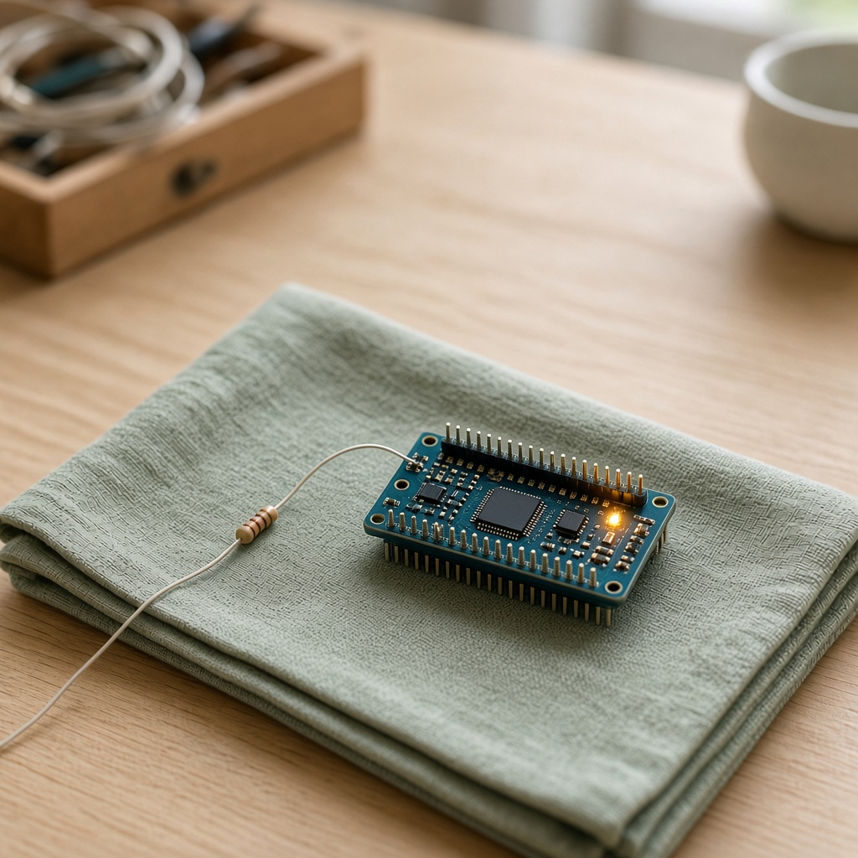
YEAR 7 · LESSON 1 OF 5
01
OF 5
Who decides when the light blinks — and what keeps that from burning it out?
TODAY'S AIM
By the end you will make a light blink on cue, and know why it needs that little resistor.
MAKE A LIGHT BLINK
Y7.1 · MAKE A LIGHT BLINK
Notes:
Cover. Say what they will be able to do by the end: By the end you will make a light blink on cue, and know why it needs that little resistor.

Slide 2
STARTER · FOR TODAY'S QUESTION
Two things this question needs
1
A bike light blinks with nobody holding the switch. What is choosing the moment?
Something inside is switching the power, over and over.
ANSWER
click to reveal
2
What happens if too much current goes through a tiny lamp?
It gets hot and dies.
ANSWER
click to reveal
Those two answers are the whole lesson. Today you build both.
Y7.1 · MAKE A LIGHT BLINK
Notes:
Both answers are the lesson. If the room says 'a battery inside the bulb', leave it standing: the predict slide is about to break it.

Slide 3

THE QUESTION · TURN AND TALK
Who decides when the light blinks — and what keeps that from burning it out?
WITH A PARTNER
Point at who you think is deciding. Then say what would wreck the light.
On our board, code decides. A pin is the switch. The resistor is what lets the light survive.
THE FIRST PIECE OF THE ANSWER
click to reveal
Y7.1 · MAKE A LIGHT BLINK
Notes:
Do not answer it for them. Collect two wrong guesses, then the gold line. The resistor half is the aim, so do not let the conversation stop at 'a chip'.

Slide 4
PREDICT · A PIECE OF THE QUESTION
The part that burns the light
An LED is connected to a 5 V pin with no resistor. What happens?
A
B
C
It lights, dimmer than usual
It lights, then burns out
Nothing: 5 V is too small
THE ANSWER
THE ANSWER
click to reveal
It lights — and then it burns out.
5 V pushes far more current through an LED than its junction can survive. The resistor is not there to dim it; it is there to set the current to about 15 mA.
Hands up for the one you chose — then we find out.
Y7.1 · MAKE A LIGHT BLINK
Notes:
Everyone commits before anyone sees the answer.
The wrong answer people give is "it lights dimmer" — 5 V does not limit the
current. Hold the reveal until most hands are up.

Slide 5
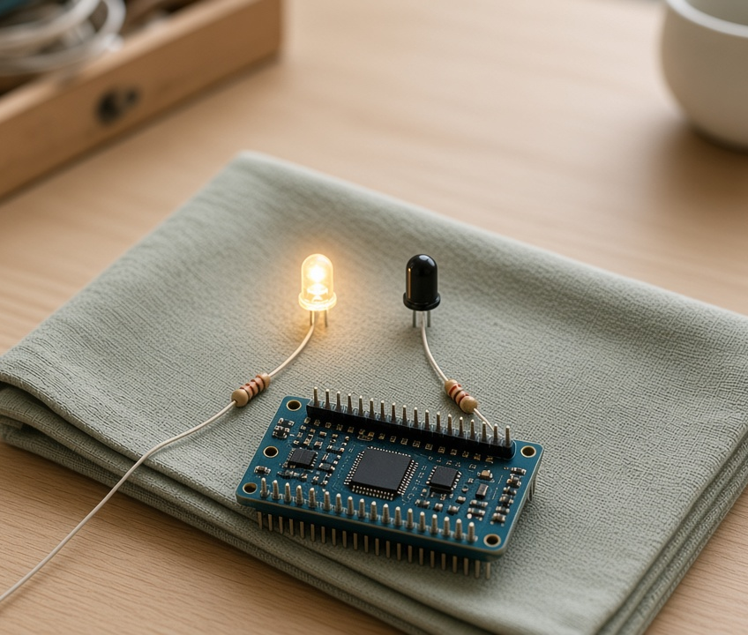
THE IDEA · THIS ANSWERS THE QUESTION
A pin is a metal leg that code can switch
HIGH is the decision: 5 V, and the light is on. LOW takes the 5 V away. The resistor is not the decision. It is what lets the light survive it.
Code decides. The resistor lets the light live. That is the whole answer.
Notes:
The one sentence to leave on the board. Point at
one leg of the board and count it out loud: this leg is pin 13, it has two
states, HIGH is 5 V and LOW is 0 V. Point at the resistor and say again that its
job is current, not brightness.

Slide 6

BUILD · 15 MINUTES
Wire it in Tinkercad
1
Drag an Arduino Uno and a breadboard onto the canvas.
2
Add an LED. The long leg is the positive one.
3
Run a 220 Ω resistor from pin 13 to the long leg.
4
Wire the short leg to a GND pin.
Illustrative interface. Use the live Tinkercad menus.
Y7.1 · MAKE A LIGHT BLINK
Notes:
Fifteen minutes. Demo the whole build first at the
front, then let them copy it. The one thing to police is the LED's long leg:
half the failures in this lesson are a reversed LED.

Slide 7
DECODE THE CODE
Six lines, one blinking light
void setup() {
pinMode(13, OUTPUT);
}
void loop() {
digitalWrite(13, HIGH);
delay(500);
digitalWrite(13, LOW);
delay(500);
}
PINMODE(13, OUTPUT)
Faces pin 13 outwards. It will push current, not listen.
DIGITALWRITE(13, HIGH)
Connects pin 13 to 5 V. Current flows, the LED lights.
DELAY(500)
Waits 500 ms — half a second — doing nothing at all.
Type it. Do not copy it.
Y7.1 · MAKE A LIGHT BLINK
Notes:
Type it, do not paste it. Three lines carry the
whole lesson: pinMode says which direction the pin faces, digitalWrite sets it,
delay waits. Read the code out loud once before they start.

Slide 8
TEST · PROOF YOU CAN ANSWER IT
What success looks like
✓
The LED goes on and off, once a second.
1 s on, 1 s off
✓
Change both delays to 100. It blinks five times as fast.
100 ms
✓
Press Upload and the program starts again from setup().
restarts
WATCH FOR
LED on and never changing? You ran the simulation instead of uploading. Press Upload, then Start Simulation.
Y7.1 · MAKE A LIGHT BLINK
Notes:
The check is observable, not a feeling. If the
LED is lit but static, loop() is not running: they pressed Start Simulation and
not Upload. That is the most common first-lesson error.

Slide 9
DEBUG · 5 MINUTES
It does not work. Find the fault.
WHAT YOU SEE
A
The resistor is too big
The LED is in the breadboard, the code is uploaded, and nothing lights.
B
The LED is in backwards
C
delay() is too long
THE FAULT
THE FAULT
click to reveal
The LED is in backwards.
The long leg is the positive one and goes towards the resistor. The short leg goes to GND. Turn it round and it lights — nothing else needs to change.
Y7.1 · MAKE A LIGHT BLINK
Notes:
Do not tell them. Let them turn it round
themselves — the physical act of reversing the LED is what makes the long leg
memorable. Two minutes, then reveal.

Slide 10
CHECK · ONE QUESTION
What does digitalWrite(13, HIGH) do to pin 13?
A
B
C
Reads the voltage on pin 13
Connects pin 13 to 5 V
Connects pin 13 to GND
THE ANSWER
ANSWER — B
click to reveal
It connects pin 13 to 5 V.
HIGH is 5 V, LOW is 0 V, and a digital pin can do nothing else. Reading is a different instruction: digitalRead.
If you chose another one, say why. That is the useful bit.
Y7.1 · MAKE A LIGHT BLINK
Notes:
B is right. Watch for pupils choosing A because
they have met digitalRead already — the two instructions are easy to swap. Say
both out loud: write goes out, read comes in.

Slide 11
STRETCH · IF YOU FINISHED EARLY
If that was easy
TRY THIS
Make a pattern: two short blinks, then a long pause. Time it with a phone and match the numbers.
THEN THIS
Change the resistor to 1 kΩ. Predict what the LED does, then run it.
A bigger resistor means less current, so a dimmer LED. It still blinks.
Y7.1 · MAKE A LIGHT BLINK
Notes:
For the group that finishes in eight minutes.
Both tasks have a checkable answer, so they are not busywork.

Slide 12
EXIT TICKET · BEFORE YOU LOG OFF
Two questions, then close the laptop.
What does HIGH mean, in volts?
FINISH THE SENTENCE
1
Code decides when the light blinks. The resistor stops the light from ________.
Why does the LED need a resistor?
2
Then answer the question on the cover.
NEXT LESSON
Y7.2 — A button that lights a lamp
A pin that listens instead of speaking.
Notes:
Two minutes. The sentence frame is the answer to
the lesson; collect the slips so you can see who still thinks a pin can be
half-on.

