Slide 1
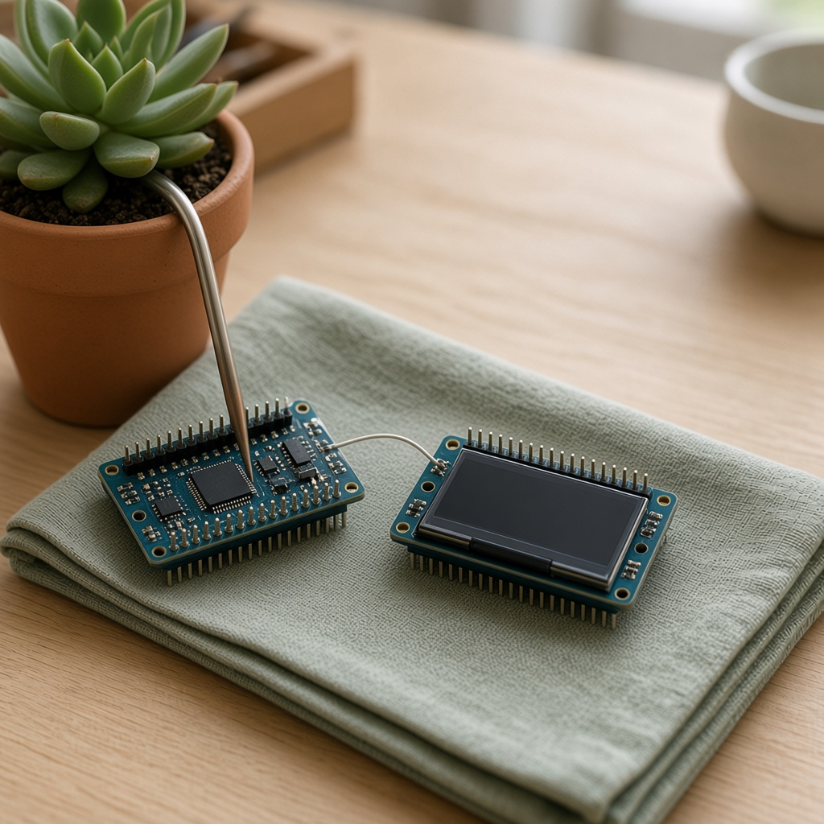
YEAR 9 · LESSON 5 OF 5
05
OF 5
The reading is on your screen. How does another machine know where one reading ends?
TODAY'S AIM
By the end you will send a reading as a message, and design a device that senses, decides, acts and reports.
A DEVICE THAT REPORTS
Y9.5 · A DEVICE THAT REPORTS
Notes:
Cover. Say what they will be able to do by the end: By the end you will send a reading as a message, and design a device that senses, decides, acts and reports.

Slide 2
STARTER · FOR TODAY'S QUESTION
Two things this question needs
1
A device this year can sense, decide and act. What has it still not done?
Told another machine.
ANSWER
click to reveal
2
If numbers are printed with nothing between them, what does the other machine see?
One long smear, not a list of readings.
ANSWER
click to reveal
A number you can see is not yet a message someone else can read.
Y9.5 · A DEVICE THAT REPORTS
Notes:
The smear is the predict. Let them describe it before you show the broken line.

Slide 3
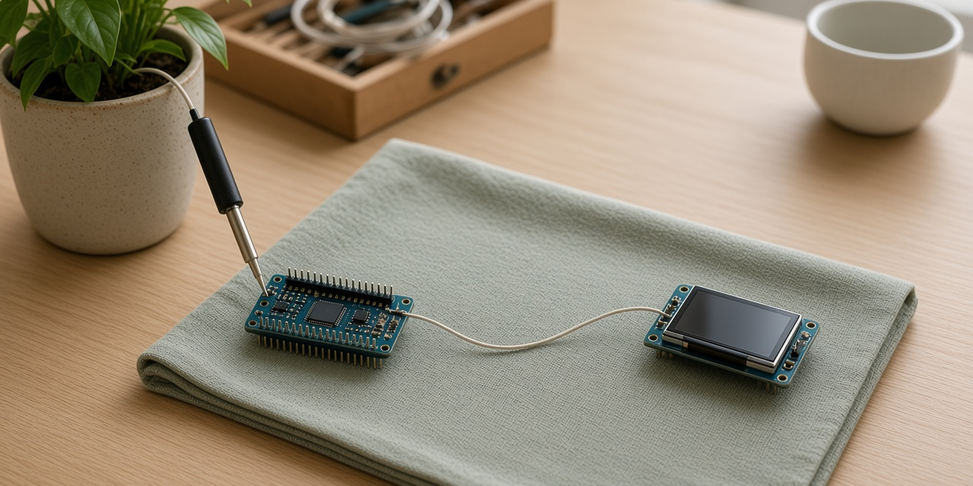
THE QUESTION · TURN AND TALK
The reading is on your screen. How does another machine know where one reading ends?
WITH A PARTNER
You receive 235234236. How many readings is that, and what would you need in order to know?
A message needs a label, a value, and an end. That agreement is a protocol.
THE FIRST PIECE OF THE ANSWER
click to reveal
Y9.5 · A DEVICE THAT REPORTS
Notes:
Let them try to split 235234236. The argument about where it breaks is the lesson.

Slide 4
PREDICT · A PIECE OF THE QUESTION
No end, so no message
The board prints 23.5, then 23.4, then 23.6, with nothing between them. What does the receiver see?
A
B
C
Three separate readings
One long number: 23.523.423.6
Nothing
THE ANSWER
THE ANSWER
click to reveal
One long number.
Without a separator or a newline the characters run together, and the receiver cannot tell where one reading stops. Framing is what turns a stream into messages.
Hands up for the one you chose — then we find out.
Y9.5 · A DEVICE THAT REPORTS
Notes:
The receiver does not see spaces. This is why
framing exists, and why every network protocol has a delimiter, a length or a
fixed size.

Slide 5
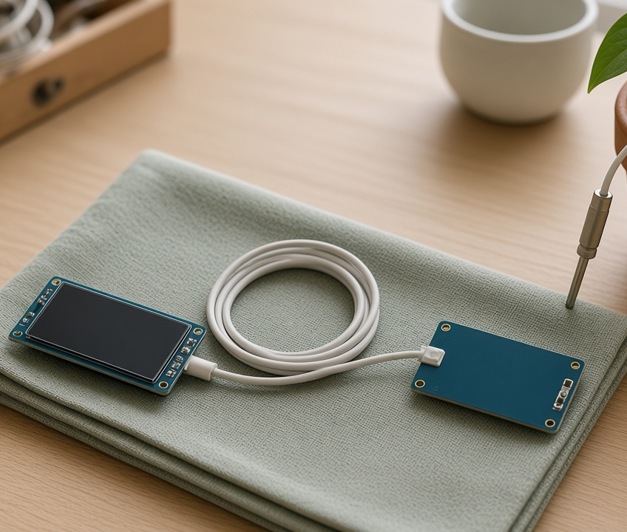
THE IDEA · THIS ANSWERS THE QUESTION
Data needs a format
Label, value, separator, end of line. That is a protocol, and it is all you need.
Without an end, the next reading glues itself to this one. The newline is what makes it a message.
Notes:
Label, value, separator, end of line. Write the
line on the board and have them read it aloud: "L colon 512 comma V colon 2.50
newline".

Slide 6
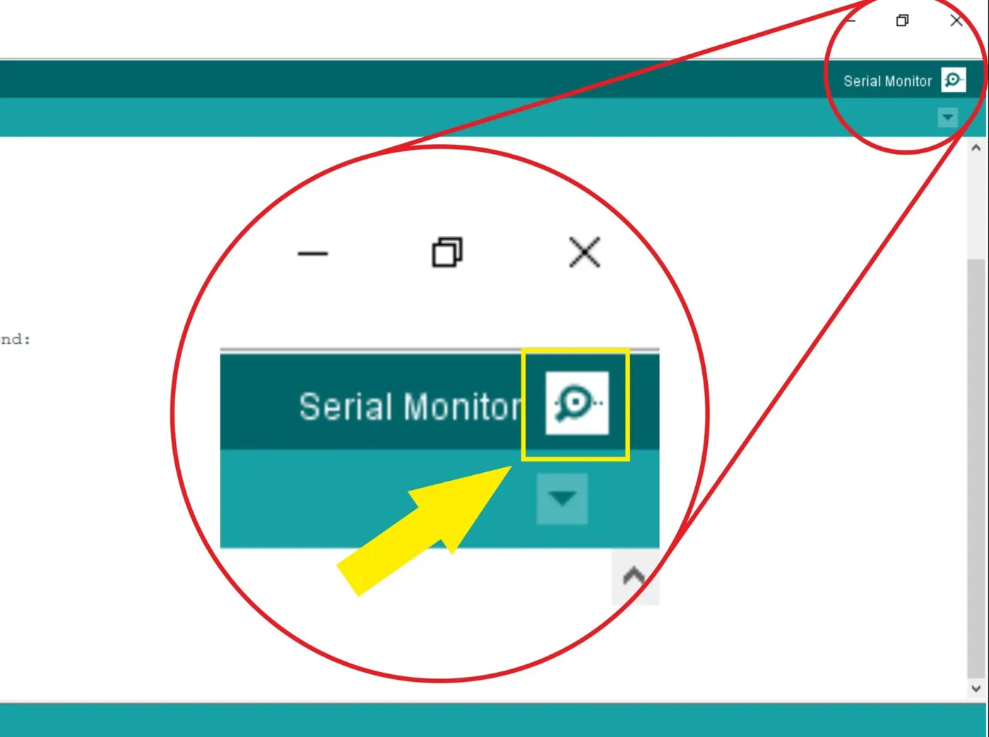
BUILD · 15 MINUTES
Send one line per reading
1
Use any sensor from Year 8 on A0.
2
Serial at 9600 baud.
3
One line per reading, with a label per value.
4
Read it in the Monitor, or on a second board.
Illustrative interface. Use the live Tinkercad menus.
Y9.5 · A DEVICE THAT REPORTS
Notes:
Any sensor from Year 8 will do. The point is the
output format, not the sensing. If you have two boards, the second one reading
the first is the best demonstration in the course.

Slide 7
DECODE THE CODE
Labels, values, and one newline
void setup() {
Serial.begin(9600);
}
void loop() {
int light = analogRead(A0);
float volts = light * 5.0 / 1024.0;
Serial.print("L:");
Serial.print(light);
Serial.print(",V:");
Serial.print(volts, 2);
Serial.println();
delay(1000);
}
PRINT VS PRINTLN
print adds nothing. println adds the newline that ends the message.
L: AND V:
Labels. The receiver knows which number is which without counting.
VOLTS, 2
Two decimal places. A format decision, not a measurement.
One line per second. Read it aloud.
Y9.5 · A DEVICE THAT REPORTS
Notes:
print versus println is the whole bug in this
lesson. Make them find the difference rather than telling them.

Slide 8
TEST · PROOF YOU CAN ANSWER IT
What success looks like
✓
One line per second, each with both labels.
1 line/s
✓
Every message ends with a newline.
println
✓
Pasting the output into a spreadsheet splits cleanly.
parses
WATCH FOR
Two readings on one line means the last call is print, not println. The newline is the frame.
Y9.5 · A DEVICE THAT REPORTS
Notes:
The spreadsheet test is practical: paste the
Monitor output in and see whether it splits into columns.

Slide 9
DEBUG · 5 MINUTES
It does not work. Find the fault.
WHAT YOU SEE
A
The sensor is too fast
The Monitor shows L:512,V:2.50L:498,V:2.43L:… all on one line.
B
The last call is print, not println
C
The labels are wrong
THE FAULT
THE FAULT
click to reveal
There is no newline at the end of the message.
Change the final Serial.print() to Serial.println(). The newline is the frame: it tells the receiver that this message is complete.
Y9.5 · A DEVICE THAT REPORTS
Notes:
A one-word fix. Let them stare at the code for
thirty seconds before you say which line.

Slide 10
CHECK · ONE QUESTION
Why does a message need an end marker?
A
B
C
To make it longer
So the receiver knows where one reading stops and the next begins
To slow the data down
THE ANSWER
ANSWER — B
click to reveal
So the receiver knows where one reading stops and the next begins.
A stream of characters has no natural boundaries. A newline, a length or a fixed size is what turns characters into messages.
If you chose another one, say why. That is the useful bit.
Y9.5 · A DEVICE THAT REPORTS
Notes:
B. Every protocol has a way of framing: a
delimiter, a length, or a fixed size. This is the idea that transfers to every
network they will ever use.

Slide 11
STRETCH · IF YOU FINISHED EARLY
If that was easy
DESIGN YOUR DEVICE
One page: what it measures, the two thresholds, what it does, and the exact message it sends. Sense, decide, act, report — four lines of the spec.
PARSE IT
On a second board, read a line with Serial.readStringUntil('\n') and split it. Print the value with its label. Two boards, one protocol.
The brief is the assessment. A device that works but cannot say what it does is not finished.
Y9.5 · A DEVICE THAT REPORTS
Notes:
The design brief is the capstone. Give it as
homework or a whole lesson. The parse task is for the group that wants more.

Slide 12
EXIT TICKET · BEFORE YOU LOG OFF
Two questions, then close the laptop.
What ends a message?
FINISH THE SENTENCE
1
Another machine can read it because each message has an ________.
Why label the fields?
2
Then answer the question on the cover.
NEXT LESSON
That is the course
Year 7 switched. Year 8 measured. Year 9 moved and reported. Now design your own.
Notes:
Close the course on the arc: switch, measure,
move, correct, report. The capstone is where they put it together.

