Slide 1
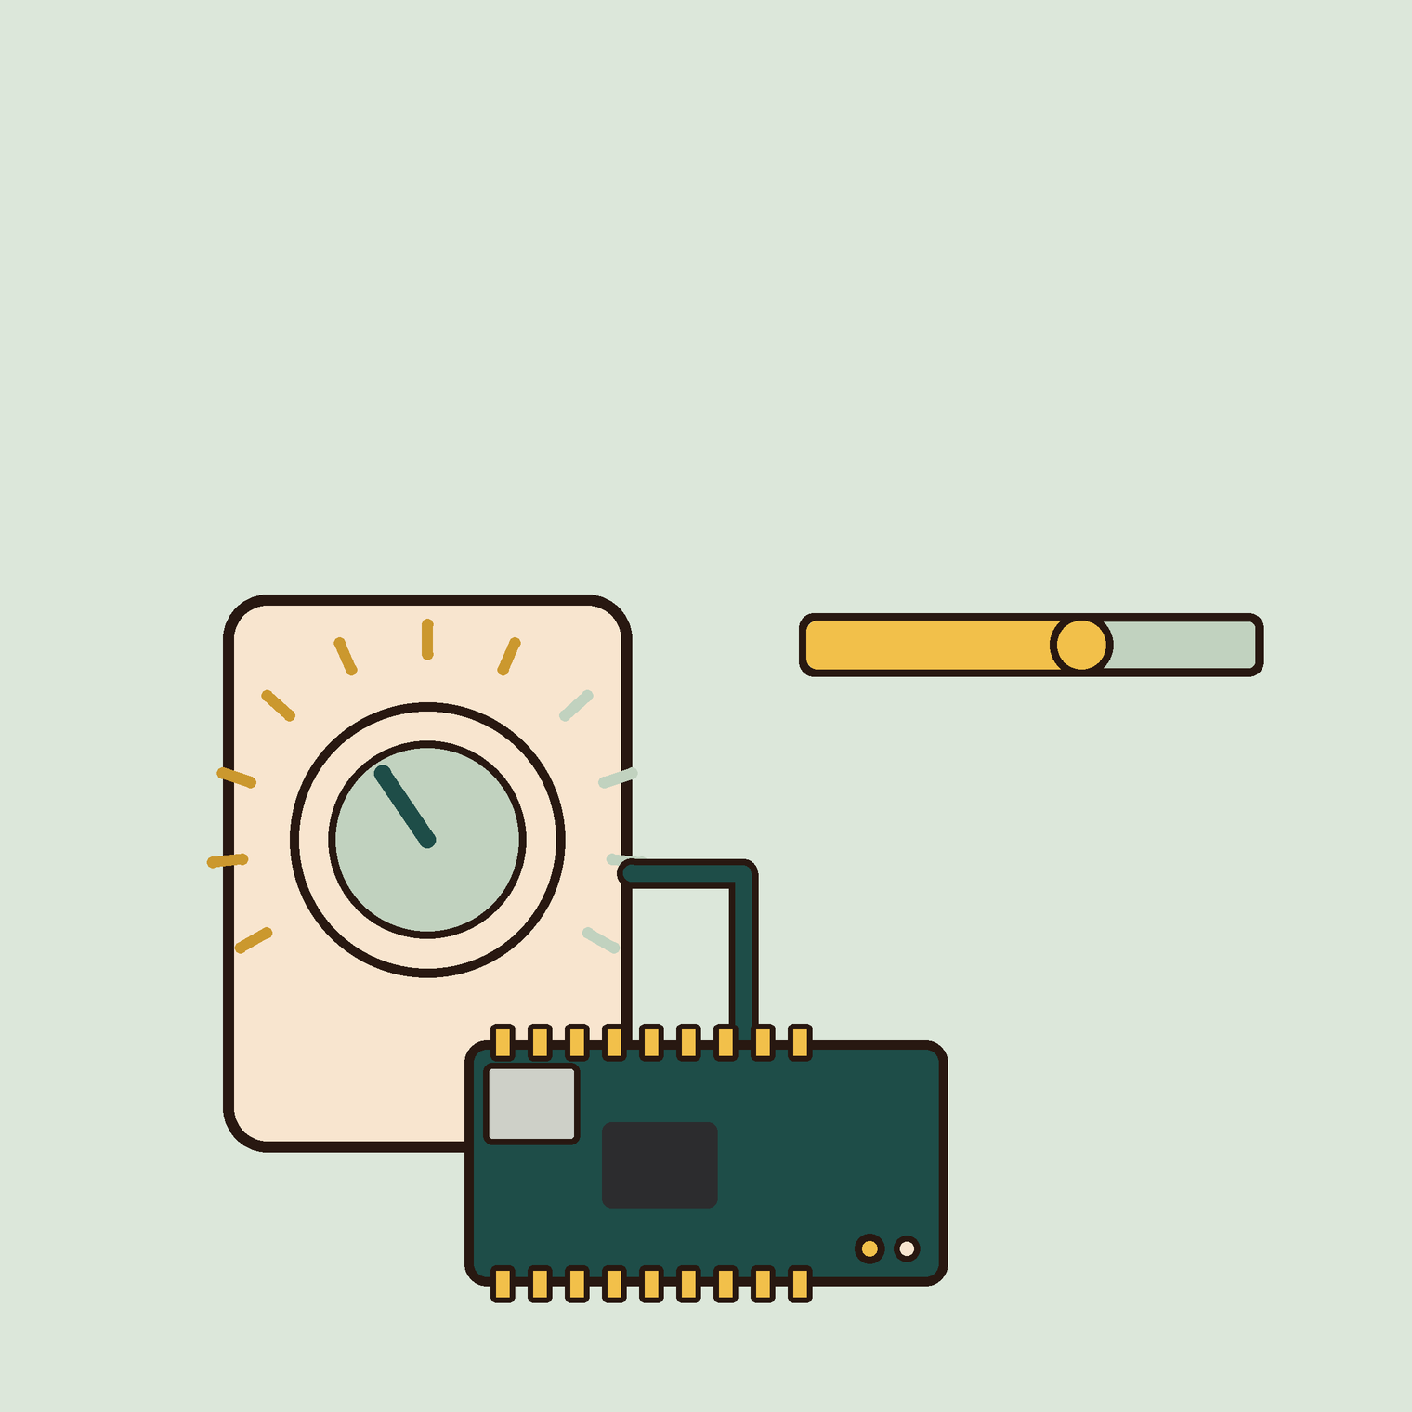
01
OF 5
YEAR 8 · ELECTRONICS · LESSON 1 OF 5
Not just on and off
By the end you will read a dial as a number from 0 to 1023, and know what that number means.
BUILD: A DIMMER DIAL
Y8.1 · NOT JUST ON AND OFF
Notes:
Cover. Say what they will be able to do by the end: By the end you will read a dial as a number from 0 to 1023, and know what that number means.

Slide 2
STARTER · 2 MINUTES
What do you remember?
1
What two values can a digital pin read?
HIGH and LOW.
ANSWER
click to reveal
2
What does HIGH mean, in volts?
5 V.
ANSWER
click to reveal
Answer it in your head before I click.
Y8.1 · NOT JUST ON AND OFF
Notes:
Two quick recalls. The second question sets
up the whole lesson: if HIGH is exactly 5 V, what is between HIGH and LOW? Most
classes will say "nothing", which is the right answer for a digital pin and the
wrong one for an analog pin.

Slide 3

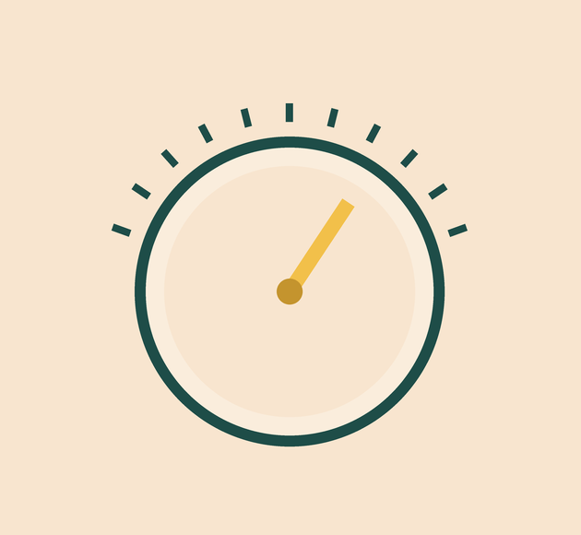
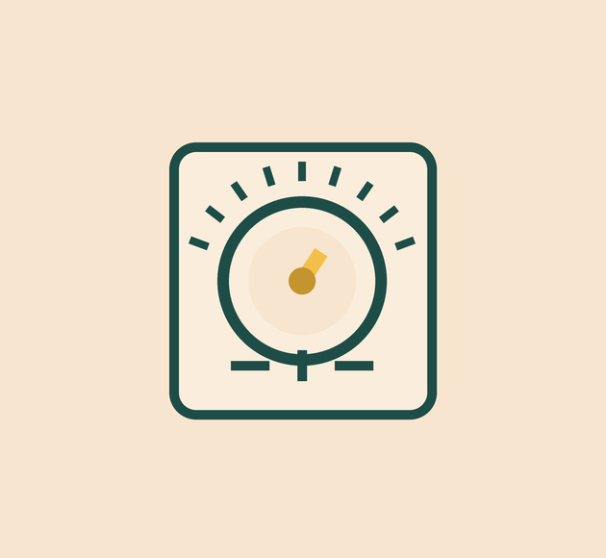
Why does a volume dial feel different from a light switch?
A dial: every position in between.
A knob: the same idea, on a panel.
A dimmer: how much, not on or off.
A switch has two positions. A dial has every position between them.
A pin can measure a voltage anywhere between 0 V and 5 V.
Y8.1 · NOT JUST ON AND OFF
Notes:
A switch is a yes/no device. A dial is a
how-much device. Get the class to name the dials in the room: volume, oven,
fan. Then the gold line.

Slide 4
PREDICT · EVERYONE COMMITS
Before I show you
The dial is exactly halfway. What does analogRead(A0) return?
A
B
C
2.5
512
5
THE ANSWER
THE ANSWER
click to reveal
About 512.
analogRead reports a step from 0 to 1023, not volts. Halfway is 2.5 V, and 2.5 is half of 5, so the step is about half of 1023.
Hands up for the one you chose — then we find out.
Y8.1 · NOT JUST ON AND OFF
Notes:
Halfway is the useful case because it
separates "the reading is volts" from "the reading is a step number". Expect
2.5 from a third of the room. Reveal slowly.

Slide 5
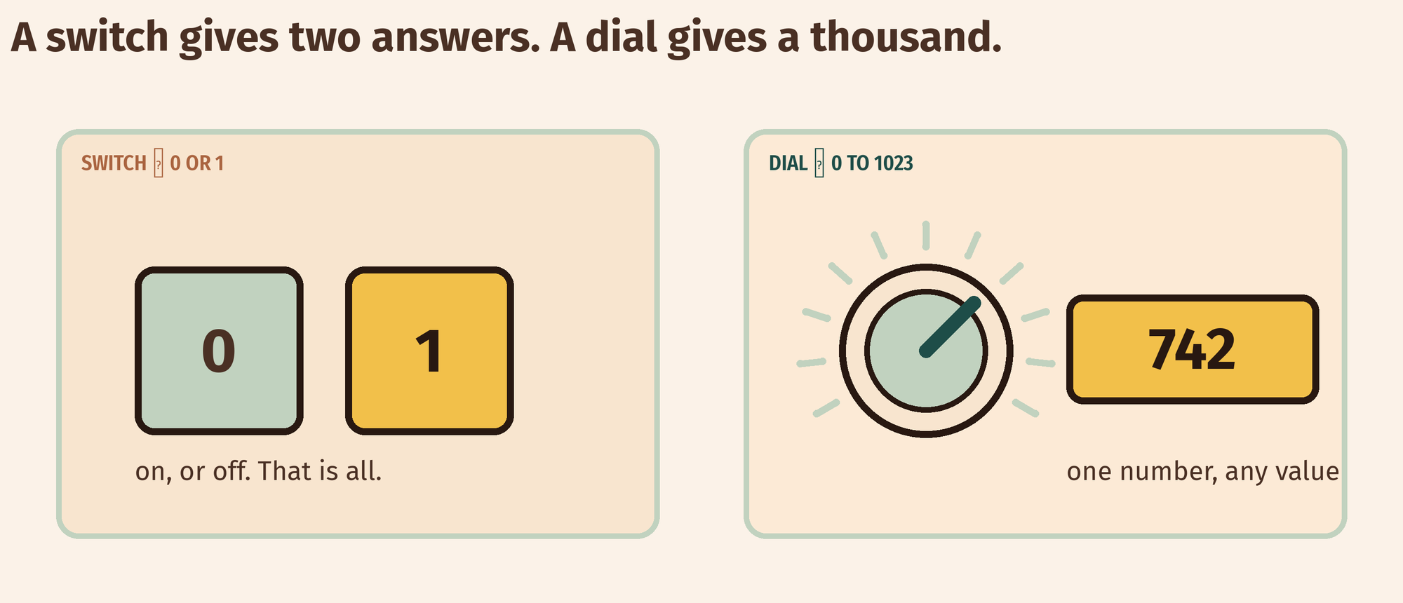
THE IDEA
An analog pin says how much, not just yes or no
analogRead gives a step from 0 to 1023, and each step is a share of 5 V.
1024 steps across 5 V: about 4.9 mV per step.
Notes:
Draw the staircase on the board if the diagram
is not enough: 1024 steps between 0 and 5 V. Each step is about 4.9 mV. That is
the resolution of the reading.

Slide 6
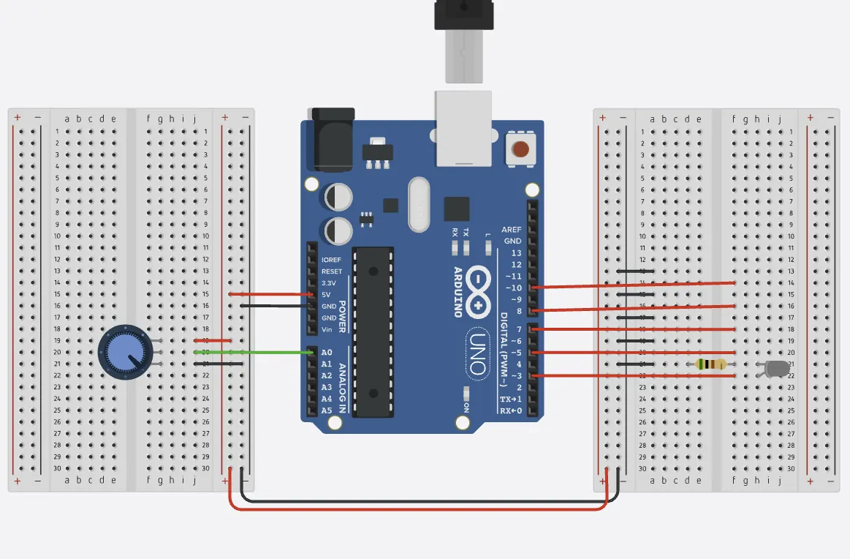
BUILD · 15 MINUTES
Wire the dial
1
Outer legs of the pot to 5 V and GND.
2
Middle leg — the wiper — to A0.
3
LED and 220 Ω on pin 9.
4
Turn the knob and watch the Serial Monitor.
Illustrative interface. Use the live Tinkercad menus.
Y8.1 · NOT JUST ON AND OFF
Notes:
The wiper is the middle leg and the only one
that matters. Pupils will wire the two outer legs to A0 and ground the middle —
check for it before they run anything.

Slide 7
DECODE THE CODE
Read the dial, print the number
void setup() {
Serial.begin(9600);
}
void loop() {
int raw = analogRead(A0);
int percent = map(raw, 0, 1023, 0, 100);
Serial.print(raw);
Serial.print(" ");
Serial.println(percent);
delay(200);
}
ANALOGREAD(A0)
A number from 0 to 1023. Not volts: a step number.
MAP(RAW, 0, 1023, 0, 100)
Stretches one range onto another. 1023 becomes 100.
SERIAL.PRINTLN(PERCENT)
Sends the value to the Monitor, one line at a time.
Turn it slowly. Watch both columns.
Y8.1 · NOT JUST ON AND OFF
Notes:
map() is the new function. Show the two ranges
side by side on the board: 0–1023 in, 0–100 out. It is a stretch, not a
calculation, and it does not round.

Slide 8
TEST IT · 5 MINUTES
What success looks like
✓
One end of the dial reads 0.
0
✓
The other end reads 1023.
1023
✓
Halfway reads about 511–513.
≈512
WATCH FOR
A number that never changes means the wiper is not connected to A0. The pin is floating and settling on one value.
Y8.1 · NOT JUST ON AND OFF
Notes:
The middle reading is the check that matters: it
proves the pin is reading a range and not just a switch.

Slide 9
DEBUG · 5 MINUTES
It does not work. Find the fault.
WHAT YOU SEE
A
The wiper is not connected to A0
The reading jumps between 0 and 1023, with nothing in between.
B
The outer legs are swapped
C
analogRead is broken
THE FAULT
THE FAULT
click to reveal
The middle leg is not connected to A0.
The two outer legs are the ends of the resistor. Only the wiper gives a voltage between them. With the wiper loose, A0 is floating and picks up whatever is nearby.
Y8.1 · NOT JUST ON AND OFF
Notes:
This is the floating pin from Year 7, in a new
costume. Ask where the wiper is before saying anything.

Slide 10
CHECK · ONE QUESTION
analogRead(A0) returns 512. What is the voltage on A0?
A
B
C
512 V
About 2.5 V
0.5 V
THE ANSWER
ANSWER — B
click to reveal
About 2.5 V.
512 is about half of 1023, so the voltage is about half of 5 V. The reading is a step number, and the voltage is what it is counting.
If you chose another one, say why. That is the useful bit.
Y8.1 · NOT JUST ON AND OFF
Notes:
B. The arithmetic is worth doing on the board:
512 ÷ 1023 × 5. About 2.5 V.

Slide 11
STRETCH · IF YOU FINISHED EARLY
If that was easy
CHANGE THE RANGE
Map the reading to 0–180 so it reads like an angle. Then to 20–30 so it reads like a temperature dial. Run each one and check the ends.
PRINT VOLTS AS WELL
Convert the reading yourself: raw * 5.0 / 1024.0. Print raw, volts and percent together. Check the middle value is about 2.5 V.
map() does not round. 3.9 becomes 3. That matters when you map to a pin.
Y8.1 · NOT JUST ON AND OFF
Notes:
Both tasks make the mapping idea concrete.
The second one links forward to calibration in Y8.4.

Slide 12
EXIT TICKET · BEFORE YOU LOG OFF
Two questions, then close the laptop.
What range does analogRead report?
FINISH THE SENTENCE
1
An analog pin answers ________, not yes or no.
What does 512 mean?
2
One word for today
NEXT LESSON
Y8.2 — A lamp that knows it's dark
The board measures voltage. Most sensors change resistance.
Notes:
The frame is the sentence they need for Y8.2,
where the sensor's own resistance has to become a voltage.

