Slide 1
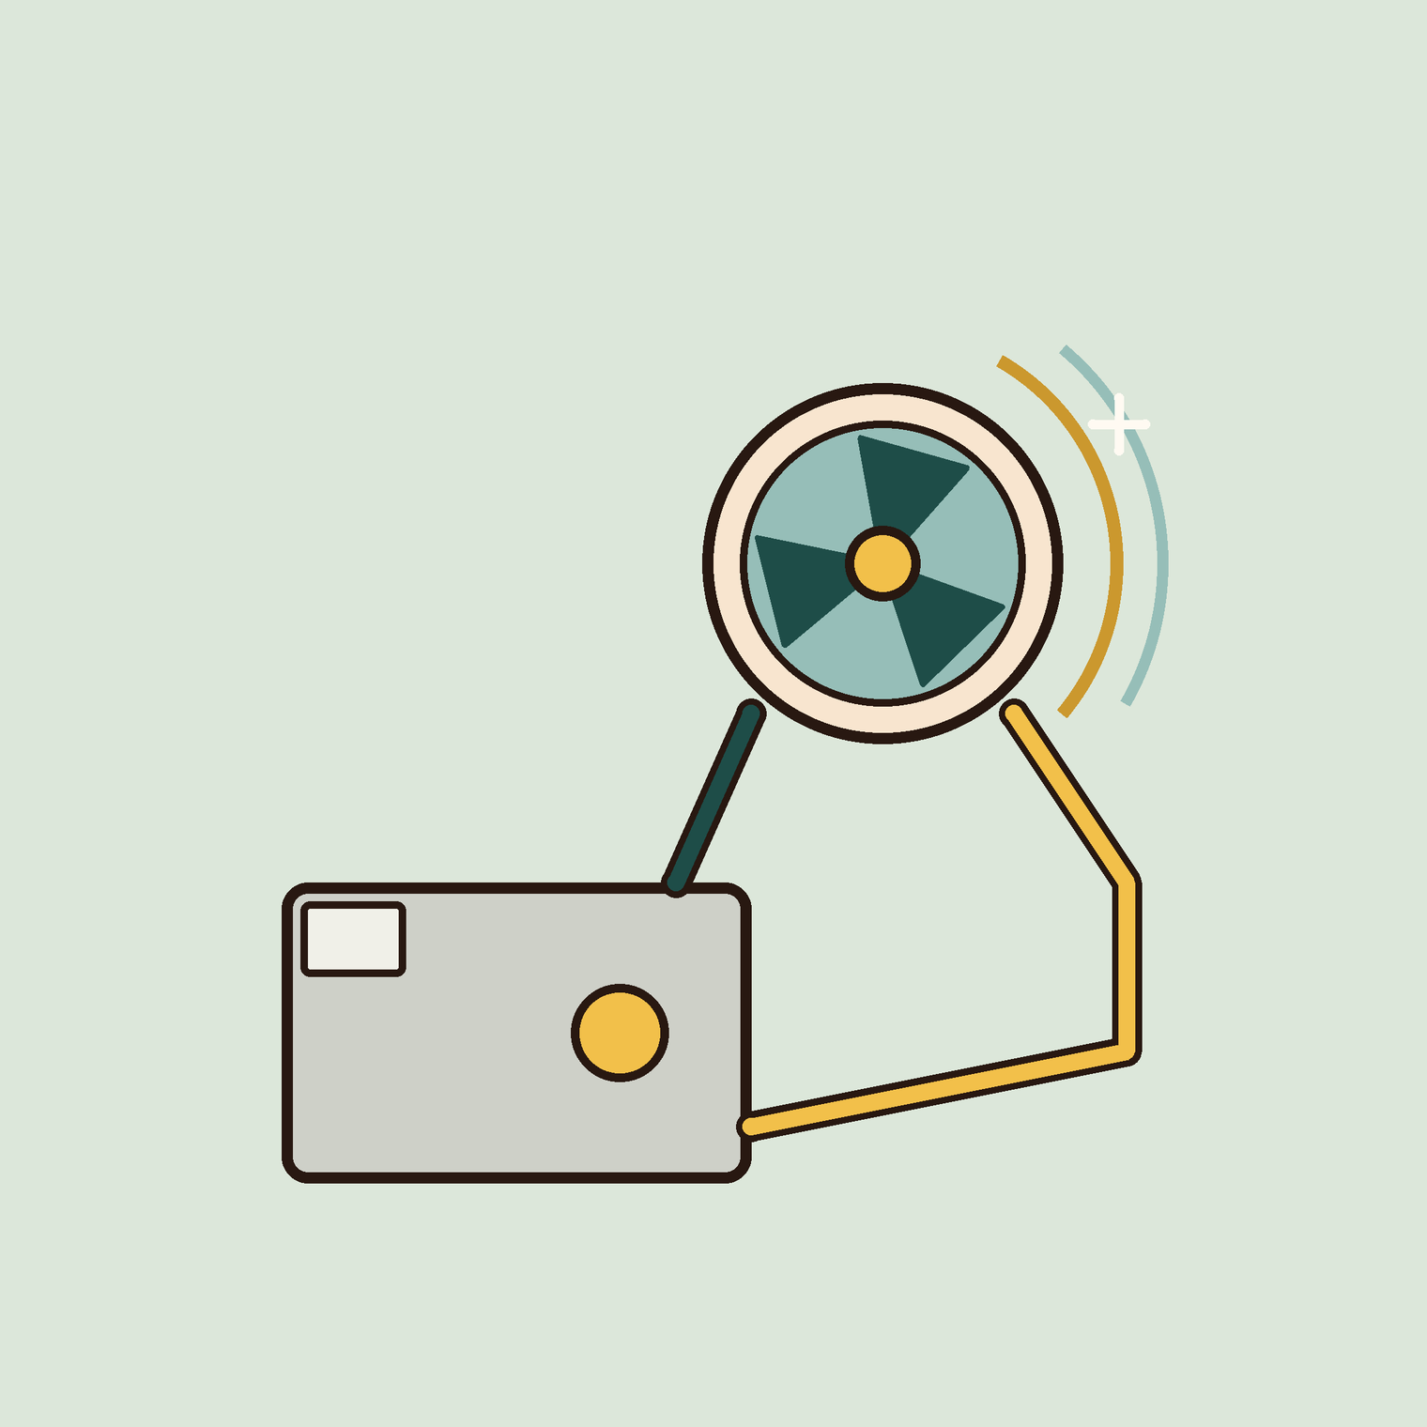
01
OF 5
YEAR 9 · ELECTRONICS · LESSON 1 OF 5
A motor needs more than a pin
By the end you will switch a motor with a small signal, and explain why the pin alone would fail.
BUILD: A MOTOR DRIVER
Y9.1 · A MOTOR NEEDS MORE THAN A PIN
Notes:
Cover. Say what they will be able to do by the end: By the end you will switch a motor with a small signal, and explain why the pin alone would fail.

Slide 2
STARTER · 2 MINUTES
What do you remember?
1
What does analogWrite(6, 128) do to the pin?
Switches 5 V on and off, about half the time.
ANSWER
click to reveal
2
What is the average voltage?
2.5 V.
ANSWER
click to reveal
Answer it in your head before I click.
Y9.1 · A MOTOR NEEDS MORE THAN A PIN
Notes:
Recall the PWM idea from Year 8. It matters
here because the same switching will now control a motor, at a much larger
current.

Slide 3

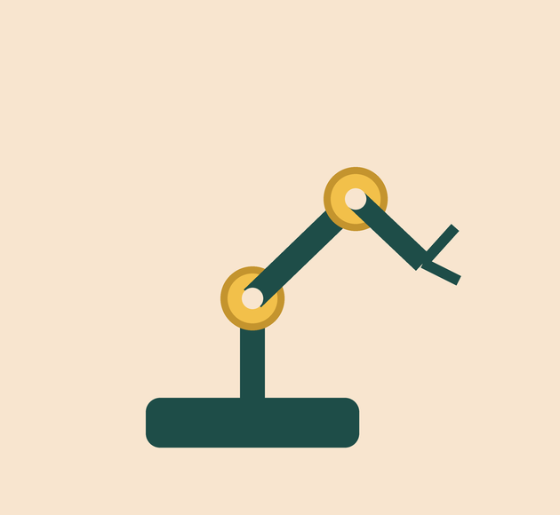
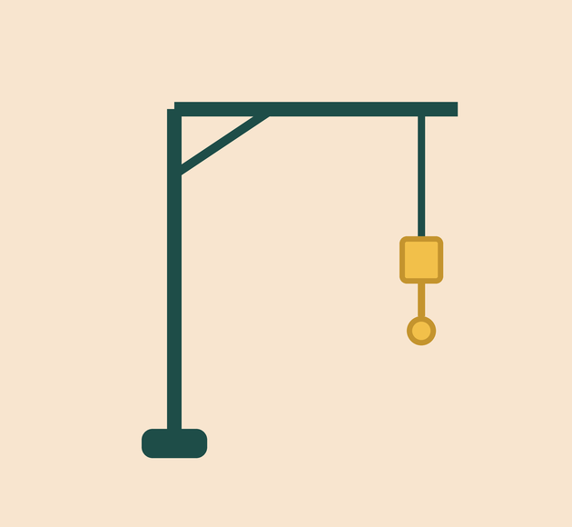
Why does a toy car need more than a battery and a switch?
A motor, and something to switch it.
Robot arm: motors with drivers.
Crane: a small control, a big load.
Motors turn electricity into movement, and they need a lot of it.
A signal decides. A power supply delivers. They are not the same job.
Y9.1 · A MOTOR NEEDS MORE THAN A PIN
Notes:
Ask what is between the battery and the motor in
a toy car. A switch, yes — but the switch is built to carry the motor's current.
That is the difference the lesson is about.

Slide 4
PREDICT · EVERYONE COMMITS
Before I show you
A motor needs 400 mA. A pin can safely give 20 mA. What happens if you connect the motor straight to the pin?
A
B
C
It spins more slowly
The pin overheats and may be destroyed
Nothing: the board limits the current
THE ANSWER
THE ANSWER
click to reveal
The pin overheats and may be destroyed.
A pin is a logic output, not a power output. 400 mA is twenty times its limit. The output inside the chip heats up, and the damage may not show until a later lesson.
Hands up for the one you chose — then we find out.
Y9.1 · A MOTOR NEEDS MORE THAN A PIN
Notes:
The number matters: 400 mA against a 20 mA
limit is twenty times over. Pupils often think the board protects itself. It
does not.

Slide 5
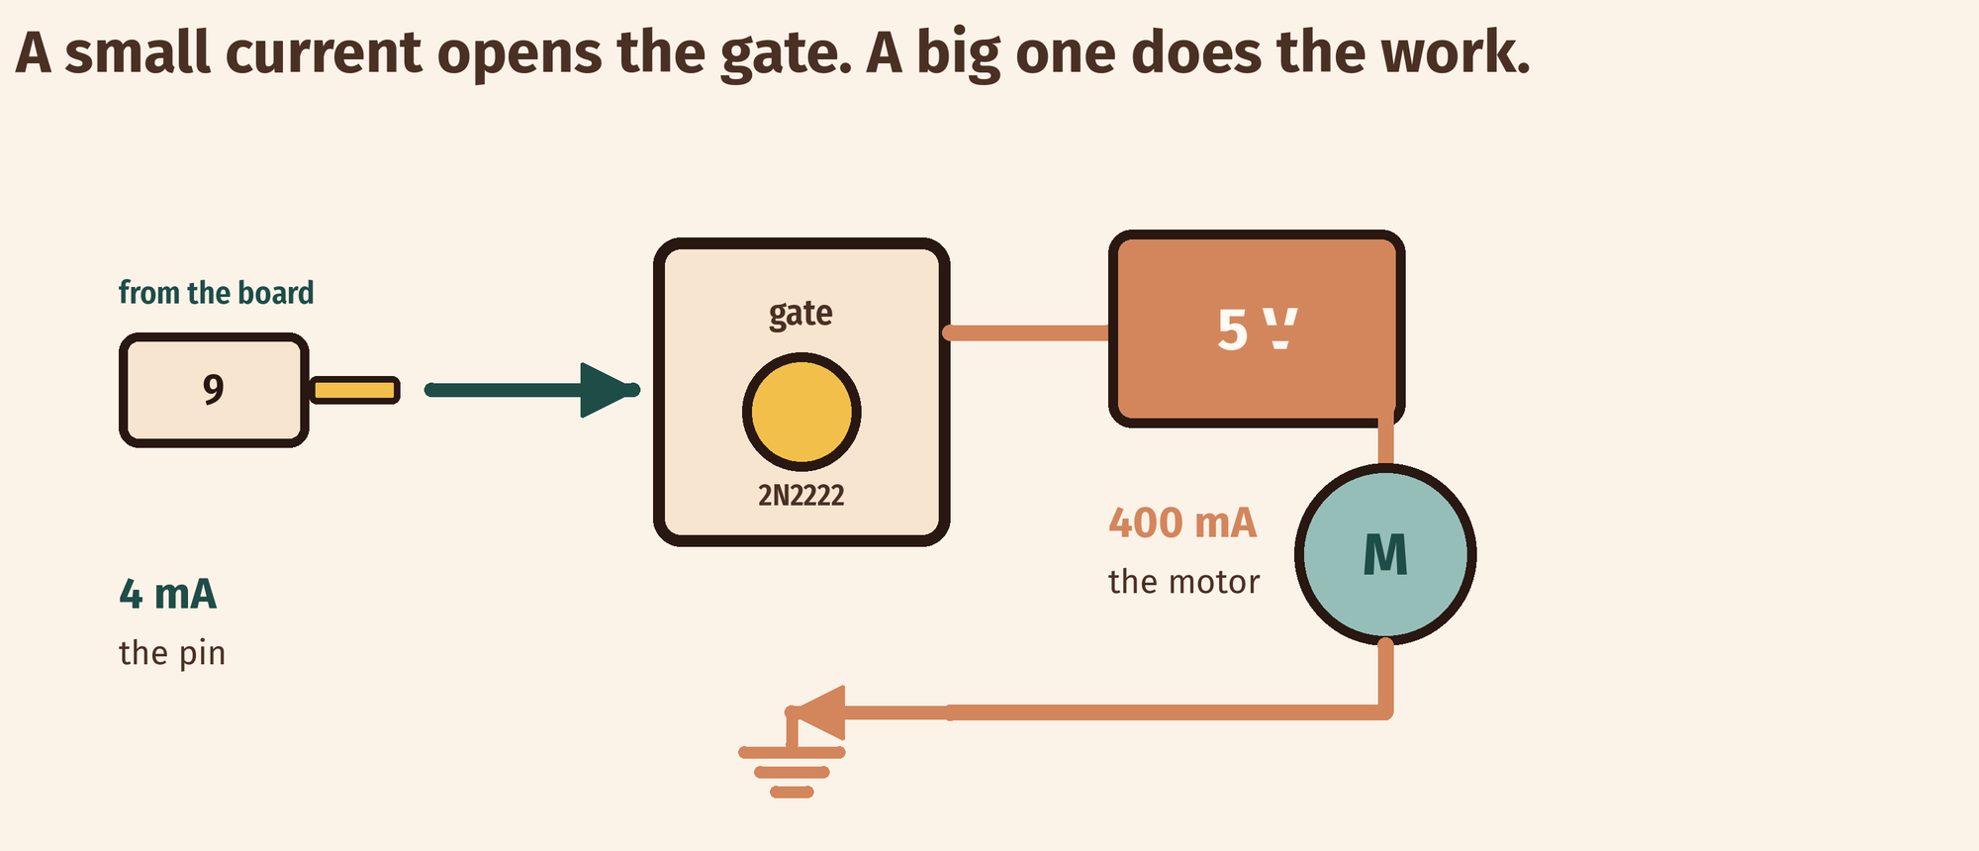
THE IDEA
A small current can switch a big one
The pin drives the base. The transistor carries the motor's current.
About 4 mA at the base lets about 400 mA flow through the motor.
Notes:
The transistor is a valve, and the base current is
the handle. 4 mA into the base lets about 400 mA through the collector. The
diode is protection, not control: say that explicitly.

Slide 6

BUILD · 15 MINUTES
Wire the driver
1
Motor and a separate 5 V supply.
2
NPN: collector to the motor, emitter to GND.
3
1 kΩ from pin 9 to the base.
4
Diode across the motor, and join both grounds.
Illustrative interface. Use the live Tinkercad menus.
Y9.1 · A MOTOR NEEDS MORE THAN A PIN
Notes:
Four things to check in every build: common
ground, base resistor, diode direction, separate supply. Put those four on the
board and walk the room with them.

Slide 7
DECODE THE CODE
The pin only says on or off
void setup() {
pinMode(9, OUTPUT);
}
void loop() {
digitalWrite(9, HIGH);
delay(2000);
digitalWrite(9, LOW);
delay(2000);
}
DIGITALWRITE(9, HIGH)
About 4 mA into the base. That is all the pin has to do.
THE TRANSISTOR
Collector current is set by the motor and the supply, not by the pin.
DELAY(2000)
Two seconds on, two seconds off. The motor never sees the pin.
Two seconds on, two seconds off.
Y9.1 · A MOTOR NEEDS MORE THAN A PIN
Notes:
The code is deliberately dull. The intelligence is
in the wiring: the pin only ever says on or off.

Slide 8
TEST IT · 5 MINUTES
What success looks like
✓
The motor runs for two seconds, then stops for two.
2 s / 2 s
✓
The transistor is cool or slightly warm.
cool
✓
Disconnect the base resistor: the motor stops.
0 mA base
WATCH FOR
A motor that twitches but will not spin usually has no shared ground. A hot transistor means the diode is missing or backwards.
Y9.1 · A MOTOR NEEDS MORE THAN A PIN
Notes:
Feeling the transistor is a real check: warm is
fine, hot means the base resistor is wrong or the diode is missing.

Slide 9
DEBUG · 5 MINUTES
It does not work. Find the fault.
WHAT YOU SEE
A
The motor is broken
The motor does not turn. The transistor is wired correctly and the code runs.
B
The two supplies do not share a ground
C
The diode is backwards
THE FAULT
THE FAULT
click to reveal
There is no common ground.
The base current has to return to the pin's ground. Join the emitter's ground to the Arduino GND. Without that shared point, the transistor never turns on.
Y9.1 · A MOTOR NEEDS MORE THAN A PIN
Notes:
No common ground is the error that costs the most
time, because both circuits look complete on their own. Trace the return path
with a finger.

Slide 10
CHECK · ONE QUESTION
Why is there a diode across the motor?
A
B
C
To stop the motor spinning backwards
To give the motor's collapsing magnetic field a safe path
To reduce the current
THE ANSWER
ANSWER — B
click to reveal
To give the collapsing magnetic field a safe path.
A motor is a coil. Switch it off and the field collapses, and the coil generates a voltage spike that can destroy the transistor. The diode sends that current round the motor instead.
If you chose another one, say why. That is the useful bit.
Y9.1 · A MOTOR NEEDS MORE THAN A PIN
Notes:
B. A motor is a coil. Switching it off
collapses the field, and the coil generates a spike. The diode gives it a path
back through the coil instead of through the transistor.

Slide 11
STRETCH · IF YOU FINISHED EARLY
If that was easy
MEASURE THE BASE CURRENT
Put a multimeter, in current mode, in series with the 1 kΩ. It should read about 4 mA. Change to 10 kΩ and see whether the motor still starts.
TWO MOTORS
One transistor per motor, one pin each. One 5 V supply can run both. Why can the supply do it when the board's 5 V pin cannot?
4 mA switching 400 mA is a gain of about 100. That is what a transistor is for.
Y9.1 · A MOTOR NEEDS MORE THAN A PIN
Notes:
Measuring 4 mA is a good use of a multimeter
and makes the hFE idea real. Do not let them put the meter across the
transistor in current mode.

Slide 12
EXIT TICKET · BEFORE YOU LOG OFF
Two questions, then close the laptop.
Why can't a pin drive a motor?
FINISH THE SENTENCE
1
The pin carries the ________; the transistor carries the power.
What does the transistor do?
2
One word for today
NEXT LESSON
Y9.2 — Control the speed
The same switch, opened and closed hundreds of times a second.
Notes:
The frame is the sentence of the unit. Collect it and
check that "signal" and "power" are both there.

