Slide 1

03
OF 5
YEAR 9 · ELECTRONICS · LESSON 3 OF 5
A servo asks for a position
By the end you will command a servo to an angle, and explain why its signal is not a dimmer's.
BUILD: A DIAL-CONTROLLED ARM
Y9.3 · A SERVO ASKS FOR A POSITION
Notes:
Cover. Say what they will be able to do by the end: By the end you will command a servo to an angle, and explain why its signal is not a dimmer's.

Slide 2
STARTER · 2 MINUTES
What do you remember?
1
What does 25% duty do to the average power?
It gives about a quarter of it.
ANSWER
click to reveal
2
Why is motor speed not exactly proportional?
Friction and the motor's own resistance.
ANSWER
click to reveal
Answer it in your head before I click.
Y9.3 · A SERVO ASKS FOR A POSITION
Notes:
Recall the average-power idea. The servo
lesson is the contrast: the same kind of pulse, but the width is read as a
number rather than averaged.

Slide 3



How does a robot arm know where its elbow is?
A servo holds an angle.
A gimbal: three axes, three servos.
Stage lights: aimed, not spun.
A servo does not spin freely. It moves to a position and holds it.
The pulse width is the instruction: 1 ms is one end, 2 ms the other.
Y9.3 · A SERVO ASKS FOR A POSITION
Notes:
A servo is a motor with a position sensor and a
controller inside. That is why it can hold an angle. If you have one, hold it
and try to turn the arm — it resists.

Slide 4
PREDICT · EVERYONE COMMITS
Before I show you
A servo gets a pulse every 20 ms. What does the width of the pulse tell it?
A
B
C
How fast to turn
What angle to hold
Which direction to spin
THE ANSWER
THE ANSWER
click to reveal
What angle to hold.
1.0 ms is one end of the range, 2.0 ms the other, and 1.5 ms the middle. The servo's own circuit turns the motor until its position matches the pulse.
Hands up for the one you chose — then we find out.
Y9.3 · A SERVO ASKS FOR A POSITION
Notes:
B is right, and it is the difference between a
motor and a servo. A is the answer for a DC motor, and it is the misconception
to name out loud.

Slide 5
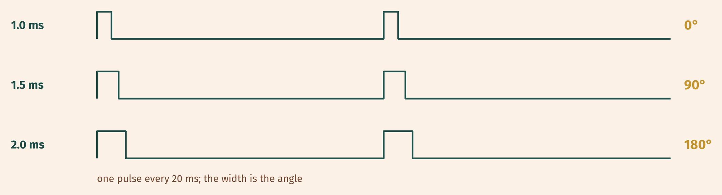
THE IDEA
A pulse is an instruction, not a power level
Every 20 ms the board sends a pulse. Its width sets the angle the servo holds.
1.0 ms → 0°, 1.5 ms → 90°, 2.0 ms → 180°.
Notes:
This is a setpoint, the word used in every control
system. Write it on the board. Lesson 4 uses it again.

Slide 6

BUILD · 15 MINUTES
Three wires, one of them a signal
1
Signal wire to pin 9.
2
Power from a separate 5 V supply.
3
Join the grounds.
4
Pot on A0 to choose the angle.
Illustrative interface. Use the live Tinkercad menus.
Y9.3 · A SERVO ASKS FOR A POSITION
Notes:
Three wires: power, ground, signal. The signal is
the only one that goes to the board. Power comes from a separate supply, and
the grounds are joined — the same rule as the motor.

Slide 7
DECODE THE CODE
Ask for an angle
#include <Servo.h>
Servo arm;
void setup() {
arm.attach(9);
Serial.begin(9600);
}
void loop() {
int knob = analogRead(A0);
int angle = map(knob, 0, 1023, 0, 180);
arm.write(angle);
Serial.println(angle);
delay(20);
}
#INCLUDE <SERVO.H>
Adds the library that generates the 20 ms pulse for you.
ARM.ATTACH(9);
Tells the library which pin sends the pulses.
ARM.WRITE(ANGLE);
An angle in degrees, 0 to 180. Not a speed, and not a duty cycle.
0 to 180 degrees, not 0 to 255.
Y9.3 · A SERVO ASKS FOR A POSITION
Notes:
The Servo library does the pulse timing. Point
out that arm.write(90) is a position, not a speed — the word write is the same
as digitalWrite, but the meaning is different.

Slide 8
TEST IT · 5 MINUTES
What success looks like
✓
The arm follows the knob across the full range.
0–180°
✓
At 90 the arm sits in the middle of its travel.
90°
✓
It holds its position when you stop turning.
holds
WATCH FOR
Twitching or a board reset means the servo is drawing from the board's 5 V pin. Separate supply, shared ground.
Y9.3 · A SERVO ASKS FOR A POSITION
Notes:
The hold test is the one that distinguishes a servo
from a motor. Push the arm gently and it should resist.

Slide 9
DEBUG · 5 MINUTES
It does not work. Find the fault.
WHAT YOU SEE
A
The signal wire is on the wrong pin
The servo twitches, and sometimes the whole board resets when it moves.
B
It is powered from the board's 5 V pin
C
The angle is out of range
THE FAULT
THE FAULT
click to reveal
The servo is taking its current from the board.
Use a separate 5 V supply for the servo, join the grounds, and keep only the signal on pin 9. The board is a controller, not a power supply.
Y9.3 · A SERVO ASKS FOR A POSITION
Notes:
A small servo can pull over an amp at start-up.
The board's 5 V pin cannot supply that, so the voltage sags and the chip resets.
This is the same signal-versus-power lesson as Y9.1.

Slide 10
CHECK · ONE QUESTION
A pulse of 1.5 ms means what?
A
B
C
0°
90°
180°
THE ANSWER
ANSWER — B
click to reveal
90°.
1.5 ms is halfway between 1.0 and 2.0 ms, and halfway between 0° and 180° is 90°.
If you chose another one, say why. That is the useful bit.
Y9.3 · A SERVO ASKS FOR A POSITION
Notes:
B. Halfway between the two ends of the pulse
range is halfway between the two ends of the travel.

Slide 11
STRETCH · IF YOU FINISHED EARLY
If that was easy
SWEEP IT
Use a for loop to sweep 0 → 180 in steps of 5, with a 20 ms delay. Why does the arm move smoothly rather than jumping?
TWO SERVOS
Attach a second servo on pin 10 and move them to different angles. Watch the current draw. This is why robots carry big batteries.
A servo is a motor, a position sensor and a controller in one box.
Y9.3 · A SERVO ASKS FOR A POSITION
Notes:
The sweep is the classic servo demo and the
loop makes the pulse sequence visible. Two servos makes the supply point
physically obvious.

Slide 12
EXIT TICKET · BEFORE YOU LOG OFF
Two questions, then close the laptop.
What does the pulse width control?
FINISH THE SENTENCE
1
A servo is told a ________, not a speed.
Why does a servo need its own supply?
2
One word for today
NEXT LESSON
Y9.4 — A system that corrects itself
The first loop that measures its own result.
Notes:
The frame, "position", is the whole distinction from
Y9.2. Ask them to say the difference in one sentence.

