Slide 1
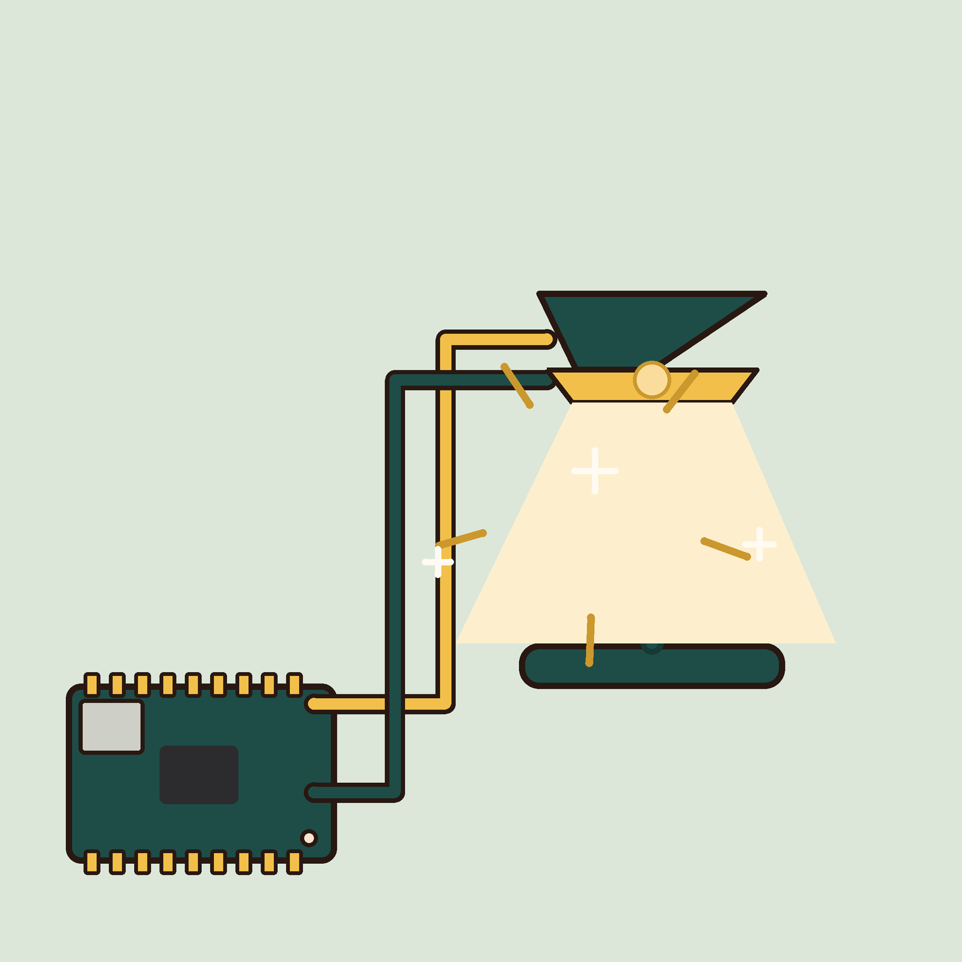
01
YEAR 7 · ELECTRONICS · LESSON 1 OF 5
Make a light blink
OF 5
By the end you will make a light blink on cue, and know why it needs that little resistor.
BUILD: A BLINKING LIGHT
Y7.1 · MAKE A LIGHT BLINK
Notes:
Cover. Say what they will be able to do by the end: By the end you will make a light blink on cue, and know why it needs that little resistor.

Slide 2
STARTER · FIRST LESSON
Two questions to start
1
A bike light, a phone torch, a traffic light. What do they all do when you press the switch?
A light comes on. Same part in all three: an LED.
ANSWER
click to reveal
2
Where does the power come from — and what is the switch actually doing?
A battery or the mains. The switch just decides when the power gets through.
ANSWER
click to reveal
Say your answer to the person next to you. A guess is fine.
Y7.1 · MAKE A LIGHT BLINK
Notes:
Two questions, thirty seconds, no hands up.
Both answers are on screen after a click. The point is to find out who already
thinks an LED is a tiny bulb with a battery inside — they will say so, and that
is the misconception lesson 1 is here to fix.

Slide 3
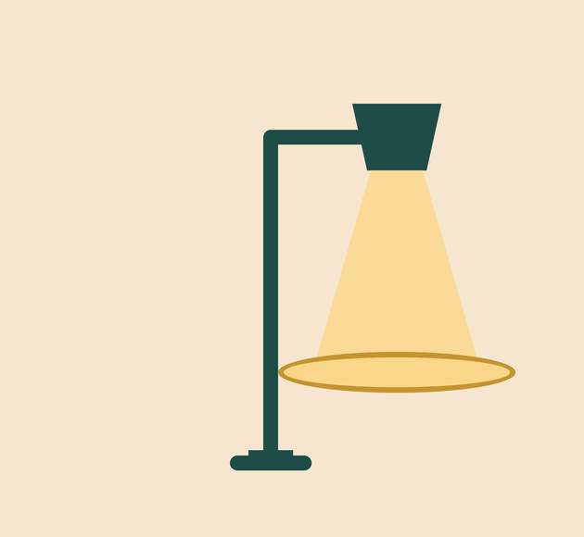

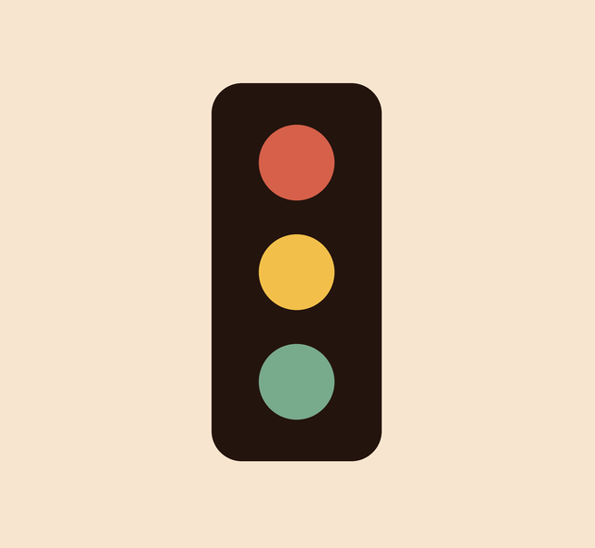
A bike light, a TV on standby, a traffic light. Who is doing the switching?
Bike light. Press the switch, the light comes on.
TV standby. The little red light means it is still awake.
Traffic light. Three lights, taking turns.
Somewhere inside each one, a switch is being told when to open and close.
On our board, that switch is a metal leg called a pin. Code flicks it.
Y7.1 · MAKE A LIGHT BLINK
Notes:
Ask for other examples before you move on: a fridge
light, a car headlight, the little light on a TV. Then the gold line: the switch
is the interesting part, and a computer can be that switch. This is the first
time the word "pin" appears, and it is earned: they have just seen a switch do
the work.

Slide 4
PREDICT · EVERYONE COMMITS
Before I show you
An LED is connected to a 5 V pin with no resistor. What happens?
A
B
C
It lights, dimmer than usual
It lights, then burns out
Nothing: 5 V is too small
THE ANSWER
THE ANSWER
click to reveal
It lights — and then it burns out.
5 V pushes far more current through an LED than its junction can survive. The resistor is not there to dim it; it is there to set the current to about 15 mA.
Hands up for the one you chose — then we find out.
Y7.1 · MAKE A LIGHT BLINK
Notes:
Everyone commits before anyone sees the answer.
The wrong answer people give is "it lights dimmer" — 5 V does not limit the
current. Hold the reveal until most hands are up.

Slide 5
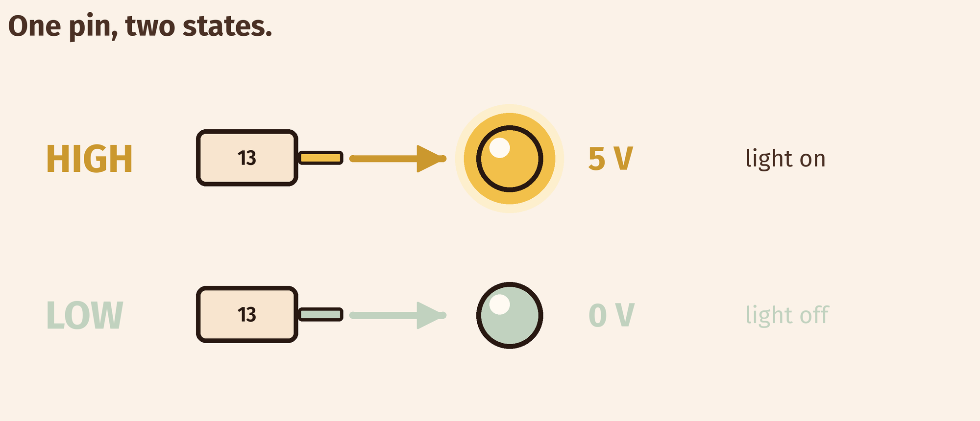
THE IDEA
A pin is a metal leg that code can switch
HIGH puts 5 V on it. LOW takes the 5 V away. There is no half-on.
The same pin, two states. The resistor stays the same in both.
Notes:
The one sentence to leave on the board. Point at
one leg of the board and count it out loud: this leg is pin 13, it has two
states, HIGH is 5 V and LOW is 0 V. Point at the resistor and say again that its
job is current, not brightness.

Slide 6

BUILD · 15 MINUTES
Wire it in Tinkercad
1
Drag an Arduino Uno and a breadboard onto the canvas.
2
Add an LED. The long leg is the positive one.
3
Run a 220 Ω resistor from pin 13 to the long leg.
4
Wire the short leg to a GND pin.
Illustrative interface. Use the live Tinkercad menus.
Y7.1 · MAKE A LIGHT BLINK
Notes:
Fifteen minutes. Demo the whole build first at the
front, then let them copy it. The one thing to police is the LED's long leg:
half the failures in this lesson are a reversed LED.

Slide 7
DECODE THE CODE
Six lines, one blinking light
void setup() {
pinMode(13, OUTPUT);
}
void loop() {
digitalWrite(13, HIGH);
delay(500);
digitalWrite(13, LOW);
delay(500);
}
PINMODE(13, OUTPUT)
Faces pin 13 outwards. It will push current, not listen.
DIGITALWRITE(13, HIGH)
Connects pin 13 to 5 V. Current flows, the LED lights.
DELAY(500)
Waits 500 ms — half a second — doing nothing at all.
Type it. Do not copy it.
Y7.1 · MAKE A LIGHT BLINK
Notes:
Type it, do not paste it. Three lines carry the
whole lesson: pinMode says which direction the pin faces, digitalWrite sets it,
delay waits. Read the code out loud once before they start.

Slide 8
TEST · 5 MINUTES
What success looks like
✓
The LED goes on and off, once a second.
1 s on, 1 s off
✓
Change both delays to 100. It blinks five times as fast.
100 ms
✓
Press Upload and the program starts again from setup().
restarts
WATCH FOR
LED on and never changing? You ran the simulation instead of uploading. Press Upload, then Start Simulation.
Y7.1 · MAKE A LIGHT BLINK
Notes:
The check is observable, not a feeling. If the
LED is lit but static, loop() is not running: they pressed Start Simulation and
not Upload. That is the most common first-lesson error.

Slide 9
DEBUG · 5 MINUTES
It does not work. Find the fault.
WHAT YOU SEE
A
The resistor is too big
The LED is in the breadboard, the code is uploaded, and nothing lights.
B
The LED is in backwards
C
delay() is too long
THE FAULT
THE FAULT
click to reveal
The LED is in backwards.
The long leg is the positive one and goes towards the resistor. The short leg goes to GND. Turn it round and it lights — nothing else needs to change.
Y7.1 · MAKE A LIGHT BLINK
Notes:
Do not tell them. Let them turn it round
themselves — the physical act of reversing the LED is what makes the long leg
memorable. Two minutes, then reveal.

Slide 10
CHECK · ONE QUESTION
What does digitalWrite(13, HIGH) do to pin 13?
A
B
C
Reads the voltage on pin 13
Connects pin 13 to 5 V
Connects pin 13 to GND
THE ANSWER
ANSWER — B
click to reveal
It connects pin 13 to 5 V.
HIGH is 5 V, LOW is 0 V, and a digital pin can do nothing else. Reading is a different instruction: digitalRead.
If you chose another one, say why. That is the useful bit.
Y7.1 · MAKE A LIGHT BLINK
Notes:
B is right. Watch for pupils choosing A because
they have met digitalRead already — the two instructions are easy to swap. Say
both out loud: write goes out, read comes in.

Slide 11
STRETCH · IF YOU FINISHED EARLY
If that was easy
TRY THIS
Make a pattern: two short blinks, then a long pause. Time it with a phone and match the numbers.
THEN THIS
Change the resistor to 1 kΩ. Predict what the LED does, then run it.
A bigger resistor means less current, so a dimmer LED. It still blinks.
Y7.1 · MAKE A LIGHT BLINK
Notes:
For the group that finishes in eight minutes.
Both tasks have a checkable answer, so they are not busywork.

Slide 12
EXIT TICKET · BEFORE YOU LOG OFF
Two questions, then close the laptop.
What does HIGH mean, in volts?
FINISH THE SENTENCE
1
A pin is a metal leg that code can ________.
Why does the LED need a resistor?
2
One word for today
NEXT LESSON
Y7.2 — A button that lights a lamp
A pin that listens instead of speaking.
Notes:
Two minutes. The sentence frame is the answer to
the lesson; collect the slips so you can see who still thinks a pin can be
half-on.

