Slide 1
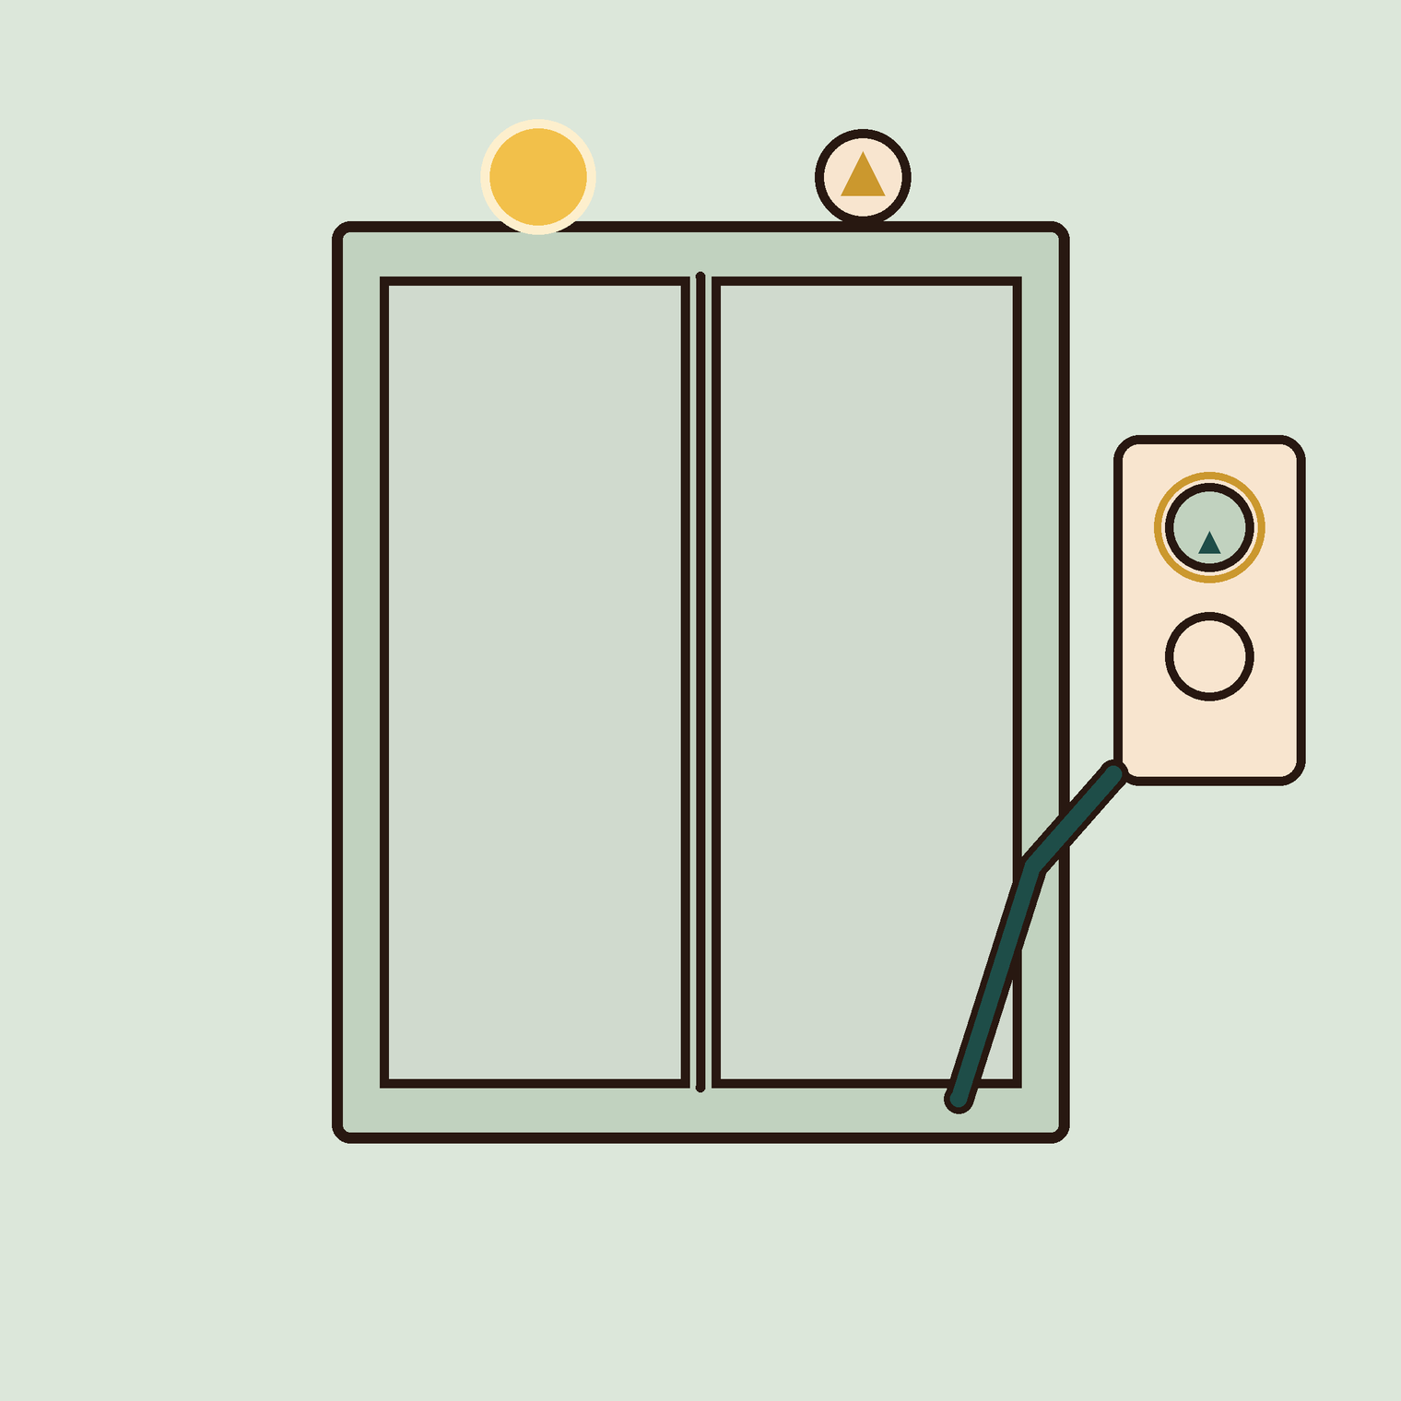
03
YEAR 7 · ELECTRONICS · LESSON 3 OF 5
Two things must be true
OF 5
By the end you will combine two inputs with && and ||, and write the rule down before you code it.
BUILD: LIFT SAFETY
Y7.3 · TWO THINGS MUST BE TRUE
Notes:
Cover. Say what they will be able to do by the end: By the end you will combine two inputs with && and ||, and write the rule down before you code it.

Slide 2
STARTER · 2 MINUTES
What do you remember?
1
What does the pull-down resistor do?
Holds the pin at 0 V when nothing is pressing it.
ANSWER
click to reveal
2
Which pin mode lets a pin listen?
INPUT.
ANSWER
click to reveal
Answer it in your head before I click.
Y7.3 · TWO THINGS MUST BE TRUE
Notes:
Both recall questions are load-bearing: the
resistor answer is what they will need again when two buttons each need one.

Slide 3


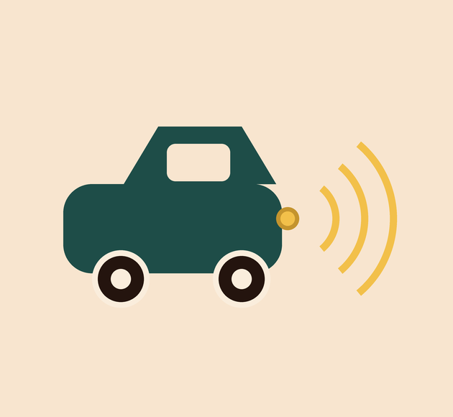
Why will the lift not move with the door open?
Lift doors. Shut, and a button.
Washing machine. Door locked.
Car. In gear, foot on the brake.
In every case, two things must be true at the same time.
One condition is easy. Real machines check two or three before they act.
Y7.3 · TWO THINGS MUST BE TRUE
Notes:
Ask why. Every answer is a version of "two
things have to be true". Write the two things on the board as they say them.

Slide 4
PREDICT · EVERYONE COMMITS
Before I show you
The motor must run only when the door is shut AND the button is pressed. Which line does that?
A
B
C
if (door == HIGH || button == HIGH)
if (door == HIGH && button == HIGH)
if (door == HIGH + button == HIGH)
THE ANSWER
THE ANSWER
click to reveal
The second one: &&.
&& means both sides must be true. || means either side is enough. On a keyboard, Shift + A needs both keys, so it behaves like &&.
Hands up for the one you chose — then we find out.
Y7.3 · TWO THINGS MUST BE TRUE
Notes:
The third option is nonsense on purpose; it
makes the difference between && and || the only real question. Reveal, then read
the line out loud as "if door AND button".

Slide 5
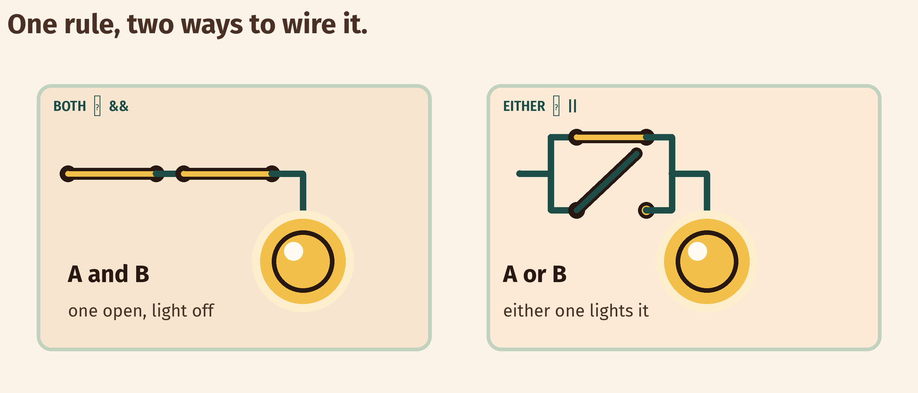
THE IDEA
&& means both, || means either
Write the rule as a table first. Four rows for two buttons, and the answer is visible before any code.
Series is AND. Parallel is OR. Same switches, different wiring.
Notes:
Series and parallel are the same two switches wired
differently. If you have two physical switches and a torch bulb, wire both on the
desk — it takes two minutes and lands better than the picture.

Slide 6
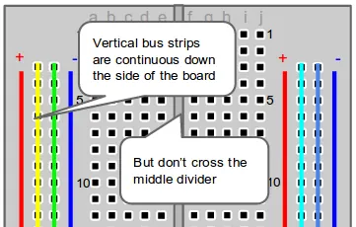
BUILD · 15 MINUTES
Two buttons, one light
1
Button A to pin 2, button B to pin 3.
2
A 10 kΩ pull-down from each pin to GND.
3
LED and 220 Ω on pin 13.
4
Fill in the four-row truth table in your book.
Illustrative interface. Use the live Tinkercad menus.
Y7.3 · TWO THINGS MUST BE TRUE
Notes:
Two pull-downs, one each. Pupils will try to share
one resistor between both buttons; that is the error to look for.

Slide 7
DECODE THE CODE
One rule, two inputs
void setup() {
pinMode(2, INPUT);
pinMode(3, INPUT);
pinMode(13, OUTPUT);
}
void loop() {
int a = digitalRead(2);
int b = digitalRead(3);
if (a == HIGH && b == HIGH) {
digitalWrite(13, HIGH);
} else {
digitalWrite(13, LOW);
}
}
&&
Both sides true. One false side and the whole line is false.
||
Either side true is enough. False only when both are false.
ELSE
Runs when the if was false. One per if, at most.
Say the condition out loud before you run it.
Y7.3 · TWO THINGS MUST BE TRUE
Notes:
Ask them to read the condition out loud before
running it. Half the room will read || as "and" — that is the misconception this
lesson exists to catch.

Slide 8
TEST IT · 5 MINUTES
Test all four rows
✓
Press A only: the LED stays off.
off
✓
Press B only: the LED stays off.
off
✓
Press both: the LED comes on.
on
WATCH FOR
If either button alone lights it, the condition is an OR wearing an AND's clothes. Read the line again.
Y7.3 · TWO THINGS MUST BE TRUE
Notes:
All four rows, out loud, as a class. The two
single-button rows are where a wrong operator shows itself.

Slide 9
DEBUG · 5 MINUTES
It does not work. Find the fault.
WHAT YOU SEE
A
The pins are swapped
The LED comes on when either button is pressed, not only when both are.
B
The code uses || where it needs &&
C
The LED is backwards
THE FAULT
THE FAULT
click to reveal
The || on the if line.
Read it aloud: 'if A or B'. The lift would open with the door still open. Change || to && and test all four rows again.
Y7.3 · TWO THINGS MUST BE TRUE
Notes:
One character wrong is the whole bug. Show the fix
as a one-character edit, not a rewrite.

Slide 10
CHECK · ONE QUESTION
Which operator is true when at least one of two buttons is pressed?
A
B
C
&&
||
!
THE ANSWER
ANSWER — B
click to reveal
|| — or.
|| is false only when both sides are false. ! is not a joiner: it flips one condition, so !HIGH is LOW.
If you chose another one, say why. That is the useful bit.
Y7.3 · TWO THINGS MUST BE TRUE
Notes:
B. The ! is worth a mention: it means NOT,
and it will appear in Year 8 when a sensor reads the wrong way round.

Slide 11
STRETCH · IF YOU FINISHED EARLY
If that was easy
THREE CONDITIONS
Add a third button on pin 4. The car starts only if all three are true. Then change it so it starts if the key AND (seat OR brake). Write the table first: it now has eight rows.
SAY IT IN WORDS
For each of the four rows, write one sentence: 'A pressed, B released, so the lift stays still because…' A table you cannot explain is a table you do not understand.
Eight rows is not eight times harder. It is the same rule, applied carefully.
Y7.3 · TWO THINGS MUST BE TRUE
Notes:
The second task is the real stretch: eight rows
forces them to be systematic instead of guessing.

Slide 12
EXIT TICKET · BEFORE YOU LOG OFF
Two questions, then close the laptop.
What does && mean?
FINISH THE SENTENCE
1
The lift moves only when the door is shut ________ the button is pressed.
When is || false?
2
One word for today
NEXT LESSON
Y7.4 — The board remembers
A variable is how a program keeps a number.
Notes:
The frame is deliberately the exact sentence
structure of the code. Collect and check for the wrong joiner.

