Slide 1
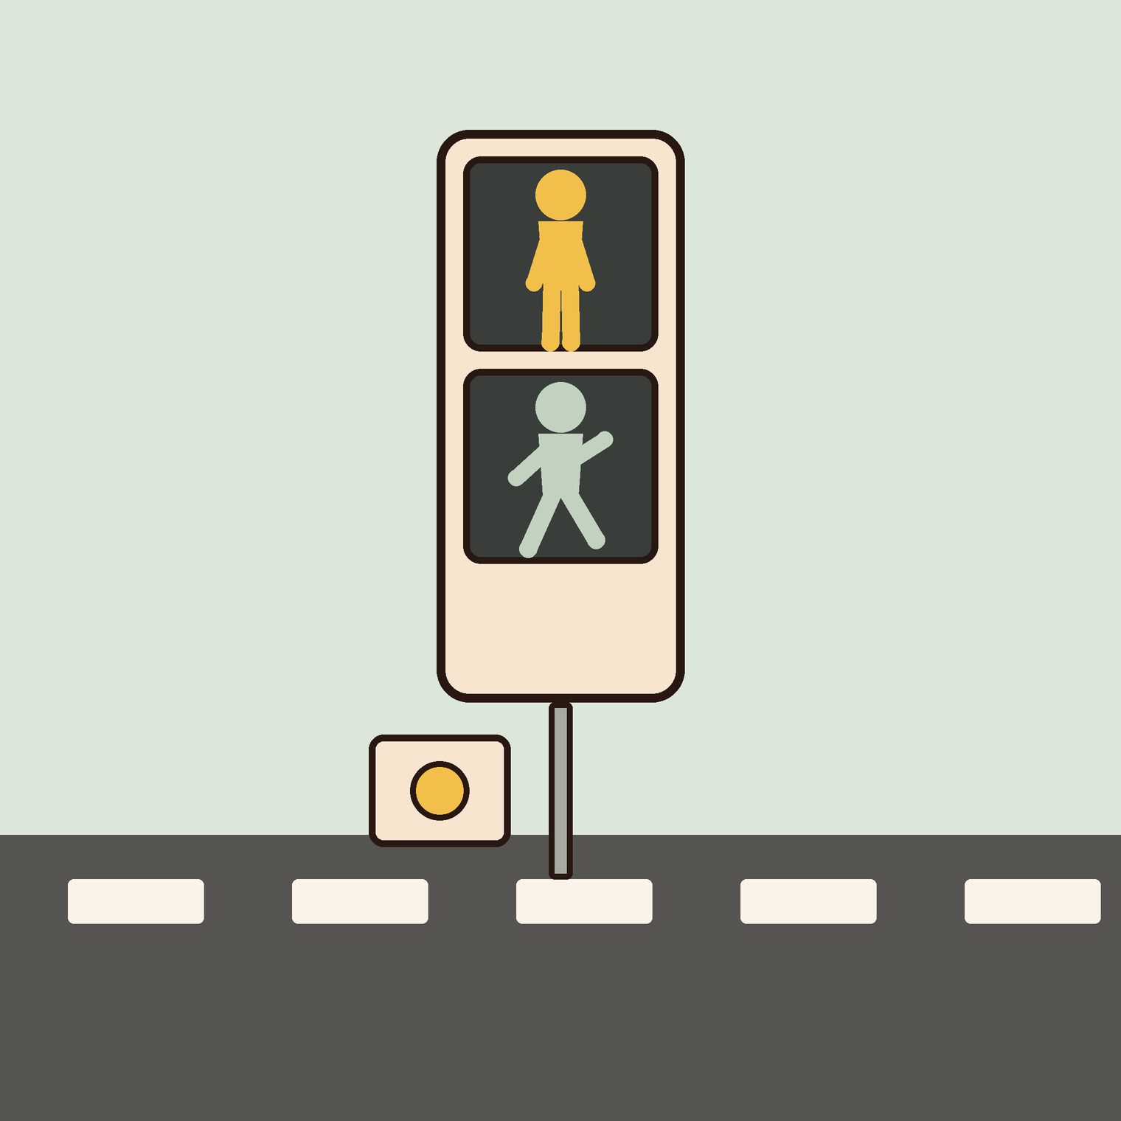
05
YEAR 7 · ELECTRONICS · LESSON 5 OF 5
Design a crossing
OF 5
By the end you will design the states of a traffic light, build it, and time it.
BUILD: A TRAFFIC LIGHT
Y7.5 · DESIGN A CROSSING
Notes:
Cover. Say what they will be able to do by the end: By the end you will design the states of a traffic light, build it, and time it.

Slide 2
STARTER · 2 MINUTES
What do you remember?
1
Where must a counter be declared to keep its value?
Outside loop(), at the top.
ANSWER
click to reveal
2
What does digitalRead return?
HIGH or LOW.
ANSWER
click to reveal
Answer it in your head before I click.
Y7.5 · DESIGN A CROSSING
Notes:
Recall the two hard ideas of Year 7: where a
variable lives, and what digitalRead gives you. Both are used today.

Slide 3
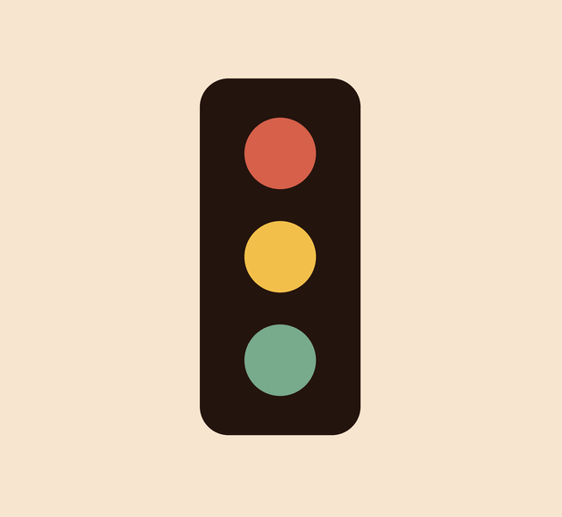


Why does the UK have a red-and-amber light that most countries do not?
Three lamps, four states.
A sequence the driver can predict.
Rules that must not overlap.
The lamps are simple. The sequence is the design.
A machine can hold a state like red-and-amber until its time is up.
Y7.5 · DESIGN A CROSSING
Notes:
The red-and-amber state is a good fact and a better
question: the sequence is designed, not natural. That is the point of the
lesson.

Slide 4
PREDICT · EVERYONE COMMITS
Before I show you
A traffic light has three LEDs. How many can be on at the same time?
A
B
C
Only ever one
Sometimes two
All three
THE ANSWER
THE ANSWER
click to reveal
Sometimes two — red and amber together.
That state tells drivers the next one is green. It is a real state with a real duration, and it is why the light is a state machine and not three timers.
Hands up for the one you chose — then we find out.
Y7.5 · DESIGN A CROSSING
Notes:
Most will say one. The reveal is a real
technical detail, and it makes the point that the rules decide, not the
hardware.

Slide 5
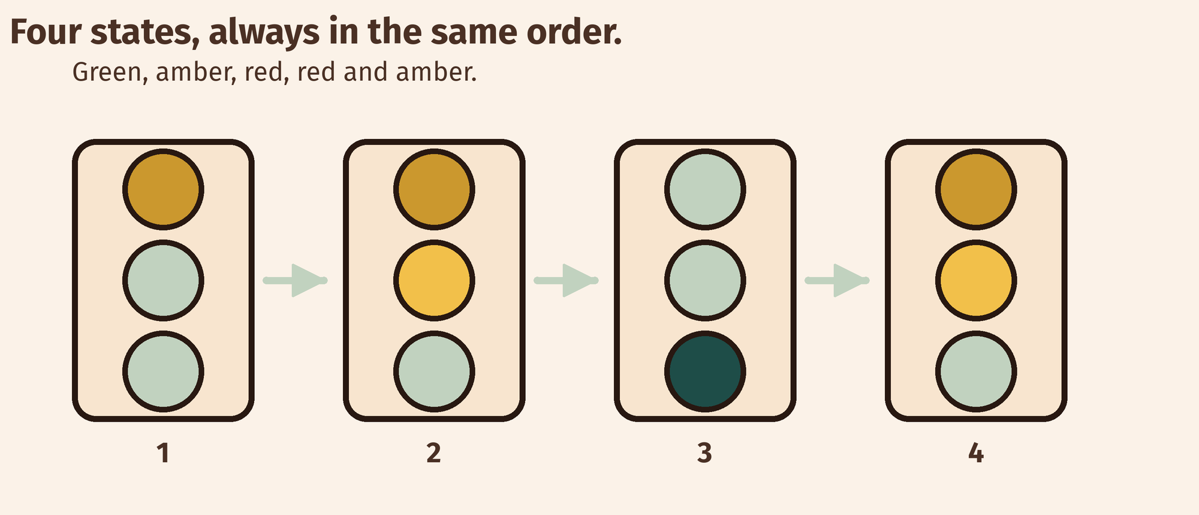
THE IDEA
A sequence of states is a machine
List the states. Then list what moves you from one to the next. That list is the program.
Each circle is a set of outputs. Each arrow is one delay and a change.
Notes:
States first, arrows second. If they can draw the
four circles and the arrows, the code is a transcription job.

Slide 6

BUILD · 15 MINUTES
Three LEDs, one sequence
1
Red on pin 11, amber on 10, green on 9.
2
Every LED gets its own 220 Ω resistor.
3
All three short legs share the GND rail.
4
Draw the states and the times in your book first.
Illustrative interface. Use the live Tinkercad menus.
Y7.5 · DESIGN A CROSSING
Notes:
The design step is before the wiring, on purpose.
Pupils who wire first will code by trial and error and learn nothing about
states.

Slide 7
DECODE THE CODE
Four states, in order
void setup() {
pinMode(9, OUTPUT); // green
pinMode(10, OUTPUT); // amber
pinMode(11, OUTPUT); // red
}
void loop() {
digitalWrite(9, HIGH); // green
delay(6000);
digitalWrite(9, LOW);
digitalWrite(10, HIGH); // amber
delay(2000);
digitalWrite(10, LOW);
digitalWrite(11, HIGH); // red
delay(6000);
digitalWrite(10, HIGH); // red + amber
delay(2000);
digitalWrite(11, LOW);
digitalWrite(10, LOW); // back to green
}
EVERY STATE SETS EVERY PIN
A pin stays where you left it. Switching one on is not switching the others off.
DELAY(6000)
Six seconds of doing nothing at all. Nothing else on the board runs during a delay.
ORDER MATTERS
The loop runs top to bottom, then starts again. The last line leads back to the first state.
Time one full cycle with a stopwatch.
Y7.5 · DESIGN A CROSSING
Notes:
Read the sequence as a story, not as code: green,
wait, amber, wait, red, wait, red and amber, wait. Then the code is obvious.
Point out that delay stops everything — this is the seed for Year 9.

Slide 8
TEST IT · 5 MINUTES
What success looks like
✓
The four states run in order: green, amber, red, red+amber.
4 states
✓
Each state lasts as long as you planned.
6/2/6/2 s
✓
No two LEDs are lit unless you meant them to be.
no overlap
WATCH FOR
Green and red together means a missing digitalWrite(..., LOW). Walk the sequence and write down all three pins for each state.
Y7.5 · DESIGN A CROSSING
Notes:
Watch one full cycle with a stopwatch. If green
never goes off, a LOW is missing.

Slide 9
DEBUG · 5 MINUTES
It does not work. Find the fault.
WHAT YOU SEE
A
A resistor is missing
Green and red are lit at the same time.
B
One pin is never switched off
C
delay() is too short
THE FAULT
THE FAULT
click to reveal
One digitalWrite(..., LOW) is missing.
A pin keeps its last value. Every state must set every LED, even the ones that are staying off. Write the three pins out for each state and the gap appears.
Y7.5 · DESIGN A CROSSING
Notes:
The classic. Ask for a table of all three pins
per state — the missing LOW shows up immediately in a table and is invisible in
the code.

Slide 10
CHECK · ONE QUESTION
What is a state?
A
B
C
A delay
The set of outputs at one moment
A pin number
THE ANSWER
ANSWER — B
click to reveal
The set of outputs at one moment.
A state is the whole picture: which lamps are on right now. A machine is a list of states and the rules for moving between them.
If you chose another one, say why. That is the useful bit.
Y7.5 · DESIGN A CROSSING
Notes:
B. Insist on the words "at one moment":
a state is a snapshot, not a duration. The duration is how long you stay in it.

Slide 11
STRETCH · IF YOU FINISHED EARLY
If that was easy
ADD A PEDESTRIAN LIGHT
A fourth LED and a button. Pressing the button must not interrupt the cycle: it sets a flag, and the next red lasts longer.
WRITE THE DESIGN, NOT THE CODE
Make a table: state, which lamps, how long, what leaves it. Hand it to someone else and see if they can build it from the table alone.
A flag is a variable that remembers a request. That is a Year 8 idea arriving early.
Y7.5 · DESIGN A CROSSING
Notes:
The pedestrian button is the right stretch
because it introduces a flag — a variable that remembers a request. That is a
Year 8 idea arriving early.

Slide 12
EXIT TICKET · BEFORE YOU LOG OFF
Two questions, then close the laptop.
Name the four states, in order.
FINISH THE SENTENCE
1
A machine is a list of ________ and the rules between them.
Why does a pin stay on if you never switch it off?
2
One word for today
NEXT LESSON
That is Year 7
Year 8 starts with a pin that reads a number, not just HIGH or LOW.
Notes:
Close the year on the arc: switch, listen,
decide, remember, sequence. Year 8 starts with a pin that reads a number.

