Slide 1
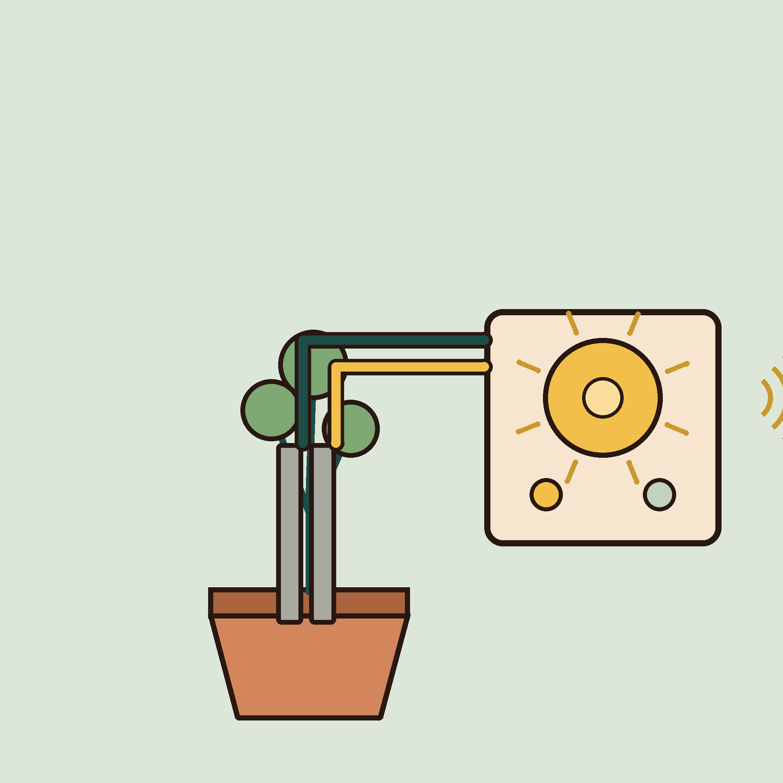
05
YEAR 8 · ELECTRONICS · LESSON 5 OF 5
A plant alarm that will not chatter
OF 5
By the end you will build a device that senses, decides and acts, and stop it chattering at the threshold.
BUILD: A PLANT ALARM
Y8.5 · A PLANT ALARM THAT WILL NOT CHATTER
Notes:
Cover. Say what they will be able to do by the end: By the end you will build a device that senses, decides and acts, and stop it chattering at the threshold.

Slide 2
STARTER · 2 MINUTES
What do you remember?
1
What voltage does the TMP36 give at 0 °C?
0.5 V.
ANSWER
click to reveal
2
Why write 5.0 rather than 5?
So the division uses decimals, not whole numbers.
ANSWER
click to reveal
Answer it in your head before I click.
Y8.5 · A PLANT ALARM THAT WILL NOT CHATTER
Notes:
Two recalls that the capstone depends on.
Both are from Y8.4.

Slide 3



Why does a plant die while the watering can is full?
Soil: wet or dry, a number.
The plant cannot ask.
A greenhouse: heat and water.
A plant needs water at the right time, not all the time.
Sense, decide, act. Every automatic device is those three words.
Y8.5 · A PLANT ALARM THAT WILL NOT CHATTER
Notes:
The question is deliberately odd: a full
watering can does not help a plant that is already dead. The point is timing,
which needs a decision.

Slide 4
PREDICT · EVERYONE COMMITS
Before I show you
The threshold is 400. The reading wobbles between 398 and 402. What does the buzzer do?
A
B
C
Stays on
Stays off
Switches on and off rapidly
THE ANSWER
THE ANSWER
click to reveal
It chatters.
One threshold plus a wobbling signal means the rule flips on every pass. Two thresholds — on below 380, off above 420 — stop it. The gap is called hysteresis.
Hands up for the one you chose — then we find out.
Y8.5 · A PLANT ALARM THAT WILL NOT CHATTER
Notes:
Chattering is the phenomenon; hysteresis is
the fix. Let them watch a one-threshold version chatter in Tinkercad before
the reveal if you have time.

Slide 5
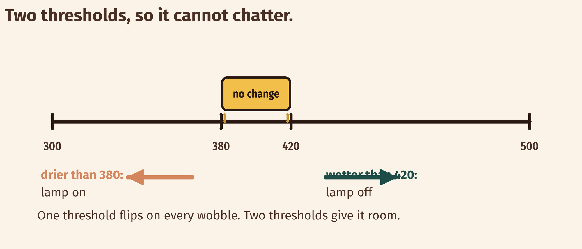
THE IDEA
Two thresholds beat one
Switch on below the low mark. Switch off above the high mark. The gap is the memory.
The reading still wobbles. The output does not.
Notes:
The output has memory: it stays where it is
between the two thresholds. That is a state, arriving again from Year 7, now
used for a different job.

Slide 6
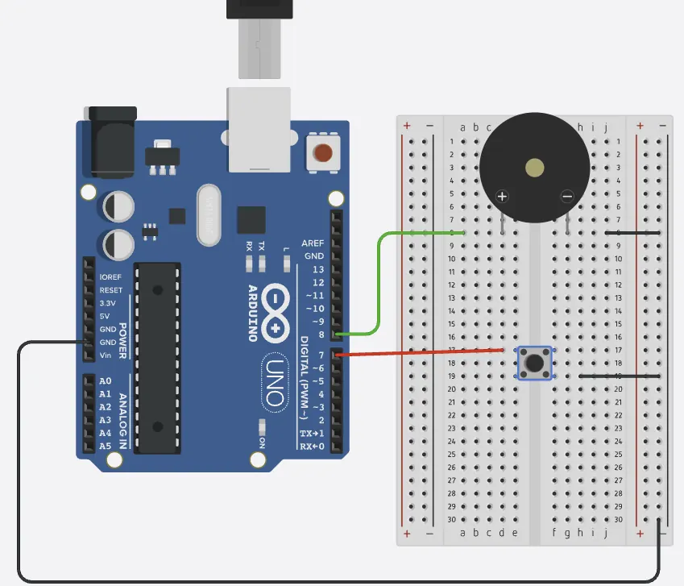
BUILD · 15 MINUTES
Wire the plant alarm
1
Probe into A0 and 5 V (two nails work).
2
10 kΩ from A0 down to GND.
3
Buzzer on pin 8, LED on pin 9.
4
Test in dry air, then in a wet cup.
Illustrative interface. Use the live Tinkercad menus.
Y8.5 · A PLANT ALARM THAT WILL NOT CHATTER
Notes:
If you have no soil probe, two nails in a cup
of soil work. Check the direction of the reading in dry and wet soil before any
code is written — it is the thing that decides the rule.

Slide 7
DECODE THE CODE
A flag, two rules, two outputs
int dry = 0;
void setup() {
pinMode(8, OUTPUT);
pinMode(9, OUTPUT);
Serial.begin(9600);
}
void loop() {
int wetness = analogRead(A0);
if (wetness < 380) dry = 1;
if (wetness > 420) dry = 0;
digitalWrite(8, dry);
digitalWrite(9, dry);
Serial.println(wetness);
delay(200);
}
IF (WETNESS < 380) DRY = 1;
One rule sets the flag. A variable that remembers a decision is a state.
IF (WETNESS > 420) DRY = 0;
A second rule clears it. Between the marks, nothing changes.
DIGITALWRITE(8, DRY)
The flag drives the output. The sensor never drives it directly.
Between 380 and 420, nothing happens.
Y8.5 · A PLANT ALARM THAT WILL NOT CHATTER
Notes:
The flag `dry` is the state. The two ifs set
and clear it. Nothing happens between 380 and 420, and that is the whole
trick.

Slide 8
TEST IT · 5 MINUTES
What success looks like
✓
Dry air: the buzzer sounds and the LED is on.
dry
✓
Wet tissue: both go off.
wet
✓
At the boundary: no rapid clicking.
no chatter
WATCH FOR
Chatter means the two thresholds are too close, or you only wrote one. The gap must be wider than the wobble.
Y8.5 · A PLANT ALARM THAT WILL NOT CHATTER
Notes:
The boundary test is the one to spend time on.
Wave the probe slowly through the threshold and listen.

Slide 9
DEBUG · 5 MINUTES
It does not work. Find the fault.
WHAT YOU SEE
A
The buzzer is wired backwards
The buzzer is on when the soil is wet, and off when it is dry.
B
The comparison is the wrong way round
C
The delay is too long
THE FAULT
THE FAULT
click to reveal
The probe is the other way round in the divider: wet now reads low and dry reads high.
Print the reading in dry soil and in water before writing the rule. With the probe at the top of the divider, dry soil gives a low number, which is why the alarm tests below 380. Swap the probe and the 10 kΩ, or reverse both comparisons.
Y8.5 · A PLANT ALARM THAT WILL NOT CHATTER
Notes:
The inverted rule is the most common. Ask them to
print the reading in dry air first, then in water. Data before code.

Slide 10
CHECK · ONE QUESTION
Why two thresholds instead of one?
A
B
C
To make the code longer
So a wobbling reading cannot make the output chatter
Because analogRead is noisy
THE ANSWER
ANSWER — B
click to reveal
So a wobbling reading cannot make the output chatter.
One threshold flips on every wobble. The gap means the output changes only when the reading has really moved.
If you chose another one, say why. That is the useful bit.
Y8.5 · A PLANT ALARM THAT WILL NOT CHATTER
Notes:
B. The gap is not a fudge; it is the width of the
noise, on purpose.

Slide 11
STRETCH · IF YOU FINISHED EARLY
If that was easy
THREE STATES
Print DRY, DAMP or WET using two thresholds and an else-if chain. Decide what the buzzer does in each state.
CHOOSE A THRESHOLD FROM DATA
Print the reading with millis() as a timestamp. Leave it running for ten minutes, then find the highest and lowest values. Pick your thresholds from those numbers.
A threshold chosen from data is a design decision. A guessed one is a bug waiting to happen.
Y8.5 · A PLANT ALARM THAT WILL NOT CHATTER
Notes:
The logging task is how a real threshold is
chosen: from data, not from a guess. Ten minutes of logging is enough to make
the point.

Slide 12
EXIT TICKET · BEFORE YOU LOG OFF
Two questions, then close the laptop.
Name the three parts of any automatic device.
FINISH THE SENTENCE
1
A device senses, ________ and acts.
What is hysteresis for?
2
One word for today
NEXT LESSON
That is Year 8
Year 9: current, motors, and a loop that corrects itself.
Notes:
Close the unit by naming the shape: sense,
decide, act. Year 9 adds the hard part — making something move.

