Slide 1
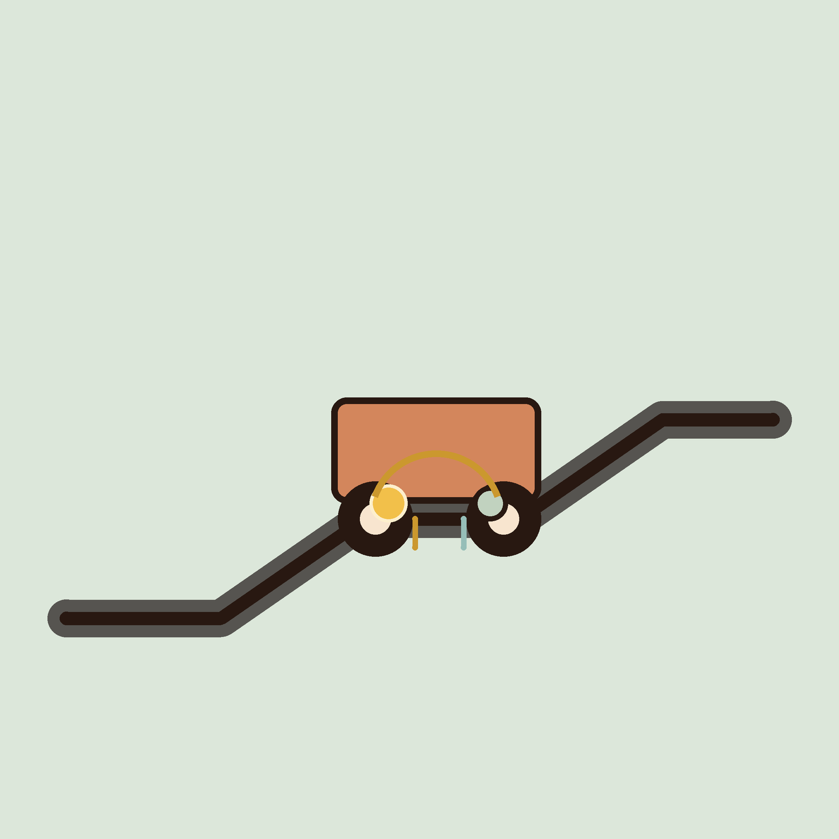
04
YEAR 9 · ELECTRONICS · LESSON 4 OF 5
A system that corrects itself
OF 5
By the end you will close a feedback loop: a servo that turns towards the light and settles.
BUILD: A LIGHT TRACKER
Y9.4 · A SYSTEM THAT CORRECTS ITSELF
Notes:
Cover. Say what they will be able to do by the end: By the end you will close a feedback loop: a servo that turns towards the light and settles.

Slide 2
STARTER · 2 MINUTES
What do you remember?
1
What does the pulse width tell a servo?
The angle to hold.
ANSWER
click to reveal
2
Why does a servo need a separate supply?
It can draw more current than the board can give.
ANSWER
click to reveal
Answer it in your head before I click.
Y9.4 · A SYSTEM THAT CORRECTS ITSELF
Notes:
Recall the servo setpoint. Today the setpoint
comes from a sensor instead of a knob, which is the step from remote control to
automatic control.

Slide 3
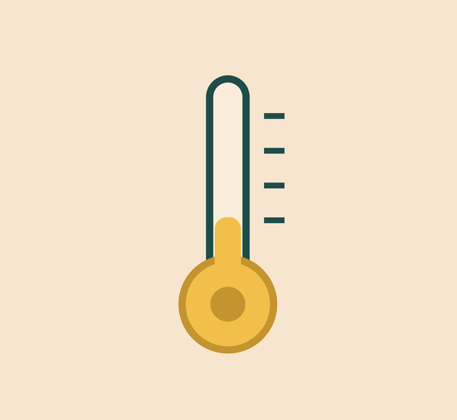

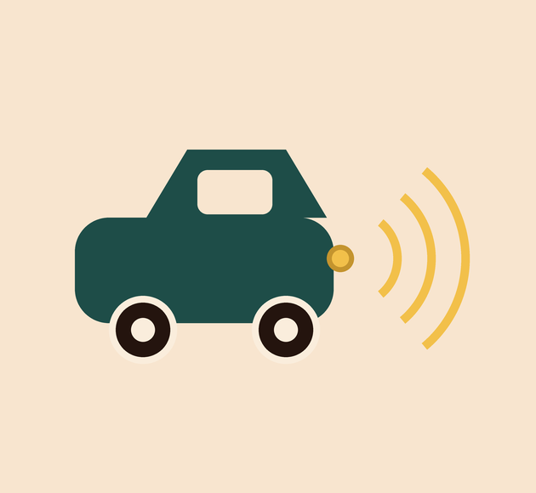
How does a thermostat hold a room at 20 °C when a window is open?
Measure the result.
Act on the difference.
Cruise control does the same.
It measures the result, compares it with the target, and corrects the error.
A control loop is measure, compare, act — over and over.
Y9.4 · A SYSTEM THAT CORRECTS ITSELF
Notes:
A thermostat is the clearest control loop most
pupils already know. Ask what it measures and what it does. Then ask what
happens when a window is opened — the loop corrects.

Slide 4
PREDICT · EVERYONE COMMITS
Before I show you
A heater switches on below 20 °C and off above 21 °C. The room is at 20.5 °C. What happens?
A
B
C
It switches on
It switches off
It depends what it was doing before
THE ANSWER
THE ANSWER
click to reveal
It depends what it was doing before.
Between the two thresholds nothing changes. The output has memory, and that memory is what stops it chattering — the same hysteresis as Year 8, now inside a loop.
Hands up for the one you chose — then we find out.
Y9.4 · A SYSTEM THAT CORRECTS ITSELF
Notes:
C surprises people. It is hysteresis from Y8.5,
now inside a loop. The output has memory, and that memory is a feature.

Slide 5
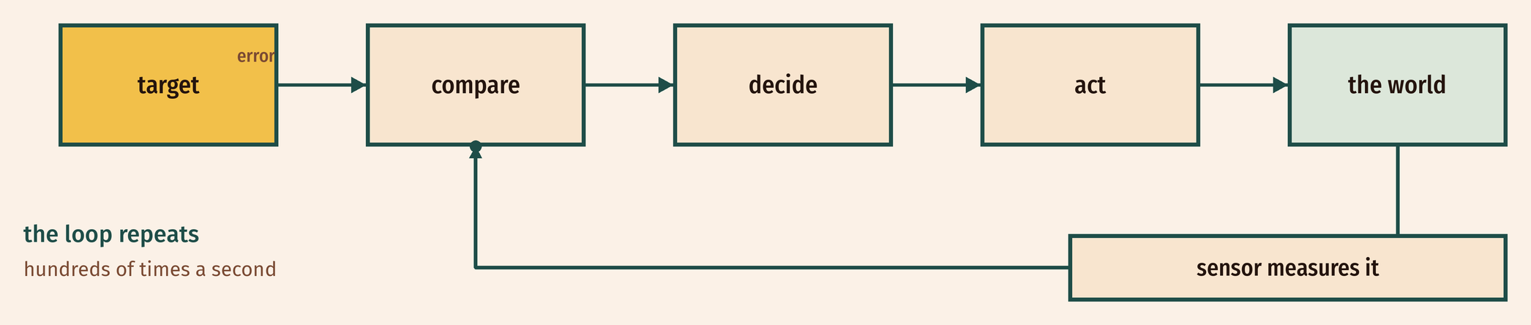
THE IDEA
Measure, compare, act, repeat
The error is the difference between the target and the measurement. The controller acts on the error.
The loop runs hundreds of times a second. That is what makes it control.
Notes:
Error = target − measured. The controller acts on
the error, not on the measurement. That distinction is the lesson. Draw the loop
on the board with the class.

Slide 6

BUILD · 15 MINUTES
Give the arm two eyes
1
Two LDRs, left and right, into A0 and A1.
2
Each needs its own 10 kΩ to GND.
3
Servo signal on pin 9, separate supply.
4
Shade one sensor and watch the arm turn.
Illustrative interface. Use the live Tinkercad menus.
Y9.4 · A SYSTEM THAT CORRECTS ITSELF
Notes:
Two LDRs make a pair of eyes. The divider is the
one from Y8.2, twice. Shade one sensor with a hand — that is the whole demo, and
it is satisfying.

Slide 7
DECODE THE CODE
The loop, in twelve lines
#include <Servo.h>
Servo arm;
int angle = 90;
void setup() {
arm.attach(9);
arm.write(angle);
Serial.begin(9600);
}
void loop() {
int left = analogRead(A0);
int right = analogRead(A1);
if (left > right + 40) angle = angle - 2;
if (right > left + 40) angle = angle + 2;
angle = constrain(angle, 0, 180);
arm.write(angle);
Serial.println(angle);
delay(20);
}
LEFT > RIGHT + 40
A deadband: a small difference is ignored, so the arm does not hunt.
ANGLE = ANGLE - 2
The correction. Small steps, often, beat one big jump.
CONSTRAIN(ANGLE, 0, 180)
Keeps the command inside the servo's travel.
Shade one LDR with your hand.
Y9.4 · A SYSTEM THAT CORRECTS ITSELF
Notes:
The deadband (+ 40) is the anti-hunting device.
Without it the arm oscillates forever. If a pupil asks why 40, the honest answer
is: because the sensors disagree by about 30 when the light is even.

Slide 8
TEST IT · 5 MINUTES
What success looks like
✓
Torch on the left: the arm turns left.
tracks
✓
Torch on the right: it turns right.
tracks
✓
Hold still: the arm settles, with no hunting.
settles
WATCH FOR
Hunting means the deadband is too small. Widen 40 to 80 and try again.
Y9.4 · A SYSTEM THAT CORRECTS ITSELF
Notes:
Settling is the sign of a working loop. Hunting is
the sign of over-correction. Ask them to find the widest deadband that still
tracks, and the narrowest that does not hunt.

Slide 9
DEBUG · 5 MINUTES
It does not work. Find the fault.
WHAT YOU SEE
A
The servo is broken
The arm swings past the light and keeps hunting back and forth.
B
The deadband is too small
C
The LDRs are swapped
THE FAULT
THE FAULT
click to reveal
The deadband is too narrow for how much the two sensors disagree.
Widen the deadband (40 → 80), or take smaller steps (2 → 1). A controller that overcorrects oscillates. Every control system has this failure mode.
Y9.4 · A SYSTEM THAT CORRECTS ITSELF
Notes:
Oscillation is the classic control failure. It is
not a bug in the sensor; it is a correction that is too big for the error.

Slide 10
CHECK · ONE QUESTION
What is the error in a control loop?
A
B
C
A mistake in the code
The difference between the target and the measurement
The delay between readings
THE ANSWER
ANSWER — B
click to reveal
The difference between the target and the measurement.
Error = target − measured. The controller's job is to reduce it. When the error is inside the deadband, the system stops correcting.
If you chose another one, say why. That is the useful bit.
Y9.4 · A SYSTEM THAT CORRECTS ITSELF
Notes:
B. Error is a number, not a mistake. That
distinction is worth making explicit in a room full of Year 9s.

Slide 11
STRETCH · IF YOU FINISHED EARLY
If that was easy
PROPORTIONAL CONTROL
Make the step proportional to the difference: step = (left - right) / 20. Small error, small correction. Watch how much more smoothly it settles.
LOG THE ERROR
Print left, right and angle every pass. Find the moment the error crosses zero. That is the arm arriving.
Proportional control is one line of maths. It is how most real controllers work.
Y9.4 · A SYSTEM THAT CORRECTS ITSELF
Notes:
Proportional control is the real thing, and it
is one line. They will see the arm settle much more smoothly.

Slide 12
EXIT TICKET · BEFORE YOU LOG OFF
Two questions, then close the laptop.
What are the four parts of a control loop?
FINISH THE SENTENCE
1
The error is the difference between the ________ and the measurement.
What happens if the correction is too big?
2
One word for today
NEXT LESSON
Y9.5 — A device that reports
One reading, one line, one message another machine can read.
Notes:
The frame is the definition. If the room cannot
give the four parts, write them on the board and move on — Y9.5 uses them in the
capstone brief.

