Slide 1
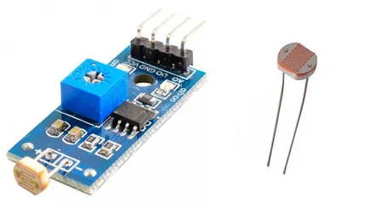
ELECTRONICS
Variables and decisions
By the end you will compare two readings and choose what to do.
Notes:
This is the decision lesson: store, compare, combine.

Slide 2
WATCH FIRST
Where does a program keep a number?
Watch from 9 seconds. Then we store two readings and choose.
Play the video
Notes:
Play this before the question. It is what a variable is, and why the code gives a pin a name.

Slide 3
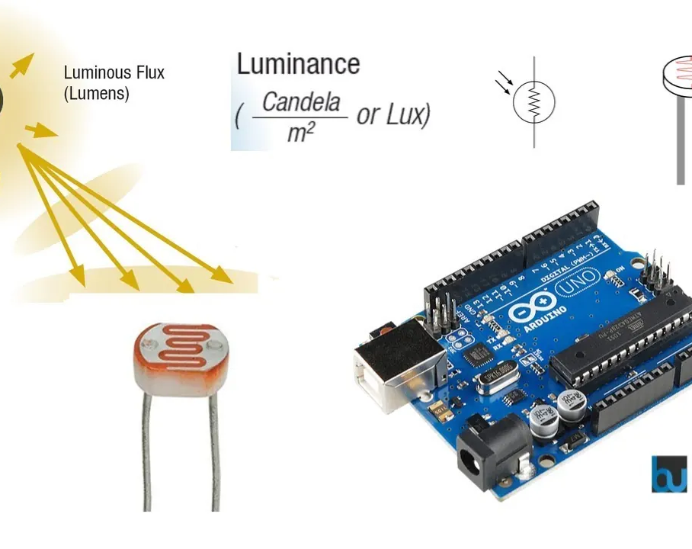
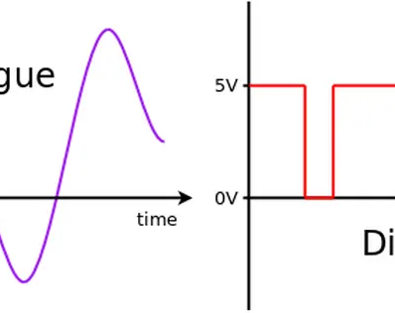

One side of the room is brighter. How does the program decide?
One sensor on the left.
One sensor on the right.
The program has to choose.
Each sensor gives a number. The program has to compare them.
Store both numbers, then test them.
Notes:
They should say 'compare the two numbers'.

Slide 4
A variable stores a value
int
= and ==
A whole number, such as a sensor reading or a count.
= stores a value. == asks if two values are equal. They are not the same.
The name should say what the number is. lightLeft is clearer than x.
Notes:
float is for a decimal, such as 23.7. bool is only true or false.

Slide 5
if chooses. AND and OR combine.
if, else if, else
&& and ||
if runs when its test is true. else if tries another test. else runs when none of them were true.
&& is true only when both tests are true. || is true when at least one test is true.
Notes:
Write the rule in a sentence before they type it.

Slide 6
Which side is brighter?
void loop() {
int left = analogRead(A0);
int right = analogRead(A1);
if (left > right) {
Serial.println("left");
} else if (right > left) {
Serial.println("right");
} else {
Serial.println("same");
}
}
Two variables
left and right each store one reading, so you can compare them.
else if
Checked only when the first test was false.
else
Runs when the two readings are equal. Somebody has to cover that case.
Notes:
Ask what is printed if both readings are 400. The answer is same.

Slide 7
Add an AND
1
Pick a number that means 'dark', such as 200.
CHECK
When should the alarm print?
2
Print alarm only when left < 200 and right < 200.
3
Use && between the two tests.
Only when both are dark.
4
Cover both sensors, then cover only one.
Notes:
One sensor in the dark must not be enough. That is what && is for.

Slide 8
CHECK
ANSWER
What is the difference between = and ==?
= stores. == compares.
You are writing an if test.
= puts a value into a variable. == asks whether two values are equal.
Notes:
Using one = inside if is a common bug. Show it if someone hits it.

