Slide 1
Intro to OS & File Systems
COMP1521 H13C

Slide 2
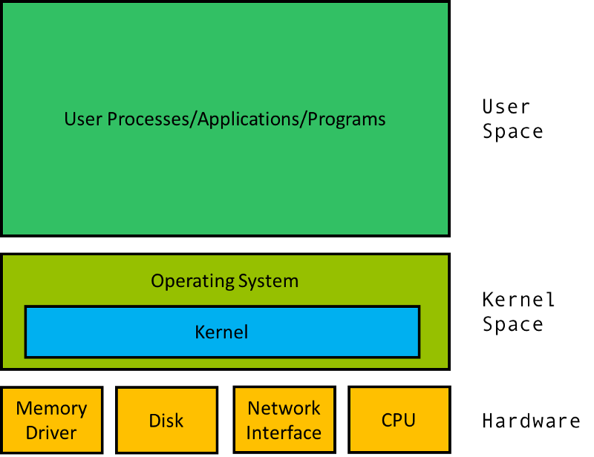
Basic OS Architecture
Operating system – software serving as the interface between the hardware and the user
Kernel – software serving as the interface between the hardware and the applications
User-space = non-privileged
Kernel-space = privileged

Slide 3
Privileged vs Non-Privileged
Used by OS kernel | Used by users
Full access to hardware | Limited access to hardware
Full access to memory | Limited access to memory
Can perform hardware operations | Needs to request hardware operations

Slide 4
System Calls
System calls – syscalls allow programs to request privileged hardware operations
To perform operation, execution is transferred to OS code in privileged mode
If the operation is valid/allowed, it is performed.
Code execution is transferred back to user code in non-privileged mode
Example syscall operations
I/O (read/write)
Memory allocation (malloc)
Process creation (posix_spawn)
Network communications (connect)

Slide 5
File System Terminology (Unix oriented)
File System – a means of storing and retrieving data to/from a physical device
File – a sequence of zero or more bytes
On Linux, everything is a file. Including hardware devices like disks or peripherals
Directory – special file storing a list of other files or directories
`.` is a special file for current directory
`..` is a special file for parent directory
Metadata – information about files, stored by the file system
File Inodes – Structure for file metadata
Inode Number – unique number for an inode, that identifies a file in a file system

Slide 6
Linking
File system links let multiple paths point to the same file
Hard links
Points to an actual file inode
Hard links pointing to the same file must be on the same filesystem
File is destroyed when last hard link is removed
Normal files in Unix are hardlinks
Symbolic links (symlinks)
Points to a pathname
Symlinks are traced until file is reached or until limit (40) is reached

Slide 7
Device Types
Devices (like peripherals) also appear as files in the Linux file system
There are 2 primary device types
Character Devices (aka character special files)
Transfer data, 1 character/byte at a time in a stream
Eg: keyboard sending 1 keystroke at a time
Block Devices (aka block special files)
Transfer data in larger fixed-sized blocks
Eg: hard drives typically have a block size of 512 bytes or 4kB (usual)

Slide 8
File Descriptors
File Descriptor – small integer used by processes and system calls to reference files
File descriptors are allocated per-process, kept in an array-structure called the file descriptor table
Common file descriptors
stdin – 0
stdout – 1
stderr - 2

Slide 9
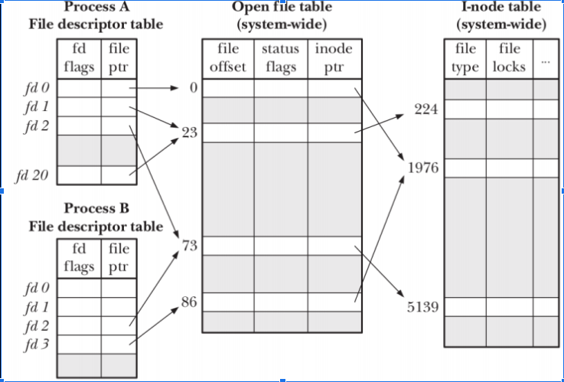
Extension: The Open File Table
For more info: https://www.usna.edu/Users/cs/wcbrown/courses/IC221/classes/L09/Class.html

