Slide 1



Fund Management Capstone
BFIN 491
SPRING 2026
BEAU BARTHULY, BAILEY BINANDO, KJELLEN BOGARD
Notes:
Bailey

Slide 2
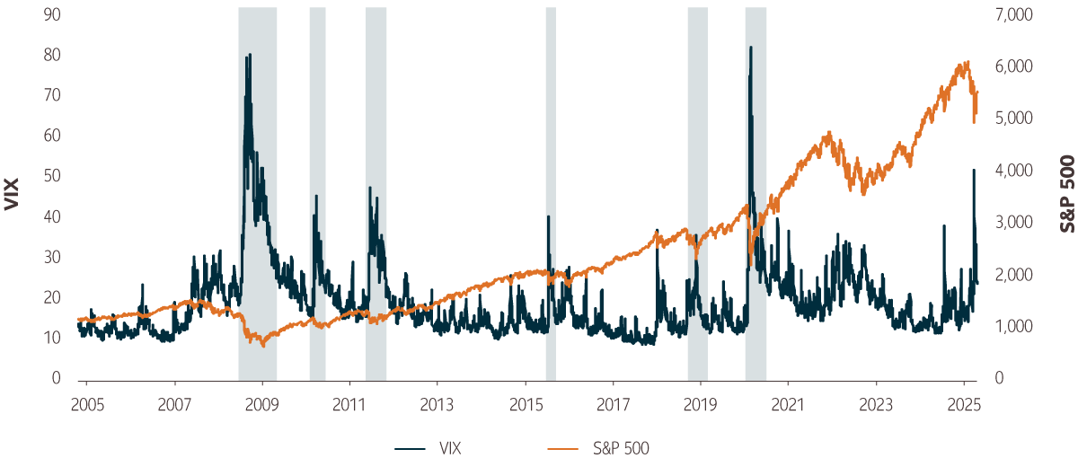
MARKET DEMAND
PWC Global Investor Survey 2025:
Macroeconomic volatility, inflation, and geopolitics are key investor concerns
Investors prioritize resilience and risk management over macro-driven growth
Persistent Volatility Highlights the Need for Diversified, Risk-Managed Portfolios
Source: Sun Life Global Investments
Notes:
Bailey

Slide 3
Target Market & Objective
Target Client Profile:
Age: 30–45
Time Horizon: 20-35+ Years
Risk: Moderate-Aggressive
Investment Objective:
Maximize long-term risk-adjusted returns
Reduce concentration risk and volatility
Maintain broad sector diversification
Low Risk
High Risk
Conservative
Moderate - Conservative
Moderate
Moderate - Aggressive
Aggressive
Long-term equity growth with controlled volatility through diversification and rebalancing
Notes:
Bailey

Slide 4
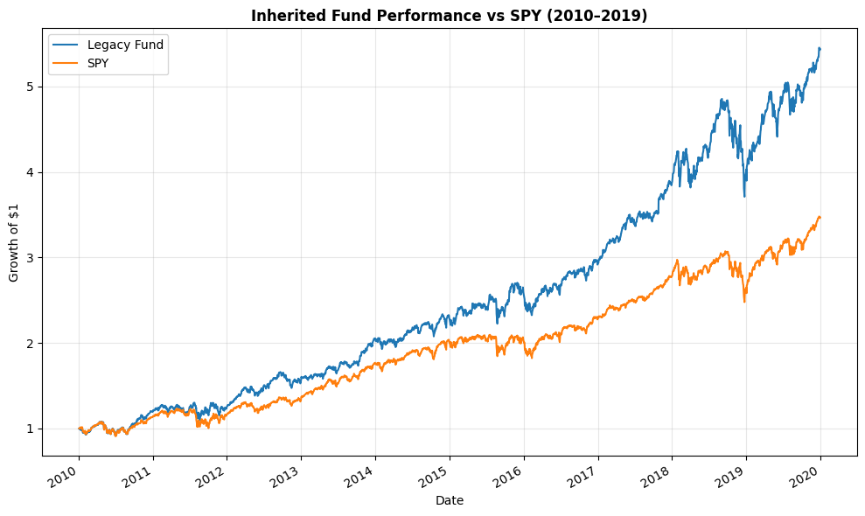
Case setup
Fund Context
Equity-only fund, 10 stocks
Inception: Jan 2010 | Initial Capital: $1M
Our Role
Manager Takeover: Jan 2020
Redesign using pre-2020 data only
Evaluation Framework
Out-of-sample: 2020-2025
Comparison: Legacy vs. Static vs. Active
Benchmark: SPY
Notes:
Kjellen

Slide 5
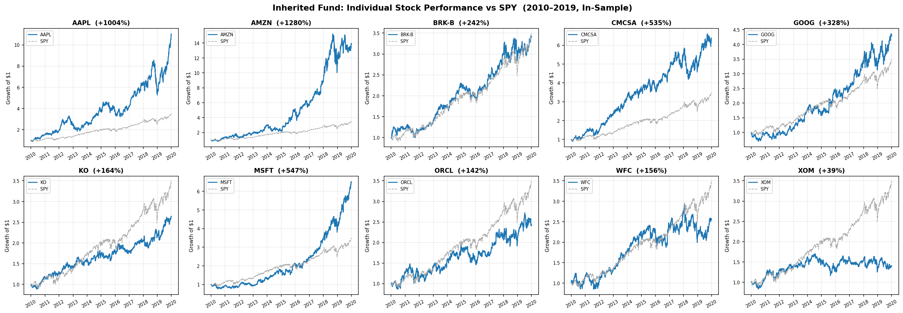
Inherited Fund
Notes:
Kjellen

Slide 6
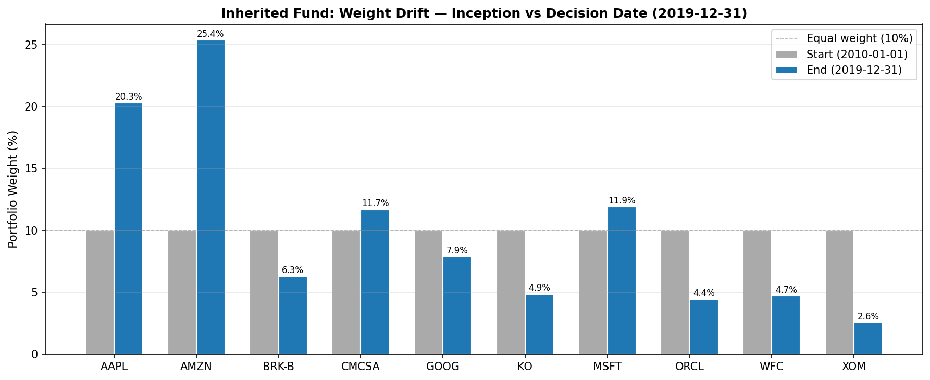
Inherited Fund Diagnosis
Inherited Fund Takeaways (In-Sample):
Dominant holdings: AAPL (~20%), AMZN (~25%)
Key Risk: High concentration in tech (~50%)
Performance: Strong returns (~18.48%), but driven by a few stocks
Annualized Return | Annualized Volatility | Sharpe | Max Drawdown
18.48% | 16.65% | 1.11 | -23.59%
Notes:
Kjellen

Slide 7
Stock Screening Criteria
Screening Framework:
Market Cap > $50B
3+ Consecutive years of positive net income
Identifiable competitive moat (brand, network effect, cost advantage, etc.)
Max 2-3 holdings per GICS sector
Sample of Stock Candidates
Candidate | Sector
V | Financials
MA | Financials
JPM | Financials
WMT | Consumer Staples
COST | Consumer Staples
TGT | Consumer Stables
Notes:
Bailey

Slide 8
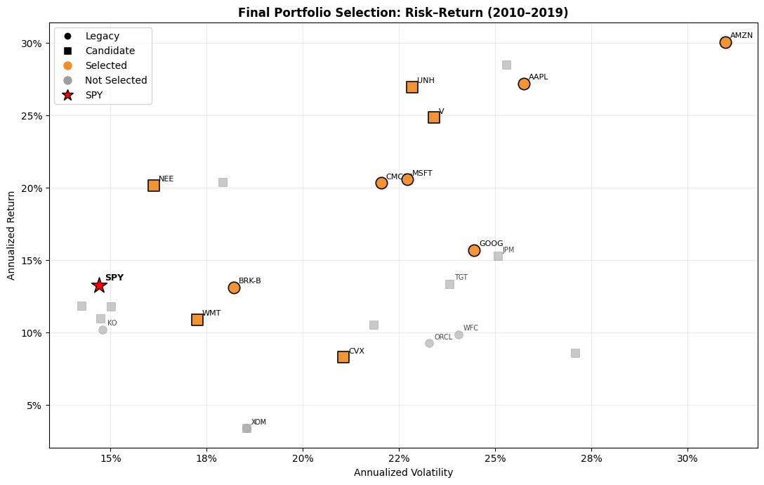
Portfolio Screening Process
Start: Legacy + Candidates
Stock Selection
Implement: Static & Active
Key Decisions
Criteria: Market Cap >$50B, 3+ Years Positive NI, Competitive Moat, Sector Cap
Kept: AAPL, AMZN, MSFT, GOOG, CMSA
Dropped: XOM, KO, ORCL, WFC, BRK-B
Added: V, WMT, CVX, NEE, UNH
Notes:
Beau

Slide 9
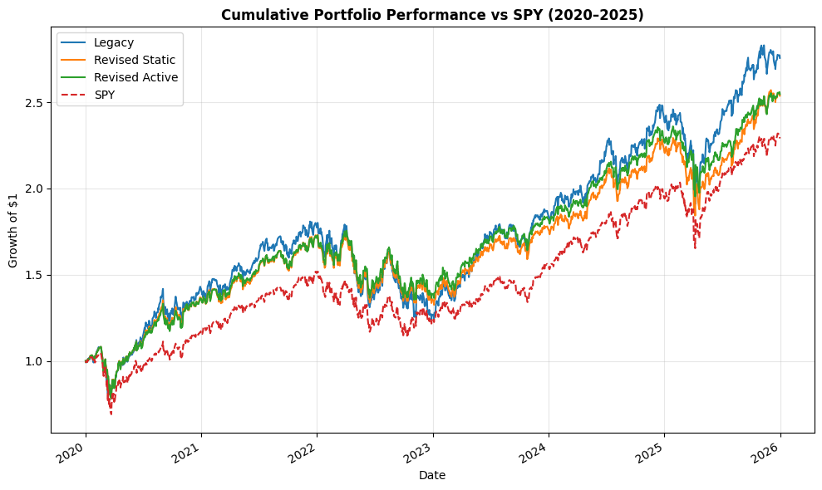
Revised Portfolio
Final weights are non-equal, favoring high-alpha stocks
Higher Sharpe & Sortino (Revised Active Leads)
Lower Drawdowns vs. Legacy
Reduced Concentration Risk
Portfolio | Sharpe | Max Drawdown
Legacy | 0.759 | -31.38%
Revised Active | 0.793 | -27.83%
Implement the revised portfolio using a Sharpe-tilt strategy to improve risk-adjusted performance and reduce drawdowns.
Notes:
Beau

Slide 10
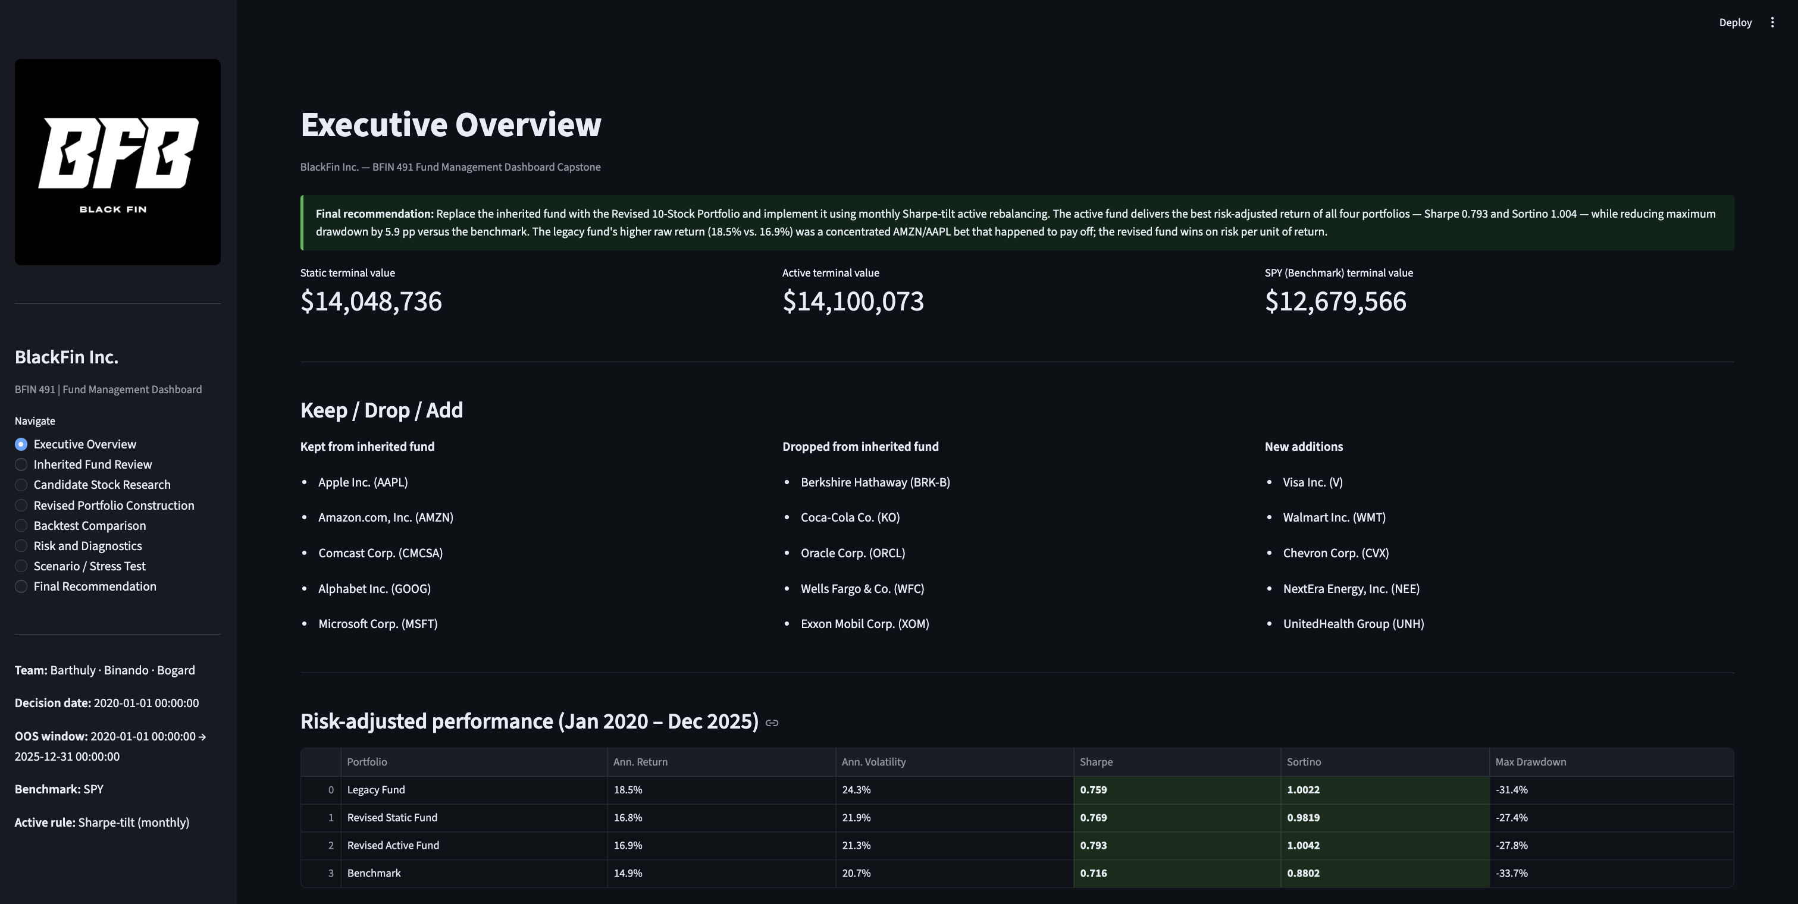
Limitations & Dashboard
Historical Dependence
Limited Universe (10 stocks)
Model Simplicity
Transaction Costs
Live demo:
Fund overview | Backtest Comparison | Risk Diagnostics
Notes:
Beau

Slide 11
THANK YOU!
AND A SPECIAL THANKS TO PROFESSOR LI

Slide 12
References
PwC. “Global Investor Survey 2025 .” Investors look for resilience and innovation in 2026, December 8, 2025. https://www.pwc.com/gx/en/issues/c-suite-insights/global-investor-survey.html.
Sun Life Global Investments. “What Is the Vix Volatility Index & Why It Matters.” Investor Education, May 28, 2025. https://www.sunlifeglobalinvestments.com/en/insights/investor-education/understanding-market-volatility/what-is-the-vix-volatility-index-and-why-it-matters/.
Yahoo Finance. “Historical Price Data.” Accessed May 2, 2026. https://finance.yahoo.com/.

