Slide 1
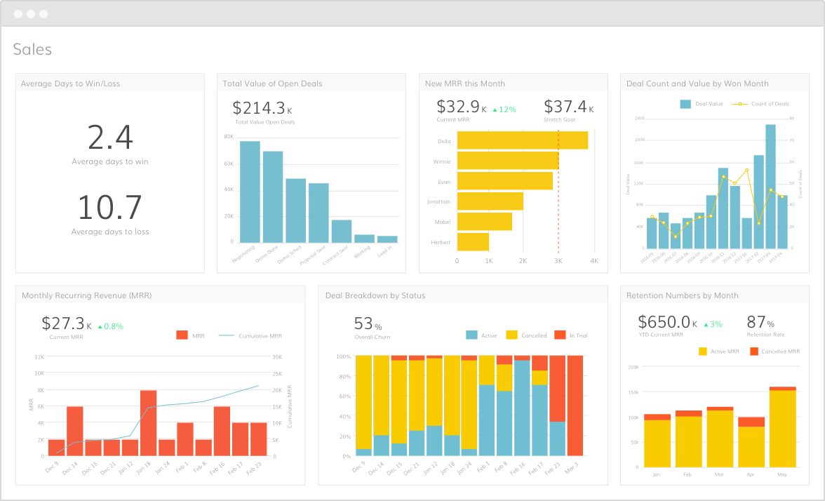
Sales Dashboard for a fashion store chain
Team Members:
Michael Nicodemus
Sai Tong
Beau Batchelor
Sujit Singh

Slide 2
Agenda
Sales Dashboard
  Project Summary
  Dashboard Views
  Libraries
  Stories
  Q & A
2

Slide 3
Project Summary
Overview
Create Visualizations for Sales Data on Interactive Dashboards for a Fashion store chain in the US.
Approach and Data Collection:
Acquire sample historical sales data from a Fashion Store Chains located in many cities in United States.
Deploy Dashboards Portal on Heroku cloud platform. Use online mLab MongoDB database to store sales data.
Use Javascript, Python, HTML, CSS to create interactive visualizations with Geo Map, Tabular and Line charts.

Slide 4
Dashboard Views
Home Page
Line Chart
Geo Map
Tabular View

Slide 5
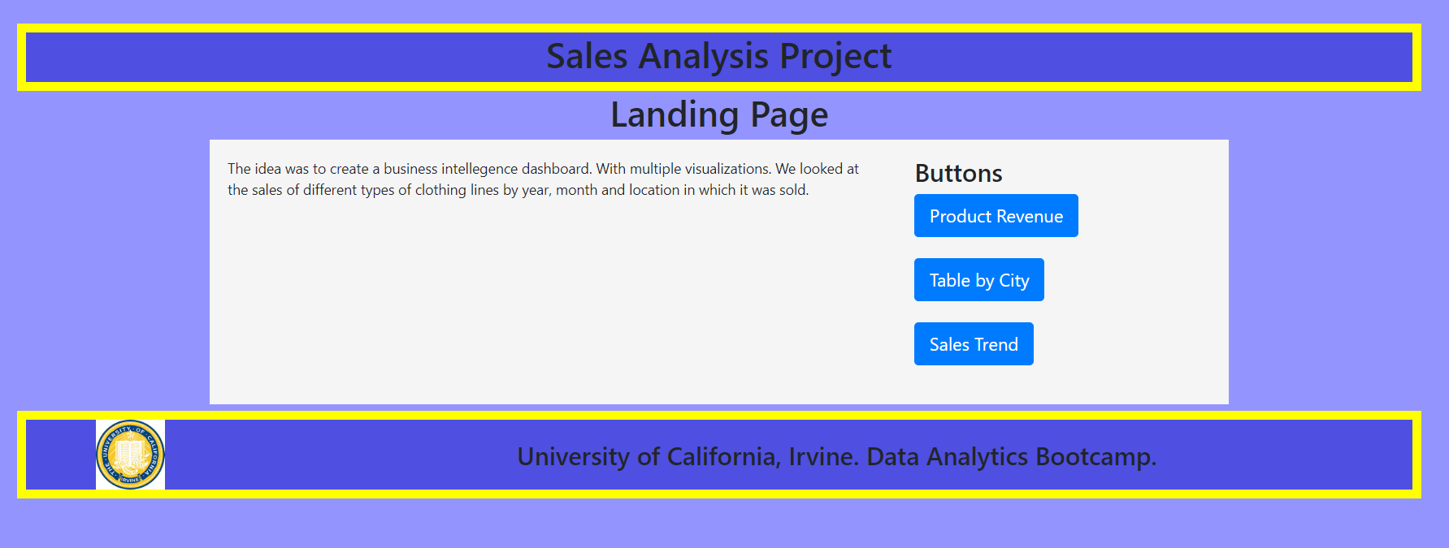
Dashboard Views
Home Page

Slide 6
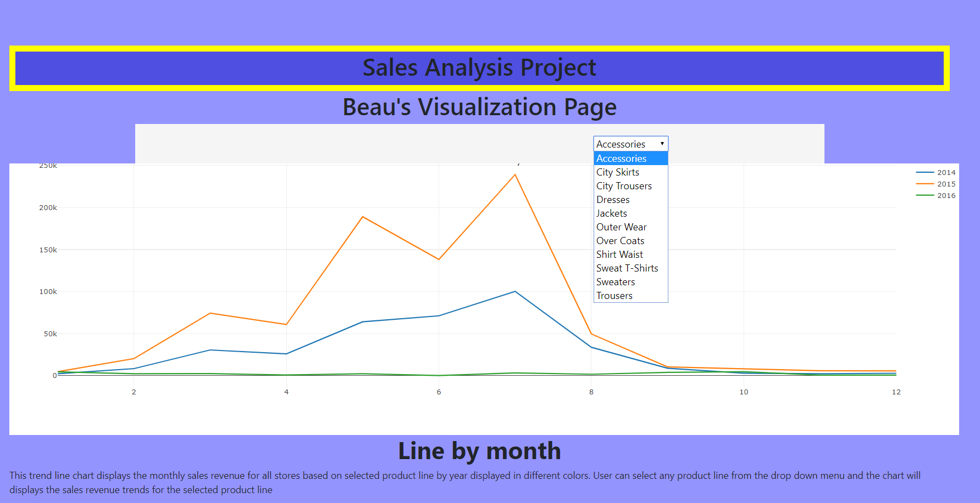
Dashboard Views
Sales Trend

Slide 7
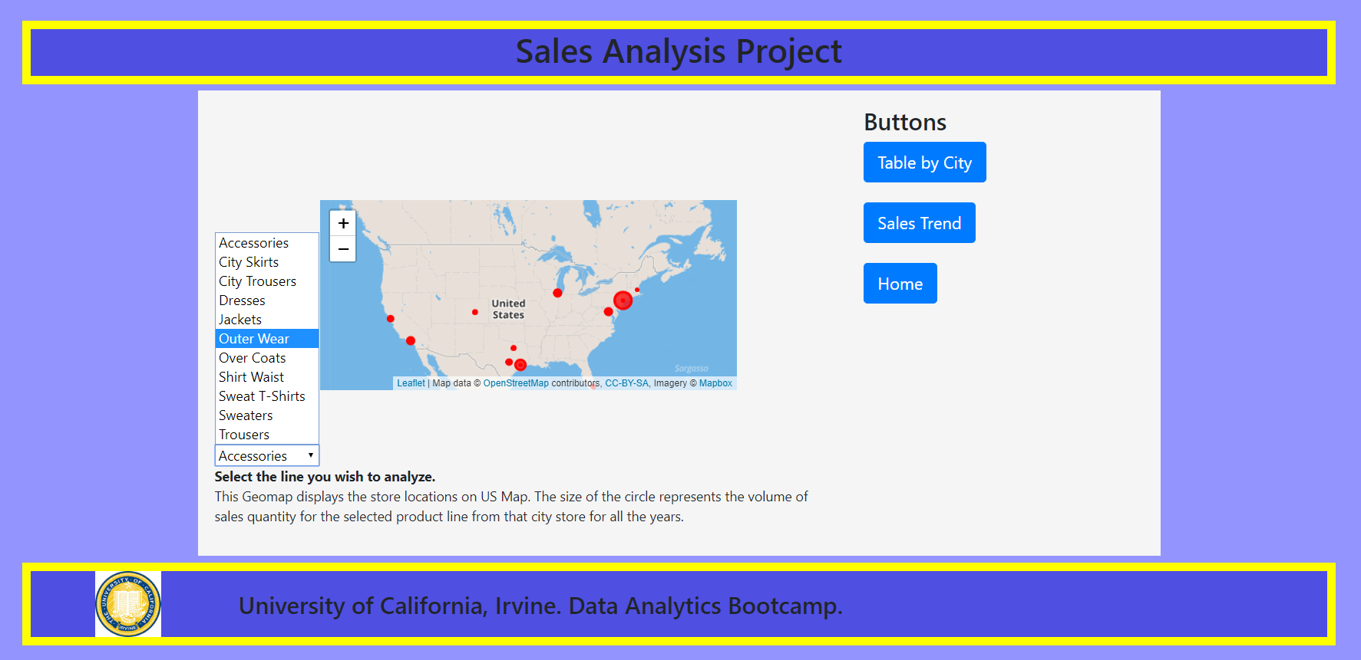
Dashboard Views
Geo Map

Slide 8
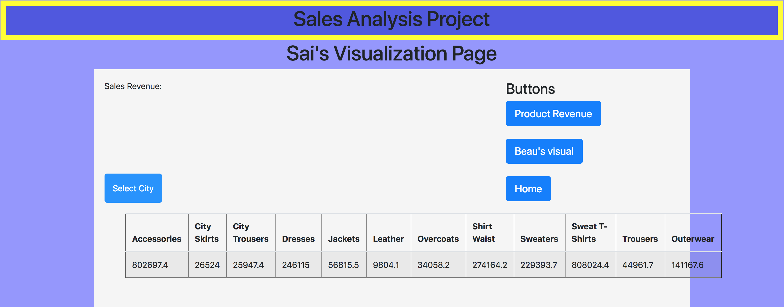
Dashboard Views
Tabular View

Slide 9
Libraries Used
Python Pandas
GitHub
D3.js
PyMongo
Flask
Plotly
Geomap
React

