Slide 1

Let your PostgreSQL data
travel back in time
French acronym for
"Enregistrement des Mises A Jour"
i.e. "updates recording"

Slide 2
E-Maj, what is it for?
E-Maj allows the data content to travel back in time, with a table level granularity
By recording content changes on sets of application tables, it is possible to
  Count them
  Easily look at them
  Revert them
  Replay them
Usable with
  Applications in test or in production
  Databases of all sizes

Slide 3
2 main components
Emaj_web
A web client : Emaj_web
(php)
Other clients
(psql,...)
SQL
SQL
Database
The PostgreSQL extension emaj
(PL/pgSQL)
emaj
Open Source, GPL license

Slide 4
Concepts
Tables Group
  A set of tables and/or sequences having the same life cycle
  Belonging to one or several schemas
  The main object manipulated by users
Mark
  Stable point in the life of a “tables group”
E-Maj Rollback
  Positioning a “tables group” at a previously set “mark” state

Slide 5

An updates recording based on triggers
Log triggers and functions
SQL
Insert
Application
tables
Log tables
Insert Update Delete
Truncate
Rollback function
Delete
Insert

Slide 6
Main objects
emaj_viewer
role
Log triggers and functions
E-Maj
environment
SQL
Insert
Application
tables
Log tables
Insert Update Delete
Truncate
Rollback function
Tables group
Delete
Insert
emaj_adm
role

Slide 7
Install E-Maj
Download and install the extension
Log on the target database as super-user and execute
  CREATE EXTENSION emaj CASCADE;
Alternative installation (for DBaaS cloud environments)
  psql … -f sql/emaj-<version>.sql

Slide 8
Initialization
For each group:
  1) Create an empty group
  SELECT emaj_create_group ();
  2) Add tables and sequences
  SELECT emaj_assign_tables ();
  SELECT emaj_assign_sequences ();
    Create 1 log tables, sequences, triggers and functions
NB: SELECT emaj_drop_group ()
  … drop an existing group

Slide 9
Recording and setting marks
“Starting” a group
  emaj_start_group () activates the log triggers and sets a first mark
Setting a mark
  emaj_set_mark_group () sets an intermediate mark
“Stopping” a group
  emaj_stop_group () deactivates the log triggers
  => a rollback is not possible anymore

Slide 10
Examine logs
Each application table has its own log table
  Can be examined to look at changes
  By default emaj.<schéma>_<table>_log
A log table contains
  The same columns as its related application table
  And some technical columns to know who did what change and when

Slide 11
2 “E-Maj rollback” modes
2 functions pour reset a tables group in the state it had at a given mark
« simple Rollback »
  emaj_rollback_group()
  Log triggers are deactivated during the operation
  Canceled logs and marks are deleted
« logged Rollback »
  emaj_logged_rollback_group()
  Log triggers are not deactivated during the operation
  Canceled logs and marks are kept
A logged rollback can be canceled
Tables and sequences may travel back and forth in time !
All what is after the rollback target mark is “forgotten”

Slide 12
A typical E-Maj usage (production batch processing)
Abort !
Proc. 1
Proc. 2
Proc. 3
App. tables
start_group
set_mark
set_mark
rollback_group
Log tables

Slide 13
A typical E-Maj usage in test environment
4 processings to test in sequence
After test 3, a new version of processing 2 must be re-tested
Then perform the remaining tests
M1
M2
M3
M4
Proc. 1
Proc. 2
Proc. 3
Rlbk
Proc. 2’
Rlbk
Proc. 4
emaj_rollback_group(M4)
emaj_logged_rollback_group(M2)

Slide 14
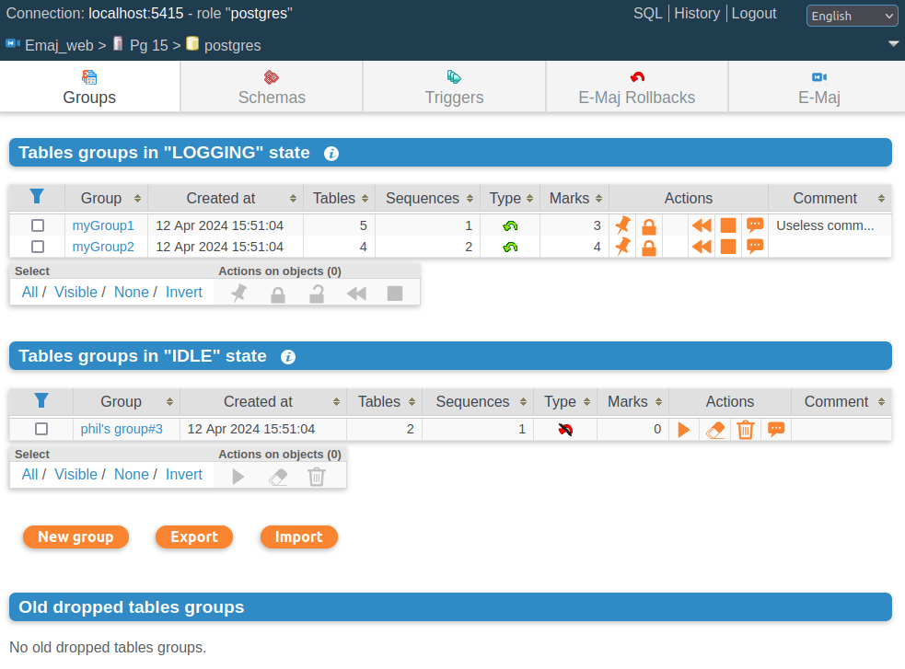
Emaj_web
For administrators and users
All E-Maj objects (groups, marks...) and their attributes
(almost) all possible actions on E-Maj objects
Tables groups list

Slide 15
And much more
Functions to:
  Manage groups (rename, comment, protect)
  Manage marks (rename, delete, comment, protect)
  Analyze or get statistics about data changes
  Manage E-Maj rollback operations
3 clients to monitor recorded tables changes, execute E-Maj rollbacks with parallelism, and monitor the rollback operations

Slide 16

It’s demo time
Ready to travel in time ?

Slide 17
Current limitations
Minimum PostgreSQL version = 12
Every application table belonging to a “rollbackable” group needs a PRIMARY KEY
DDL statements cannot be logged or cancelled by E-Maj
FOREIGN KEYs defined on partitionned tables are incompatible with E-Maj rollbacks

Slide 18
The characteristics which drove the design
Reliability
  Absolute data integrity after updates cancellation
Ease of use
  Simple concepts
  SQL API for automation
  Logs easy to read
Performance
  Limited log overhead
  Acceptable “rollback” duration
Security
  2 dedicated roles
Maintenability
  PL/pgSQL (no changes in Postgres core)

Slide 19

To go further
Download
  pgxn.org : https://pgxn.org/dist/e-maj/
    Includes a much more detailed presentation
  RPM repo : yum.postgresql.org
Projects on github.com
  E-Maj : https://github.com/dalibo/emaj
  Emaj_web : https://github.com/dalibo/emaj_web
On-line Documentation
  In English (or French) : https://emaj.readthedocs.io/en/latest/

