Slide 1

Let your PostgreSQL data
travel back in time
French acronym for
"Enregistrement des Mises A Jour"
i.e. "updates recording"

Slide 2
E-Maj, what is it for?
E-Maj allows the data content to travel back in time, with a table level granularity
By recording updates on sets of application tables, it is possible to
  Count them (statistic function),
  Easily view them (audit function),
  Revert them ("rollback" function),
  Replay them (script generation, or revert a revert...)
Usable with
  applications in test or in production
  databases of all sizes

Slide 3
The gains
In test environment
  Helps the application tests management by providing a quick way to
    Examine updates generated by the application, for debugging purpose
    Cancel updates generated by the application in order to easily repeat tests
In production environment
  Allows to cancel processings
    Without being obliged to save and restore the instance by pg_dump/pg_restore or by physical copy
    With a finer granularity
  Avoids to loose entire batch processing nights by helping the recovery after failure
  Very interesting with large tables and few updates

Slide 4

The components
E-Maj, the heart
  A PostgreSQL extension
  Open Source, under GPL licence
  Download from pgxn.org - https://pgxn.org/dist/e-maj/
  Sources available on github.com - https://github.com/dalibo/emaj
Emaj_web
  A web client - https://github.com/dalibo/emaj_web
The online documentation
  In English (or French) - https://emaj.readthedocs.io/en/latest/

Slide 5
The characteristics which drove the design
Reliability
  Absolute data integrity after updates cancellation
  Management of all usual objects (tables, sequences, contraints,...)
Ease of use for DBAs, production people, application developpers and testers,...
  Easy to understand and use
  Easy to integrate into an automatized production (thus scriptable)
Performance
  Limited log overhead
  Acceptable “rollback” duration
Security
Maintenability

Slide 6
Concepts
Tables Group = a set of tables and/or sequences belonging to one or several schemas and having the same life cycle ; it's the only object manipulated by users
Mark = stable point in the life of a tables group, whose state can be set back ; identified by a name
E-Maj Rollback = positioning of a tables group at a previously set mark state
  NB: this concept is different from the transaction rollbacks performed by the RDBMS
    a “RDBMS-rollback” cancels the current transaction
    a “E-Maj rollback” cancels updates from several commited transactions

Slide 7
Concepts (2)
By default, a tables group is created as rollbackable
A tables group may be created as audit-only
  E-Maj rollbacks are not possible
  Useful to capture data changes for tables without PRIMARY KEY or of type UNLOGGED
Log session = time interval when a tables group capture data changes ; it is bounded by the tables group start and stop actions.

Slide 8

An updates recording based on triggers
Log triggers and functions
SQL
Insert
Application
tables
Log tables
Insert Update Delete
Truncate
Rollback function
Delete
Insert

Slide 9
Main objects
emaj_viewer
role
Log triggers and functions
E-Maj
environment
SQL
Insert
Application
tables
Log tables
Insert Update Delete
Truncate
Rollback function
Tables group
Delete
Insert
emaj_adm
role

Slide 10
Management of application sequences
Sequence increments are not individually recorded
At set mark time
  The state of each sequence of the group is stored into an internal table
At E-Maj rollback time
  Each sequence is reset to its state recorded at the targeted mark

Slide 11
Install E-Maj
Standart install
  pgxn install E-Maj --sudo
  Log on the target database as super-user and execute
    CREATE EXTENSION emaj CASCADE;
Install on DBaaS cloud environment
  Download from pgxn.org and unzip the extension
  psql … -f sql/emaj-<version>.sql
This adds to the database
  the extensions dblink et btree_gist if needed
  1 schema, named 'emaj', with about 190 functions, 19 technical tables, 12 types, 1 view, 1 sequence, 3 event triggers
  2 roles

Slide 12
Initialization
For each group:
  1) Create an empty group
  SELECT emaj_create_group (group, is_rollbackable [,comment]);
  2) Add tables and sequences
  SELECT emaj_assign_tables (schema, inclusion regexp, exclusion regexp, group);
  SELECT emaj_assign_sequences (schema, inclusion regexp, exclusion regexp, group);
    Ex: all tables of a schema except those suffixed by sav:
    '.*', 'sav$'
    Create for each application table: 1 log table, 1 log sequence, 1 log trigger and its function
NB: SELECT emaj_drop_group (group)
  … drop an existing group

Slide 13
The 3 main functions to manage groups
“Starting” a group
  emaj_start_group (group, mark)
  activates the log triggers and sets a first mark
Setting a mark
  emaj_set_mark_group (group, mark [,comment])
  sets an intermediate mark
“Stopping” a group
  emaj_stop_group (group [,mark])
  deactivates the log triggers => a rollback is not possible anymore
The % character in a mark name represents the current date and time

Slide 14
Examine logs
Examining log tables may largely help the application debuging
Each application table has its own log table
  emaj_<schema>.<table>_log
A log table contains
  The same columns as its related application table
  And some technical columns
A single row change in an application table generates
  1 log row for an INSERT (image of the new row)
  1 log row for a DELETE or a TRUNCATE (image of the old row)
  2 log rows for an UPDATE (image of the old and the new rows)
A TRUNCATE generates also a single log row

Slide 15
Log tables technical columns
6 technical columns at the end of each log row
  emaj_verb : SQL statement type - INS/UPD/DEL/TRU
  emaj_tuple : row type - OLD/NEW
  emaj_gid : internal sequence number
  emaj_changed : time of the update - clock_timestamp()
  emaj_txid : transaction identifier - txid_current()
  emaj_user : connection role of the client - session_user
… and some others can be added
It is possible to identify clients and transactions, and analyze the timing of the program execution

Slide 16
Generated columns on application tables
(GENERATED ALWAYS AS expression)
Type | Physical (STORED) | Virtual
Minimum Postgres version | 12 | 18
Structure in log table | A standart column
Content in log table | Expression result | NULL
SQL visualisation of the changes impact | Direct examination of the log table column | Use the expression
Expression change (ALTER TABLE … ALTER COLUMN … SET EXPRESSION ...) | Blocked by E-Maj (*) | Possible
Expression drop (ALTER TABLE … ALTER COLUMN … DROP EXPRESSION) | Possible, but risky for data integrity at subsequent E-Maj rollback operations | Not applicable (forbiden by PostgreSQL)
Column transformation: generated ⇔ standart (ALTER TABLE … DROP COLUMN …, ADD COLUMN ...) | Detected by E-Maj at mark set and rollback attempts (*)
(*) the table must be temporarily removed from its group

Slide 17
Counting recorded data changes
3 statistical functions, at tables group level and for a given marks interval
  emaj_log_stat_group (group, start_mark, end_mark)
  quickly returns an estimate of recorded changes per table
  emaj_detailed_log_stat_group (group, start_mark, end_mark)
  scans log tables and returns precise statistics on their content, per table, statement type (INSERT / UPDATE / DELETE / TRUNCATE) and ROLE
  emaj_sequence_stat_group (group, start_mark, end_mark) returns the number of increments per sequence

Slide 18
Counting recorded data changes (2)
2 functions quickly return an estimate of recorded changes for one table for each elementary marks interval on a given time frame
  emaj_log_stat_table (schema, table, start_date_time, end_date_time)
  emaj_log_stat_table (schema, table, start_group, start_mark, end_group, end_mark)
2 functions return the number of increments for one sequence for each elementary marks interval on a given time frame
  emaj_log_stat_sequence (schema, sequence, start_date_time, end_date_time)
  emaj_log_stat_sequence (schema, sequence, start_group, start_mark, end_group, end_mark)

Slide 19
Cancel updates : the “simple” rollback
A “rollback” function allows to reset a tables group in the state it had at a given mark
  emaj_rollback_group (group, mark [, false [, comment]])
How this works
  Log triggers are deactivated during the operation
  Each table is reset to its mark state using an optimised algorithm
  Application sequences are reset to their mark state
  Takes into account the foreign keys, if any
  The canceled logs and marks are deleted
  => all what is after the rollback mark is forgotten

Slide 20
An optimised rollback algorithm
It processes each primary key value only once
emaj_set_mark_group(M1)
emaj_set_mark_group(M2)
emaj_set_mark_group(M3)
emaj_rollback_group(M2)
Del
3
Del
6
Ins
1
Ins
2
Ins
1
Ins
2
Ins
3
Upd
2->4
Upd
4->5
Del
1
Upd
5->6
Application updates
Rollback updates

Slide 21
A typical E-Maj usage (production batch processing)
Abort !
Proc. 1
Proc. 2
Proc. 3
App. tables
start_group
set_mark
set_mark
rollback_group
stop_group
Log tables

Slide 22
Cancelling updates : the “logged” rollback
emaj_logged_rollback_group (group, mark[, false [, comment]])
Different from the “simple” rollback
  Log triggers are NOT deactivated during the operation
  => the updates generated by the rollback are recorded
  Cancelled logs et marks are NOT deleted
So we can revert an E-Maj rollback ! And more generally let a tables group travel back and forth in time !
2 marks are automatically set before and after the rollback
  RLBK_<rollback id>_START and RLBK_<rollback id>_DONE
During the rollback, tables remain accessible in read mode

Slide 23
A typical E-Maj usage in test environment
4 processings to test in sequence
After test 3, a new version of processing 2 must be re-tested
Then perform the remaining tests
RLBK...START
RLBK...DONE
M1
M2
M3
M4
Proc. 1
Proc. 2
Proc. 3
Rlbk
Proc. 2’
Rlbk
Proc. 4
emaj_rollback_group(M4)
emaj_logged_rollback_group(M2)

Slide 24
Estimating an E-Maj rollback duration
In order to know if we have enough time to perform the operation or if another way to recover would be more efficient
A function estimates the time needed to rollback a group to a given mark
  emaj_estimate_rollback_group (group, mark)

Slide 25
Executing a parallel E-Maj rollback
A perl client performs rollbacks with parallelism
  emajParallelRollback.pl -d <database> -h <host> -p <port> -U <user> -W <password> -g <group_name or groups_list> -m <mark> -s <nb_sessions> [-l] [-c comment>]
Automatically spreads the tables to process into a given number of parallel sessions
All sessions belong to a single transaction (2PC)
  => max_prepared_transactions >= nb sessions
Needs perl software with its PostgreSQL extension

Slide 26
Monitoring E-Maj rollbacks in execution
A function
  SELECT * FROM emaj.emaj_rollback_activity ();
  returns
    The characteristics of rollbacks (group, mark...)
    Their state
    Their current duration
    An estimate of the remaining duration and the already executed %
Needs to setup the value of the “dblink_user_password” parameter in the emaj_param table

Slide 27
Monitoring E-Maj rollbacks
A perl client to monitor the executing or completed rollbacks
  emajRollbackMonitor.pl -d <database> -h <host> -p <port> -U <user> -W <password> -n <nb_iterations> -i <refresh_rate_in_seconds> -l <nb_completed rollbacks> -a <completed_rollbacks_history_depth_in_hours>
E-Maj (version 4.2.0) - Monitoring rollbacks activity
---------------------------------------------------------------
21/03/2023 - 08:31:23
** rollback 34 started at 2023-03-21 08:31:16.777887+01 for groups {myGroup1}
status: COMMITTED ; ended at 2023-03-21 08:31:16.9553+01
** rollback 35 started at 2023-03-21 08:31:17.180421+01 for groups {myGroup1}
status: COMMITTED ; ended at 2023-03-21 08:31:17.480194+01
-> rollback 36 started at 2023-03-21 08:29:26.003502+01 for groups {group20101}
status: EXECUTING ; completion 85 %; 00:00:20 remaining

Slide 28
Consolidate a “logged” rollback
“Consolidate” a rollback means transform a “logged rollback” into a “simple rollback”
Intermediate logs and marks are deleted, recovering some place in the logs
  emaj_consolidate_rollback_group (groups, end_rollback_mark)
Tables can be updated during the consolidation
A function returns the list of consolidable rollbacks
  emaj_get_consolidable_rollbacks ()

Slide 29
Example of E-Maj rollback consolidation
...M2...START
...M2...DONE
M1
M2
M3
M4
upd log
upd log
upd log
rlbk log
upd log
upd log
emaj_logged_rollback_group(M2)
emaj_consolidate_rollback_group(...M2...DONE)

Slide 30

Being protected against unattended E-Maj rollbacks
2 functions to manage the protection of a tables group
  emaj_protect_group (group)
  emaj_unprotect_group (group)
2 functions to manage the protection of a mark
  emaj_protect_mark_group (group, mark) blocks any attempt to rollback to a mark prior the protected mark
  emaj_unprotect_mark_group (group, mark)
set_mark M2
set_mark M1
protect_mark M2
set_mark M3
rollback M2
rollback M1
OK
Refused

Slide 31
The emajStat client to monitor changes recording
A perl client to count changes on tables and sequences since the latest mark of their group and since the previous display, in absolute value and changes per second
Many options to filter groups, tables and sequences, define the refresh parameters, …
  For the details: emajStat.pl --help
E-Maj (version 4.5.0) - Monitoring logged changes on database regression (@127.0.0.1:5412)
------------------------------------------------------------------------------------
2024/08/15 08:12:59 - Logging: groups=2/3 tables=11/11 sequences=4/4 - Changes since 1.004 sec: 0 (0.000 c/s)
Group name + Latest mark + Changes since mark + Changes since prev.
myGroup1 | Multi-1 (2024/08/15 08:12:38) | 359 (17.045 c/s) | 0 (0.000 c/s)
Table name + Group + Changes since mark + Changes since prev.
myschema1.mytbl1 | myGroup1 | 211 (10.018 c/s) | 0 (0.000 c/s)
myschema1.myTbl3 | myGroup1 | 60 ( 2.849 c/s) | 0 (0.000 c/s)
myschema1.mytbl2b | myGroup1 | 52 ( 2.469 c/s) | 0 (0.000 c/s)
myschema1.mytbl2 | myGroup1 | 27 ( 1.282 c/s) | 0 (0.000 c/s)
myschema1.mytbl4 | myGroup1 | 9 ( 0.427 c/s) | 0 (0.000 c/s)
Sequence name + Group + Changes since mark + Changes since prev.
myschema1.mytbl2b_col20_seq | myGroup1 | -5 (-0.237 c/s) | 0 (0.000 c/s)
myschema1.myTbl3_col31_seq | myGroup1 | -20 (-0.950 c/s) | 0 (0.000 c/s)

Slide 32
emajStat logic and parameters
--include-groups
--exclude-groups
Filtre
sur les
noms
D
i
s
p
l
a
y
Tables
group in
“Logging”
state
Filter
on
names
Aggregation
Sort and
limit
g
--max-groups
Filter
on
names
Look at
log
sequences
Sort and
limit
Tables
in groups
t
--include-tables
--exclude-tables
--max-tables
Sequences
in groups
S
Filter
on
names
Look at
sequences
Sort and
limit
S
--include-sequences
--exclude-sequences
--max-sequences

Slide 33
Analyse recorded data changes
Dump on files, by COPY, in a given directory, a log tables extracts and sequences of a group
  emaj_dump_changes_group (group, start_mark, end_mark, options_list, tables/seq_array, directory)
Generate SQL to extract recorded changes between 2 marks for all or some tables or sequences of a group
  In the instance disk space :
  emaj_gen_sql_dump_changes_group (group, start_mark, end_mark, options_list, tables/seq_array, file)
  In an emaj_temp_sql temporary table, for any use by any client :
  emaj_gen_sql_dump_changes_group (group, start_mark, end_mark, options_list, tables/seq_array)

Slide 34
Analyse data changes: the options
Common to emaj_dump_changes_group() and emaj_gen_sql_dump_changes_group()
  CONSOLIDATION = NONE (default) | PARTIAL | FULL
  EMAJ_COLUMNS = ALL | MIN | (list) : selects E-Maj technical columns
  COLS_ORDER = LOG_TABLE | PK : sets the order of delivered columns
  ORDER_BY = PK | TIME : sets the order of delivered rows, by PK or emaj_gid
  SEQUENCES_ONLY : excludes tables
  TABLES_ONLY : excludes sequences
For emaj_dump_changes_group()
  COPY_OPTIONS = (options list) : for the COPY TO generation
  NO_EMPTY_FILES : removes empty files (tables without changes)
For emaj_gen_sql_dump_changes_group()
  PSQL_COPY_DIR = directory : generates a \copy for each statement, with this directory
  PSQL_COPY_OPTIONS = (liste options) : sets the \copy options
  SQL_FORMAT = RAW | PRETTY : formats each statement on 1 or several lines

Slide 35
Analyse data changes: the consolidated vision of changes
The consolidated vision of changes provides a net outcome of recorded changes, for a given time range and for each primary key
  At most: 1 “OLD” row (the initial state) and 1 “NEW” row (the final state)
  Ex: if UPDATE ‘A’→’B’ then UPDATE ‘B’→’C’, row OLD = ‘A’ and row NEW = ‘C’
Therefore each examined table must have an explicit PK
2 consolidation kinds
  “Partial consolidation”: without taking into account the columns content
  “Full consolidation”: examining the changed data
    For a given PK, no change is reported if all columns of both “OLD” and “NEW” rows are equal
    Ex: no change reported for a given PK if UPDATE ‘A’→’B’ then UPDATE ‘B’→’A’, or if INSERT then DELETE
Sequences
  1 “OLD” row and 1 “NEW” row for the initial and final sequence’s characteristics
  In “Full consolidation” mode, no row is returned if the sequence has not been changed

Slide 36
Analyse data changes: emaj_temp_sql temporary table structure
CREATE TEMP TABLE emaj_temp_sql (
sql_stmt_number INT, -- Statement number
-- (0 for the initial comment)
sql_line_number INT, -- Line number within the statement
-- (0 for the initial comment of the statement)
sql_rel_kind TEXT, -- Relation kind: "table" or "sequence"
sql_schema TEXT, -- Schema name
sql_tblseq TEXT, -- Table or sequence name
sql_first_mark TEXT, -- Fist mark name (for the table/sequence)
sql_last_mark TEXT, -- Last mark name (for the table/sequence)
sql_group TEXT, -- Tables group owning the relation
sql_nb_changes BIGINT, -- Estimated number of changes to process
sql_file_name_suffix TEXT, -- File name suffix
sql_text TEXT, -- SQL statement text
sql_result BIGINT -- Column dedicated to the caller for its operations
-- (some other can be added with ALTER TABLE)
);
An index on the 2 first columns

Slide 37
Replay data changes
Generate a sql script replaying the elementary recorded changes between 2 marks, for some or all tables and sequences of a group
  In the instance disk space:
  emaj_gen_sql_group (group, start_mark, end_mark, dest_file [,tables/seq_list])
  Anywhere, with psql:
  SELECT emaj_gen_sql_group (group, start_mark, end_mark, NULL [,tables/seq_list])
  \copy (SELECT * FROM emaj_sql_script) TO ‘dest_file’
Useful in test environment to “replicate” the changes produced by a processing

Slide 38
The tables group life cycle
« unknown »
Drop group
Create group
« idle »
Stop group
Start group
« logging »
Rollback group
Set a mark

Slide 39
Tables groups dynamic adjustment
To add one or several tables
  emaj_assign_table(schema, table, group, properties [, mark])
  emaj_assign_tables(schema, tables list, group, properties [, mark])
  emaj_assign_tables(schema, selection filter, exclusion filter, group, properties [, mark])
Properties:
  JSON format
  To define the priority and the tablespaces for log data and index
Selection and exclusion filters: RegExp

Slide 40
Tables groups dynamic adjustment
Example
  emaj_assign_tables(‘myschema’, ‘tbl.*’,’_sav$’, ‘mygroup’, ‘{“priority”:1}’::json)
  assigns to the group ‘mygroup’ and with the priority 1 all tables of the schema ‘myschema’ whose name starts with ‘tbl’ and doesn’t end with ‘_sav’

Slide 41
Tables groups dynamic adjustment
Similarly:
  emaj_assign_sequence() and emaj_assign_sequences()
  emaj_modify_table() and emaj_modify_tables()
  emaj_move_table() and emaj_move_tables()
  emaj_move_sequence() and emaj_move_sequences()
  emaj_remove_table() and emaj_remove_tables()
  emaj_remove_sequence() and emaj_remove_sequences()

Slide 42
Impact of logging group structure changes on rollbacks
Table t2 removed at mark m3, t3 added at m2, t4 removed at m2 and added at m3
emaj_rollback_group(<groupe>,’m1’, true) would pr
m1
m2
m3
m4
t1
t2
]
t3
[
t4
]
[

Slide 43
Impact of logging group structure changes on statistics and content changes extracts
emaj_log_stat_group(<groupe>,’m1’,’m4’) and
emaj_dump_changes_group(<groupe>,’m1’,’m4’,...) would report:
m1
m2
m3
m4
t1
t2
]
t3
[
t4
]
[

Slide 44
Impact of logging group structure changes on the SQL scripts generation
emaj_gen_sql_group(<group>,’m1’,’m4’) would process:
m1
m2
m3
m4
t1
t2
]
t3
[
t4
]
[

Slide 45
Modify the structure of a table in a LOGGING group
For actions like: rename the table, change its schema, add/drop/rename a column, change a column type
The log table structure is impacted
3 steps
  Remove the table from its tables group
  ALTER TABLE
  Add the table into its tables group
Constraint: an E-Maj rollback to a prior mark will not be able to go beyond the structure change
Idem to rename a sequence of change its schema

Slide 46
Processing several groups in a single operation
Some “multi-groups” variants of functions
  emaj_start_groups (groups_array, … )
  emaj_stop_groups (groups_array, … )
  emaj_set_mark_groups (groups_array, … )
  emaj_rollback_groups (groups_array, … )
  emaj_logged_rollback_groups (groups_array, … )
  emaj_log_stat_groups (groups_array, … )
  emaj_gen_sql_groups (groups_array, … )
Allows to get marks shared by several groups
Both PostgreSQL syntaxes for groups arrays
  ARRAY['group 1', 'group 2', … ]
  '{"group 1", "group 2", … }'

Slide 47
Managing marks
Comment a mark for a group (add/modify/suppress)
  emaj_comment_mark_group (group, mark, comment)
Rename a mark
  emaj_rename_mark_group (group, old_name, new_name)
Delete a mark
  emaj_delete_mark_group (group, mark)
  If the deleted mark is the first one, logs prior the second one are deleted
Delete all marks prior a given mark
  emaj_delete_before_mark_group (group, mark)
  Deletes logs prior the mark (it may take a long time...)

Slide 48
Managing mark (2)
Search for marks
  emaj_find_previous_mark_group (group, date-time) returns the mark immediately preceeding a given date and time
  emaj_find_previous_mark_group (group, mark) returns the mark immediately preceeding a given mark
“EMAJ_LAST_MARK” represents the last set mark for a group
  Usable for all parameters defining an existing mark

Slide 49
Other actions on groups
Comment a group (add/modify/suppress)
  emaj_comment_group (group, comment)
Purge log tables of a stopped group (anticipating its next restart)
  emaj_reset_group (group)
Export / import tables groups configurations
  emaj_export_groups_configuration ()
  emaj_import_groups_configuration ()
Force a group stop (in case of problem with the normal stop function)
  emaj_force_stop_group (group)

Slide 50
Other actions on groups
Snap on files in a given directory, by COPY, all tables and sequences of a group
  emaj_snap_group (group, directory, copy_options)
3 useful functions to write idempotent scripts to
  create/drop a tables group
    emaj_does_exist_group (group)
  start/stop a tables group
    emaj_is_logging_group (group)
  Set a mark
    emaj_does_exist_mark_group (group, mark)
Erase histories about a dropped tables group
  emaj_forget_group (group)

Slide 51
Other actions
Get the current emaj extension version or drop the extension
  emaj_get_version ()
  emaj_drop_extension ()
Verify the good health of the E-Maj installation
  emaj_verify_all ()
Get the current log table of a given application table
  emaj_get_current_log_table ()
Manualy purge obsoletes traces
  emaj_purge_histories ()
Create/modify/delete a comment on a rollback
  emaj_comment_rollback ()
Export or import parameters configuration
  emaj_export_parameters_configuration ()
  emaj_import_parameters_configuration ()

Slide 52
Temporary or permanent logging?
Temporary logging = steps like
  emaj_start_group()
  repeat
    processiong
    emaj_set_mark()
  emaj_stop_group()
At next start, old logs are purged
But stops and starts set very heavy locks
Permanent logging = no repeated group stop/restart
  Obsolete data in log tables must be regularly deleted, using the emaj_delete_before_mark() function
The deletion can be costly if the volume of log to delete is big

Slide 53
For large databases...
Log tables and indexes can be stored into tablespaces
  2 optional properties set when assigning tables to groups

Slide 54
To ensure the reliability
No change in the PostgreSQL engine
Many systematic checks, in particular at group start, mark set or rollback times:
  Do all required tables, sequences, functions and triggers exist?
  Consistency of columns between the application tables and the related log tables (existence, type)?
Heavy locks on tables at start_group, set_mark_group and rollback_group, to be sure that no transaction is currently updating application tables
  The order of lock setting can be influence by a priority level defined for each table
Rollback all tables and sequences by a single transaction

Slide 55
To ensure the reliability (2)
“event triggers” block unintentional drops or some component changes (tables, sequences, functions...)
  2 functions to deactivate/reactivate the lock-in
  emaj_disable_protection_by_event_triggers ()
  emaj_enable_protection_by_event_triggers ()

Slide 56

Impact of application triggers on E-Maj rollbacks
group
Triggers of type BEFORE on a table belonging to a tables group
  Values really inserted into the database are recorded into the log
  => to be disabled at E-Maj rollback
Triggers of type AFTER updating a table belonging to the same tables group
  The rollback will reset both tables with the right content
  => to be disabled at E-Maj rollback
Other cases : study the impacts
SQL
Before
trigger
table
log
rollback
group
SQL
table_1
log_1
After
trigger
rollback
table_2
log_2

Slide 57
Impact of application triggers on E-Maj rollbacks
By default, application triggers are automatically disabled by E-Maj rollbacks
A trigger may be left in its state at rollback time if it is registered as is
2 properties for emaj_assign_table(), emaj_assign_tables(), emaj_modify_table() and emaj_modify_tables() functions to specify the triggers that must be ignored by the E-Maj rollback processing
  "ignored_triggers": ["trg1","trg2",…] lists trigger names
  "ignored_triggers_profiles": ["regexp1","regexp2",…] lists regular expressions that select trigger names

Slide 58
To contribute to the security
2 NOLOGIN roles whose rigths may be granted:
  emaj_adm for the E-Maj administration
  emaj_viewer to just look at E-Maj objects (logs, marks, statistics)
E-Maj objects are only created and handled by a super-user or a member of the emaj_adm role
No other right has to be granted on E-Maj schemas, tables and functions
Log triggers are created with the “SECURITY DEFINER” attribute
No need to give additional rights to application tables or sequences

Slide 59
Performances
Log overhead
  Highly depends on hardware and on the application read/write SQL ratio
  Typically a few % on elapse times
  But can be much higher on pure data loading
Rollback duration
  Of course depends on the number of updates to cancel
  Also highly depends on
    The hardware configuration
    Tables structure (row sizes, indexes, foreign keys, other constraints…)
  But almost always shorter than a logical restore

Slide 60
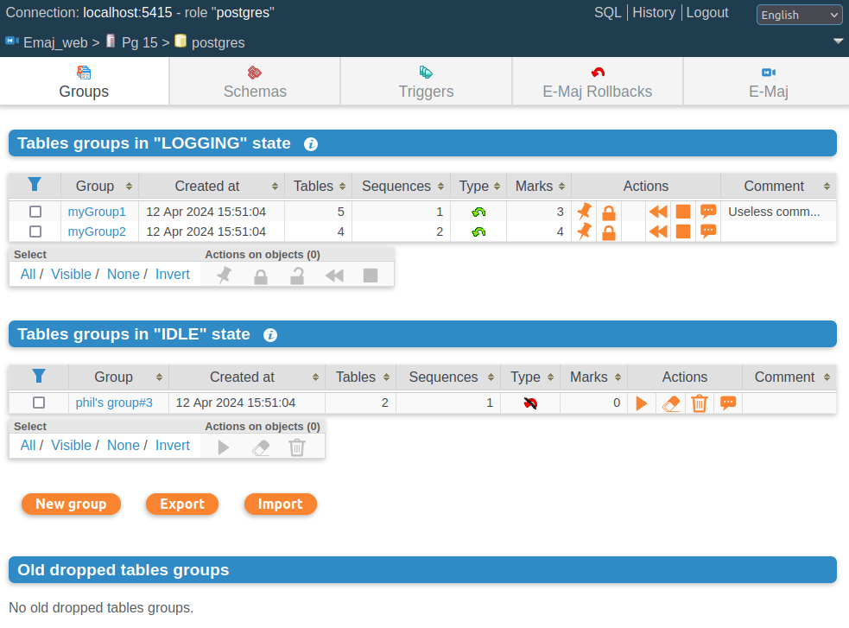
Emaj_web
For administrators and users
All E-Maj objects (groups, marks...) and their attributes
(almost) all possible actions on E-Maj objects
Tables groups list

Slide 61
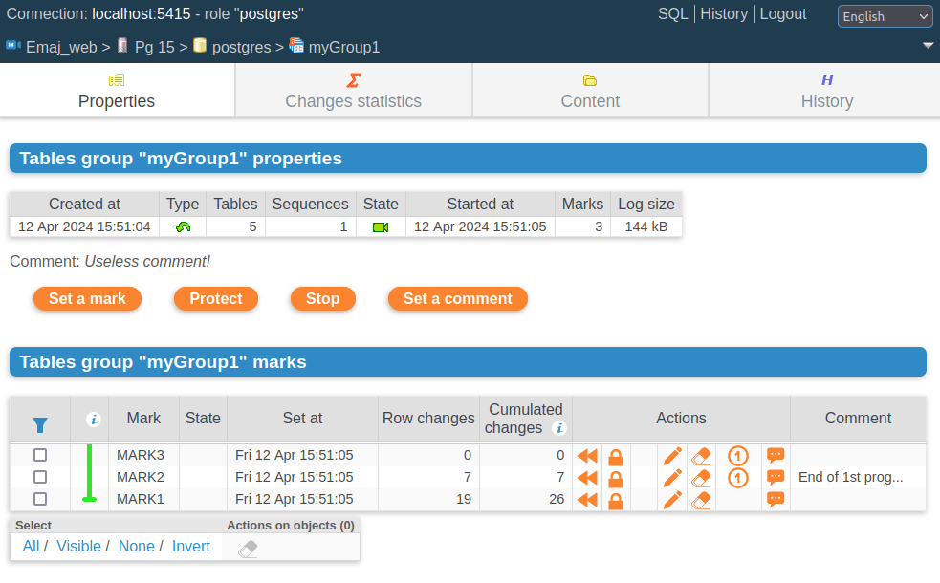
Emaj_web : tables group details

Slide 62
Current limitations
Minimum PostgreSQL version = 12
Every application table belonging to a rollbackable group needs a PRIMARY KEY
DDL statements cannot be logged or cancelled by E-Maj
  Changing a table’s structure requires to temporarily remove the table from its group
FOREIGN KEYs defined on partitionned tables are incompatible with E-Maj rollbacks
  => define them on each partition

Slide 63
To conclude...
Many more informations in
  the documentation: https://emaj.readthedocs.io/en/latest/index.html
  the README et CHANGES files
Many thanks to all contributors and users
Feel free to give any feedback through github or email (phb.emaj@free.fr)

