Slide 1
E-Maj
-
With this PostgreSQL extension,
let your data travel back in time
French acronym for
"Enregistrement des Mises A Jour"
i.e. "updates recording"

Slide 2
E-Maj, what is it for?
E-Maj allows the data content to travel back in time, with a table level granularity
By recording updates on sets of application tables, it is possible to
  Count them (statistic function),
  Easily view them (audit function),
  Revert them ("rollback" function),
  Replay them (script generation, or revert a revert...)
Usable with
  applications in test or in production
  databases of all sizes

Slide 3
The gains
In test environment
  Helps the application tests management by providing a quick way to
    Examine updates generated by the application, for debugging purpose
    Cancel updates generated by the application in order to easily repeat tests
In production environment
  Allows to cancel processings
    Without being obliged to save and restore the instance by pg_dump/pg_restore or by physical copy
    With a finer granularity
  Avoids to loose entire batch processing nights by helping the recovery after failure
  Very interesting with large tables and few updates

Slide 4

The components
E-Maj, the heart
  A PostgreSQL extension
  Open Source, under GPL licence
  Download from pgxn.org - https://pgxn.org/dist/e-maj/
  Sources available on github.com - https://github.com/beaud76/emaj
2 web clients
  The Emaj_web application - https://github.com/beaud76/emaj_web
  A plug-in for phpPgAdmin - https://github.com/beaud76/emaj_ppa_plugin
The online documentation
  In English (or French) - https://emaj.readthedocs.io/en/stable/

Slide 5
The characteristics which drove the design
Reliability
  Absolute data integrity after updates cancellation
  Management of all usual objects (tables, sequences, contraints,...)
Ease of use for DBAs, production people, application developpers and testers,...
  Easy to understand and use
  Easy to integrate into an automatized production (thus scriptable)
Performance
  Limited log overhead
  Acceptable “rollback” duration
Security
Maintenability

Slide 6
Concepts
Tables Group = a set of tables and/or sequences belonging to one or several schemas and having the same life cycle ; it's the only object manipulated by users
Mark = stable point in the life of a tables group, whose state can be set back ; identified by a name
E-Maj Rollback = positioning of a tables group at a previously set mark state
  NB: this concept is different from the transaction rollbacks performed by the RDBMS
    a “RDBMS-rollback” cancels the current transaction
    a “E-Maj rollback” cancels updates from several commited transactions

Slide 7
Concepts (addon)
By default, a tables group is created as “rollbackable”
A tables group may be created as “audit-only”
  E-Maj rollbacks are not possible
  But
    TRUNCATE are recorded and not blocked
    A table may have no declared PRIMARY KEY

Slide 8

An updates recording based on triggers
Log triggers and functions
SQL
Insert
Application
tables
Log tables
Insert Update Delete
Rollback function
Delete
Insert

Slide 9
Main objects
emaj_viewer
role
Log triggers and functions
emaj schema
SQL
Insert
Application
tables
Log tables
Insert Update Delete
Rollback function
Tables group
Delete
Insert
emaj_adm
role

Slide 10
Management of application sequences
Sequence increments are not individually recorded
At set mark time
  The state of each sequence of the group is stored into an internal table
At E-Maj rollback time
  Each sequence is reset to its state recorded at the targeted mark

Slide 11
Install E-Maj
Download and unzip the extension
Install : sudo make install
Log on the target database as super-user and execute
  CREATE EXTENSION IF NOT EXISTS dblink;
  CREATE EXTENSION IF NOT EXISTS btree_gist;
  CREATE EXTENSION emaj;
The installation adds to the database
  1 schema, named 'emaj', with about 110 functions, 15 technical tables, 8 types, 1 view, 1 sequence, 2 event triggers
  2 roles

Slide 12
Initialization
Populate the emaj_group_def table to define the tables groups content
  1 row per application table/sequence
  At least grpdef_group, grpdef_schema and grpdef_tblseq columns
For each group:
  SELECT emaj_create_group (group, is_rollbackable);
  Creates for each application table:
    1 log table + 1 sequence
    1 trigger + 1 log function
  NB: SELECT emaj_drop_group (group)
    … drops an existing group

Slide 13
The 3 main functions to manage groups
“Starting” a group
  emaj_start_group (group, mark)
  activates the log triggers and sets a first mark
Setting a mark
  emaj_set_mark_group (group, mark)
  sets an intermediate mark
“Stopping” a group
  emaj_stop_group (group [,mark])
  deactivates the log triggers => a rollback is not possible anymore
The % character in a mark name represents the current date and time

Slide 14
Examine logs
Examining log tables may largely help the application debuging
Each application table has its own log table
  by default emaj.<schéma>_<table>_log
A log table contains
  The same columns as its related application table
  And some technical columns
A single row change in an application table generates
  1 log row for an INSERT (image of the new row)
  1 log row for a DELETE (image of the old row)
  2 log rows for an UPDATE (image of the old and the new rows)
A TRUNCATE generates a single log row

Slide 15
Log tables technical columns
8 technical columns at the end of each log row
  emaj_verb : SQL statement type - INS/UPD/DEL/TRU
  emaj_tuple : row type - OLD/NEW
  emaj_gid : internal sequence number
  emaj_changed : time of the update - clock_timestamp()
  emaj_txid : transaction identifier - txid_current()
  emaj_user : connection role of the client - session_user
  emaj_user_ip : client ip adress - inet_client_addr()
  emaj_user_port : client ip port – inet_client_port()
It is possible to identify clients and transactions, and analyze the timing of the program execution

Slide 16
Counting updates
2 statistical functions
  emaj_log_stat_group (group, start_mark, end_mark)
  quickly returns an estimate of recorded updates
    by table
    between 2 marks (or between 1 mark and the current state)
  emaj_detailed_log_stat_group (group, start_mark, end_mark)
  scans log tables and returns precise statistics on their content
    by table
    by statement type (INSERT / UPDATE / DELETE)
    by ROLE
    between 2 marks (or between 1 mark and the current state)

Slide 17
Cancel updates : the “simple” rollback
A “rollback” function allows to reset a tables group in the state it had at a given mark
  emaj_rollback_group (group, mark, false)
How this works
  Log triggers are deactivated during the operation
  Each table is reset to its mark state using an optimised algorithm
  Application sequences are reset to their mark state
  Takes into account the foreign keys, if any
  The canceled logs and marks are deleted
  => all what is after the rollback mark is forgotten

Slide 18
An optimised rollback algorithm
It processes each primary key value only once
emaj_set_mark_group(M1)
emaj_set_mark_group(M2)
emaj_set_mark_group(M3)
emaj_rollback_group(M2)
Del
3
Del
6
Ins
1
Ins
2
Ins
1
Ins
2
Ins
3
Upd
2->4
Upd
4->5
Del
1
Upd
5->6
Application updates
Rollback updates

Slide 19
A typical E-Maj usage (production batch processing)
Abort !
Proc. 1
Proc. 2
Proc. 3
App. tables
start_group
set_mark
set_mark
rollback_group
stop_group
Log tables

Slide 20
Cancelling updates : the “logged” rollback
Different from the “simple” rollback
  Log triggers are NOT deactivated during the operation
  => the updates generated by the rollback are recorded
  Cancelled logs et marks are NOT deleted
So we can revert an E-Maj rollback ! And more generally let a tables group travel back and forth in time !
2 marks are automaticaly set before and after the rollback
  RLBK_<marque cible>_<HH.MI.SS.MS>_START
  RLBK_<marque cible>_<HH.MI.SS.MS>_DONE
During the rollback, tables remain accessible in read mode

Slide 21
A typical E-Maj usage in test environment
4 processings to test in sequence
After test 3, a new version of processing 2 must be re-tested
Then perform the remaining tests
...M2...START
...M2...DONE
M1
M2
M3
M4
Proc. 1
Proc. 2
Proc. 3
Rlbk
Proc. 2’
Rlbk
Proc. 4
emaj_rollback_group(M4)
emaj_logged_rollback_group(M2)

Slide 22
Estimating an E-Maj rollback duration
In order to know if we have enough time to perform the operation or if another way to recover would be more efficient
A function estimates the time needed to rollback a group to a given mark
  emaj_estimate_rollback_group (group, mark)

Slide 23
Executing a parallel E-Maj rollback
A php client performs rollbacks with parallelism
  emajParallelRollback.php -d <database> -h <host> -p <port> -U <user> -W <password> -g <group_name or groups_list> -m <mark> -s <nb_sessions> [-l]
Automatically spreads the tables to process into a given number of parallel sessions
All sessions belong to a single transaction (2PC)
  => max_prepared_transaction >= nb sessions
Needs php with its PostgreSQL extension

Slide 24
Monitoring E-Maj rollbacks in execution
A function
  SELECT * FROM emaj.emaj_rollback_activity ();
  returns
    The characteristics of rollbacks (group, mark...)
    Their state
    Their current duration
    An estimate of the remaining duration and the already executed %
Needs to setup the value of the “dblink_user_password” parameter in the emaj_param table

Slide 25
Monitoring E-Maj rollbacks
A php client to monitor the executing or completed rollbacks
  emajRollbackMonitor.php -d <database> -h <host> -p <port> -U <user> -W <password> -n <nb_iterations> -i <refresh_rate_in_seconds> -l <nb_completed rollbacks> -a <completed_rollbacks_history_depth_in_hours>
E-Maj (version 2.2.0) - Monitoring rollbacks activity
---------------------------------------------------------------
04/09/2017 - 12:07:17
** rollback 35 started at 2017-09-04 12:06:21.474217+02 for groups {myGroup1}
status: COMMITTED ; ended at 2017-09-04 12:06:21.787615+02
-> rollback 36 started at 2017-09-04 12:04:31.769992+02 for groups {group1232}
status: EXECUTING ; completion 89 % ; 00:00:20 remaining
-> rollback 37 started at 2017-09-04 12:04:21.894546+02 for groups {group1233}
status: LOCKING ; completion 0 % ; 00:22:20 remaining

Slide 26
Consolidate a “logged” rollback
“Consolidate” a rollback means transform a “logged rollback” into a “simple rollback”
Intermediate logs and marks are deleted, recovering some place in the logs
  emaj_consolidate_rollback_group (groups, end_rollback_mark)
Tables can be updated during the consolidation
A function returns the list of consolidable rollbacks
  emaj_get_consolidable_rollbacks ()

Slide 27
Example of E-Maj rollback consolidation
...M2...START
...M2...DONE
M1
M2
M3
M4
upd log
upd log
upd log
rlbk log
upd log
upd log
emaj_logged_rollback_group(M2)
emaj_consolidate_rollback_group(...M2...DONE)

Slide 28

Being protected against unattended E-Maj rollbacks
2 functions to manage the protection of a tables group
  emaj_protect_group (group)
  emaj_unprotect_group (group)
2 functions to manage the protection of a mark
  emaj_protect_mark_group (group, mark) blocks any attempt to rollback to a mark prior the protected mark
  emaj_unprotect_mark_group (group, mark)
set_mark M2
set_mark M1
protect_mark M2
set_mark M3
rollback M2
rollback M1
OK
Refused

Slide 29
Exporting from an E-Maj environment
Generate a sql script replaying the recorded updates between 2 marks, for some or all tables and sequences of a group
  emaj_gen_sql_group (group, start_mark, end_mark, dest_file [,tables/seq_list])
Snap on files in a given directory, by COPY, all tables and sequences of a group
  emaj_snap_group (group, directory, copy_options)
Snap on files in a given directory, by COPY, a part of log tables and sequences of a group
  emaj_snap_log_group (group, start_mark, end_mark, directory, copy_options)
Useful in test to compare several executions of a processing or to “replicate” the updates produced by a processing

Slide 30
The tables group life cycle
« unknown »
Drop group
Create group
« idle »
Stop group
Start group
« logging »
Rollback group
Set a mark

Slide 31
Modifying the groups structure
2 steps
  Modify the content of the emaj_group_def table (insert/delete rows, change attributs)
  Call the function emaj_alter_group (group)
The tables group must be stopped before calling the function, to
  Add a table or a sequence
  Modify the structure af an application table
The tables group may remain in logging state, to
  Modify attributes in emaj_group_def
  Remove a table or a sequence from the group

Slide 32
Processing several groups in a single operation
Some “multi-groups” variants of functions
  emaj_start_groups (groups_array, … )
  emaj_stop_groups (groups_array, … )
  emaj_set_mark_groups (groups_array, … )
  emaj_rollback_groups (groups_array, … )
  emaj_logged_rollback_groups (groups_array, … )
  emaj_gen_sql_groups (groups_array, … )
  emaj_alter_groups (groups_array, … )
Allows to get marks shared by several groups
Both PostgreSQL syntaxes for groups arrays
  ARRAY['group 1', 'group 2', … ]
  '{"group 1", "group 2", … }'

Slide 33
Managing marks
Comment a mark for a group (add/modify/suppress)
  emaj_comment_mark_group (group, mark)
Rename a mark
  emaj_rename_mark_group (group, old_name, new_name)
Delete a mark
  emaj_delete_mark_group (group, mark)
  If the deleted mark is the first one, logs prior the second one are deleted
Delete all marks prior a given mark
  emaj_delete_before_mark_group (group, mark)
  Deletes logs prior the mark (it may take a long time...)

Slide 34
Managing mark (2)
Search for marks
  emaj_find_previous_mark_group (group, date-time) returns the mark immediately preceeding a given date and time
  emaj_find_previous_mark_group (group, mark) returns the mark immediately preceeding a given mark
“EMAJ_LAST_MARK” represents the last set mark for a group
  Usable for all parameters defining an existing mark

Slide 35
Other actions on groups
Comment a group (add/modify/suppress)
  emaj_comment_group (group, comment)
Purge log tables of a stopped group (anticipating its next restart)
  emaj_reset_group (group)
Force a group stop (in case of problem with the normal stop function)
  emaj_force_stop_group (group)

Slide 36
Other actions
Verify the good health of the E-Maj installation
  emaj_verify_all ()

Slide 37
Temporary or permanent logging?
Temporary logging = steps like
  emaj_start_group()
  repeat
    processiong
    emaj_set_mark()
  emaj_stop_group()
At next start, old logs are purged
But stops and starts set very heavy locks
Permanent logging = no repeated group stop/restart
  Obsolete data in log tables must be regularly deleted, using the emaj_delete_before_mark() function
The deletion can be costly if the volume of log to delete is big

Slide 38
For large databases...
Log tables and indexes can be stored into tablespaces
  Can be configured for each table in emaj_group_def
Log objects can be located into dedicated secondary schemas
  Can be configured for each table in emaj_group_def
  These schemas are automatically created and dropped by E-Maj

Slide 39
To ensure the reliability
No change in the PostgreSQL engine
Many systematic checks, in particular at group start, mark set or rollback times:
  Do all required tables, sequences, functions and triggers exist?
  Consistency of columns between the application tables and the related log tables (existence, type)?
Heavy locks on tables at start_group, set_mark_group and rollback_group, to be sure that no transaction is currently updating application tables
Rollback all tables and sequences by a single transaction

Slide 40
To ensure the reliability (2)
TRUNCATE statements are blocked for active “rollbackable” groups
For PostgreSQL version ≥ 9.3, “event triggers” block unintentional drops or some component changes (tables, sequences, functions...)
  2 functions to deactivate/reactivate the lock-in
  emaj_disable_protection_by_event_triggers ()
  emaj_enable_protection_by_event_triggers ()

Slide 41
To contribute to the security
2 NOLOGIN roles whose rigths may be granted:
  emaj_adm for the E-Maj administration
  emaj_viewer to just look at E-Maj objects (logs, marks, statistics)
E-Maj objects are only created and handled by a super-user or a member of the emaj_adm role
No other right has to be granted on E-Maj schemas, tables and functions
Log triggers are created with the “SECURITY DEFINER” attribute
No need to give additional rights to application tables or sequences

Slide 42
Performances
Log overhead
  Highly depends on hardware and on the application read/write SQL ratio
  Typically a few % on elapse times
  But can be much higher on pure data loading
Rollback duration
  Of course depends on the number of updates to cancel
  Also highly depends on
    The hardware configuration
    Tables structure (row sizes, indexes, foreign keys, other constraints…)
  But almost always shorter than a logical restore

Slide 43
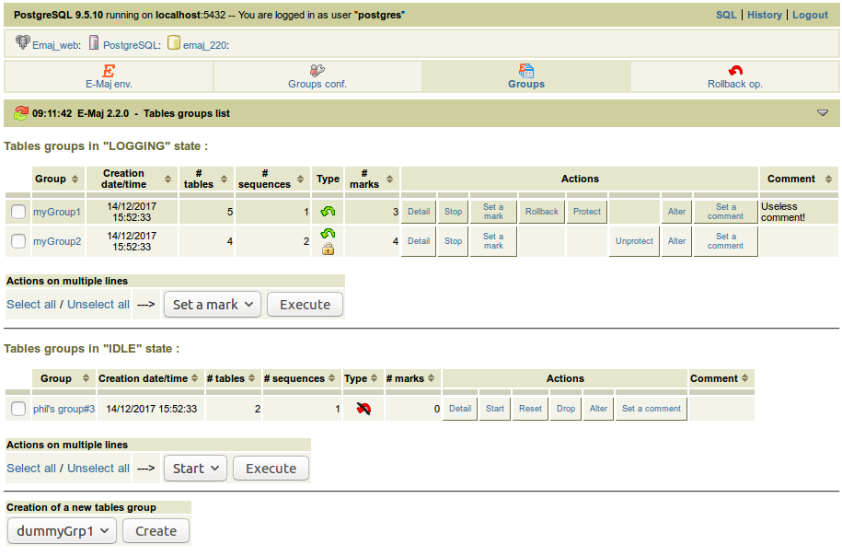
2 web clients
2 clients with same functionalities, to help administrators and users
  Independant client Emaj_web
  Plug-in totally integrated
  into phpPgAdmin (5.1+)
Shows all E-Maj objects (groups, marks...) and their attributes
Allows all possible actions on
E-Maj objects
Tables groups list

Slide 44
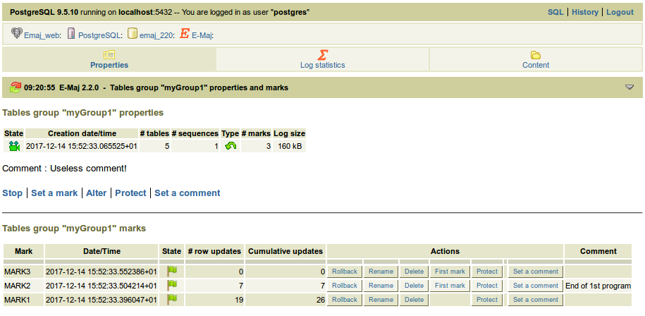
Emaj_web : tables group details
Tables group properties and marks list

Slide 45
Current limitations
Since E-Maj 2.2, the minimum required PostgreSQL version is 9.2
Every application table belonging to a rollbackable group needs a PRIMARY KEY
Table TRUNCATE statements cannot be canceled
DDL statement cannot be managed by E-Maj

Slide 46
To conclude...
Many more informations in the documentation and in the README et CHANGES files
Many thanks for their help to :
  Andreas Scherbaum, Jean-Paul Argudo and the Dalibo team, CNAF DBA, Don Levine (for the english translation)
  People who already contacted me for comments, requests...
Feel free to give any feedback through github or email (phb.emaj@free.fr)

