Slide 1
Quick Connect’s Motion for Summary Judgment
IP Litigation, 18 April 2024

Slide 2
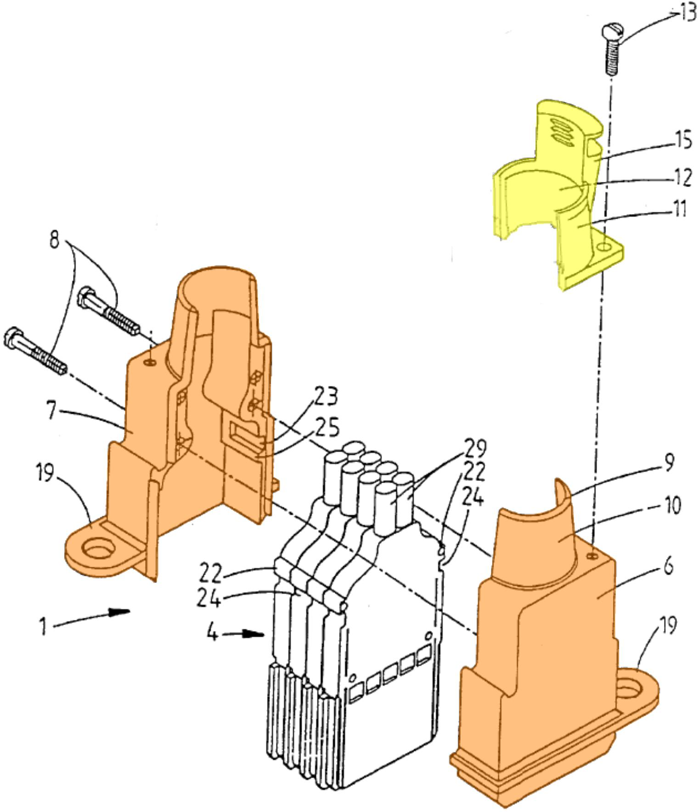
Element Three, “The Case Being Deprived of a Shielding Cap”
Element Four
Stratoview 3000 Technical Manual
The case being deprived of a shielding cap, “said connector comprises a conductive shielding cap configured to be assembled to the case body”

Slide 3
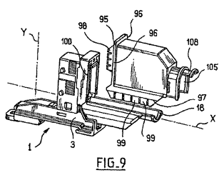
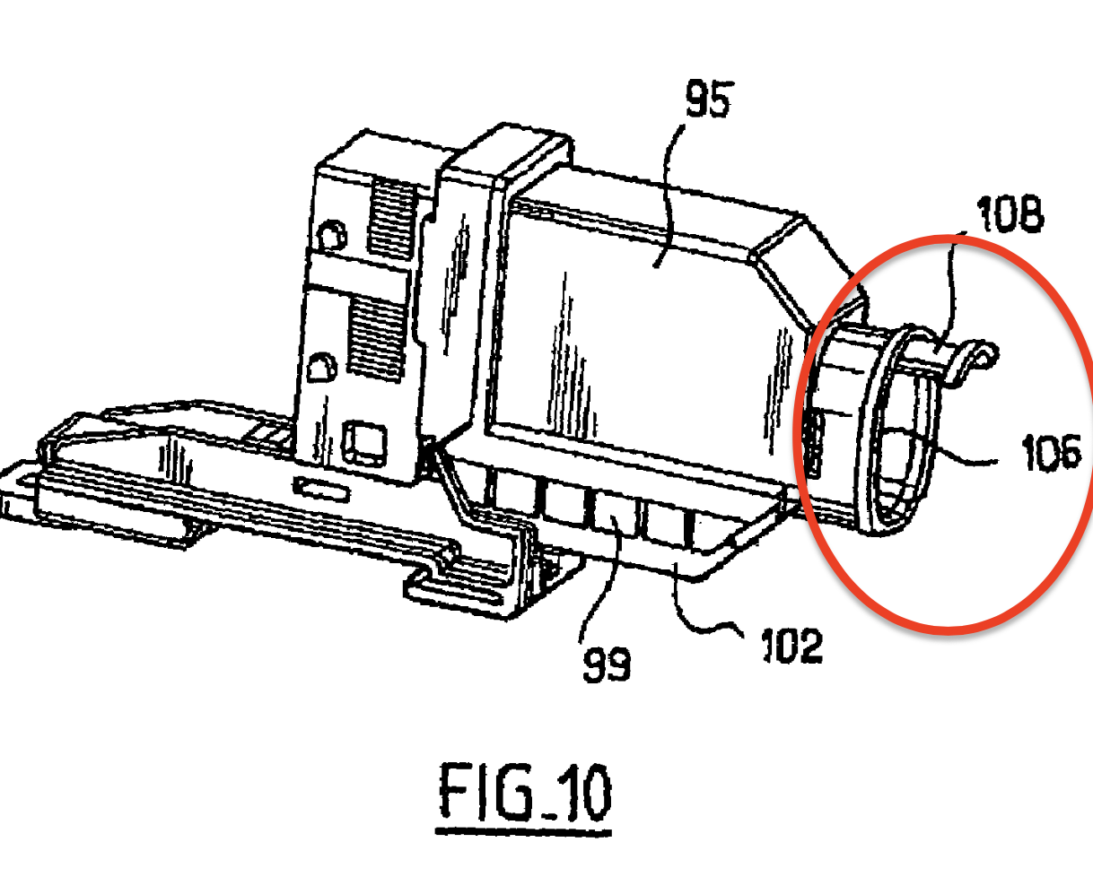
Element Five, “said rear portion being configured to co-operate with the attachment portion of the case body so as to form a tubular opening for inserting cables into the case.
The rear portion of the shielding cap 105 is configured to co-operate with the attachment portion 18 of the case body 3 so as to form a tubular opening 106, enabling the cables to be inserted. ’312 patent col. 10 lines 33-37.

Slide 4
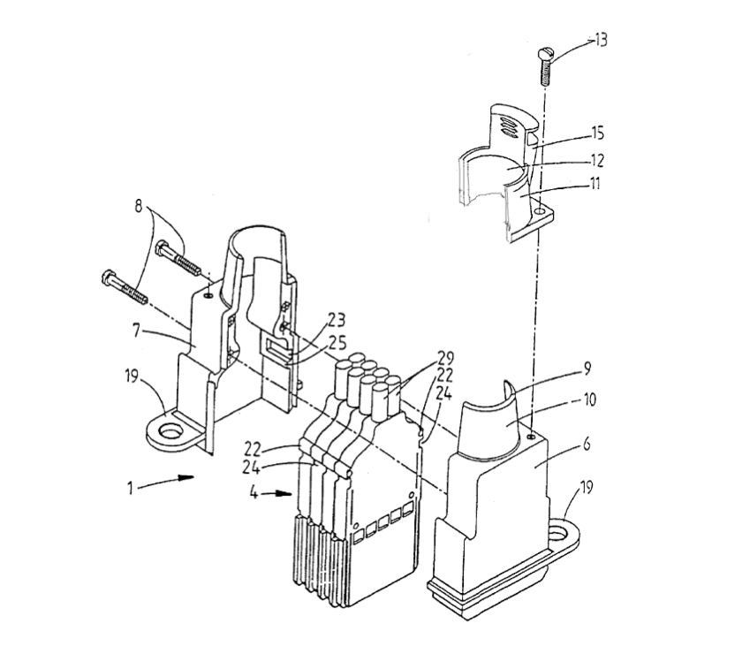
Stratoview 3000
“A case body including a cable-attachment portion which allows the attachment of multi-wire braided cables, where the cables may be attached to the rear of the case.” [Stratoview 3000 Technical Manual at 5]

Slide 5
Aero Video Systems’ Motion for Summary Judgment
IP Litigation, 18 April 2024

Slide 6
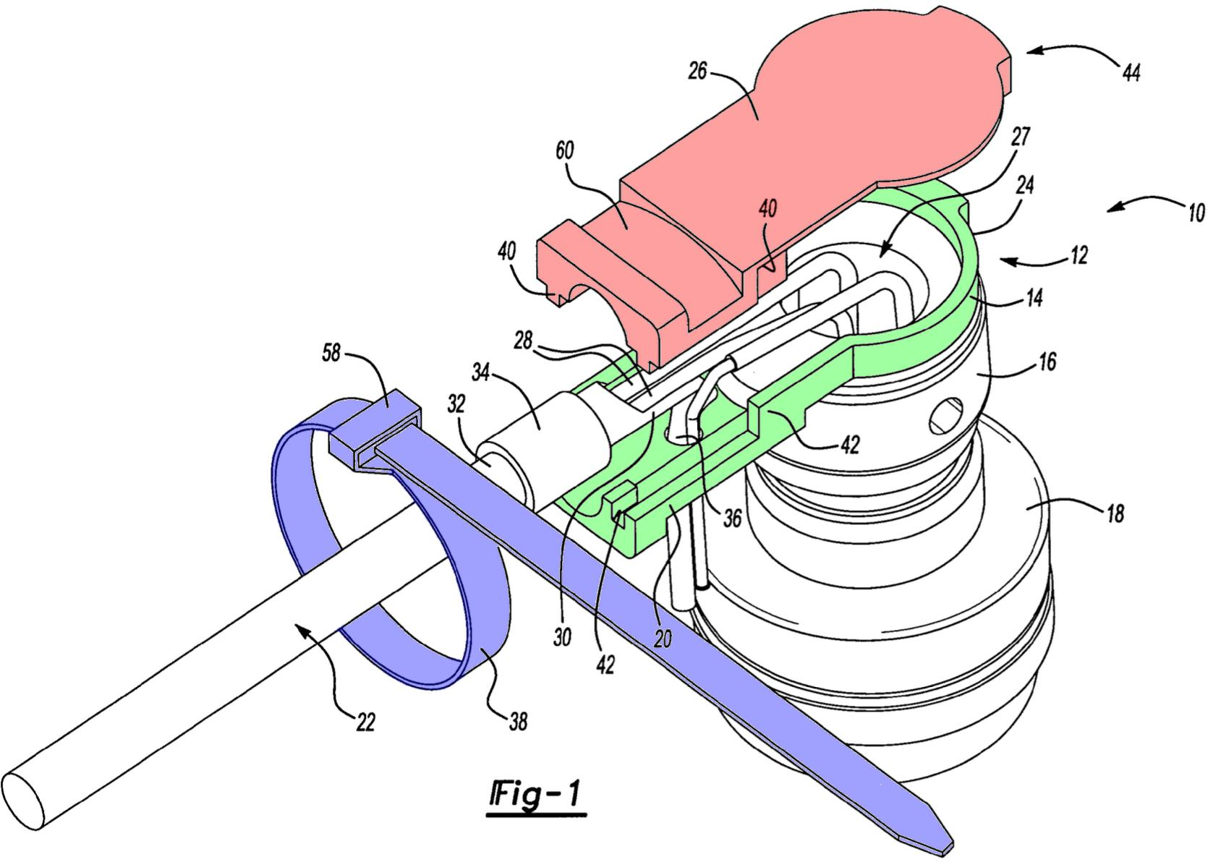
Element Four, “Said Connector Comprises a Conductive Shielding Cap Configured to Be Assembled to the Case Body”
Diep ’795 Specification
Diep ’795 Diagram
The backshell is “preferably constructed from a nickel-plated aluminum.” 2:21-22.
The “backshell includes a body and cover.” 2:35-36.
Cover secured using a “band clamp.” 3:25-28.

Slide 7
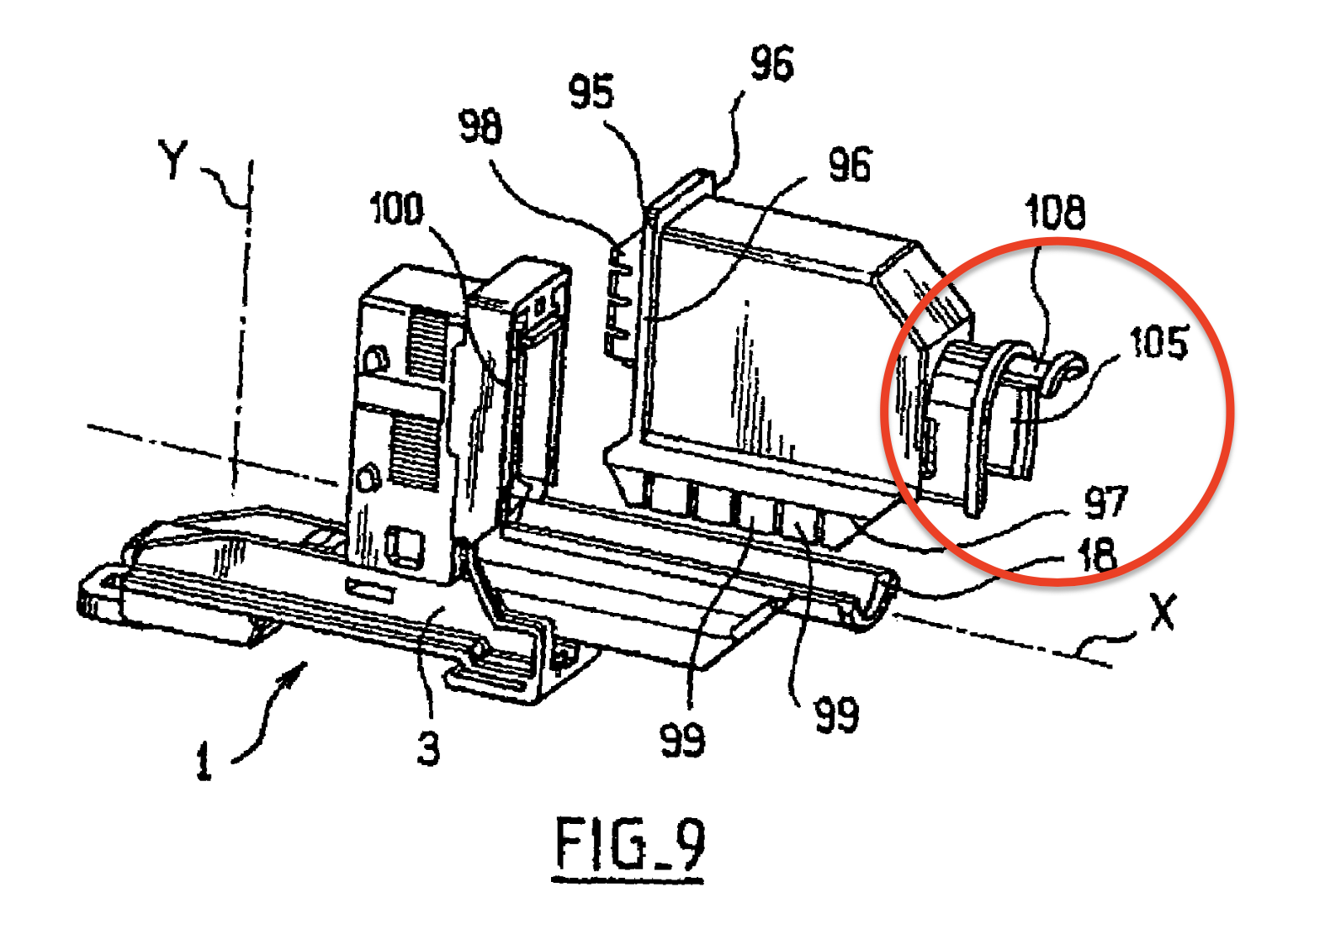
Element Five, “the shielding cap comprises a rear portion including a substantially U-shaped cross-section”
The shielding cap 95 has a rear portion 105 presenting a substantially u-shaped cross section, depicted in Figure 9. ’312 patent col. 10 lines 32-35.

Slide 8
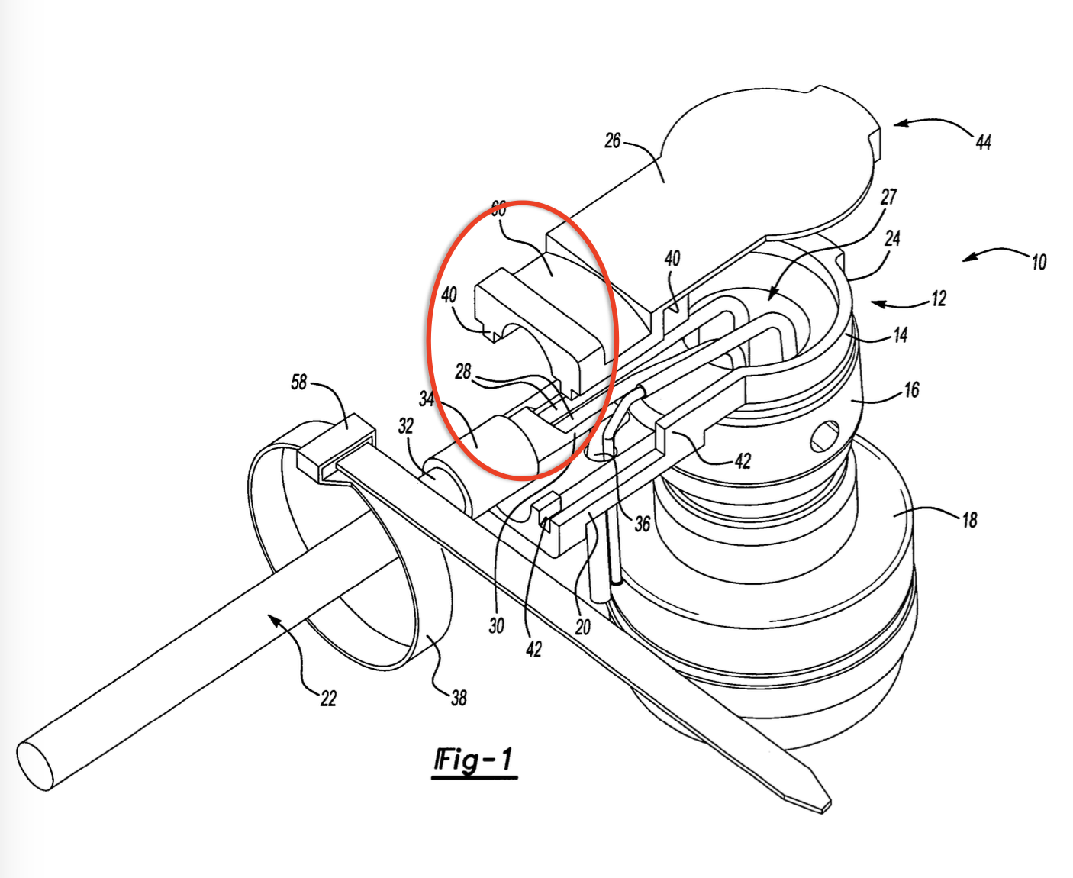
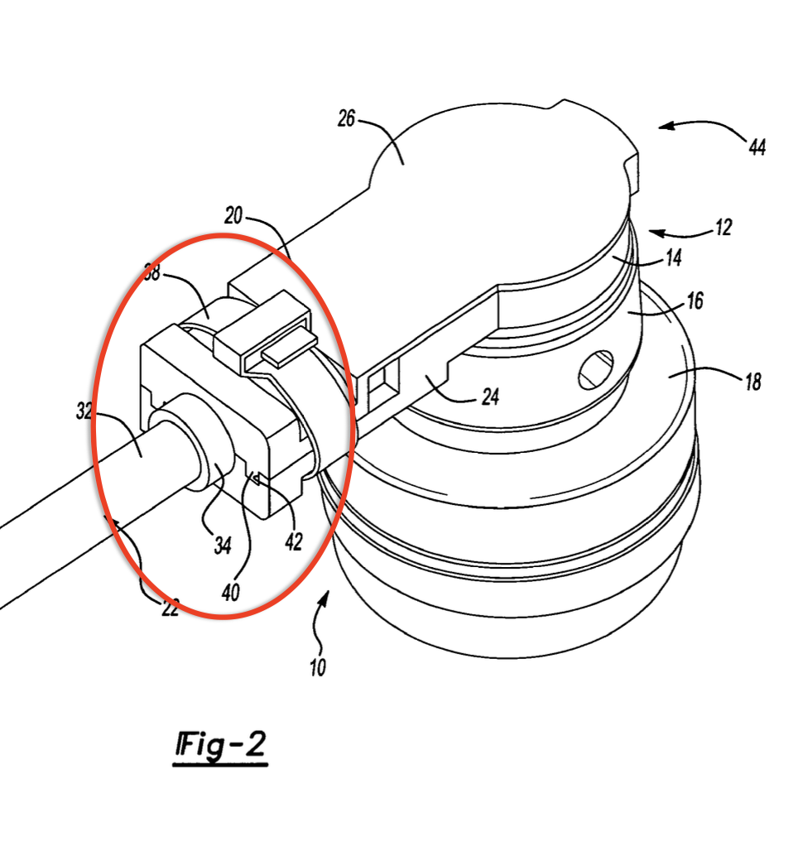
Diep ’795 Patent: the cross-section is substantially flat

