Slide 1
Data Types

Slide 2
The Marathon Program
A simple C program to convert the distance of
a marathon in miles and yards to kilometers
1 mile = 1.609 km = 1760 yards
marathon length = 26 miles and 385 yards
Program after compilation and running will print
A marathon is 42.185968 kilometers

Slide 3
/* The distance of a marathon in kilometers. */
#include <stdio.h>
int main(void)
{
int miles, yards; /* comments or */
float kilometers; //
miles = 26;
yards = 385;
kilometers = 1.609 * (miles + yards / 1760.0);
printf("\n A marathon is %f kilometers.\n\n",
kilometers);
return 0;
}

Slide 4
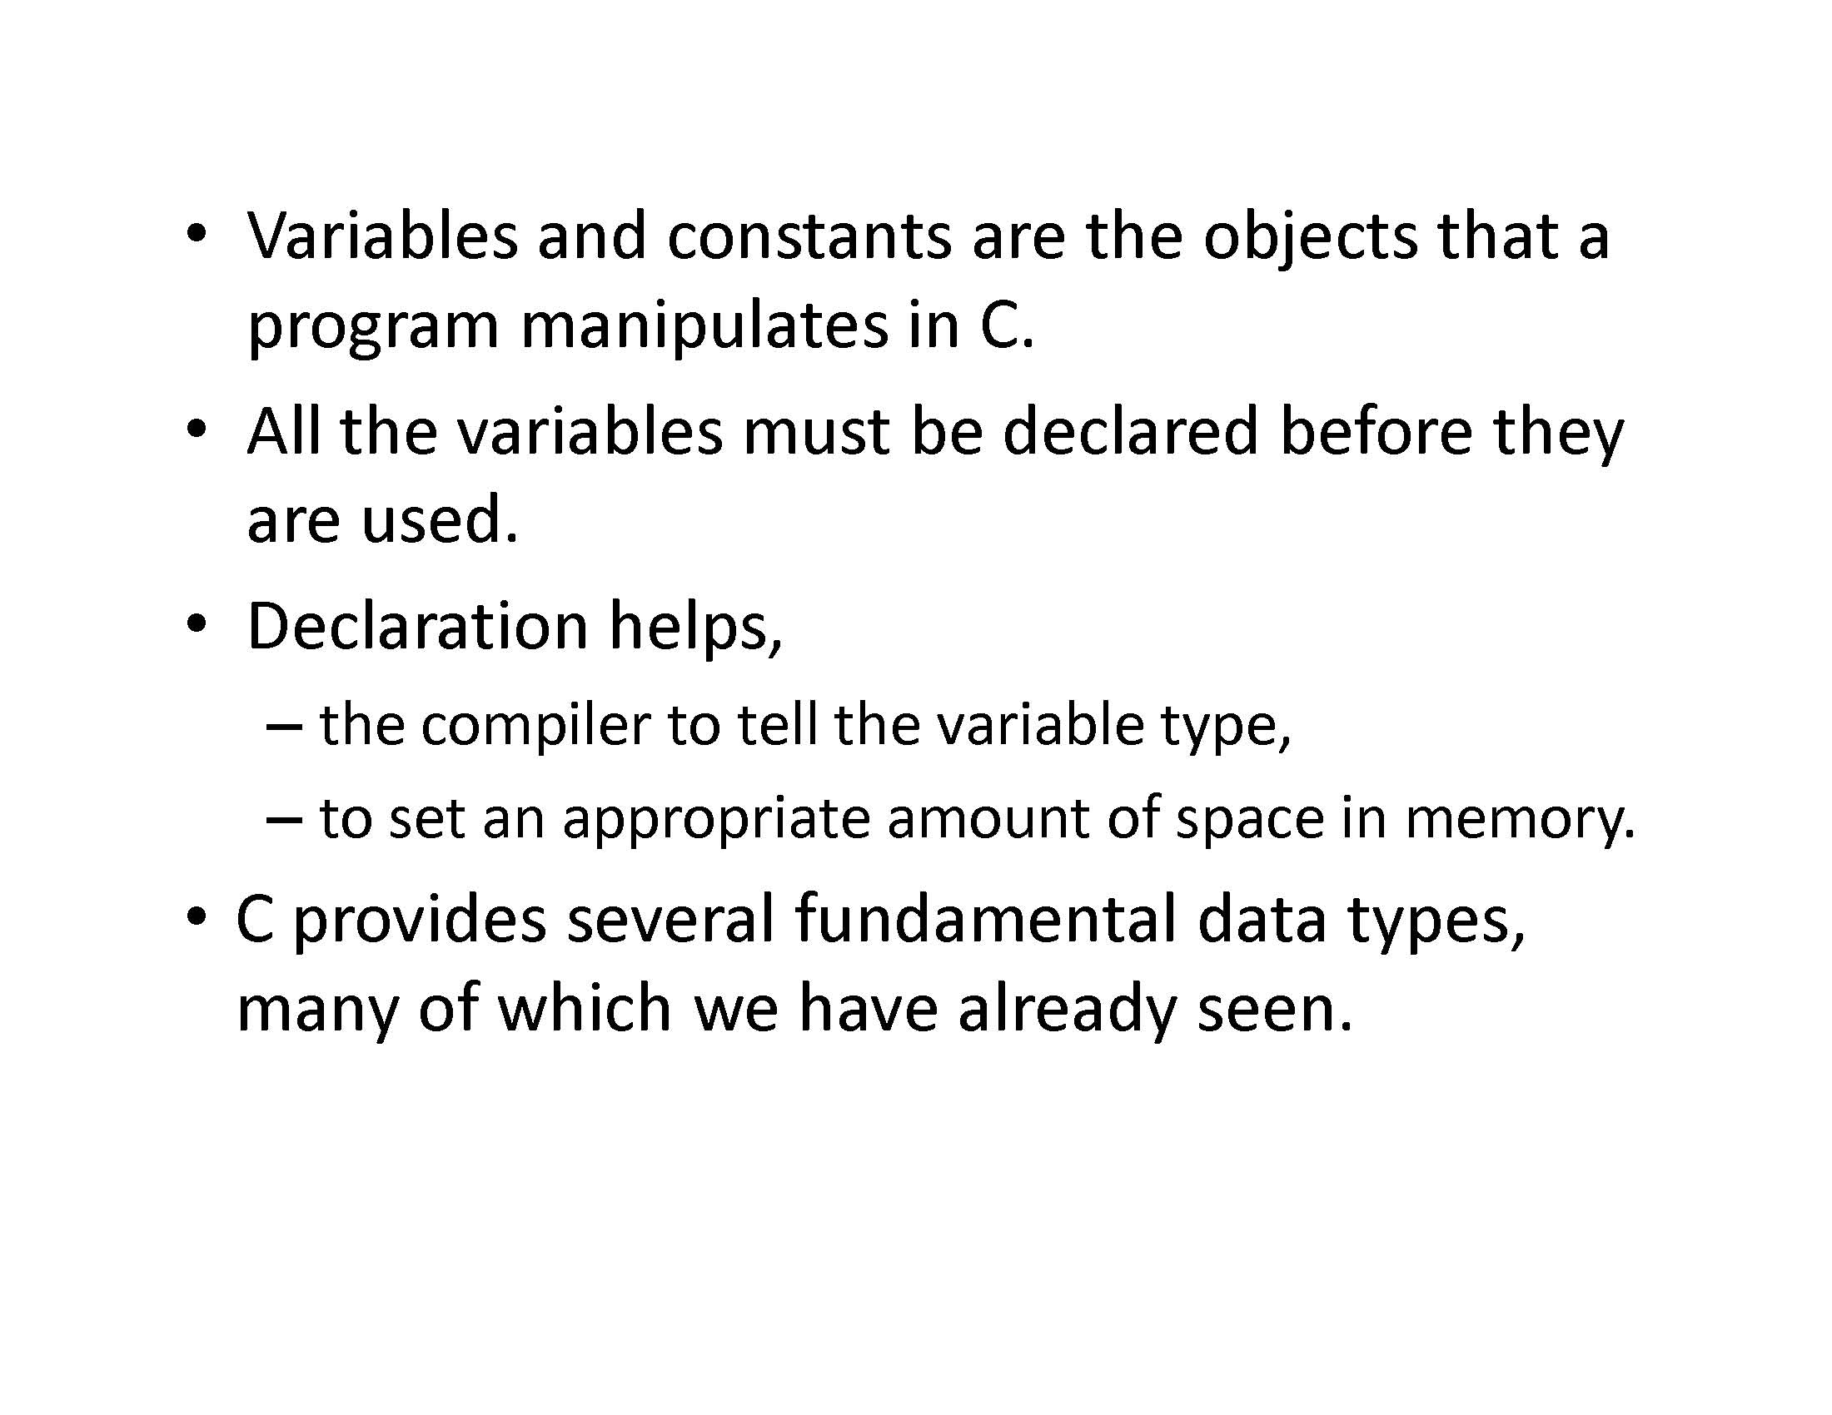

Slide 5
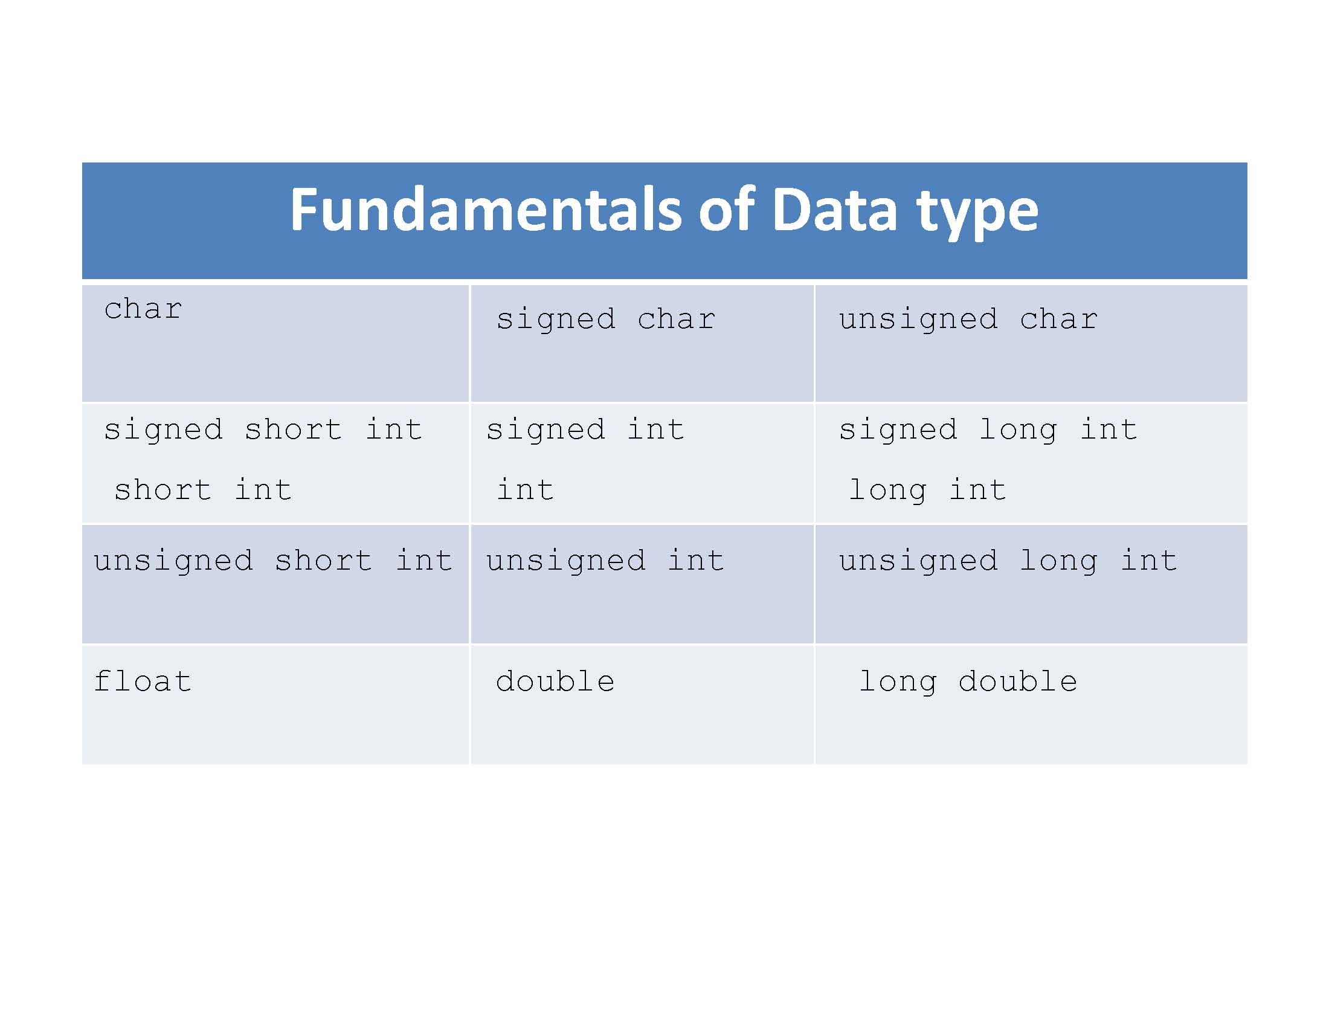

Slide 6
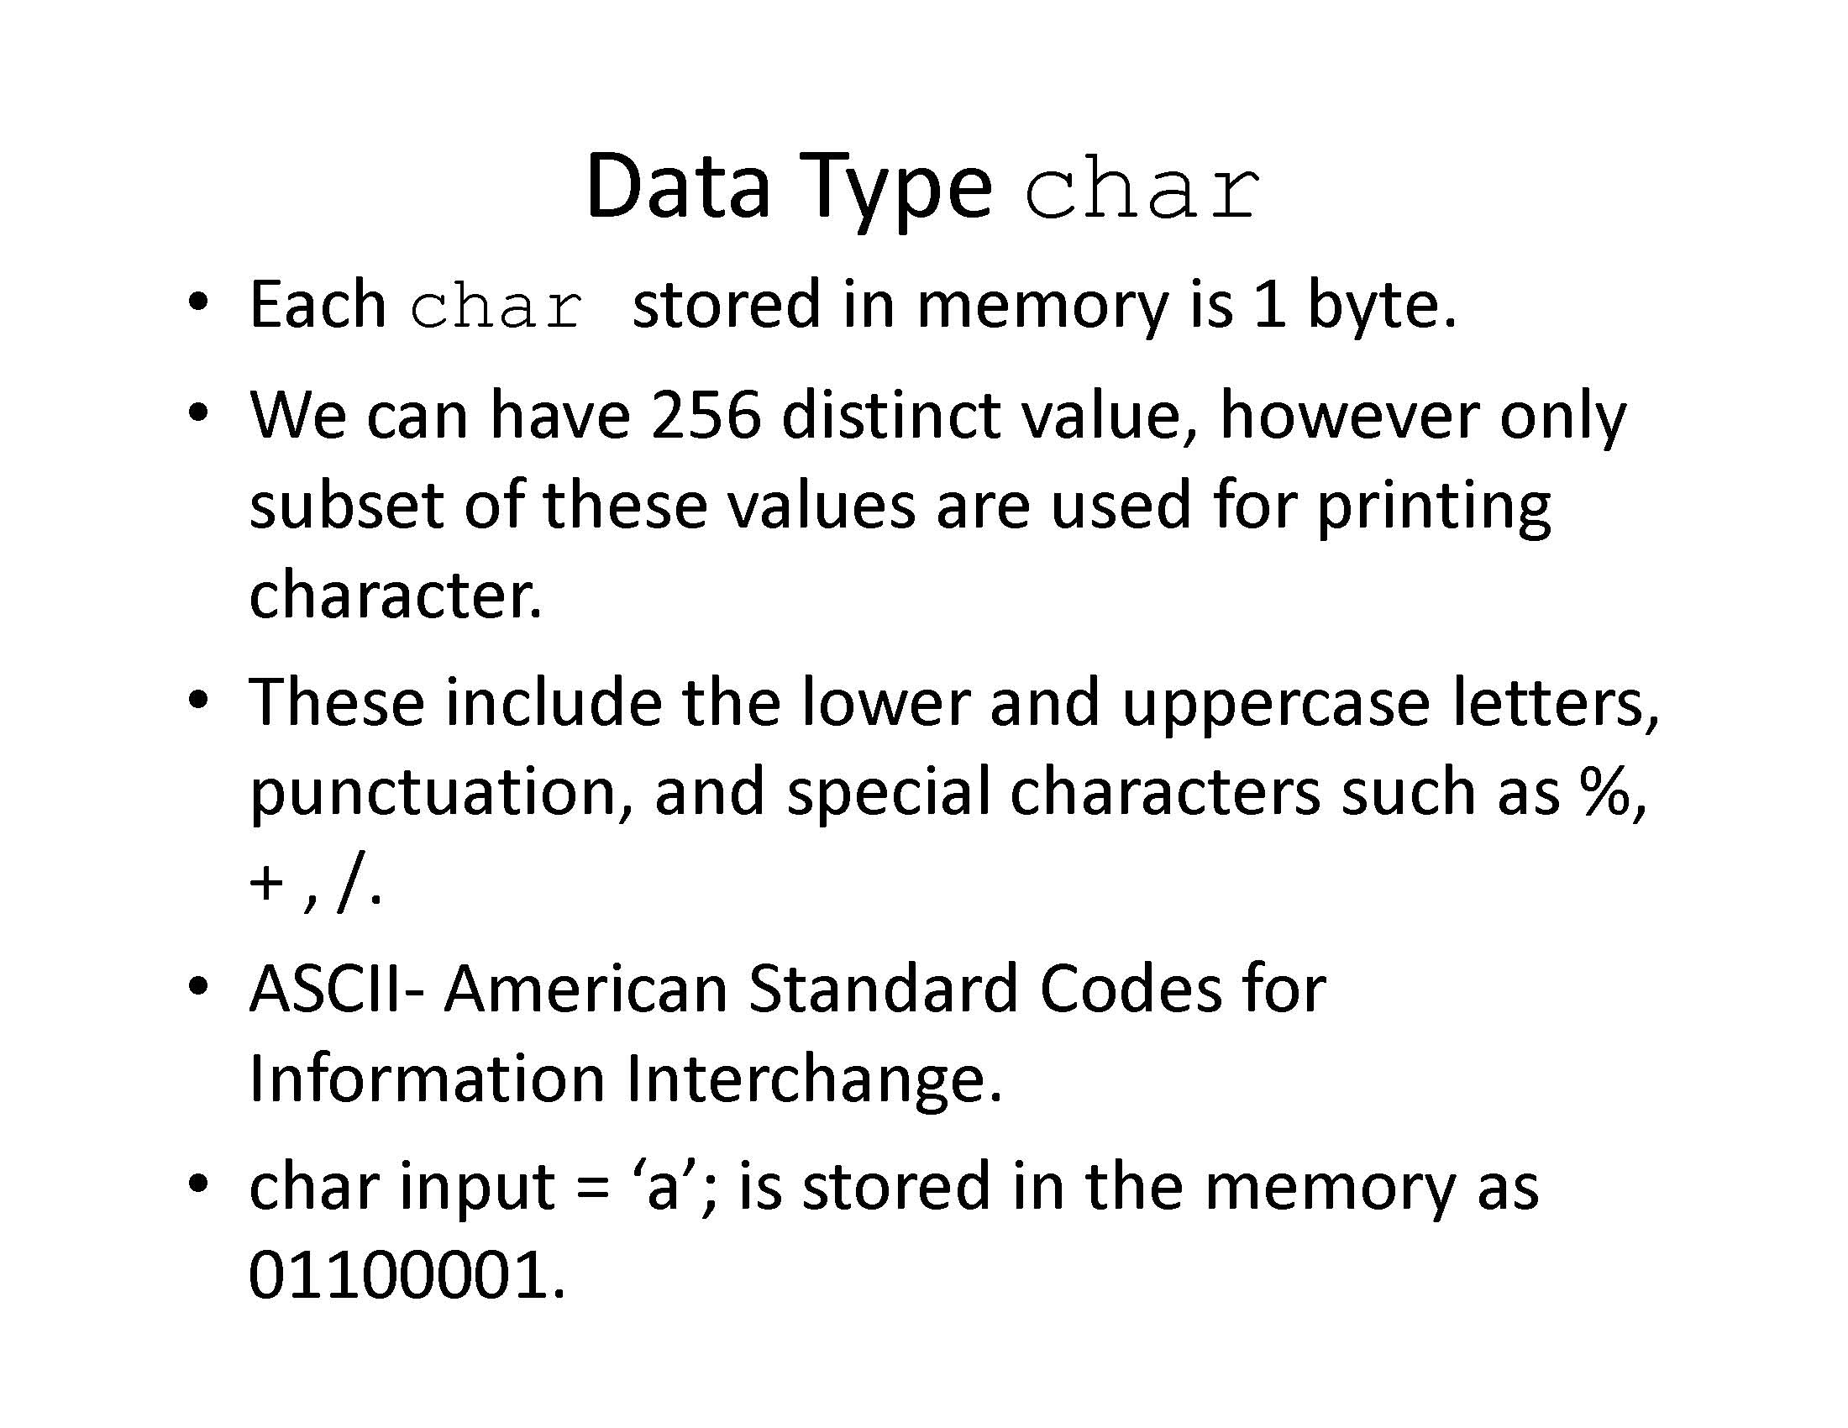

Slide 7
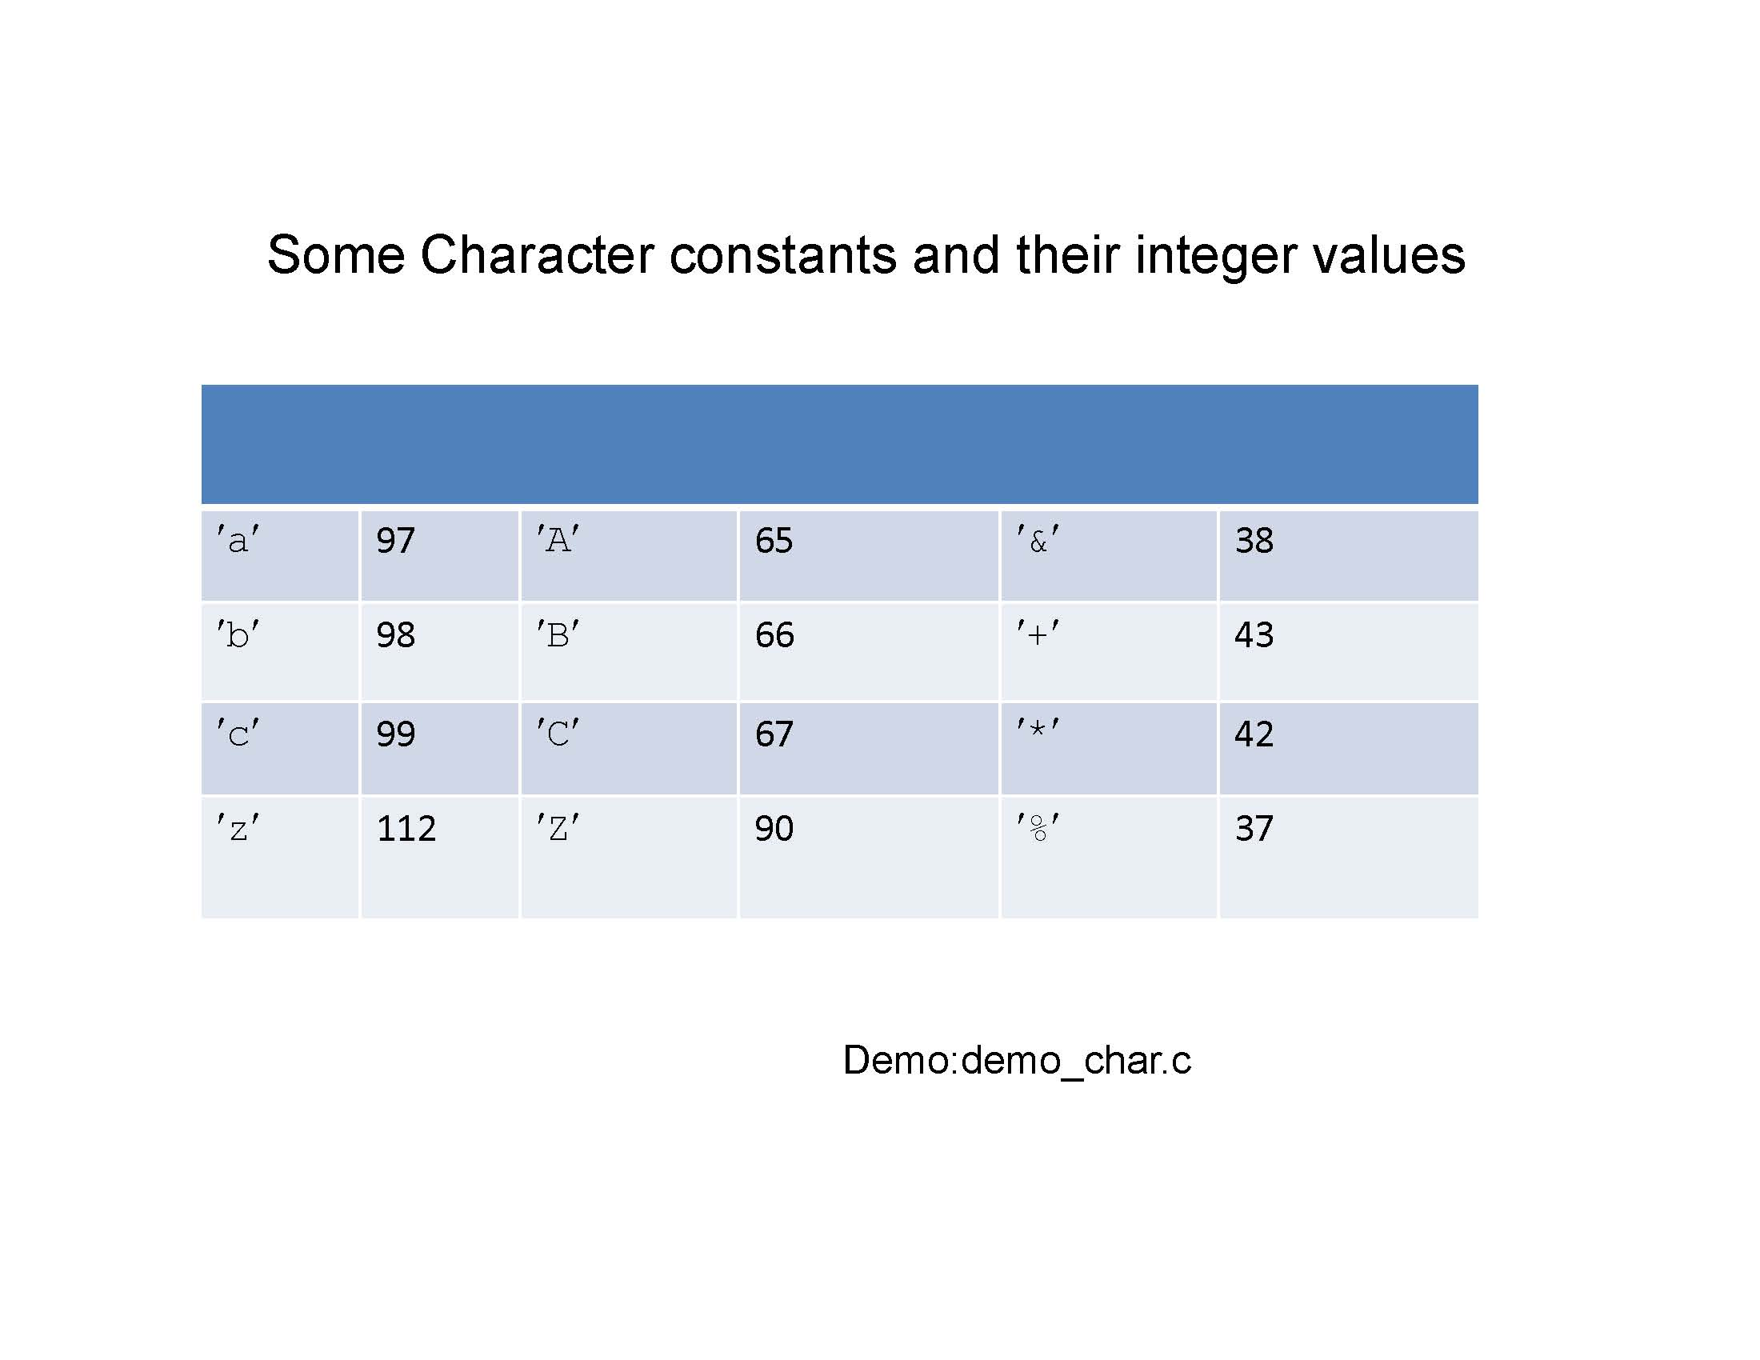

Slide 8
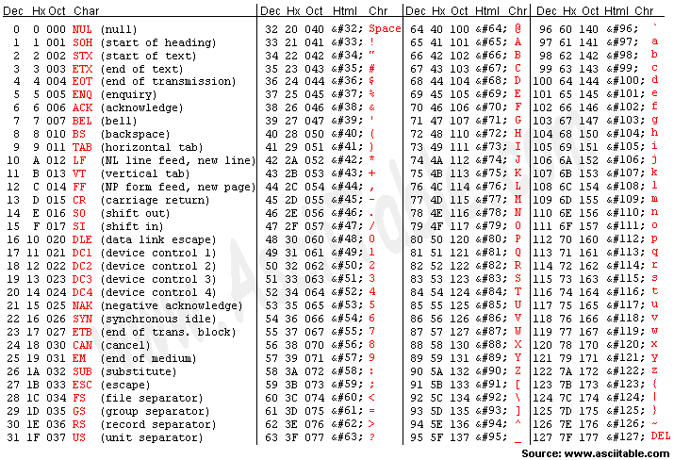

Slide 9
Demo_char.c
#include<stdio.h>
int main(void)
{
int i,j;
printf("%c\n",'a');
printf("The ASCII for %c is %d\n", 'a','a');
for(i='a';i<'z';++i)
printf("%c ",i);
printf("\n");
for(j='A';j<127;++j)
printf("%c ",j);
printf("\n");
return 0;
}

Slide 10
capitalize.c
int main(void)
{
int c;
while ((c = getchar()) != EOF)
if (c >= 'a' && c <= 'z')
putchar(c + 'A' - 'a');
else
putchar(c);
return 0;
}

Slide 11
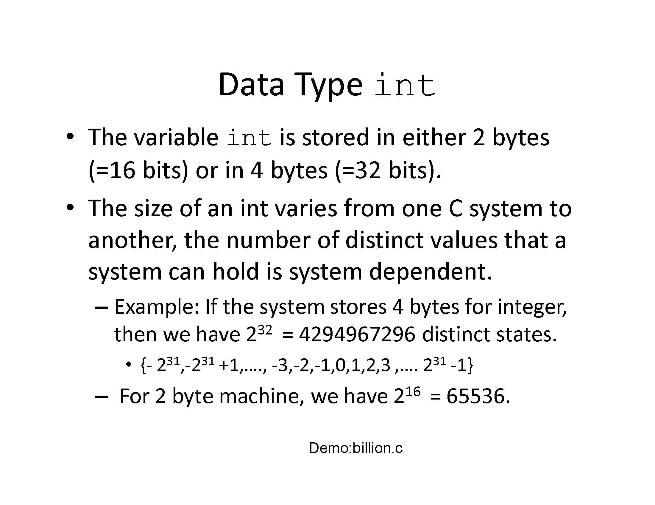

Slide 12
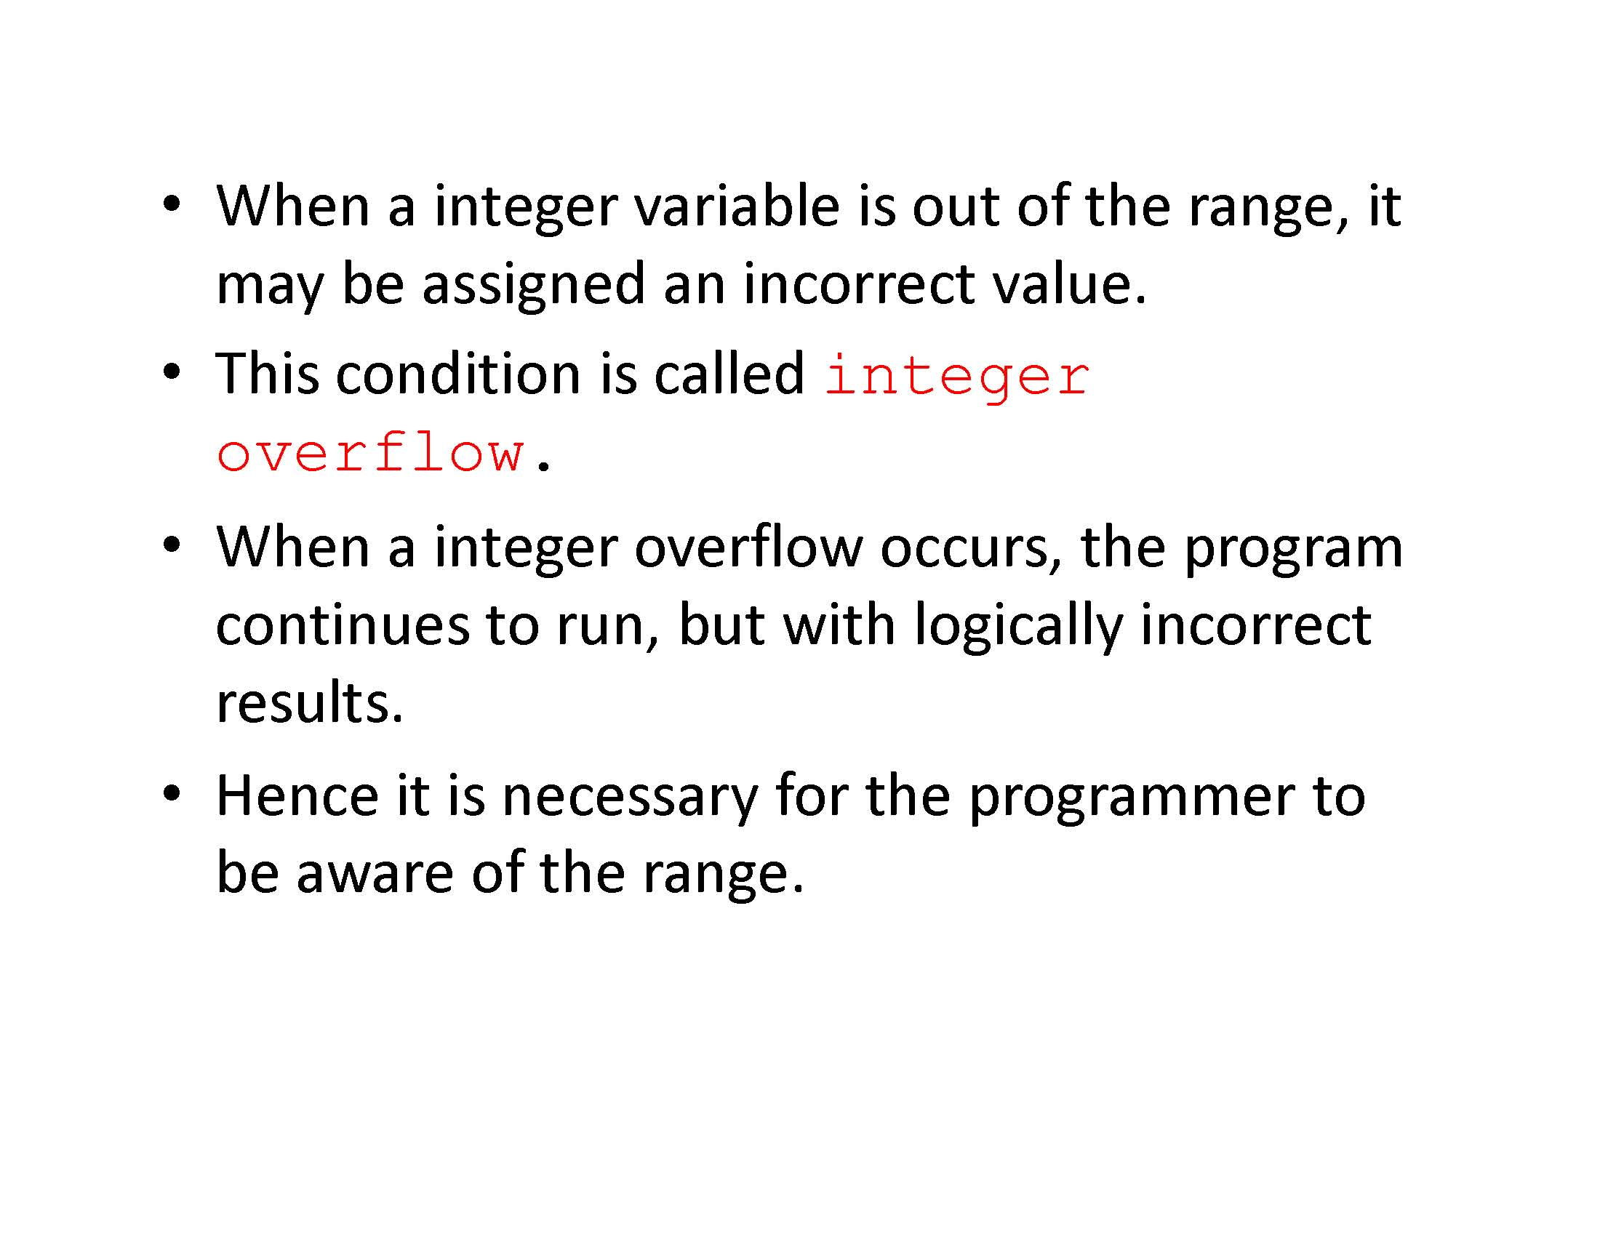

Slide 13
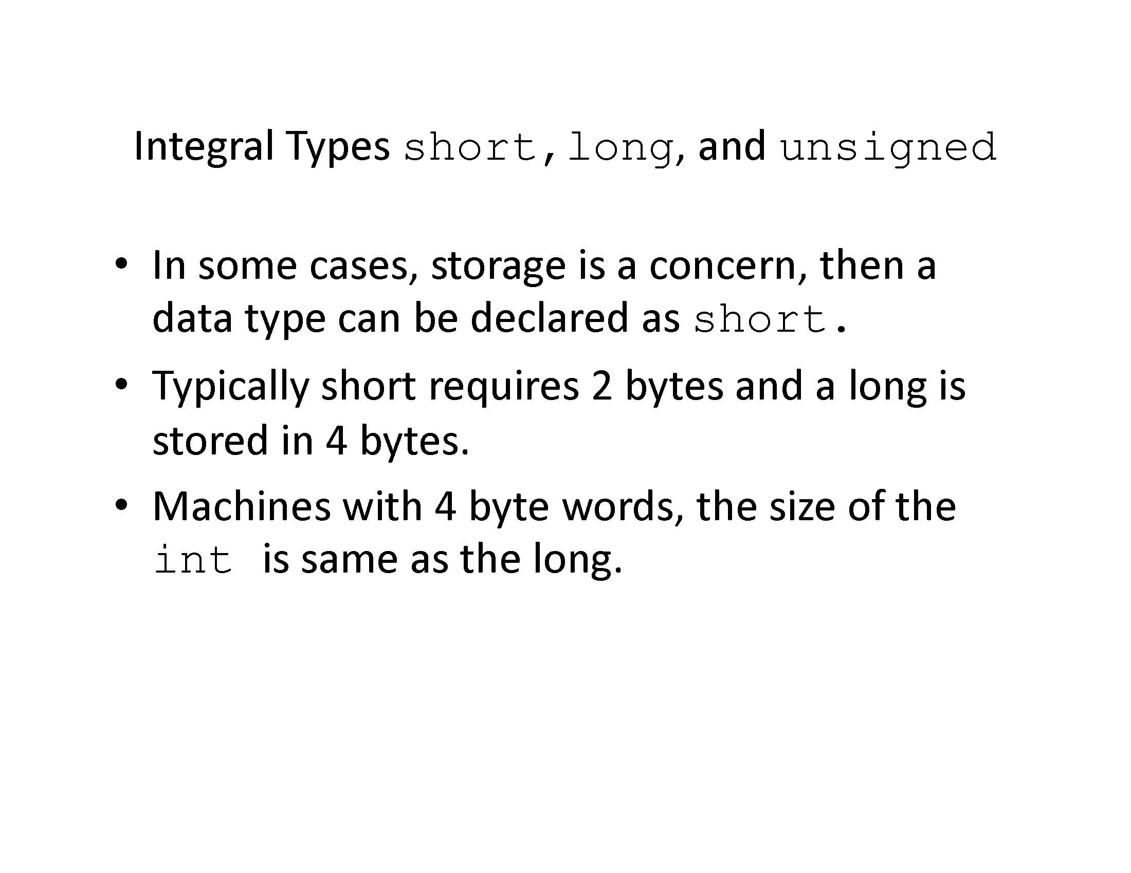

Slide 14
Float
Floating point types are float, double or long double
Floating point numbers consist of a number of significant digits and an exponent
The double and long double types use more memory but can store larger values with more significant digits

Slide 15
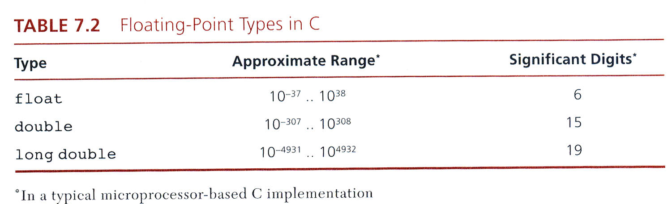
Data type float

Slide 16
Floating point numbers have a decimal point
In an expression if the complier sees the number constant 2.0 it is interpreted as a float type.
If the compiler sees 2 it is interpreted as an int type
If you have the expression 2.0*2 the result will be 4.0 due to integral promotion

Slide 17
Float Example
double x;
x = 132.45123451234512345 (20 significant digits)
Stored as
0.123451234512351*10^3 //15 significant digits
Demo float.c

Slide 18
Float.c
#include<stdio.h>
int main(void)
{
float a=11111111111.0,b=11111111111.0; //11 digits long
float c;
c = a+b;
printf(" a is %14.2f\n",c);
}

Slide 19
sizeof
#include <stdio.h>
int main(void)
{
printf("The size of some fundamental types is computed.\n\n");
printf(" char:%3d byte \n", sizeof(char));
printf(" short:%3d bytes\n", sizeof(short));
printf(" int:%3d bytes\n", sizeof(int));
printf(" long:%3d bytes\n", sizeof(long));
printf(" unsigned:%3d bytes\n", sizeof(unsigned));
printf(" float:%3d bytes\n", sizeof(float));
printf(" double:%3d bytes\n", sizeof(double));
printf("long double:%3d bytes\n", sizeof(long double));
return 0;
}

Slide 20
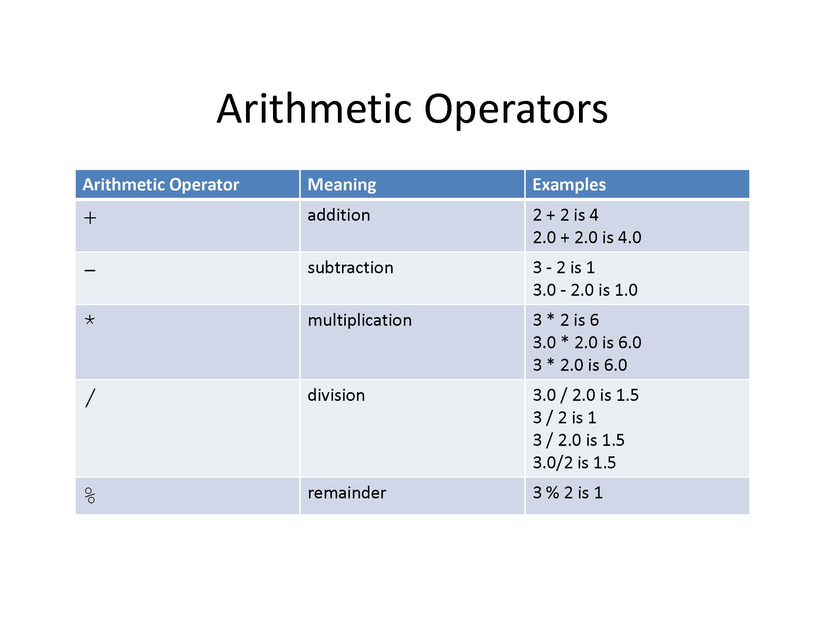

Slide 21
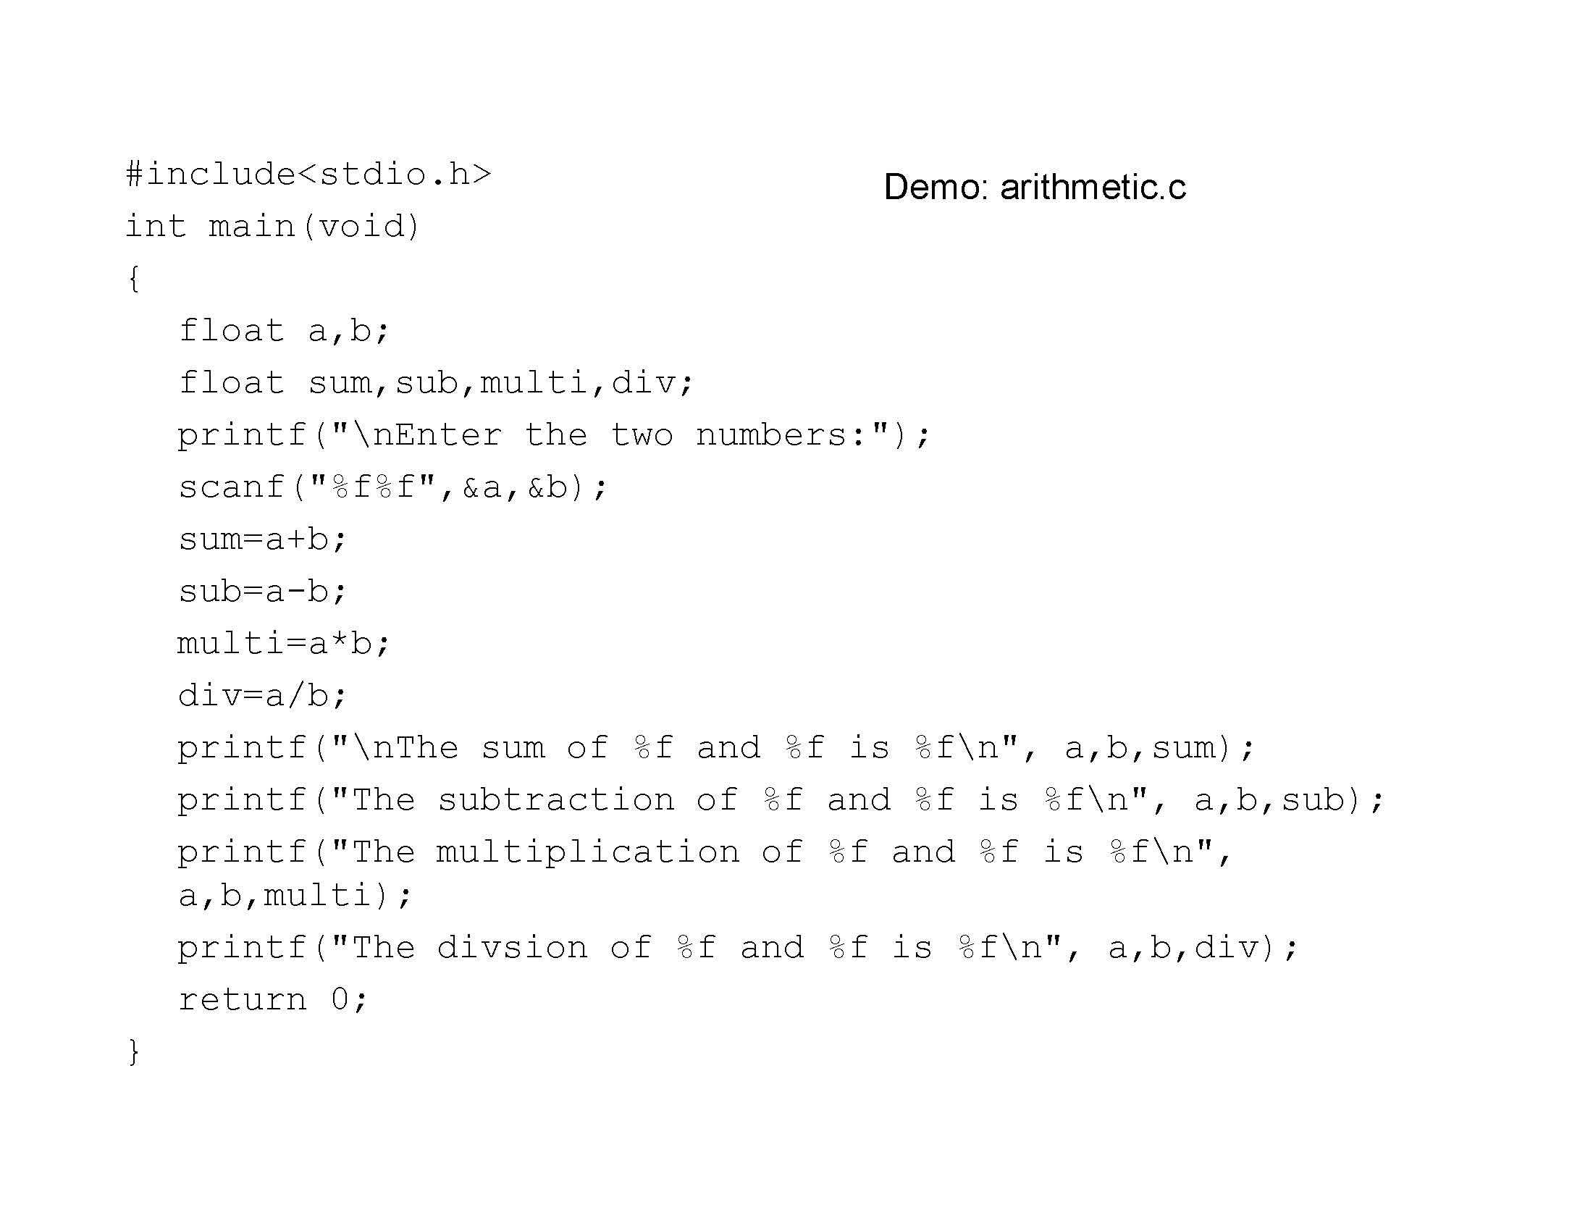

Slide 22
Integral Promotions
In an expression if the variables are of the same type the result is of the same type
If an expression contains a mix of types the result is the larger type

Slide 23
Integral Promotion
Int a=1,b=1,c;
float d=1.0,x;
double e=1.0,y;
c=a*b // an int * int = int
x=a*d // int * float = float
y=d*e //float*double = double

Slide 24
Casting
It is possible to specify the data type of an expression by casting
#include<stdio.h>
main()
{
float a = 5.25;
int b = (int)a;
printf ("the result is %d",b);
}

Slide 25
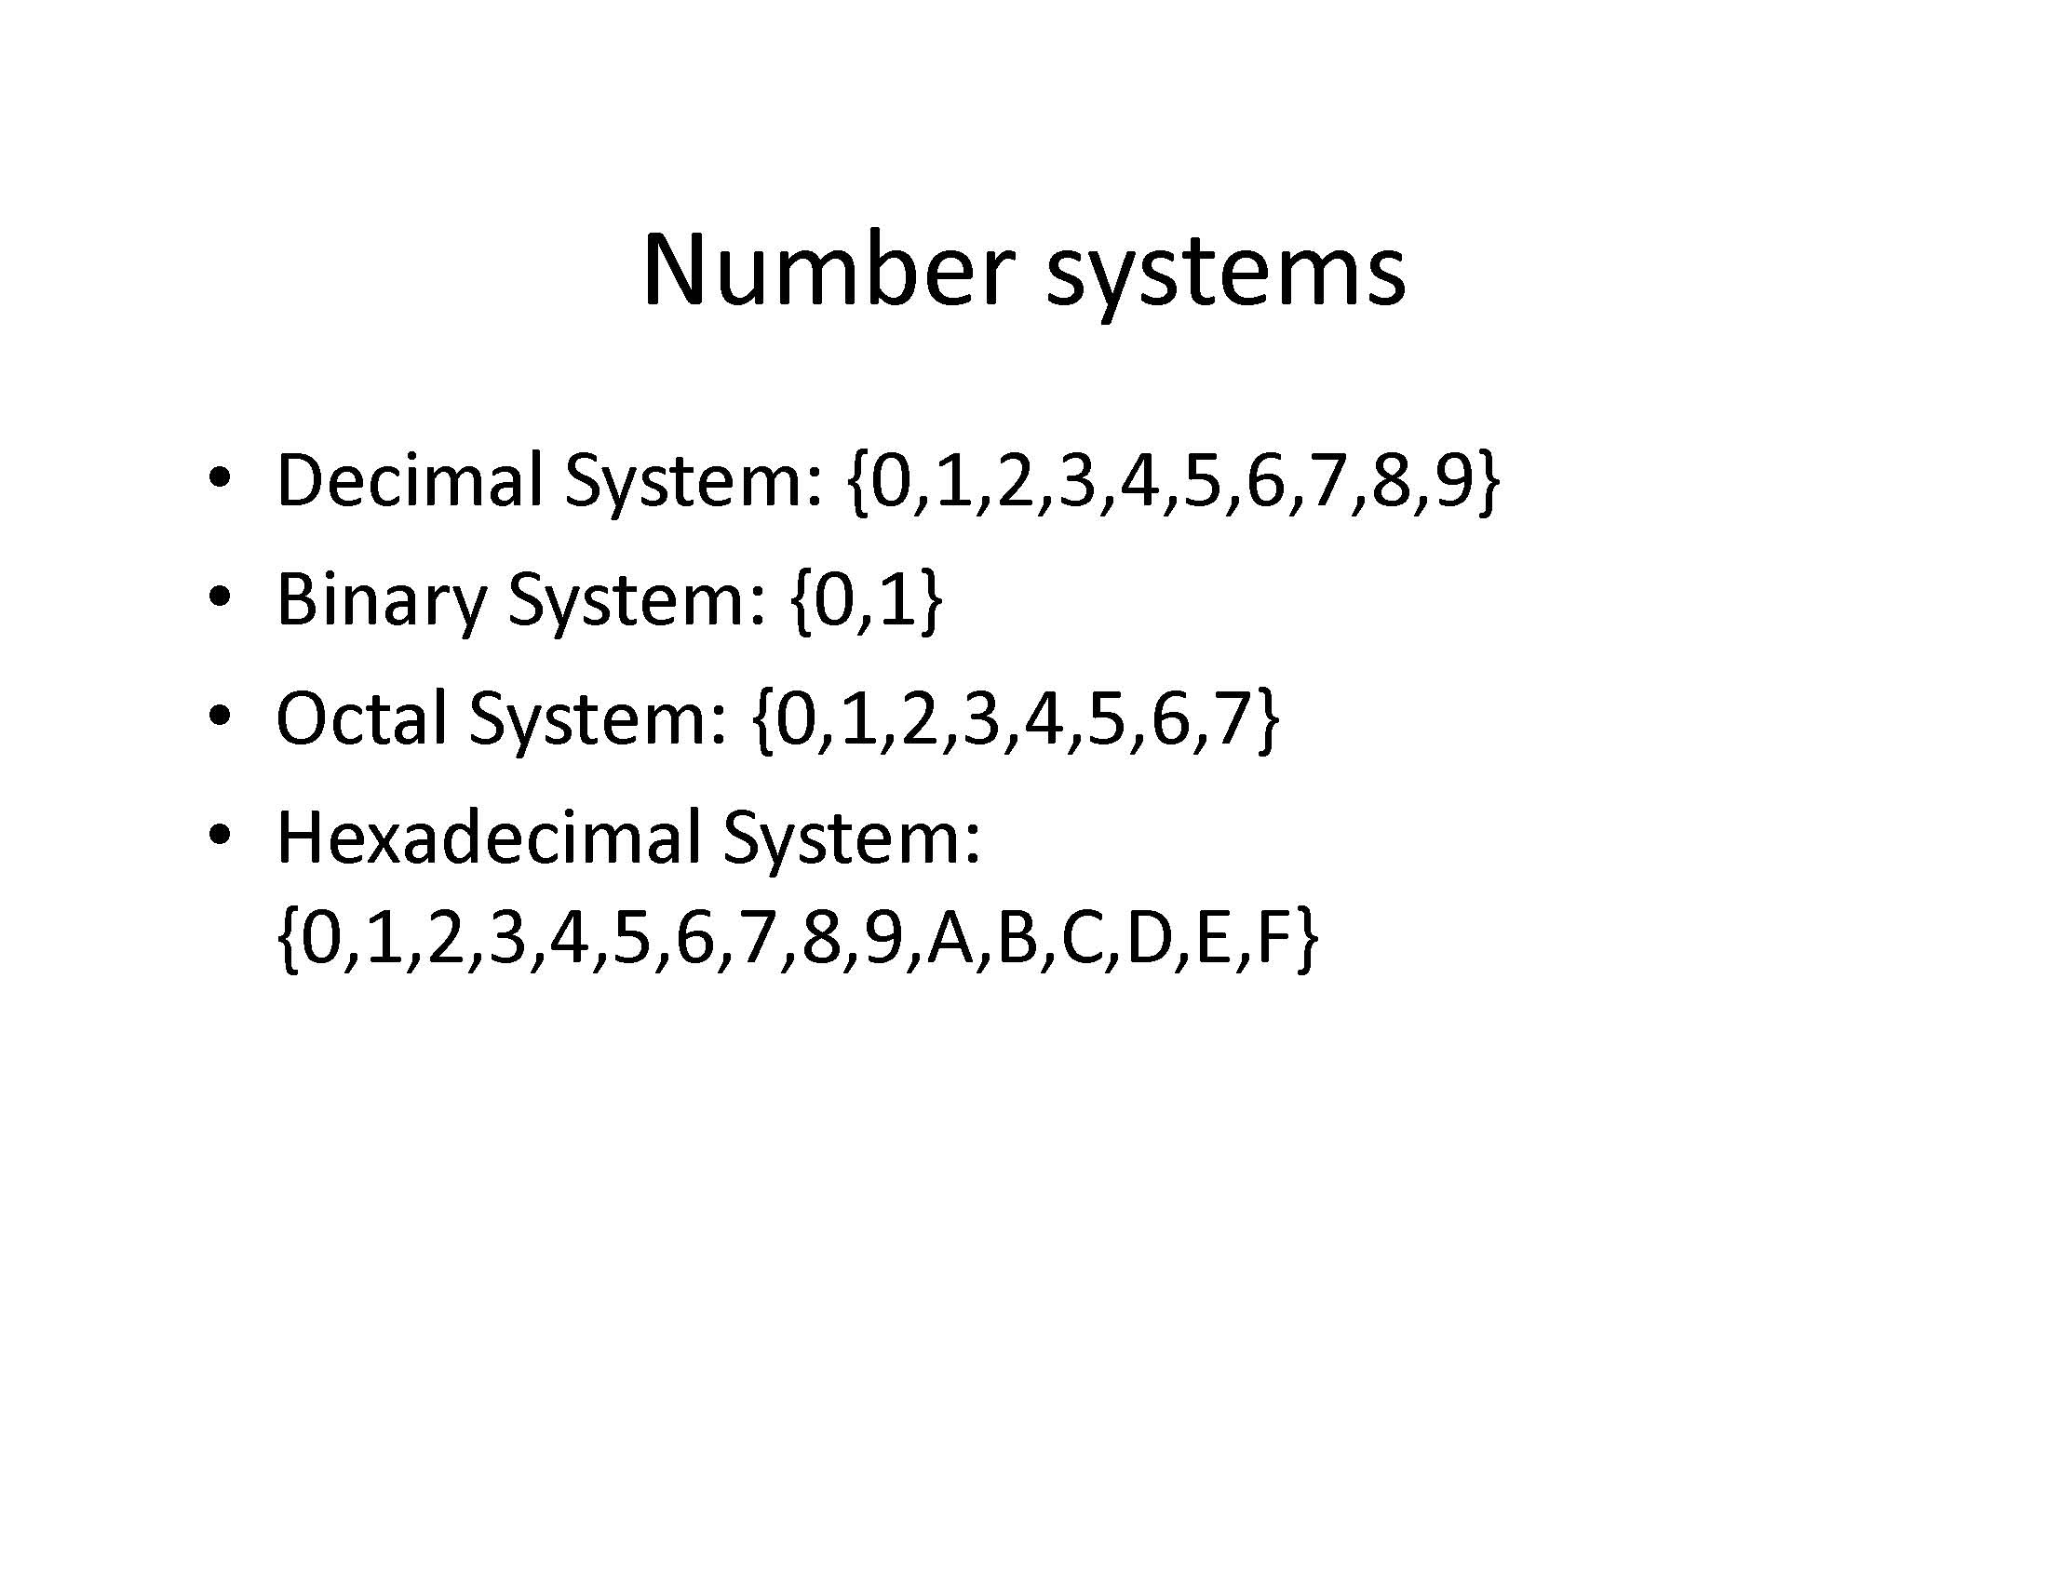

Slide 26
Number Systems
Constants prefaced by a 0 are octal constants
Example: 017 is an octal number = 15 decimal
Constants prefaced by a 0x are hex numbers
Example: 0x1c is a hex number = 28 decimal

Slide 27
Number Systems
Octal numbers are sometimes used in escape sequences (Base 8)
Hex numbers are used when working with memory addresses (Base 16)
Binary numbers are how the computer physically stores data in memory (Base 2)

Slide 28
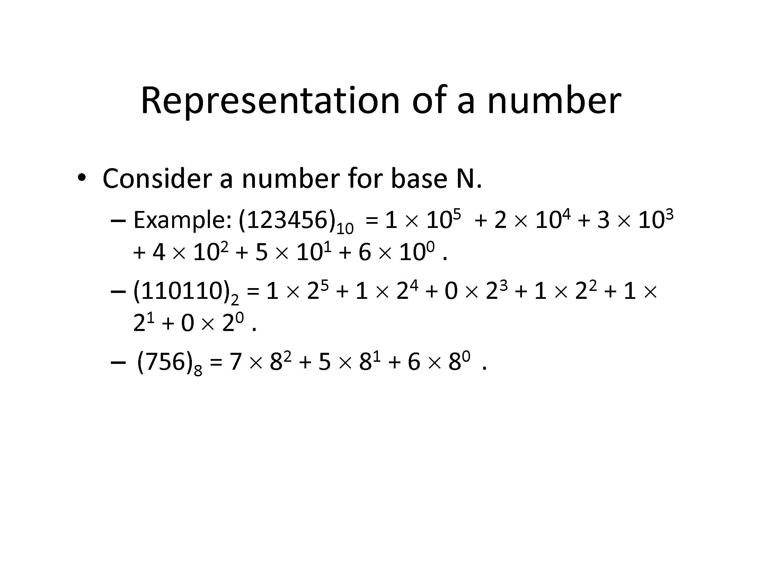

Slide 29
Decimal, hex, octal demo
#include <stdio.h>
int main(void)
{
printf("%d %x %o\n", 19, 19, 19); /* 19 13 23 */
printf("%d %x %o\n", 0x1c, 0x1c, 0x1c); /* 28 1c 34 */
printf("%d %x %o\n", 017, 017, 017); /* 15 f 17 */
printf("%d\n", 11 + 0x11 + 011); /* 37 */
printf("%x\n", 2097151); /* 1fffff */
printf("%d\n", 0x1FfFFf); /* 2097151 */
return 0;
}

