Slide 1
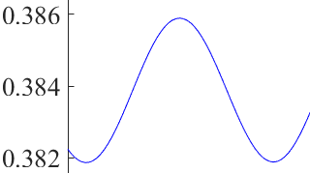
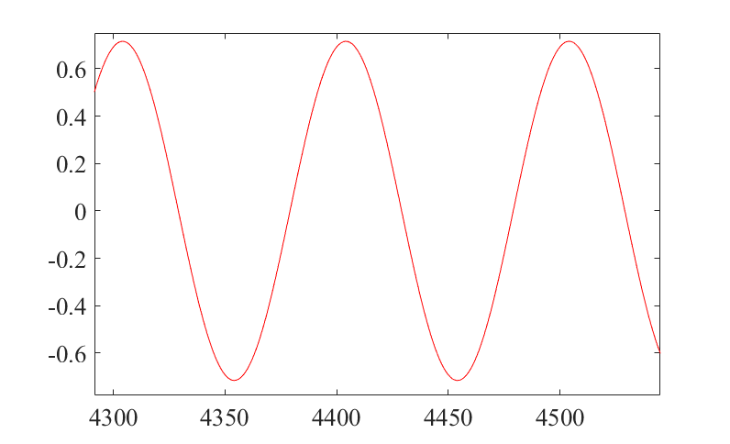
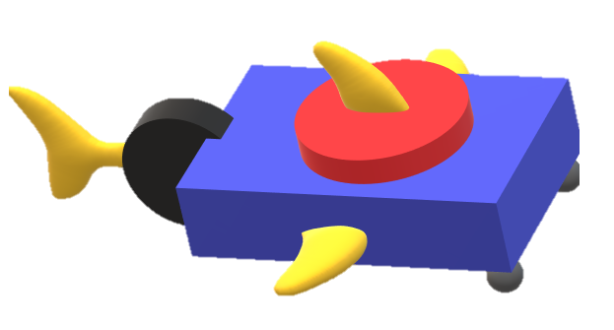

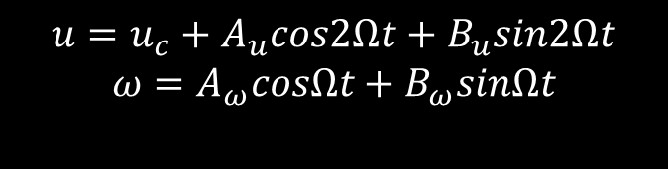


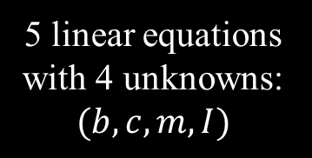





Start with swimmer simulation
Estimate limit cycle amplitudes $(A_{u},B_{u},A_{ω},B_{ω})$, and constant offset $u_{c}$
dynamics
$$A_{u},B_{u}$$
$$u=u_{c}+A_{u}cos2Ωt+B_{u}sin2Ωt$$
$$ω=A_{ω}cosΩt+B_{ω}sinΩt$$
steady state
$$u$$
$$u_{c}$$
$$ω$$
$$A_{ω},B_{ω}$$
Use least square solver to obtain sleigh parameters
$$(b,c,m,I)$$
Sleigh equations of motion:
$$\dot{u}(b,c,m,ω)$$
$$\dot{ω}\left(m,b,u,τ,I,ω\right)$$
5 linear equations with 4 unknowns:
$$(b,c,m,I)$$
Notes:
How do we do this well

