Slide 1
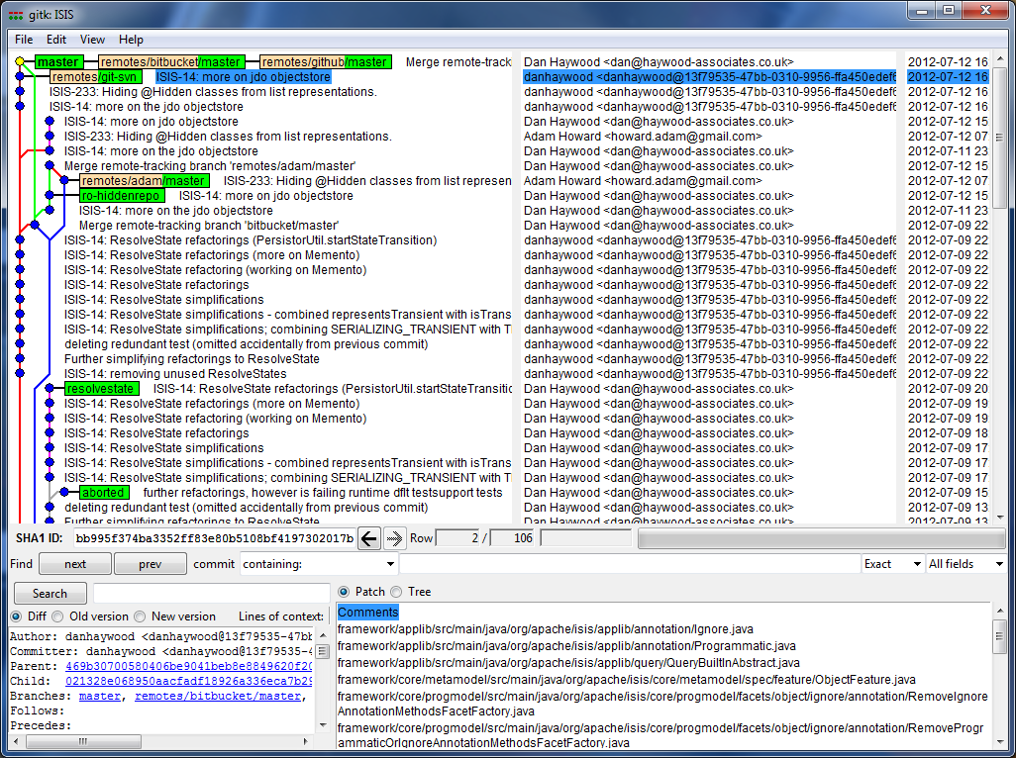
This was the commit in Adam's repo
(pulled into Dan's). This entire branch is basically orphaned.
This is the same commit, rebased against the SVN latest
This is the commit to rewind back to, then git merge --ff-only

