Slide 1

Google Cloud AI Capabilities
Intelligent Solutions for Modern Enterprise
Presenters:
Ayesha Azeem
Alina Rafi
Naeema Hamid
Fatima Ahmed
Lubaina Zafar

Slide 2

Cloud AI: Foundations and Value
Artificial Intelligence: Systems that emulate human cognitive functions to solve complex problems.
Cloud Infrastructure: Scalable, high-performance computing resources delivered securely via the internet.
Strategic Advantage: Accelerate deployment of intelligent features while reducing capital expenditure on specialized hardware.

Slide 3

Cloud TPU: High-Performance AI Infrastructure
Custom Silicon: Google-engineered hardware optimized for machine learning workloads.
Accelerated Training: Purpose-built architecture for rapid execution of massive neural networks.
Operational Efficiency: Reduces model training time from weeks to hours for complex data processing.
Industry Impact: Accelerates training for large-scale models by up to 3x compared to standard GPUs, powering breakthroughs in genomics research and real-time financial fraud detection.

Slide 4
Custom AI Development Frameworks
Cloud AutoML
Develop high-accuracy custom models without deep coding expertise. Industry use case: Retailers automate inventory classification with 95%+ precision.
Vertex AI (ML Engine)
Accelerate development with a managed environment for large-scale projects. Industry use case: Finance firms deploy predictive fraud detection models 3x faster.
Custom Training
Streamline complex machine learning workflows to focus on core business logic. Industry use case: Healthcare providers optimize diagnostic imaging pipelines.
Empower your organization with scalable, custom-built AI solutions tailored to specific business requirements.

Slide 5
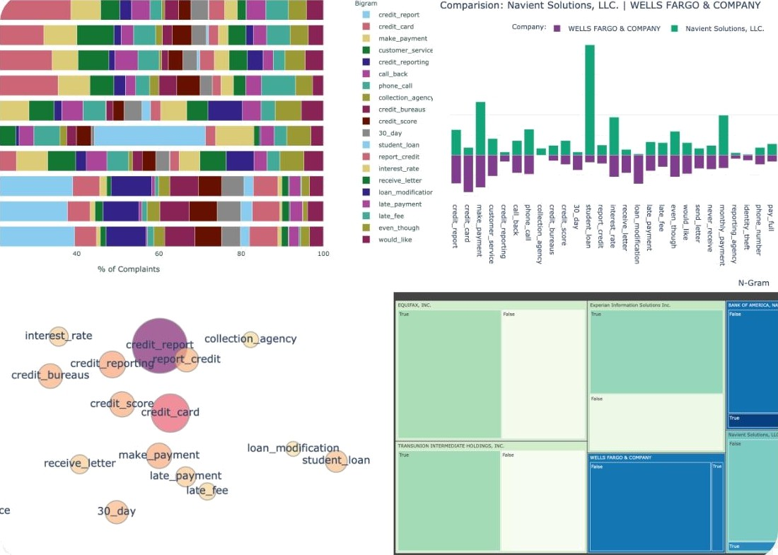
Cloud Natural Language: Text Intelligence
Syntax Analysis: Extract linguistic structure to categorize documents and automate content tagging.
Sentiment Analysis: Quantify customer feedback emotion to improve service in retail and finance sectors.
Entity Recognition: Identify and extract key names, locations, and brands to streamline healthcare record processing.
Empowering enterprises to process unstructured data at scale, reducing manual document review time by up to 80%.

Slide 6
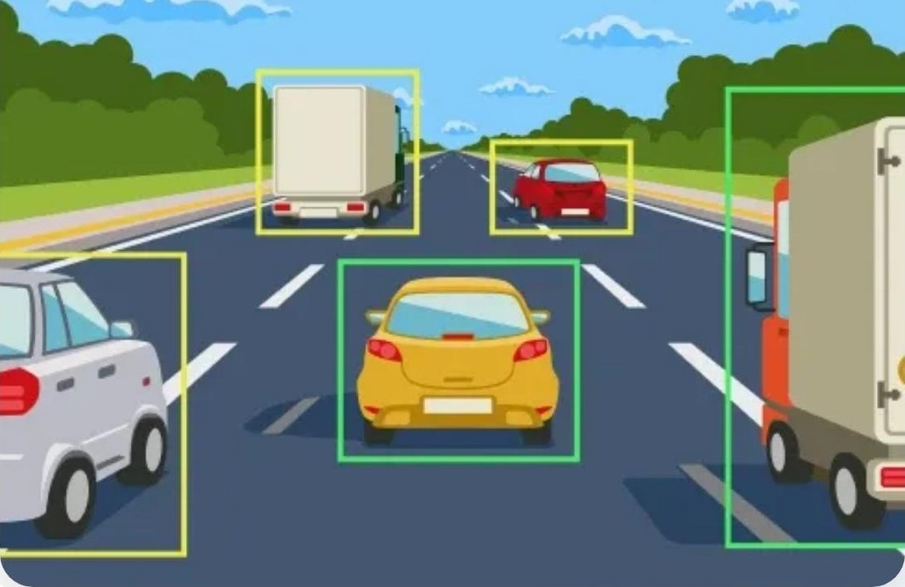
Vision & Video Intelligence: Automated Visual Analysis
Vision API: Enabl^{es im}age classification and object detection with 99% accuracy for enterprise asset management.
Video Intelligence: Indexes video content to enable granular search, utilized by media firms to reduce manual tagging time by 80%.
Detection Models: Automates extraction of text, facial features, and brand logos for retail inventory and security monitoring.
Industry Application: Streamlines visual content organization for healthcare diagnostics and retail product cataloging.

Slide 7

Cloud Translation
API Capabilities
Automate real-time text translation across 135+ languages.
Scale global operations with support for thousands of language pairs.
Process millions of requests daily with industry-leading accuracy.
Enable global engagement in retail, finance, and healthcare sectors.

Slide 8
Google Cloud AI: Core Capabilities
Custom Development: Build bespoke models with AutoML and Vertex AI, enabling 5x faster deployment for retail and finance applications.
High-Performance Infrastructure: Accelerate training workloads using Cloud TPUs, reducing compute time by up to 80% for complex neural networks.
Language Intelligence: Leverage Natural Language and Translation APIs to process global communications, supporting 100+ languages for enterprise customer support.
Perception & Sensory AI: Deploy Vision, Video, and Speech APIs to automate healthcare diagnostics and security monitoring with real-time data analysis.

Slide 9
Que stions? T hank you for your time.

