Slide 1

Google Cloud AI Capabilities
Intelligent Solutions for Modern Enterprise
Presenters:
Ayesha Azeem
Alina Rafi
Naeema Hamid
Fatima Ahmed
Lubaina Zafar

Slide 2

Cloud AI: Foundations and Value
Artificial Intelligence: Systems emulating cognitive functions to resolve complex enterprise challenges.
Cloud Infrastructure: High-performance, scalable computing resources delivered through secure, global networks.
Strategic Advantage: Accelerate intelligent feature deployment while minimizing capital expenditure on specialized hardware.

Slide 3

Cloud TPU: High-Performance AI Infrastructure
Custom Silicon: Leverage Google-engineered hardware optimized for high-intensity machine learning workloads.
Accelerated Training: Utilize purpose-built architecture to execute massive neural networks with peak performance.
Operational Efficiency: Reduce model training cycles from weeks to hours for complex data processing tasks.
Industry Impact: Accelerate large-scale model training by 3x via Cloud TPU infrastructure to drive breakthroughs in genomics and real-time fraud detection.

Slide 4
Custom AI Development Frameworks
Cloud AutoML
Build high-accuracy models without extensive coding. Industry Use Case: Retailers automate inventory classification with 95%+ precision.
Vertex AI (ML Engine)
Accelerate large-scale projects via managed environments. Industry Use Case: Finance firms deploy predictive fraud detection models 3x faster.
Custom Training
Streamline complex ML workflows to prioritize core logic. Industry Use Case: Healthcare providers optimize diagnostic imaging pipelines.
Scale custom AI solutions to meet unique enterprise requirements and drive measurable business impact.

Slide 5
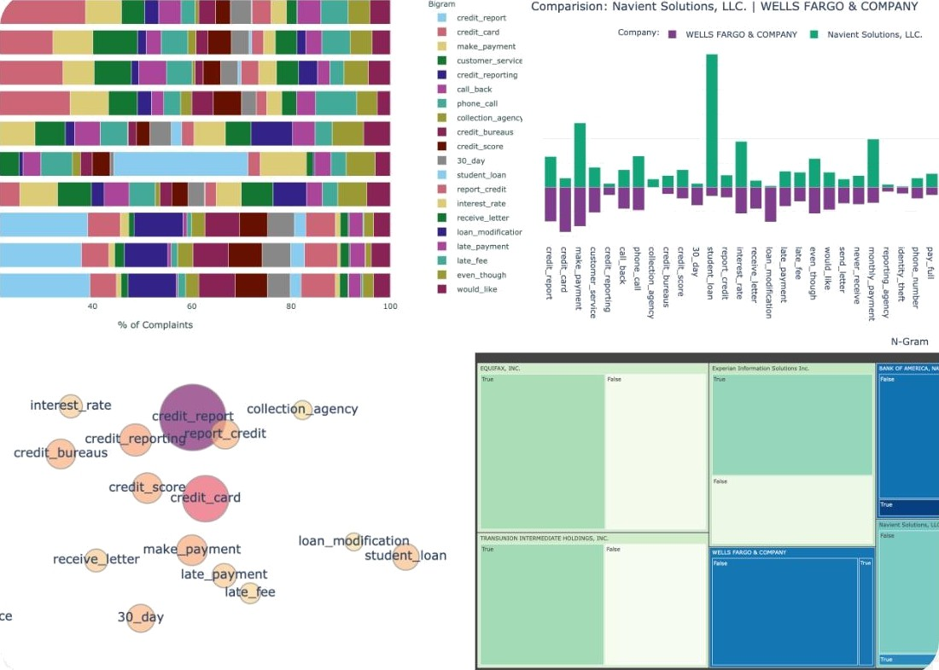
Cloud Natural Language: Text Intelligence
Syntax Analysis: Automate content tagging by extracting linguistic structures to categorize documents.
Sentiment Analysis: Improve service outcomes in retail and finance by quantifying customer feedback emotion.
Entity Recognition: Streamline healthcare record processing by identifying and extracting critical names, locations, and brands.
Scale unstructured data processing: Reduce manual document review time by 80% through automated analysis.

Slide 6
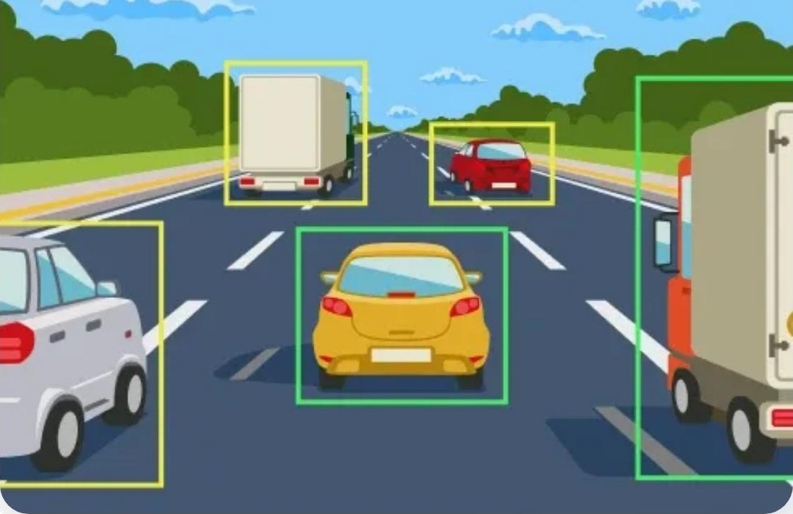
Vision & Video Intelligence: Automated Visual Analysis
Vision API: ^{Achieve} 99% accuracy in image classification and object detection for enterprise asset management.
Video Intelligence: Reduce manual tagging time by 80% via automated indexing and granular search capabilities.
Detection Models: Automate extraction of text, facial features, and brand logos for retail inventory and security monitoring.
Industry Use Case: Streamline visual content organization for healthcare diagnostics and retail product cataloging.

Slide 7

Cloud Translation
API Capabilities
• Automate real-time translation across 135+ languages to accelerate global communication.
• Scale operations seamlessly by supporting thousands of language pair combinations.
• Process millions of daily requests with industry-leading translation accuracy.
• Drive global engagement across retail, finance, and healthcare sectors.

Slide 8
Google Cloud AI: Core Capabilities
Custom Development: Accelerate retail and finance model deployment by 5x using AutoML and Vertex AI.
High-Performance Infrastructure: Reduce neural network training time by up to 80% with Cloud TPU acceleration.
Language Intelligence: Support global customer operations by processing 100+ languages via Natural Language and Translation APIs.
Perception & Sensory AI: Automate healthcare diagnostics and security monitoring through real-time Vision, Video, and Speech API analysis.

Slide 9
Questions? Thank you for your time.

