Slide 1

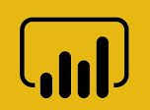


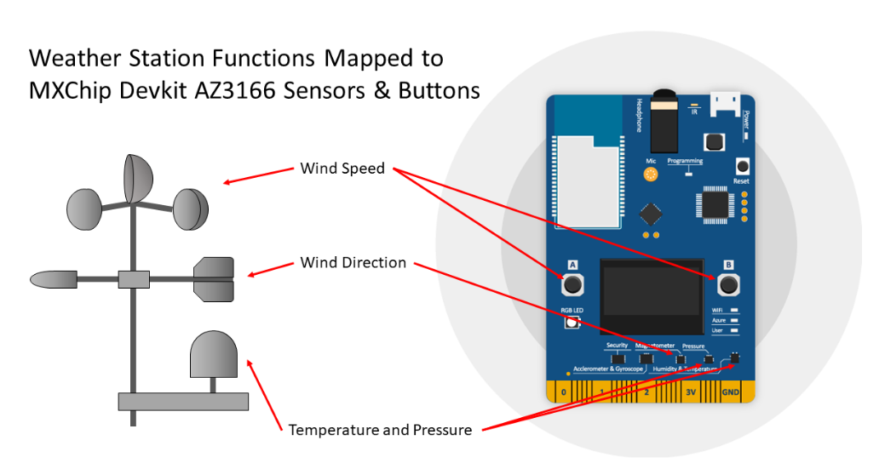





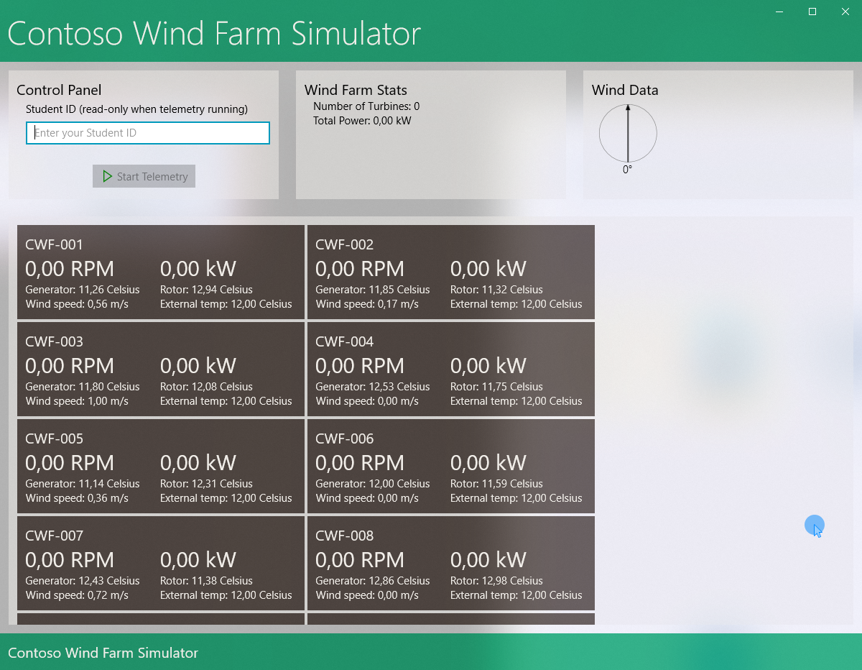
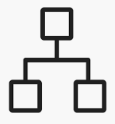



Wind Farm Simulator
Power BI Desktop
Weather Station Simulation
Time Series Insights
(iottsi7D343425)
(iotstore7d343425)
Azure Data Lake Analytics
(iotdla7d343425)
Azure Storage
Router
IoT Hub
(iothub7D343425)
Azure Stream Analytics
(iotasa7D343425)
Device Twin
Cold Path Store
Warm Path Store
Desired Props
Azure Functions
(iotfunc7D343425)
Reported Props
Data Lake Storage Gen 1
(iotdls7d343425)
Cosmos DB
(iotcosmos7D343425)
Notes:
Core Subsystems
Devices
Requirements
The wather station will leverage a number of sensors to provide the telemetry information and will connect directly (and securely) to our WiFi network that provides access to the Internet.
The weather station will provide the following telemetry data:
Temperature in Celsius (C)
Humidity in relative Humidity (rH)
Pressure in hectopascal (hPa)
Wind Speed in meters per second (m/s)
Wind Direction in degrees
Telemetry will be sent in JSON format; the field that identify the sensor telemetry data use the number data type, and the remaining fields (metadata) contain string data.
The solution must support adjusting the frequency in response to conditions detected in the cloud.
Weather Station will be simulated using an MXChip Devkit AZ3166 Devkit
The weather station application will be written in C/C++
The MXChip devkit will use on-board LEDs as follow
The WiFi LED will illuminate upon connection to the local WiFi
The Azure LED will illuminate on connection to the cloud
The User LED will flash whenever data is sent to the cloud
The RGB LED color will change in response to messages from the cloud changing the Wind Speed Status:
Green – Wind Speed is within Normal Conditions
Orange – Wind Speed is within Strong Conditions
Red – Wind Speed is within Dangerous Conditions
The MXChip OLED display will show the following information:
Wind Direction in degrees
Wind Direction as text: NORTH, NORTH-EAST, EAST, etc.
Wind Speed in m/s
Cloud Gateway (IoT Hub)
Requirements
The cloud will communicate with the Weather Station via changes made to the Device Twin. The device twin will have the following desired properties:
windSpeedStatus – string value: Normal | Strong | Dangerous
updateFrequencySeconds – number value that controls how often the device sends telemetry to the cloud.
Stream Processors
Requirements
The device telemetry will be stored in the cloud for long-term use
Azure Streaming Analytics will be used to process incoming data and direct it to the appropriate output.
Business Integration Processes
Requirements
The cloud will communicate with the Weather Station via changes made to the Device Twin
An Azure Function connected to Azure Streaming Analytics will be used to update the device twin in accordance with the requirements
Any server side cole will be written using C# and .NET
Storage
Azure Data Lake Storage Gen 1 will be used as cold storage repository; Azure Streaming Analytics will send the data to the storage, and data will then be processed in Azure Data Lake Analytics
User Interface
Optional Subsystems
Machine Learning
The device telemetry will be stored in the cloud for long-term use
Data Lake Analytics will be used to compute some statistics from telemetry data.

