Slide 1
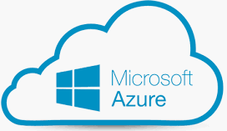


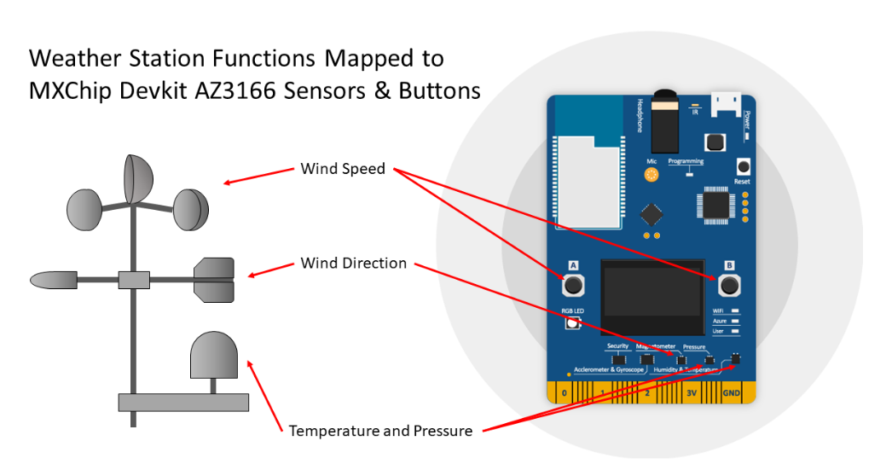







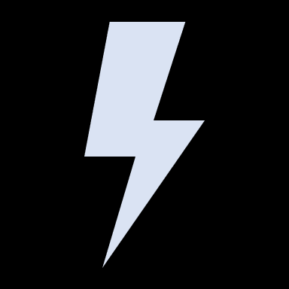
Wind Farm Simulator
Weather Station Simulation
Azure Storage
Azure Data Lake Analytics
(iotdla7d343425)
(iotstore7d343425)
Router
Cloud Gateway
(iothub7D343425)
Azure Stream Analytics
(iotasa7D343425)
Device Twin
Cold Path Store
Desired Props
Azure Function
(iotfunc7D343425)
Reported Props
Data Lake Storage Gen 1
(iotdls7d343425)
Notes:
Core Subsystems
Devices
Functional requirements, constraints and quality attributes
The wather station will leverage a number of sensors to provide the telemetry information and will connect directly (and securely) to our WiFi network that provides access to the Internet.
The weather station will provide the following telemetry data:
Temperature in Celsius (C)
Humidity in relative Humidity (rH)
Pressure in hectopascal (hPa)
Wind Speed in meters per second (m/s)
Wind Direction in degrees
Telemetry will be sent in JSON format; the field that identify the sensor telemetry data use the number data type, and the remaining fields (metadata) contain string data.
The solution must support adjusting the frequency in response to conditions detected in the cloud.
Weather Station will be simulated using an MXChip Devkit AZ3166 Devkit
The weather station application will be written in C/C++
The MXChip devkit will use on-board LEDs as follow
The WiFi LED will illuminate upon connection to the local WiFi
The Azure LED will illuminate on connection to the cloud
The User LED will flash whenever data is sent to the cloud
The RGB LED color will change in response to messages from the cloud changing the Wind Speed Status:
Green – Wind Speed is within Normal Conditions
Orange – Wind Speed is within Strong Conditions
Red – Wind Speed is within Dangerous Conditions
The MXChip OLED display will show the following information:
Wind Direction in degrees
Wind Direction as text: NORTH, NORTH-EAST, EAST, etc.
Wind Speed in m/s
Cloud Gateway (IoT Hub)
Functional requirements, constraints and quality attributes
The cloud will communicate with the Weather Station via changes made to the Device Twin. The device twin will have the following desired properties:
windSpeedStatus – string value: Normal | Strong | Dangerous
updateFrequencySeconds – number value that controls how often the device sends telemetry to the cloud.
IoT Hub enable highly secure and reliable communication between our IoT application and the device. It supports per-device authentication, built-in device management, and scaled provisioning. It allows to establish a securety-enhanced communication channel for sending and receiving data from IoT devices.
Stream Processors
Functional requirements, constraints and quality attributes
The device telemetry will be stored in the cloud for long-term use
Azure Streaming Analytics will be used to process incoming data and direct it to the appropriate output.
Business Integration Processes
Functional requirements, constraints and quality attributes
The cloud will communicate with the Weather Station via changes made to the Device Twin
An Azure Function connected to Azure Streaming Analytics will be used to update the device twin in accordance with the requirements
Any server side code will be written using C# and .NET
Storage
The device telemetry will be stored in the cloud for long-term use
Azure Data Lake Storage Gen 1 will be used as cold storage repository; Azure Streaming Analytics will send the data to the storage, and data will then be processed in Azure Data Lake Analytics. This storage technology allows to create hyper-scale, Hadoop-compatible repository for analytics on data of any size, type, and ingestion speed. Furthermore, Data Lake Storage Gen1 provides industry-standard availability and reliability and also provides enterprise-grade security for the stored data. Another important feature of this type of storage is that it can store any data in its native format, without requiring any prior transformations. Data Lake Storage Gen1 does not require a schema to be defined before the data is loaded, leaving it up to the individual analytic framework to interpret the data and define the schema at the time of the analysis. The ability to store files of arbitrary sizes and formats makes it possible for Data Lake Storage Gen1 to handle structured, semi-structured, and unstructured data.
User Interface
Optional Subsystems
Machine Learning
The device telemetry will be stored in the cloud for long-term use
Data Lake Analytics will be used to compute some statistics from telemetry data. It allows to execute big data jobs at scale through development of massively parallel programs. Furthermore, it supports enterprise-grade security and auditing features.

