Slide 1

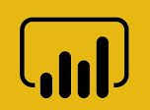


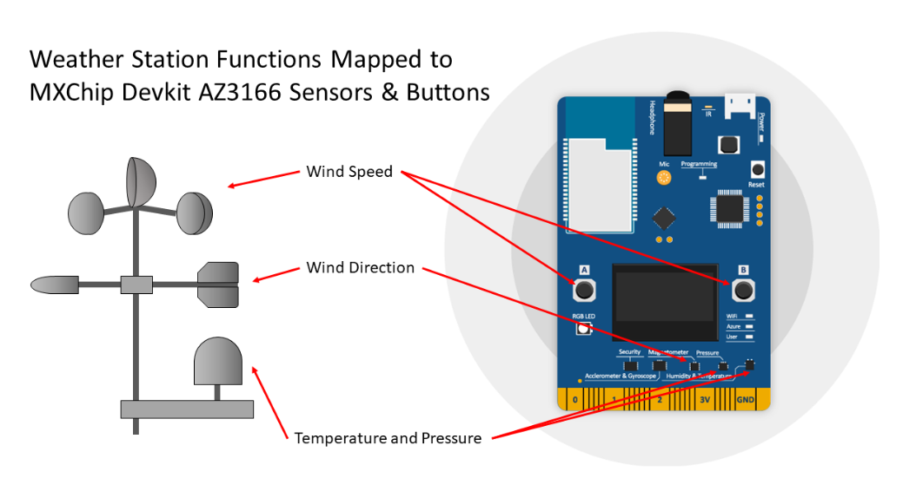





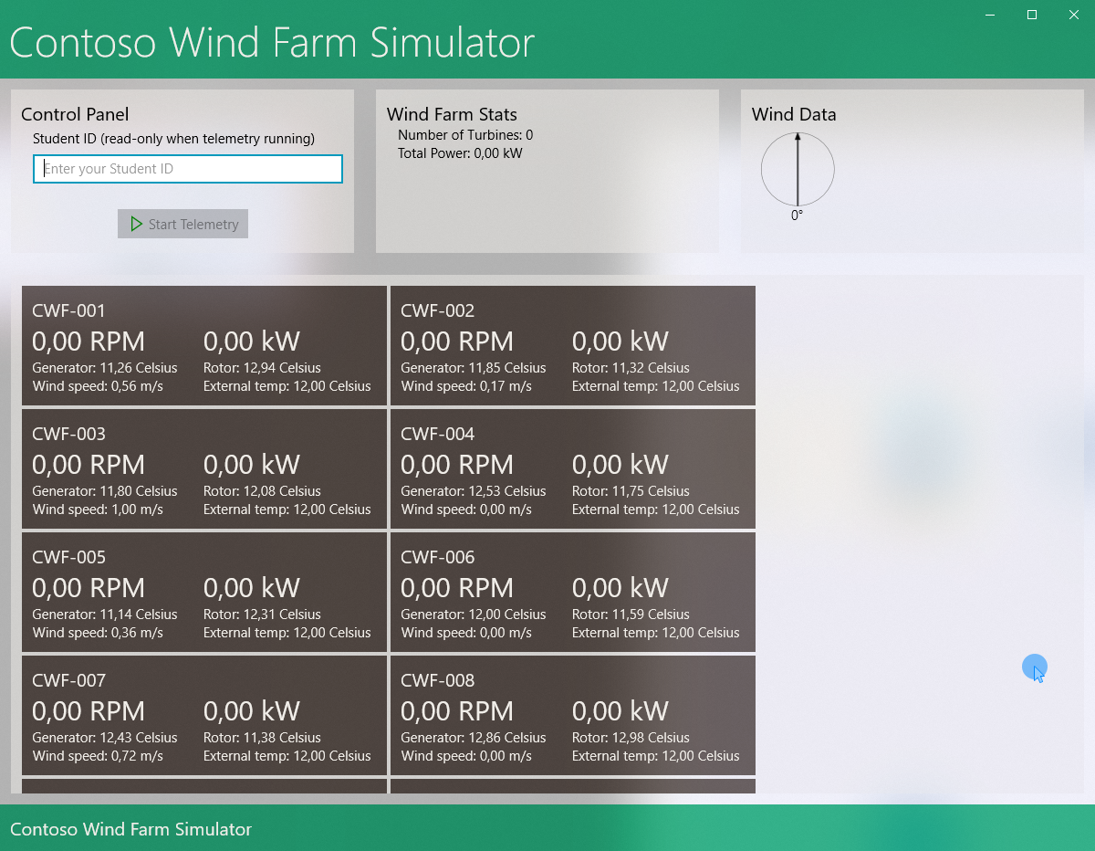
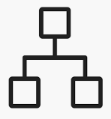



Wind Farm Simulator
Power BI Desktop
Weather Station Simulation
Time Series Insights
(iottsi7D343425)
(iotstore7d343425)
Azure Data Lake Analytics
(iotdla7d343425)
Azure Storage
Router
IoT Hub
(iothub7D343425)
Azure Stream Analytics
(iotasa7D343425)
Device Twin
Cold Path Store
Warm Path Store
Desired Props
Azure Functions
(iotfunc7D343425)
Reported Props
Data Lake Storage Gen 1
(iotdls7d343425)
Cosmos DB
(iotcosmos7D343425)
Notes:
Core Subsystems
Devices
Functional requirements, constraints and quality attributes
Each turbine in the Wind Farm will leverage a number of sensors to provide the telemetry information relating to turbine performance and will connect directly (and securely) a a network that provides access to the internet.
The Wind Turbine will provide the following telemetry data:
External Temperature in Celsius (C)
Generator Temperature in Celsius ©
Power in kiloWatts (KW)
Pressure in hectopascal (hPa)
Wind Speed in meters per second (m/s)
Shaft speeds in Revolutions per Minute (RPM)
Telemetry will be sent in JSON format; the fields that identify the sensor telemetry data use the number data type, a boolean flag that indicates if the turbine brake is on, and the remaining fields contain string data.
Cloud Gateway (IoT Hub)
IoT Hub will be used to securely connect simulated turbines and to collect telemetry data from them and to provide these data to downstream services
Stream Processors
Functional requirements, constraints and quality attributes
Azure Streaming Analytics will be used to process incoming data and direct it to the appropriate output. In the case of this proof of value, one of the destinations will be a warm path storage appropriate for high-speed access for Business Intelligence.
Storage
Functional requirements, constraints and quality attributes
Route telemetry to storage appropriate for high-speed access for Business Intelligence
Cosmos DB is a perfect choice for use as our Warm Storage solution. It allows to scale throughput and storage across any number of geographical regions. Furthermore, it offers comprehensive service level agreemenrs encompassing throughput, latency availability, and consistency. It is perfect for serverless applications that needs low order-of-millisecond response times, and needs to scale rapidly and globally.
User Interface
Functional requirements, constraints and quality attributes
Time Series Insights is used to view the following wind turbine telemetry data:
Telemetry.Power
Telemetry.WIndSpeed
Telemetry.LowSpeedShaftRpm
Telemetry.GeneratorTemperatureCelsius
Create a dashboard in Power BI desktop that displays telemetry as lines and gauges.
Use gauges to show:
Average Power
Average WindSpeed
Average LowPowerShaftRpm
Average Power Ratio
Use Line charts to show:
Average Power by Turbine over Date/Time
Average Power Ratio by Turbine over Date/Time
Time Series Insights is an invaluable tool to make trend analysis and to gain quick and near real-time insights on telemetry data as they are ingested in Iot Hub and downstream stream analytics services. This service allows to instantly access billions of curated events from Azure IoT Hub, without any up-front data preparation. It allows to perform ad-hoc time-series data exploration and operation analysis, or build custom integrations with other data sources for a more complete view of our operations.
Power BI Desktop is used for its great flexibility in terms of the rich set of visualizations available to build our dashboard and of its powerful query engine (progarmmed in M) and analytical engine (programmed in DAX).

