Slide 1
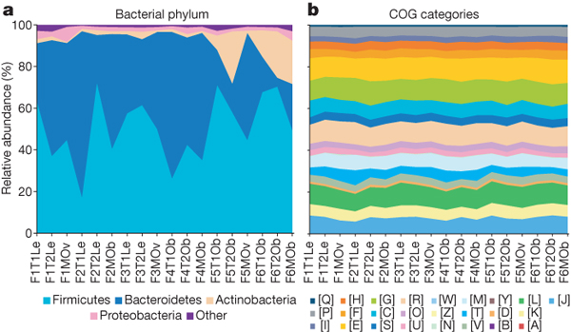

Comparison of taxonomic and functional
variations in the human gut microbiome.
PJ Turnbaugh et al. Nature 000, 1-5 (2008) doi:10.1038/nature07540

