Slide 1
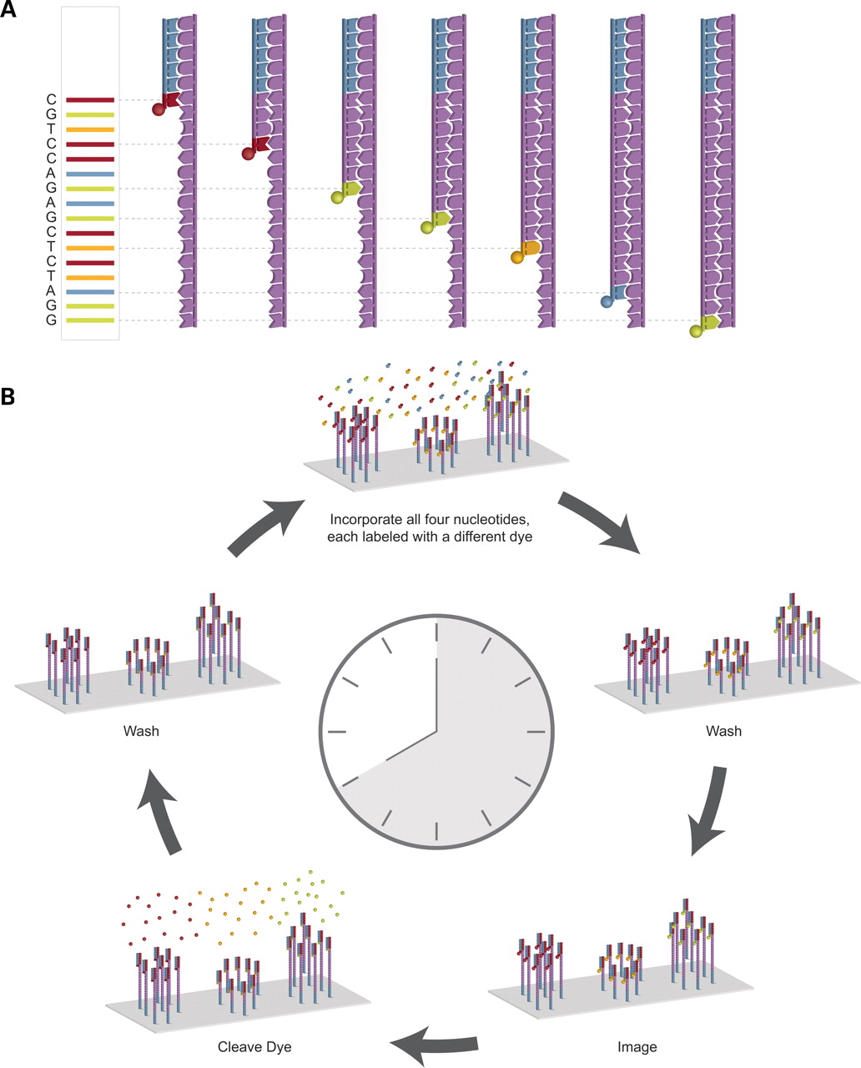

How previous generation DNA-sequencing systems work.
Eric E. Schadt et al. Hum. Mol. Genet. 2010;19:R227-R240
© The Author 2010. Published by Oxford University Press
Notes:
How previous generation DNA-sequencing systems work. (A) A modern implementation of Sanger sequencing is shown to illustrate differential labeling and use of terminator chemistry followed by size separation to resolve the sequence. (B) The Illumina sequencing process is shown to illustrate the wash-and-scan paradigm common to second-generation DNA-sequencing technologies.

